Slide 1
Elliptic Low-Pass
Order 5 | Cutoff Frequency: 2,000 Hz | Passband Ripple: 1.0 dB
File 052 / 100 | Variant 2

Slide 2
Filter Theory & Transfer Function
Transfer Function H(s) — Elliptic Order 5 |H(jω)|² = 1 / [1 + ε²·Rₙ²(ξ, ω/ωp)] ε² = 10^(Rp/10) - 1, Rp = 1.0 dB Rₙ = Chebyshev rational function ωp = 2π × 2,000 rad/s (passband edge) Equiripple in both passband and stopband Sharpest roll-off for given order and ripple

Slide 3
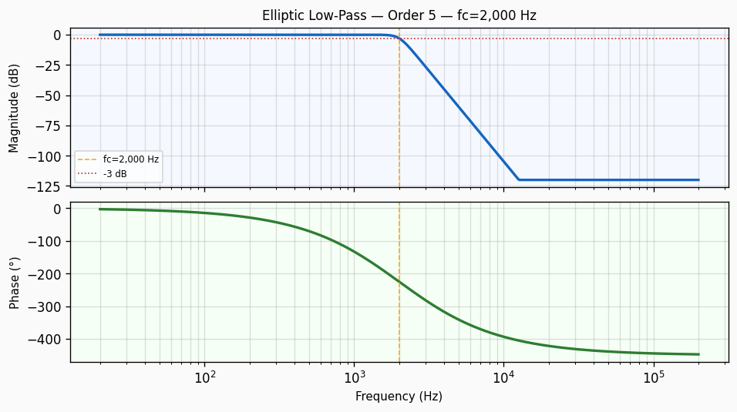
Frequency Response — Bode Plot
Bode plot of Elliptic Low-Pass order 5 filter. Top panel: magnitude response in dB showing -3 dB cutoff at 2,000 Hz with a roll-off of approximately 100 dB/decade. Bottom panel: phase response in degrees.

Slide 4
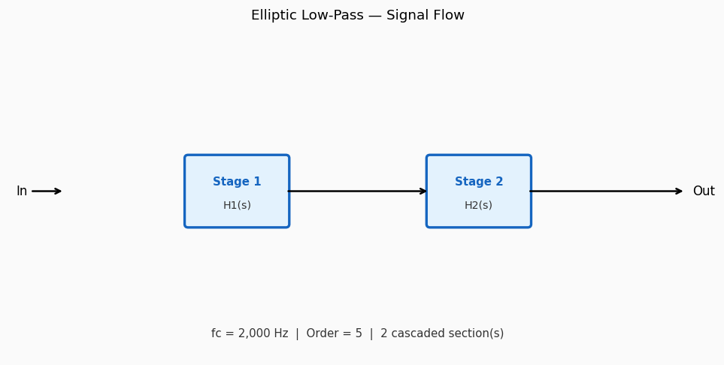
Circuit / Block Diagram
Cascade block diagram for Elliptic Low-Pass order 5. The design is decomposed into 2 second-order section(s), each realising a pair of complex conjugate poles near cutoff 2,000 Hz.

Slide 5
Design Parameters
Parameter | Value
Filter Family | Elliptic Low-Pass
Filter Type | Low-Pass
Filter Order (N) | 5
Cutoff Frequency (fc) | 2,000 Hz
Angular Cutoff (ωc) | 12566.37 rad/s
Passband Gain (0 Hz) | 0 dB
-3 dB Frequency | 2,000 Hz
Roll-off Rate | 100 dB/decade
Passband Ripple | 1.0 dB

Slide 6
Real-World Applications
• Narrowest transition band: satellite communication transponders • Multi-tone DTMF decoder front-end filtering • Anti-aliasing in high-speed ADCs where order must be minimised • Channel guard filtering in dense OFDM subcarrier spacing • Spectral containment in military frequency-hopping radios
Filter: Elliptic Low-Pass | fc = 2,000 Hz | Order = 5

