Slide 1
Microsoft
Agentic SDLC
Software Factory
Governed multi-agent software delivery from requirements to operations
Prepared by
GitHub documentation
Michael Yaacoub
csdmichael/Foundry-Agentic-Workflow-SDLC-Docs
Sr Solution Engineer, Microsoft
August 2026
Notes:
[Sources] - https://github.com/csdmichael/Foundry-Agentic-Workflow-SDLC-Docs [/Sources]

Slide 2
Microsoft
The application in one view
A responsive Software Factory that combines specialized Foundry agents, explicit workflow control, and enterprise systems of record.
12 specialized agents
3 execution policies
Requirements through Insights
Autonomous, minimal review, human review
9 evidence-aware gates
Durable execution
Policy or named-human decisions
Checkpoint, resume, retry and audit
Documentation: csdmichael/Foundry-Agentic-Workflow-SDLC-Docs
Notes:
[Sources] - https://github.com/csdmichael/Foundry-Agentic-Workflow-SDLC-Docs - Internal Agentic SDLC User Guide and project collaboration materials. [/Sources]

Slide 3
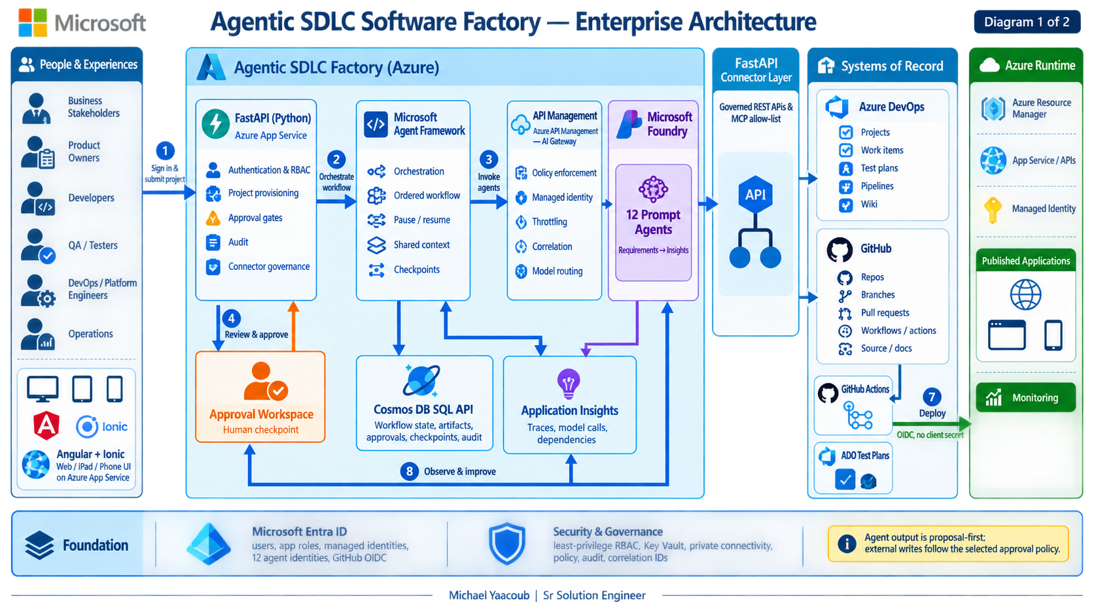
Notes:
[Sources] - https://github.com/csdmichael/Foundry-Agentic-Workflow-SDLC-Docs - Internal Agentic SDLC User Guide and project collaboration materials. [/Sources]

Slide 4
Microsoft
How the framework patterns map to this POC
The application primarily uses an explicit sequential graph, with policy branches, revision loops, and human checkpoints.
Sequential
Core SDLC progression
Guarantees stage order and evidence inheritance
Conditional
Approval policy and failure handling
Routes autonomous, minimal-review, human-review and error paths
Loop
Request changes and improvement
Returns reviewer feedback to the owning agent
Concurrent
Project sets and selected future optimizations
Runs independent projects or safe read-only analysis in parallel
Handoff / Group chat / Magentic
Optional advanced collaboration
Useful where dynamic delegation or debate adds measurable value
Documentation: csdmichael/Foundry-Agentic-Workflow-SDLC-Docs
Notes:
[Sources] - https://learn.microsoft.com/en-us/agent-framework/journey/workflows - https://learn.microsoft.com/en-us/agent-framework/workflows/ - https://github.com/csdmichael/Foundry-Agentic-Workflow-SDLC-Docs [/Sources]

Slide 5
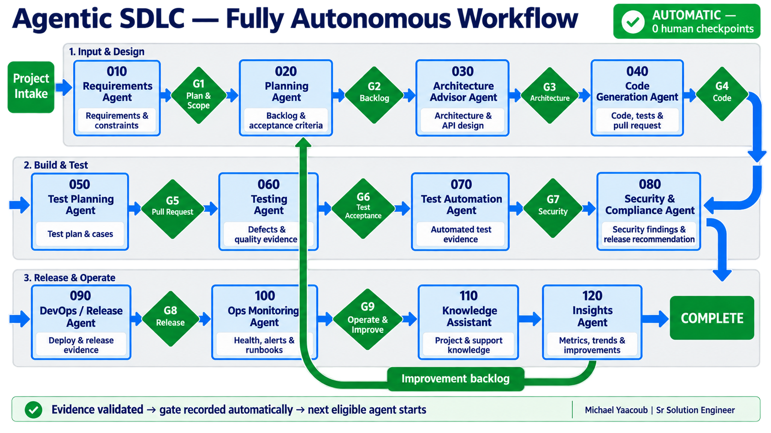
Notes:
[Sources] - https://github.com/csdmichael/Foundry-Agentic-Workflow-SDLC-Docs - Visual on this slide was generated with Microsoft Copilot. [/Sources]

Slide 6
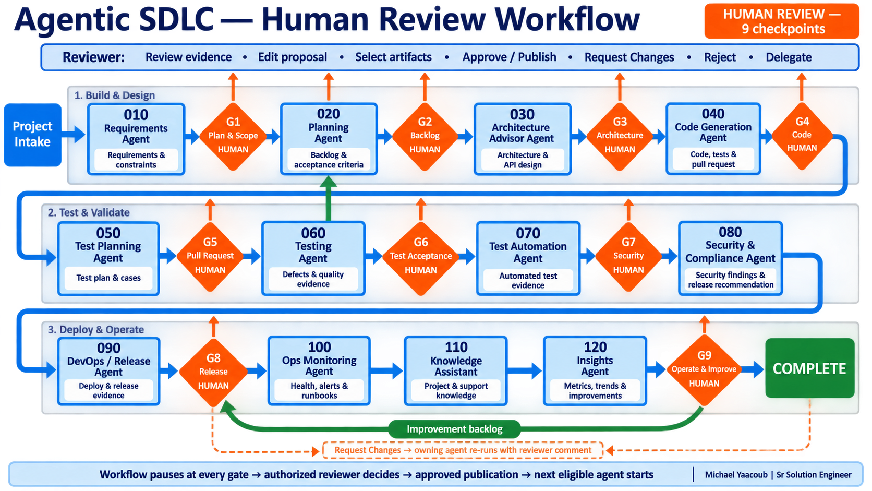
Notes:
[Sources] - https://github.com/csdmichael/Foundry-Agentic-Workflow-SDLC-Docs - Visual on this slide was generated with Microsoft Copilot. [/Sources]

Slide 7
Microsoft
Production controls covered by the POC
The application adds controls around model choice, external actions, recovery, notifications, and lifecycle management.
Model policy
Per-agent model selection, inheritance, project overrides, and Model Router where appropriate
Identity and authorization
Entra ID, guest or email OTP access, configurable roles, server-side permission checks
Tool and content guardrails
APIM boundary, tool allow-lists, token limits, validation, and refusal handling
Resilience
Persisted workflow tasks, bounded retries, persisted circuit breaker, visible deterministic failures
Traceability
Agent Activity and append-only Audit Trail correlate prompts, models, artifacts, tools and decisions
Lifecycle operations
Owner notifications, post-completion revisions, and controlled project cleanup with retained audit projection
Documentation: csdmichael/Foundry-Agentic-Workflow-SDLC-Docs
Notes:
[Sources] - https://github.com/csdmichael/Foundry-Agentic-Workflow-SDLC-Docs [/Sources]

Slide 8
Microsoft
What is persisted and where
Azure DevOps and GitHub remain the durable systems of record; orchestration state, telemetry, and runtime assets support execution.
Azure DevOps
Epics through Tasks, sprints, queries, dashboards, delivery plans, Test Plans/Runs, wiki and evidence links
GitHub
Generated application repository, branch, pull request, commits, GitHub Actions and documentation
Cosmos DB
Workflow tasks, checkpoints, agent context, decisions, approvals, operation state and idempotency records
Application telemetry
Agent traces, workflow events, user actions, approvals, audit evidence, metrics and logs
Azure App Service
Published Angular/Ionic UI and FastAPI service, health endpoint and OpenAPI surface
Documentation: csdmichael/Foundry-Agentic-Workflow-SDLC-Docs
Notes:
[Sources] - https://github.com/csdmichael/Foundry-Agentic-Workflow-SDLC-Docs [/Sources]

Slide 9
Microsoft
Choose the right execution policy
The topology and controls remain consistent; the policy changes who decides at each gate.
Autonomous
Minimal Human Review
Human Review
0 human checkpoints
4 consequential checkpoints
All 9 checkpoints
Policy validates evidence and records gate decisions
People review backlog, architecture, pull request, and release
A named reviewer decides every gated transition
Best fit
Best fit
Best fit
Trusted repeatable patterns, demos, high-volume project sets
Enterprise balance between speed and control
Regulated, high-risk, unfamiliar, or first-of-kind work
Documentation: csdmichael/Foundry-Agentic-Workflow-SDLC-Docs
Notes:
[Sources] - https://github.com/csdmichael/Foundry-Agentic-Workflow-SDLC-Docs [/Sources]

Slide 10
Microsoft
Agentic delivery with control built in
Agents generate. Evidence proves. Policy and people decide.
Prepared by
Michael Yaacoub | Sr Solution Engineer
Vinay Gandhi | Principal Solution Engineer
Documentation and reference architecture
csdmichael/Foundry-Agentic-Workflow-SDLC-Docs
Notes:
[Sources] - https://github.com/csdmichael/Foundry-Agentic-Workflow-SDLC-Docs [/Sources]

