Slide 1
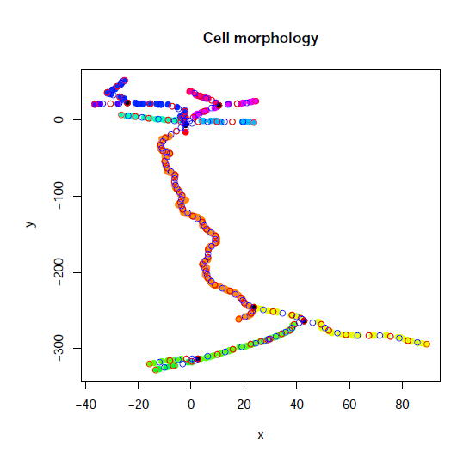
\footnote{Somogyvari et al \textit{Localization of single-cell current sources based on extracellular potential patterns: the spike CSD method.}, Eur J Neurosci 2012.}

Slide 2
Positions of the electrodes
Extracell potential of the neuron
Neuron morphology
LFPy simulation
-subtreshold synaptic inputs
LFP
test membrane
currents
skCSD method
-with different parameters
-comparison
best parameters
skCSD method
-with different parameters
-comparison
transfer matrix
C=T*V
transfer matrix
Membrane currents

Slide 3
iCSD
-parametric
estimation
for population
in 1D and 2D
kCSD
-nonparametric
estimation
for population
in 1D and 2D
CSD
-layers
- 1D
skCSD
-single neuron
with detailed
morphology
sCSD
-single neuron
as line

Slide 4
