Slide 1
HealthCal
A SMART APP FOR DISEASE PREDICTION

Slide 2
Motivation
Limited access to healthcare makes it difficult to individuals to predict risks and take precautions.
High healthcare costs prevents people from routine checkup for common threats.
Lack of awareness leads to neglecting health condition until people experience symptoms of serious health problem.

Slide 3
Why HealthCal?

Slide 4
To provide risk assessments and prediction for a range of health condition
To help users better understand their health
To reduce healthcare costs by early detection

Slide 5
Now let’s dive deeper into how HealthCal actually works!

Slide 6
Data Collection
We collected the datasets from kaggle. * Diabetes Prediction: ~1000 Data with nine columns.
* Heart attack risk prediction: ~500 Data with fourteen columns.
* Stroke risk prediction: ~5000 Data with six columns.
* Maternal health risk prediction: ~1000 Data with six columns

Slide 7
Data Preprocessing
Steps used for data pre-processing :
* Data Exploration
* Data Cleaning
* Handling Missing Values and Outliers
* Encoding Categorical Variables
* Data Transformation
* Feature Selection
* Data Splitting
* Data Normalization

Slide 8
MODELS USED
We tried multiple models for each section and choose the best one based on performance. * Diabetes Prediction: MLPClassifier - A Neural Network based model that provided ~80% accuracy.
* Heart attack risk prediction: Support Vector Classification (SVC) - a type of supervised learning algorithm that is based on the concept of finding the best decision boundary to separate data points that ensured 85% accuracy.
* Stroke risk prediction: Gaussian Naive Bayes model- A probabilistic approach for classification providing 88% accuracy.
* Maternal health risk prediction: Random Forest - A decision tree based model that provided 78% accuracy in our dataset.

Slide 9

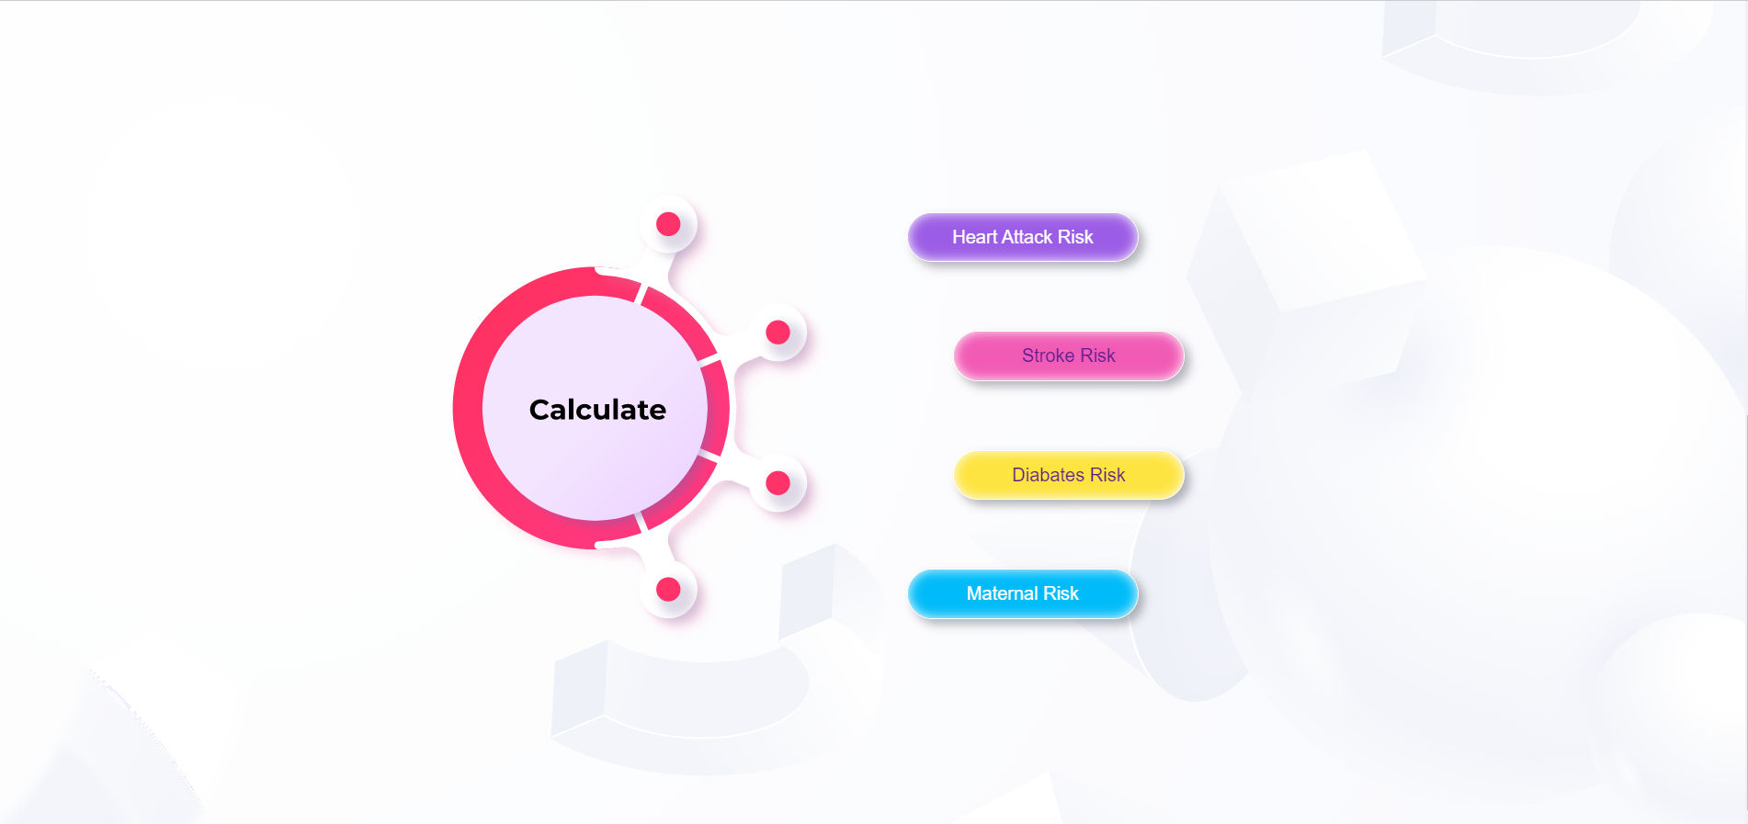
HealthCal in a nutshell
Landing Page of HealthCal

Slide 10
Landing page of HealthCal
– Introduction on HealthCal
– Navigation system to know more page
– Routing to separate disease prediction page

Slide 11
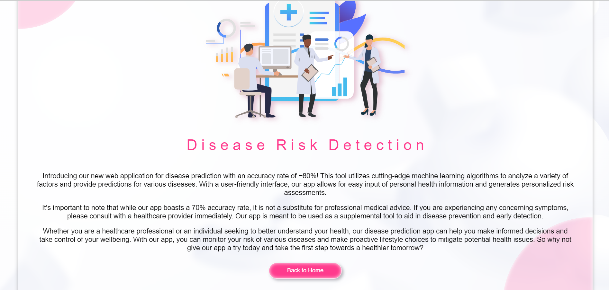
Learn more page of HealthCal
– A short overview on our app

Slide 12
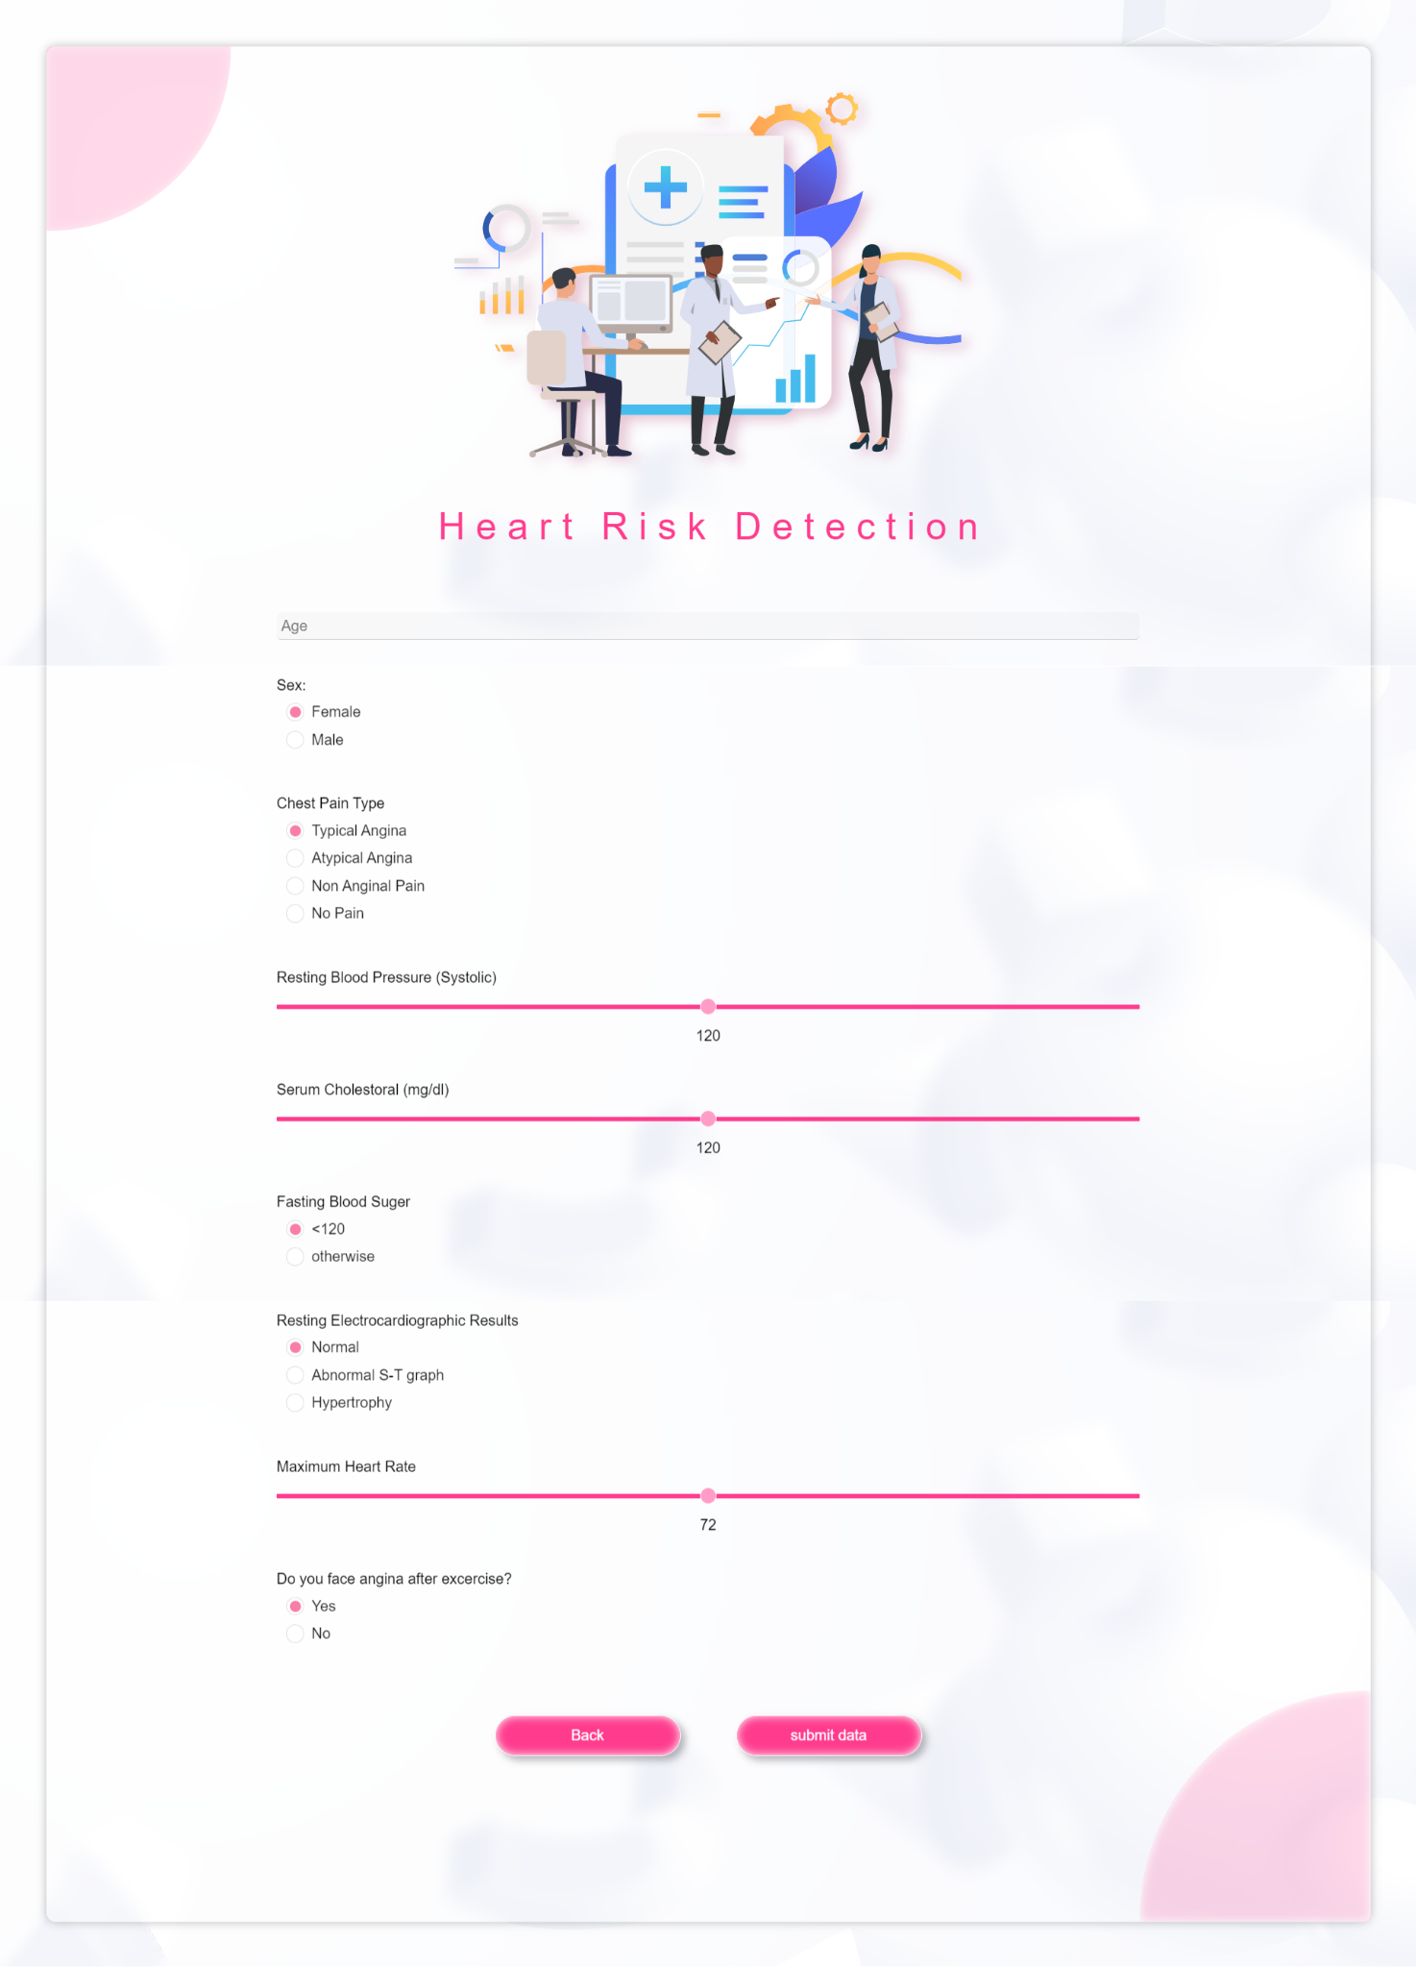
Heart Risk Prediction

Slide 13
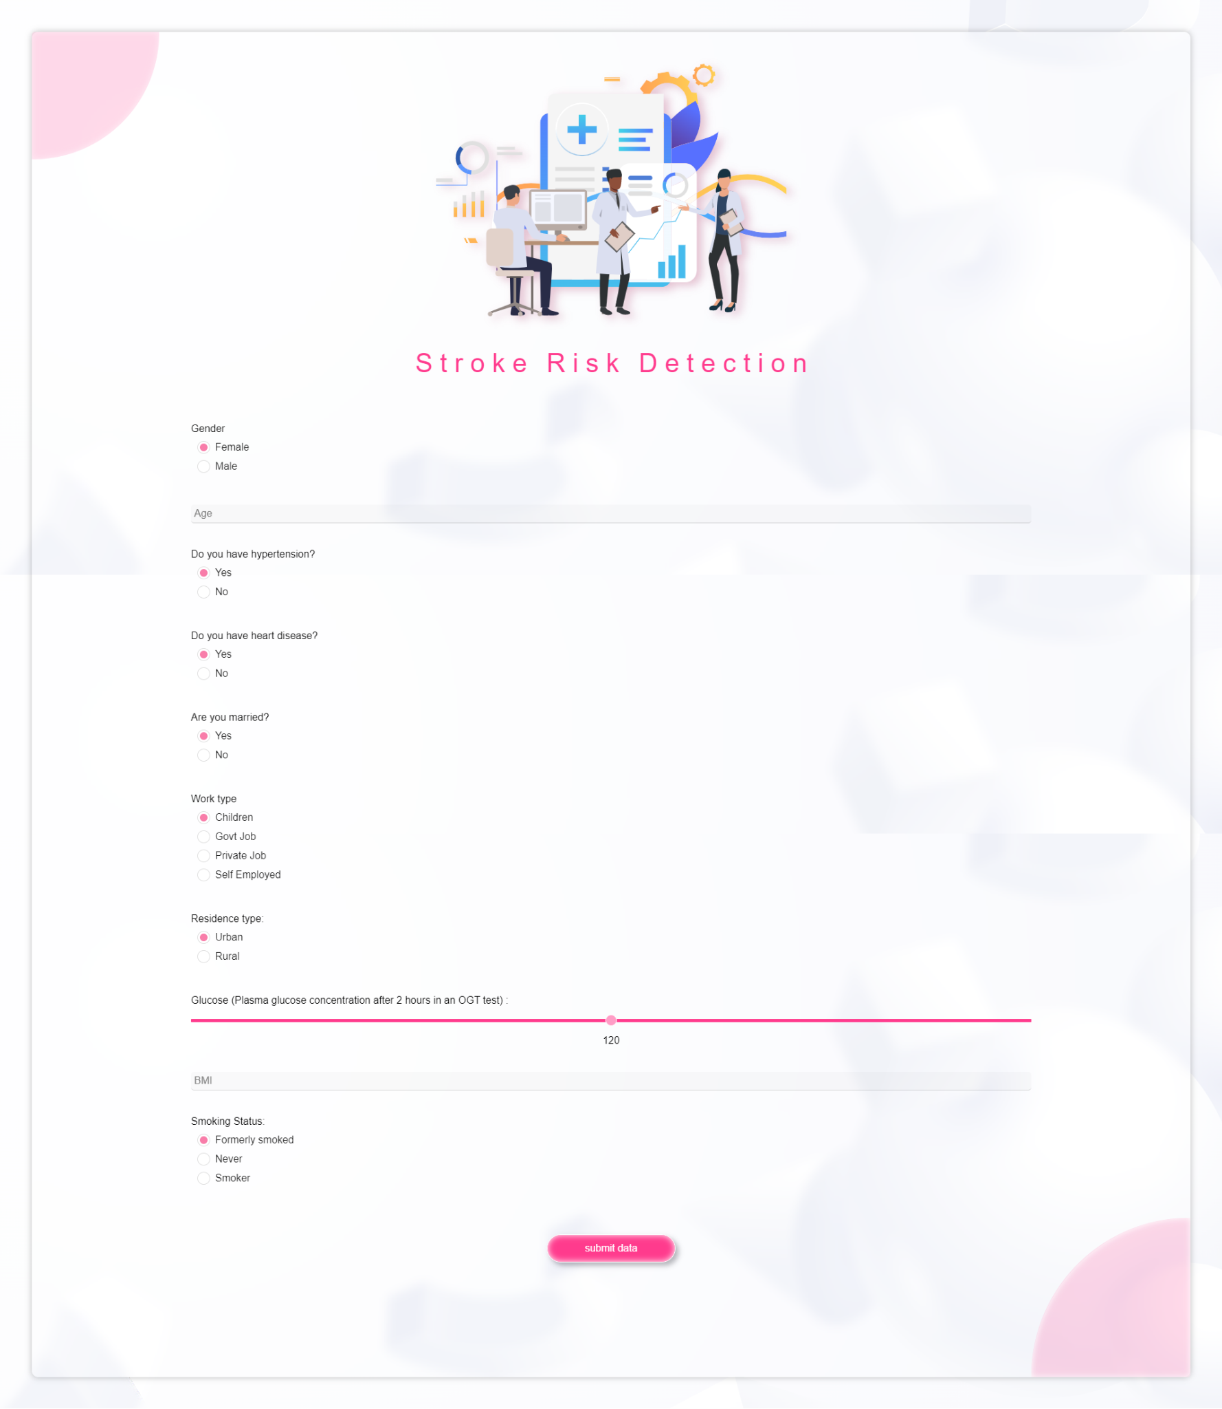
Stroke Risk Prediction

Slide 14
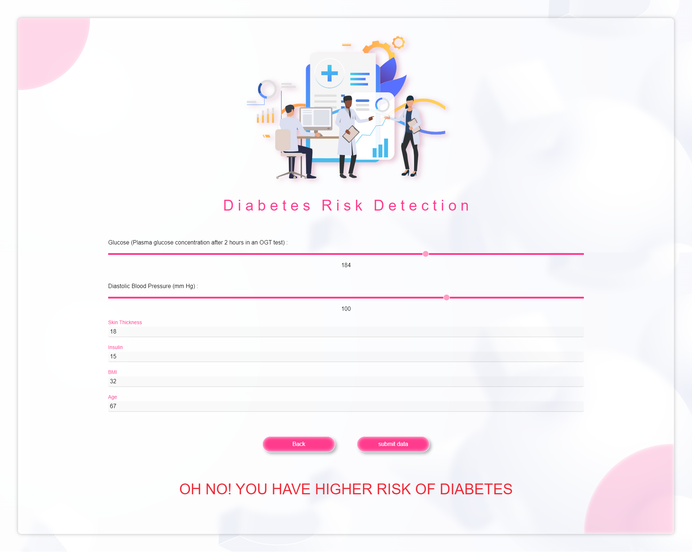
Diabetes Risk Prediction

Slide 15

Maternal Health Risk Prediction

Slide 16
Use Cases
Some use cases of HealthCal includes :
* Early detection of diseases
* Remote disease diagnosis
* Pre-diabetes detection
* Health equity
* Health tracking

Slide 17
Impacts
HealthCal can impact the society in many positive ways, including :
* Reduced health-care costs
* Improved patient outcomes
* Health education
* Improved public health
* Public health monitoring

Slide 18
Thank You
Samia Priety - 2018331008
Nasrullah Sami - 2018331036
Hrithik Majumdar Shibu - 2018331052
Mahir Mosleh - 2018331064
Rafiqul Ala Mahid - 2018331092

