Slide 1
Big Data
UNIT ‐ I
Big Data is a collection of data that is huge in volume, yet growing exponentially with time. It is a data with so large size and complexity that none of traditional data management tools can store it or process it efficiently. Big data is also a data but with huge size.

Slide 2
Introduction to big data:
Big data analytics is the use of advanced analytic techniques against very large, diverse big data sets that include structured, semi-structured and unstructured data, from different sources, and in different sizes from terabytes to zettabytes.
What is Data?
Data is defined as individual facts, such as numbers, words, measurements, observations or just descriptions of things.
For example, data might include individual prices, weights, addresses, ages, names, temperatures, dates, or distances.

Slide 3
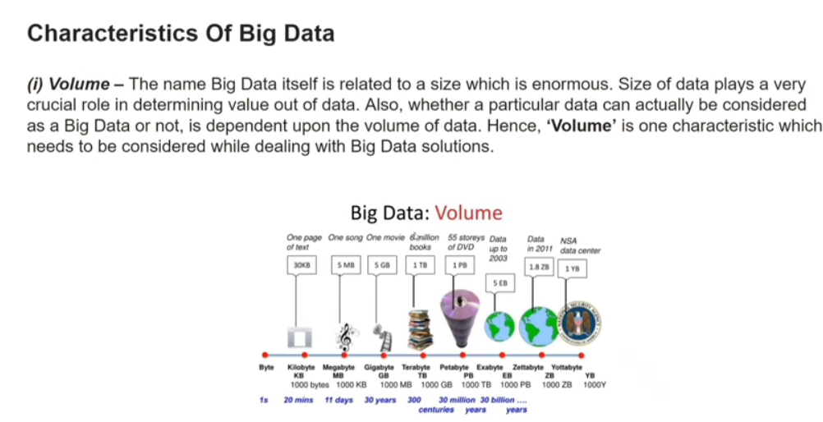

Slide 4
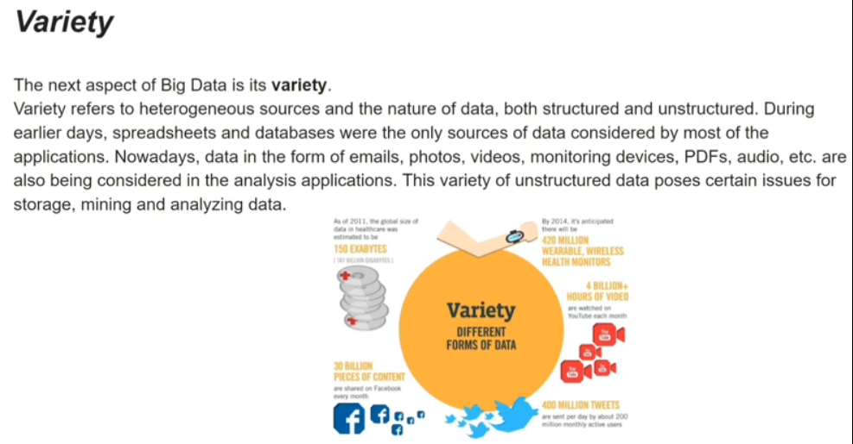

Slide 5
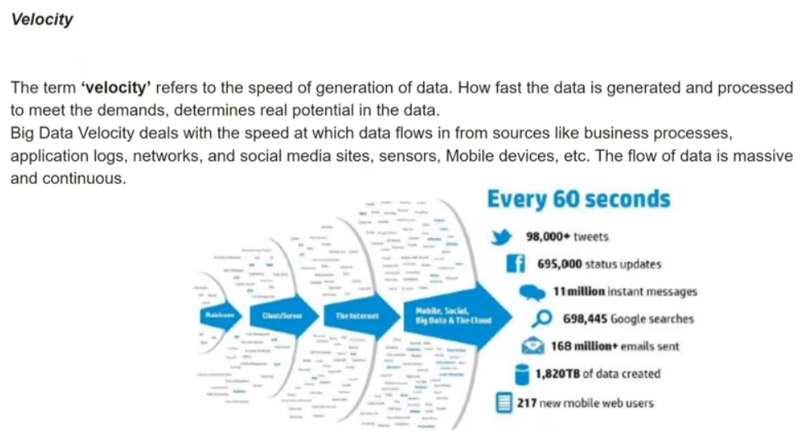

Slide 6
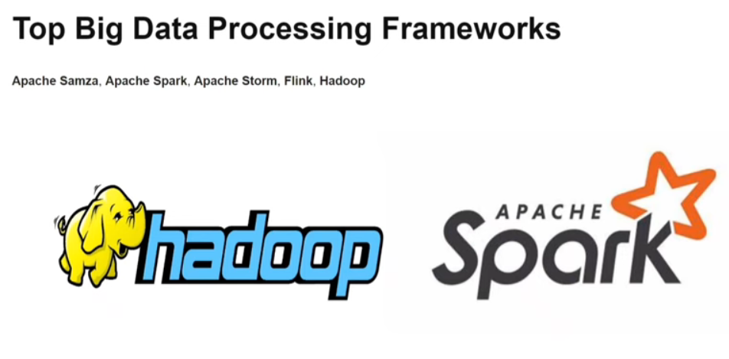

Slide 7
There are two main types of data:
Quantitative data is provided in numerical form, like the weight, volume, or cost of an item.
Qualitative data is descriptive, but non-numerical, like the name, sex, or eye colour of a person.

Slide 8
Characteristics of Data
The following are six key characteristics of data which discussed below:
1. Accuracy
2. Validity
3. Reliability
4. Timeliness
5. Relevance
6. Completeness

Slide 9
Types of Digital Data:
Structured
Unstructured
Semi Structured Data

Slide 10
Structured Data:
Structured data refers to any data that resides in a fixed field within a record or file.
Having a particular Data Model.
Meaningful data.
Data arranged in arow and column.
Structured data has the advantage of being easily entered, stored, queried and analysed.
E.g.: Relational Data Base, Spread sheets.
Structured data is often managed using Structured Query Language (SQL)

Slide 11
Sources of Structured Data:
SQL Databases
Spreadsheets such as Excel
OLTP Systems
Online forms
Sensors such as GPS or RFID tags
Network and Web server logs
Medical devices

Slide 12
Advantages of Structured Data:
Easy to understand and use: Structured data has a well-defined schema or data model, making it easy to understand and use. This allows for easy data retrieval, analysis, and reporting.
Consistency: The well-defined structure of structured data ensures consistency and accuracy in the data, making it easier to compare and analyze data across different sources.
Efficient storage and retrieval: Structured data is typically stored in relational databases, which are designed to efficiently store and retrieve large amounts of data. This makes it easy to access and process data quickly.
Enhanced data security: Structured data can be more easily secured than unstructured or semi-structured data, as access to the data can be controlled through database security protocols.
Clear data lineage: Structured data typically has a clear lineage or history, making it easy to track changes and ensure data quality.

Slide 13
Disadvantages of Structured Data:
Inflexibility: Structured data can be inflexible in terms of accommodating new types of data, as any changes to the schema or data model require significant changes to the database.
Limited complexity: Structured data is often limited in terms of the complexity of relationships between data entities. This can make it difficult to model complex real-world scenarios.
Limited context: Structured data often lacks the additional context and information that unstructured or semi-structured data can provide, making it more difficult to understand the meaning and significance of the data.
Expensive: Structured data requires the use of relational databases and related technologies, which can be expensive to implement and maintain.
Data quality: The structured nature of the data can sometimes lead to missing or incomplete data, or data that does not fit cleanly into the defined schema, leading to data quality issues.

Slide 14
Unstructured Data:
Unstructured data can not readily classify and fit into a neat box
Also called unclassified data.
Which does not confirm to any data model.
Business rules are not applied.
Indexing is not required.
E.g.: photos and graphic images, videos, streaming instrument data, webpages, Pdf files, PowerPoint presentations, emails, blog entries, wikis and word processing documents.
Sources of Unstructured Data:
Web pages
Images (JPEG, GIF, PNG, etc.)
Videos
Memos
Reports,
Word documents and PowerPoint presentations
Surveys

Slide 15
Advantages of Unstructured Data:
Its supports the data which lacks a proper format or sequence
The data is not constrained by a fixed schema
Very Flexible due to absence of schema.
Data is portable
It is very scalable
It can deal easily with the heterogeneity of sources.
These type of data have a variety of business intelligence and analytics applications.

Slide 16
Disadvantages Of Unstructured data:
It is difficult to store and manage unstructured data due to lack of schema and structure
Indexing the data is difficult and error prone due to unclear structure and not having pre-defined attributes. Due to which search results are not very accurate.
Ensuring security to data is difficult task.

Slide 17
Semi structured Data:
Self-describing data.
Metadata (Data about data).
Also called quiz data: data in between structured and semi structured.
It is a type of structured data but not followed data model.
Data which does not have rigid structure.
E.g.: E-mails, word processing software.
XML and other markup language are often used to manage semi structured data.
Sources of semi-structured Data:
E-mails
XML and other markup languages
Binary executables
TCP/IP packets
Zipped files
Integration of data from different sources
Web pages

Slide 18

New York Stock Exchange :
The New York Stock Exchange is an example of Big Data that generates about one terabyte of new trade data per day.

Slide 19

Social Media:
The statistic shows that 500+terabytes of new data get ingested into the databases of social media site Facebook, every day. This data is mainly generated in terms of photo and video uploads, message exchanges, putting comments etc.

Slide 20

Jet engine :A single Jet engine can generate 10+terabytes of data in 30 minutes of flight time. With many thousand flights per day, generation of data reaches up to many Petabytes.

Slide 21
Why Big Data?
Big Data initiatives were rated as “extremely important” to 93% of companies. Leveraging a Big Data analytics solution helps organizations to unlock the strategic values and take full advantage of their assets.
It helps organizations:
To understand Where, When and Why their customers buy
Protect the company’s client base with improved loyalty programs
Seizing cross-selling and upselling opportunities
Provide targeted promotional information
Optimize Workforce planning and operations
Improve inefficiencies in the company’s supply chain
Predict market trends
Predict future needs
Make companies more innovative and competitive
It helps companies to discover new sources of revenue

Slide 22
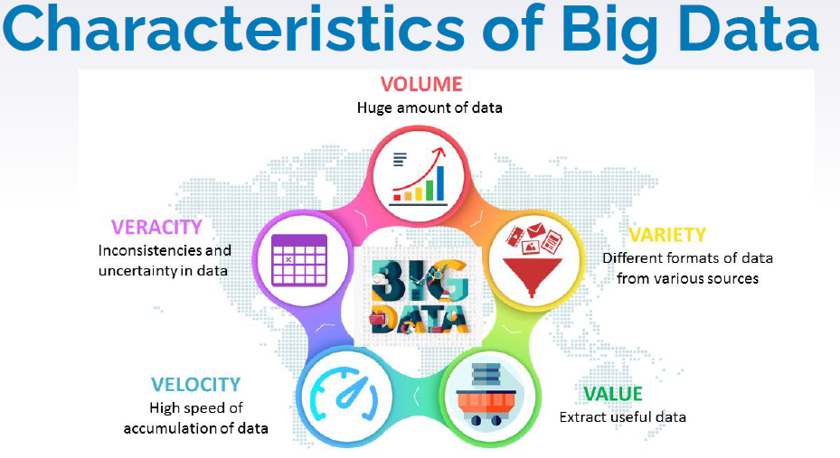
Big Data Characteristics

Slide 23
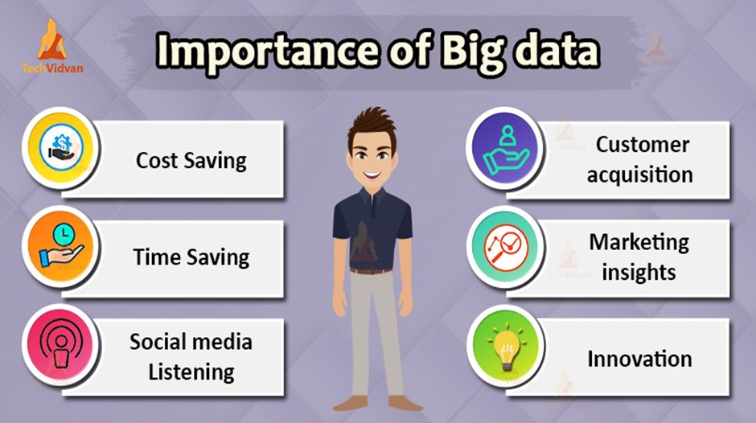

Slide 24
Challenges of Big Data
Managing massive amounts of data
Integrating data from multiple sources
Ensuring data quality
Keeping data secure
Selecting the right big data tools
Scaling systems and costs efficiently
Lack of skilled data professionals

Slide 25
What is Business Intelligence?
BI(Business Intelligence) is a set of processes, architectures, and technologies that convert raw data into meaningful information that drives profitable business actions. It is a suite of software and services to transform data into actionable intelligence and knowledge.
BI has a direct impact on organization’s strategic, tactical and operational business decisions.
BI supports fact-based decision making using historical data rather than assumptions and gut feeling.
BI tools perform data analysis and create reports, summaries, dashboards, maps, graphs, and charts to provide users with detailed intelligence about the nature of the business.

Slide 26
How Business Intelligence systems are implemented?
Here are the steps:
Step 1) Raw Data from corporate databases is extracted. The data could be spread across multiple systems heterogeneous systems.
Step 2) The data is cleaned and transformed into the data warehouse. The table can be linked, and data cubes are formed.
Step 3) Using BI system the user can ask quires, request ad-hoc reports or conduct any other analysis.

Slide 27
Advantages of Business Intelligence
Boost productivity
To improve visibility
Fix Accountability
It gives a bird’s eye view
It streamlines business processes
It allows for easy analytics.

Slide 28
BI System Disadvantages
Cost
Complexity
Limited use
Time Consuming Implementation

