Slide 1

Department of Computer Science & Engineering
AthleteHub – Athlete Portal & Sports Management System
Batch No. 19
1. 2511CS010126 - M . Sai Ram
2. 2511CS010092 - D . Sumanth
3. 2511CS010136 - K . Divija
4. 2511CS010146 - P.Raghavendra
Guide
Mrs. S. Sagarika

Slide 2
Table of Contents
➢ Abstract
➢ Module description
➢ Software design diagrams
➢ Database design
➢ User interface design
➢ Sample screen shots
➢ Conclusion

Slide 3
Abstract
AthleteHub is a web-based platform for managing athletes, coaches, organizations, training activities, tournaments, and performance records.
Objectives
• Centralize athlete and sports information
• Manage athletes, coaches, and organizations
• Track training and athlete performance
• Manage events, tournaments, and matches
• Provide secure role-based access

Slide 4
Module description
Athlete & Organization Management
• Athlete profile management
• Organization management
• Sports and athlete association
• Organization-level data isolation
Coach Management
• Coach profile management
• Coach assignment to athletes
• Assignment status tracking

Slide 5
Module description
Training Management
• Training plan creation
• Training session scheduling
• Athlete attendance tracking
Event & Tournament Management
• Event and tournament creation
• Athlete registration
• Match scheduling and results

Slide 6
Module description
Performance Management
• Performance records
• Coach evaluations
• Personal Best calculation
• Ranking history
Data Management
Data Acquisition & Bulk Import
AthleteHub supports importing athlete information from: CSV, Excel, JSON
Import Process
Upload → Mapping → Data Cleaning → Preview → Import

Slide 7
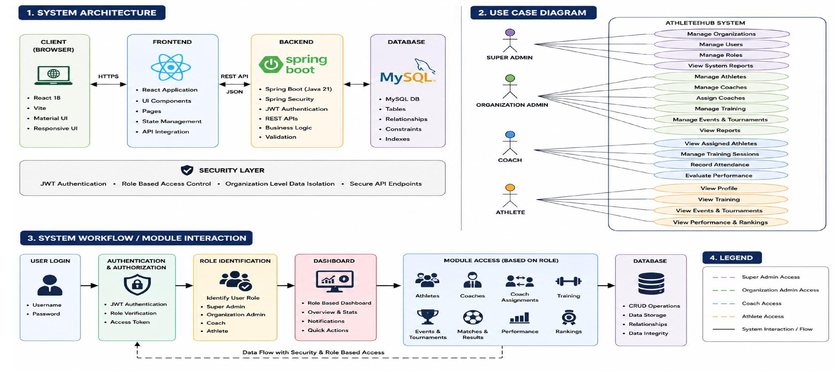
Software design diagrams

Slide 8
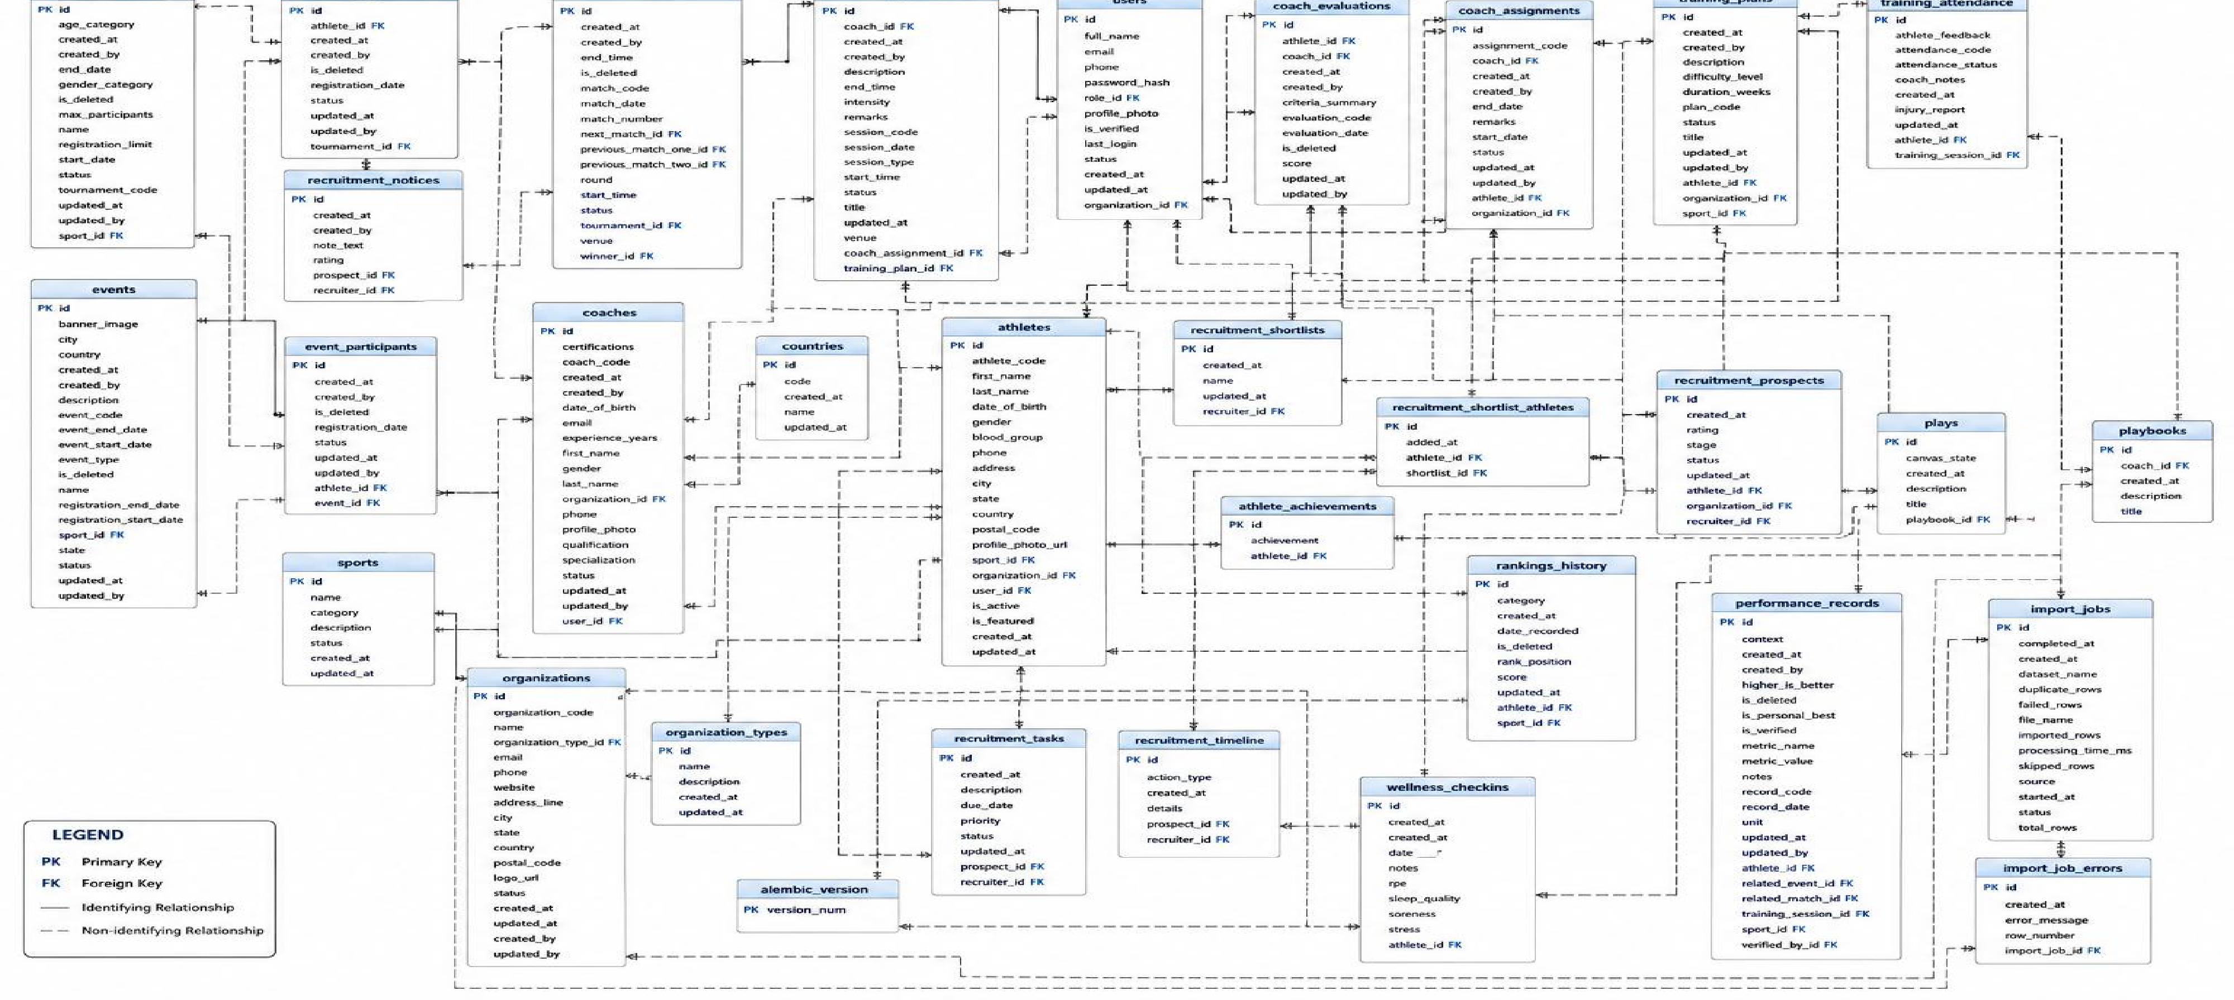
Database design

Slide 9
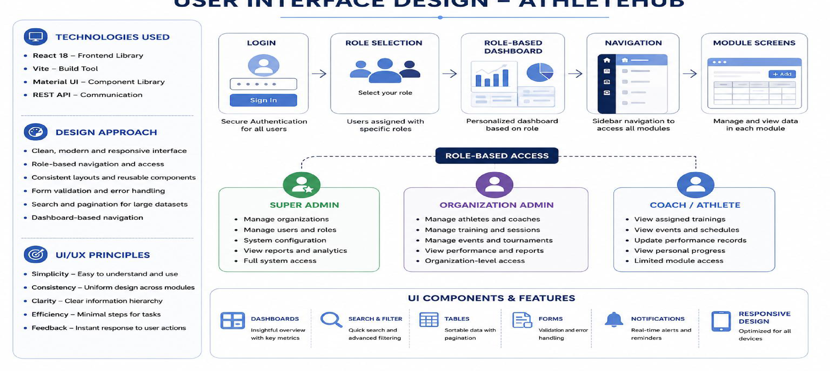
User interface design

Slide 10
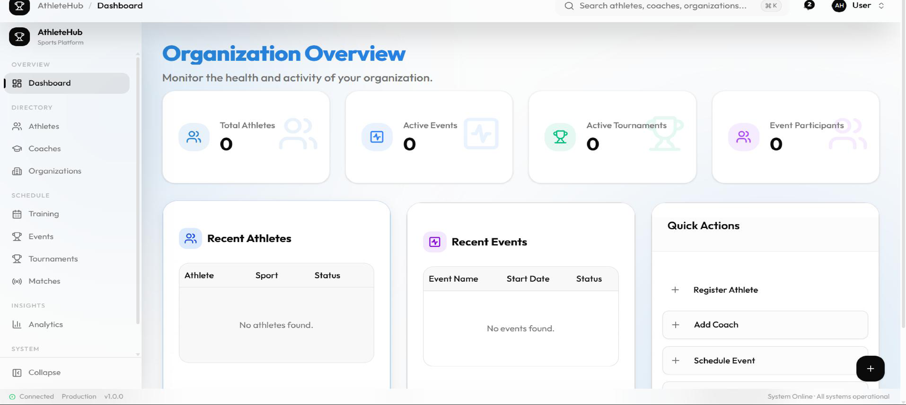
Sample screen shots

Slide 11
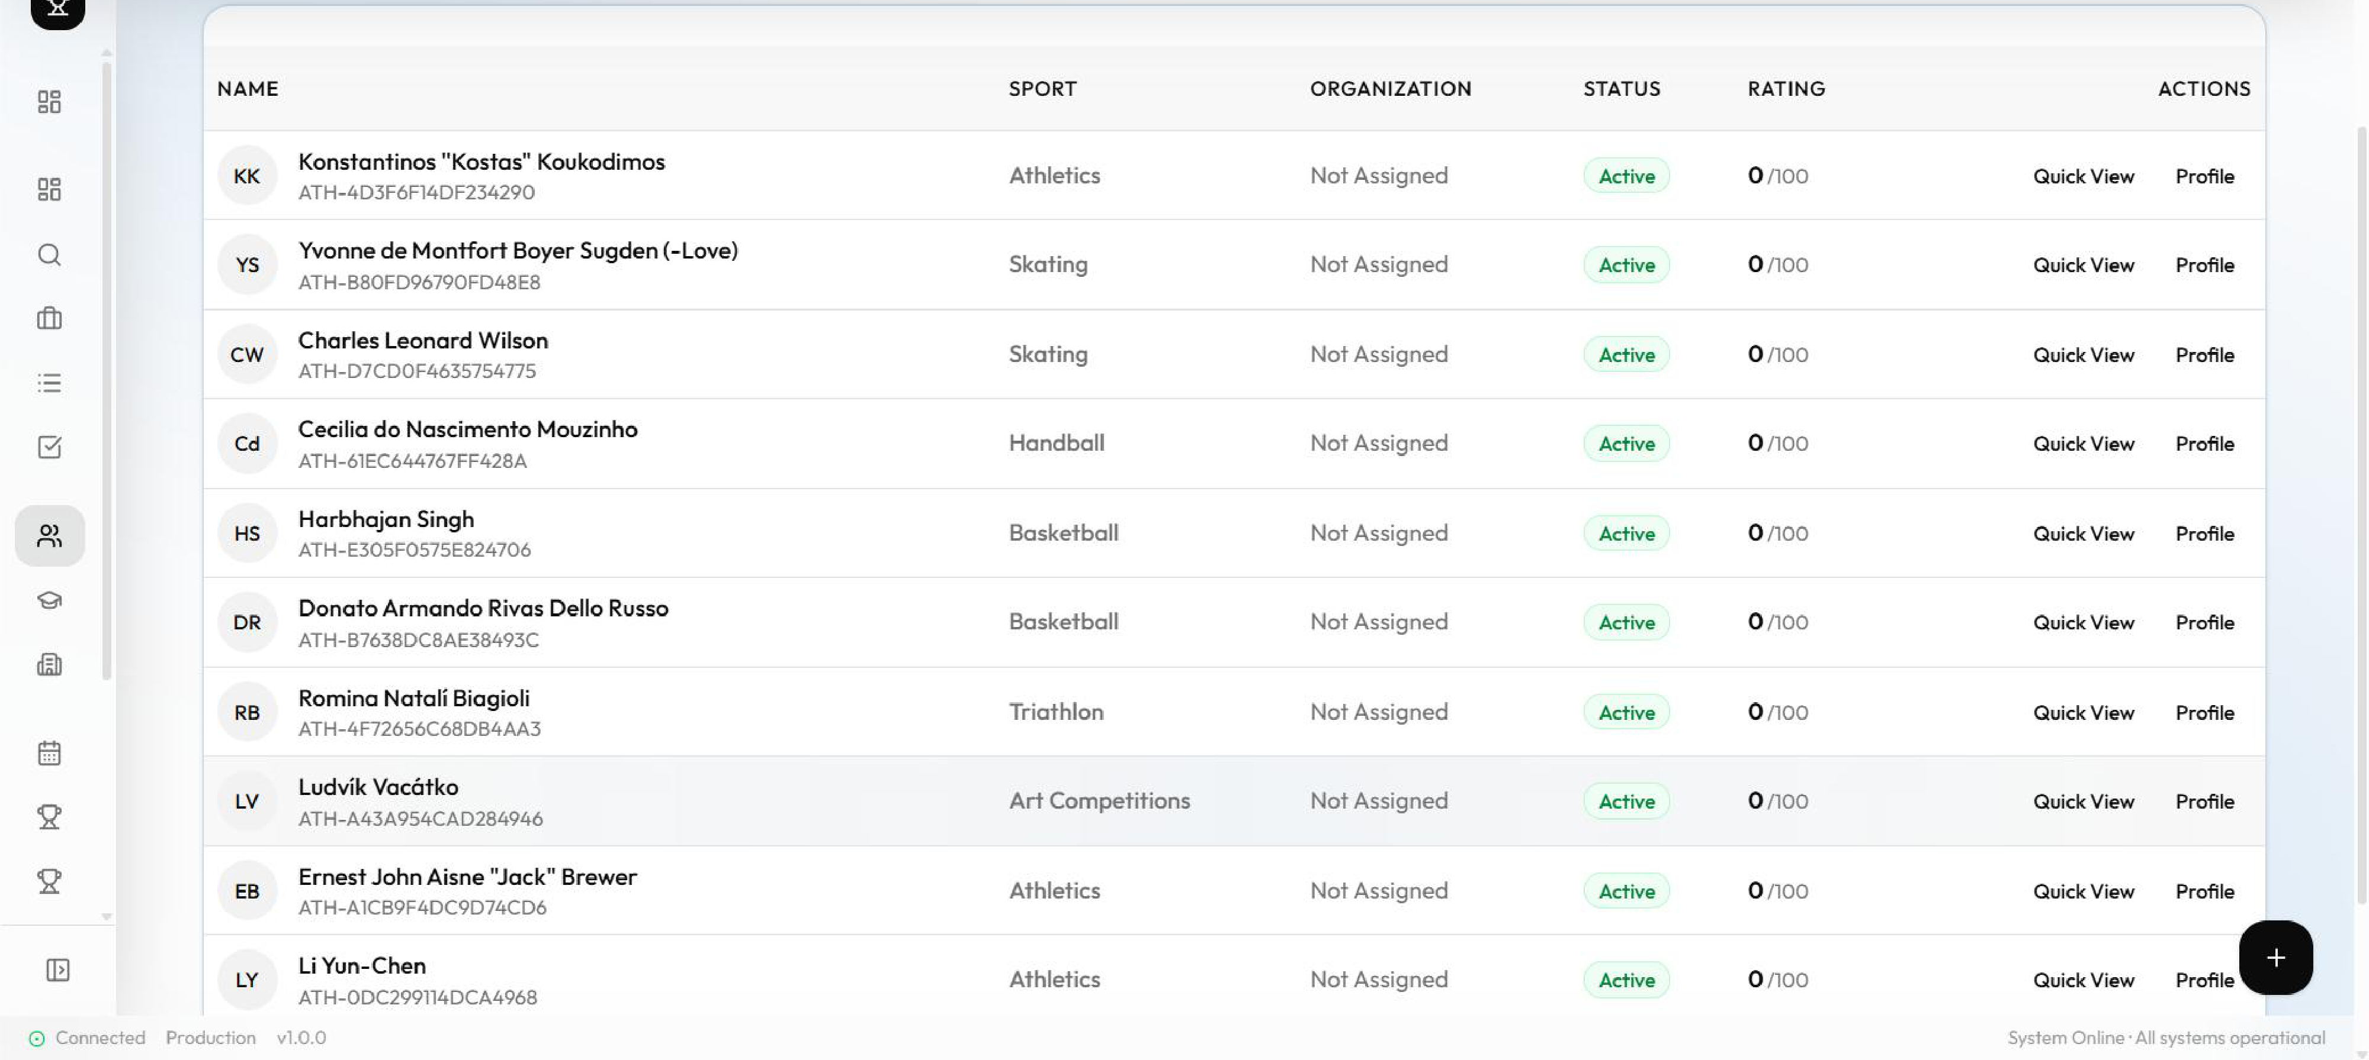
Sample screen shots

Slide 12
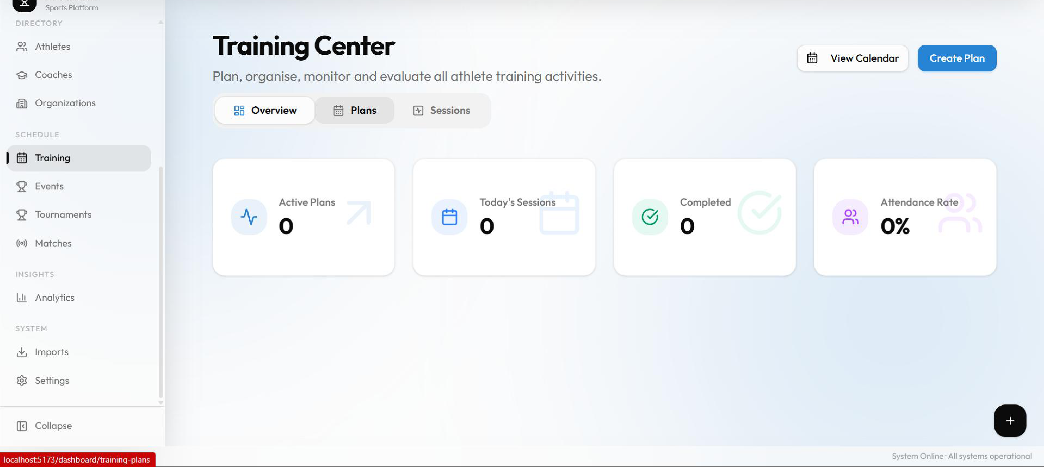
Sample screen shots

Slide 13
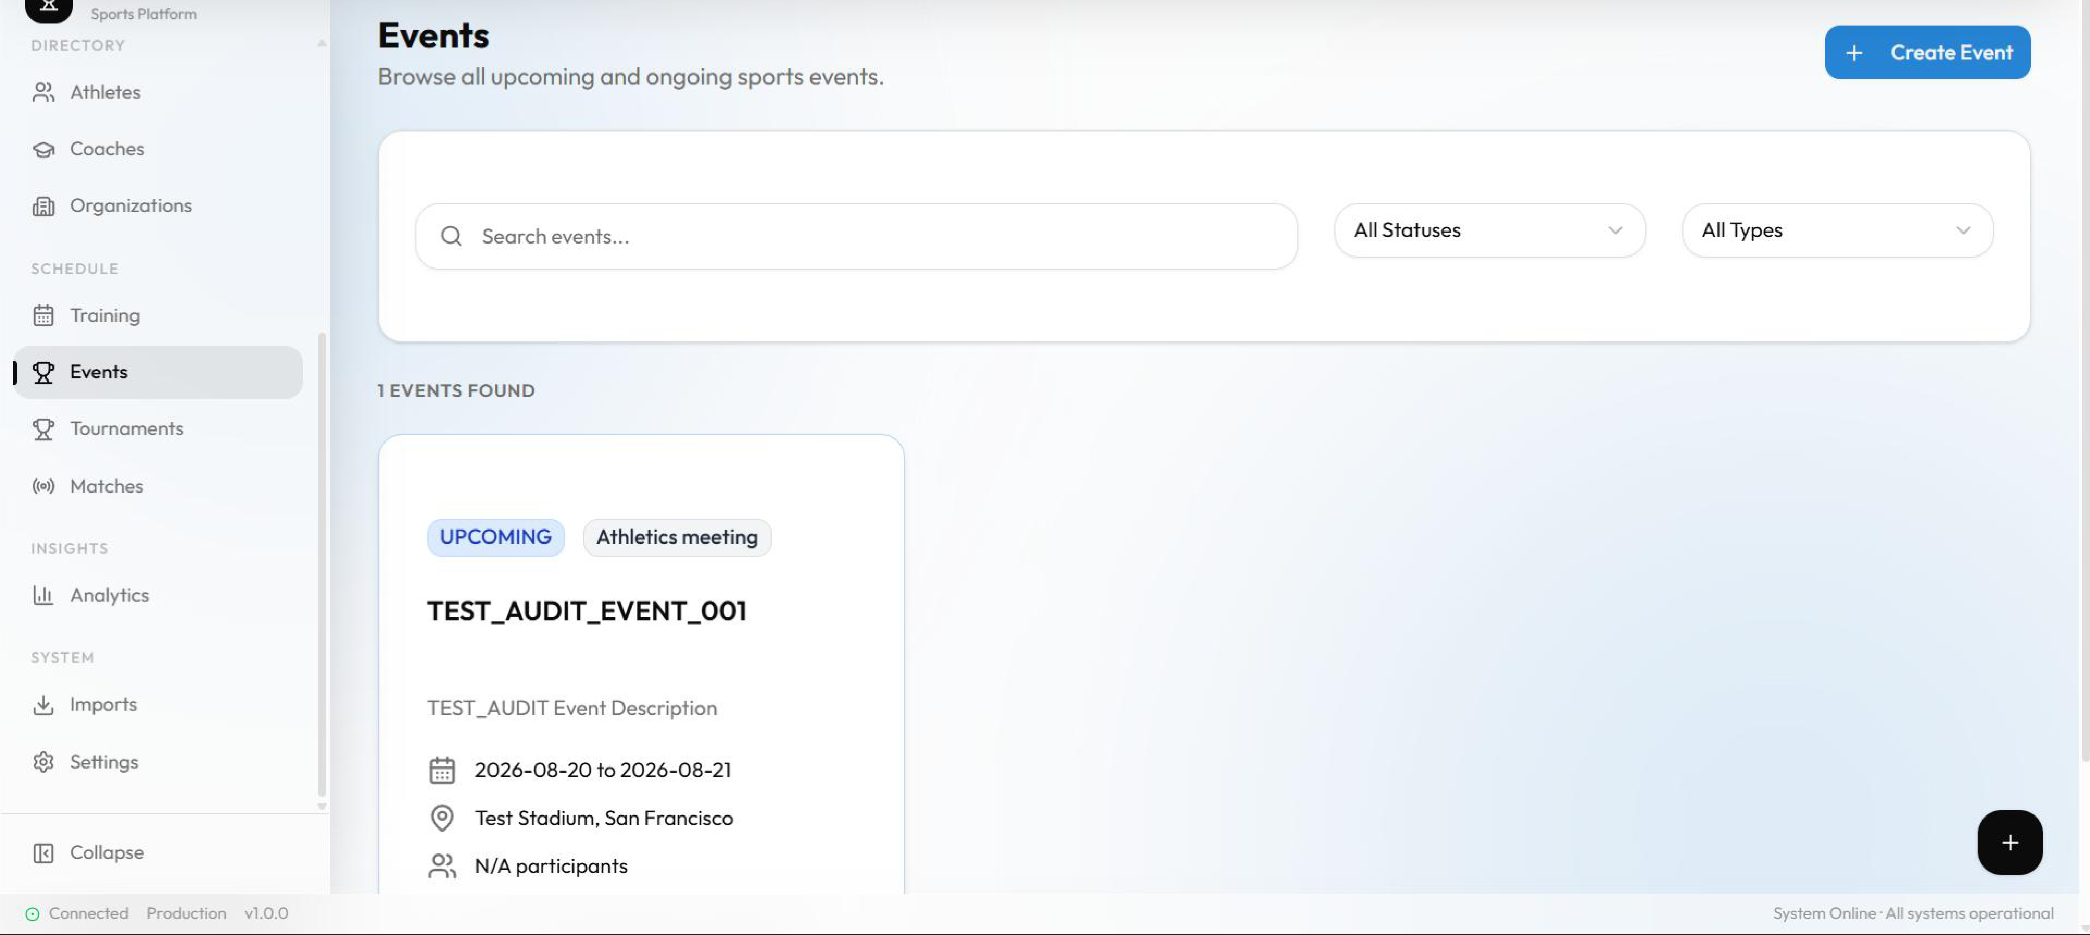
Sample screen shots

Slide 14
Conclusion
• AthleteHub provides a centralized platform for managing athletes, coaches, organizations, training, events, and performance.
• The system implements role-based access control and organization-level data isolation for secure data management.
• It integrates training, tournament, match, performance, and ranking management into a single platform.
Future Scope: AI-powered performance analysis, advanced analytics, athlete recruitment, safeguarding, and live sports integration.

Slide 15
THANK YOU

