Slide 1
Online Voting system using blockchain

Slide 2
Contents
Introduction
Problem Statement
Objective
Methodology
Use case Diagram
High Level Diagram
Proposed Work
Conclusion

Slide 3
What is Blockchain?
A blockchain is a decentralized , distributed and public ledger that is used to record transactions across many computers so that the record .A blockchain is a “distributed database that maintains a continuously growing list of ordered records called blocks”. These “blocks” are linked using cryptography.

Slide 4
PROBLEM STATEMENT
Many Challenges faced in the Paper based and the Machine based voting system and these are Less voter participation , Less efficient , more time taking , many voting frauds can takes place.
In the case of EVMs, there were many reports of misbehaving EVMs in elections , which serves as a cause of concern.
Transparency ,verifiability and secrecy are the three pillars of a free and fair elections , but EVM’s are neither transparent nor verifiable .

Slide 5
Objective
Increase Voter Participation
Increase Efficiency
Reduce time
Reduce Frauds
Verifiable and transparent Voting System
Only eligible voters must be allowed to vote

Slide 6
Methodology
► Open Block Chain
▸ Record transactions in a permanent way .
►Closed Block Chain
▸ A private network that maintains a shared record of transactions .
▸ Those who have permission only they can access network.
► Cryptography
▸ Symmetric Cryptography
▸ Asymmetric Cryptography
►Proof of Work
▸ Start >> Transaction >> Minors >> Block >> Block puzzle >>
Proof of Work >> Broadcasted new block to n/w>>
Verification of minors

Slide 7
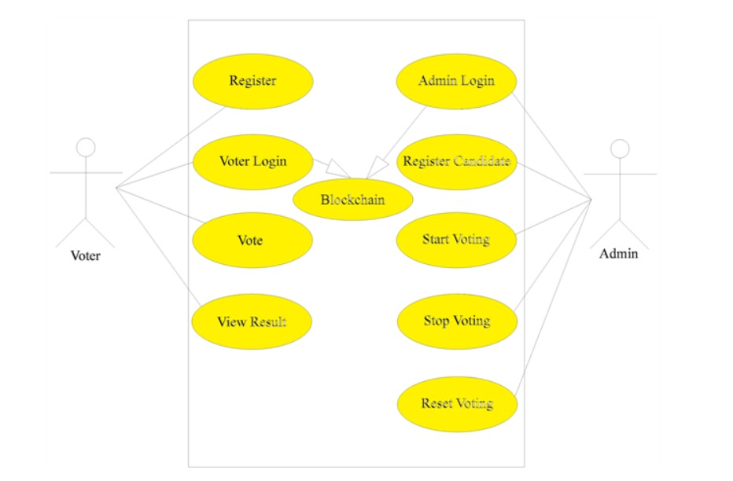
USE CaSE DIAGRAM

Slide 8
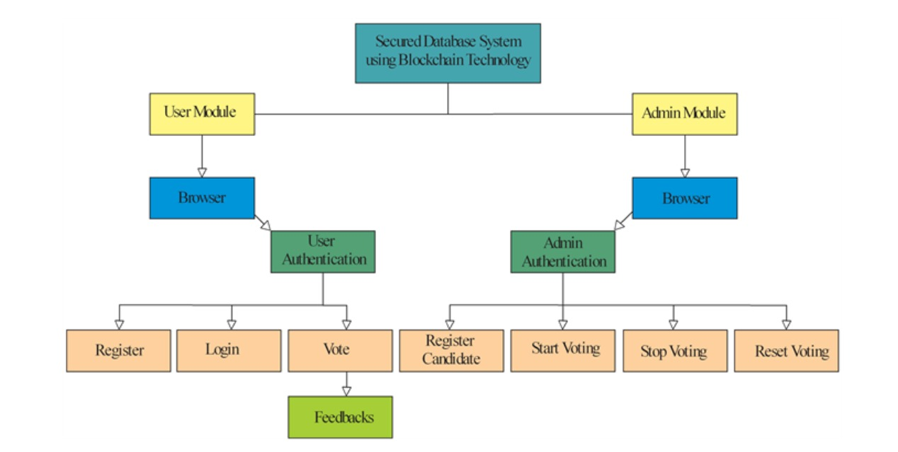
High Level Diagram

Slide 9
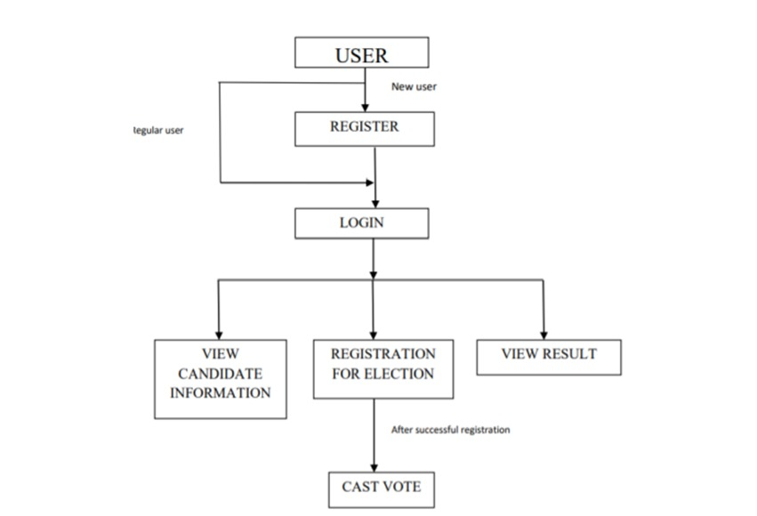
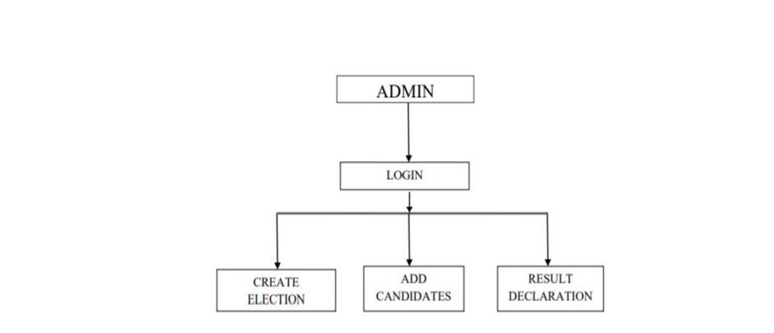
MODULES:
Admin Module
User Module

Slide 10
Proposed solution
1)This problem can be solved by using the Online Voting System Using Blockchain Technology .
2)Online Voting system using blockchain technology can increase the user participation and also increase the efficiency . It also save time , reduce frauds , making the voting process simple and secure .
3)Blockchain is a distributed, transactional database that is shared across all the nodes participating in a network and to hack all the nodes is not possible so our voting system will be secured .
4)Blockchain is immutable ledger ,so once the transaction is verified in the block and added to the blockchain, it is nearly impossible to erase or mutate the records.
5)In this we can consider two modules first one is user and second is the admin , admin can conduct the election and the user can gives the votes . Aadhar Card , Mobile number and the biometric authentication used for the verification of the voter.

Slide 11
TECH-STACK USED
BLOCKCHAIN
ETHEREUM
JAVASCRIPT
SOLIDITY
METAMASK
GANACHE
TRUFFLE
REACT-JS

Slide 12
CONCLUSION
By using the blockchain we can increase voter participation, increase efficiency, reduce time , reduce frauds. It will make the system Verifiable and transparent Voting System.

Slide 13
Thank you
Shubham Verma(Team Leader)
Shaurya Gupta
Shivam Shrivas
Vimal Kumar Dubey

