Slide 1

Department of Computer Science & Engineering
Major Project Presentation
Project Title: Medical Professional Remote Assistant System
GUIDED BY: PRESENTED BY:
Prof. Gaurav Parashar Parth Puneet
Prakhar Shukla

Slide 2

Table of Content
Abstract
Introduction
Methodology
Result
Conclusion
Reference

Slide 3

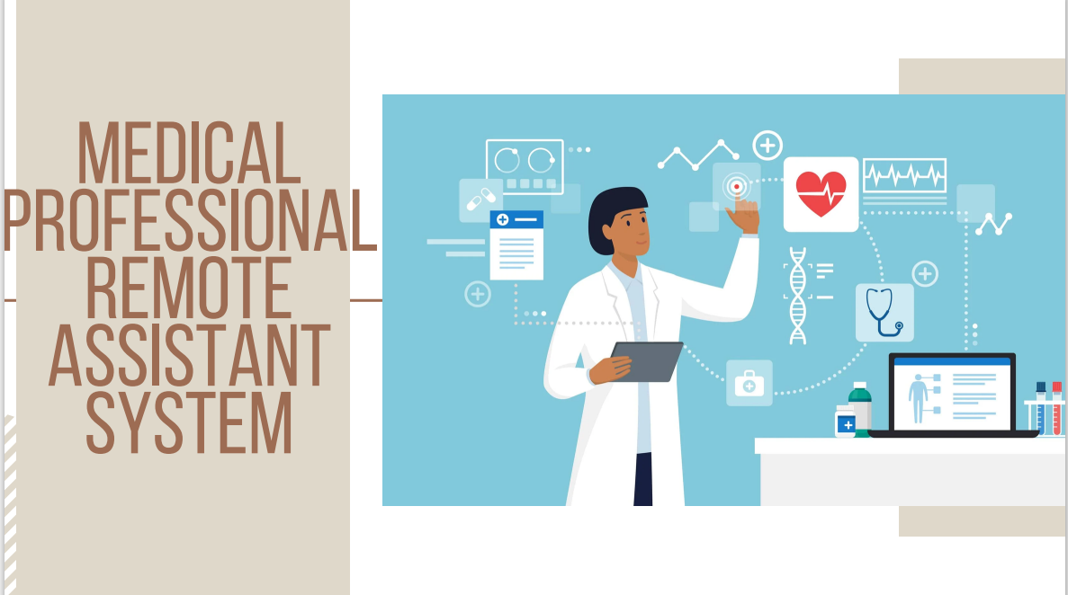

Slide 4
Abstract
The medical industry has increasingly used artificial intelligence (AI) as technology progresses. The primary advantage of machine learning comes in its capacity to derive significant insights from the immense volumes of health data gathered daily.
This work presents a diabetes prediction model that categorizes diabetes based on common parameters such as blood sugar, body mass index (BMI), age, insulin, and other relevant factors, as well as external factors that contribute to the development of diabetes.
Our analysis utilizes the PIMA India and Sylhet datasets and machine learning techniques, such as the Support Vector Machine (SVM), Naive Bayes classifier (NB), and decision tree, are used in the study.

Slide 5
Introduction
Strong well-being is foundational for a satisfying life, leading to joy and success. Health Index reflects a nation's economic strength, scientific achievements, defense capabilities, and social unity.
The true definition of health is beyond absence of diseases, it involves timely identification and intervention of illnesses and India is a country with diverse demographics, climate variations, and socio-cultural intricacies, there is a need for comprehensive health strategies.
Health index mirrors patterns of wealth or inequality, showcasing a thriving economy's investment in public health.
Diabetes is Global prevalence and impact highlighted, with risk factors and distinctions between Type 1 and Type 2 diabetes emphasized.
There is a need for Remote Health Monitoring to reach every community in India as remote health monitoring is essential due to the country's vast geography and diversified population.
Applications of ML/DL for Remote Diagnosis: In order to diagnose medical diseases remotely, reduce regional inequities, and improve access to healthcare, machine learning and deep learning are essential.
ML Diagnosis's Effectiveness in Remote Settings: More quickly and accurately than using traditional approaches, machine learning and deep learning algorithms improve the effectiveness of remote healthcare services.

Slide 6
Methodology
Load and preprocess the data. Remove inconsistencies like missing values, outliers, inconsistent data, and duplicate rows. Perform feature scaling and normalization. Split the data into training and test sets.
Select the models and perform hyperparameter tuning to achieve the best results.
Finalize the model based on the performance metric.

Slide 7
Database Collection
Dataset 1: The Dataset was gathered by doctors from patients from Sylhet Diabetes Hospital patients in Sylhet, Bangladesh. The dataset contains attributes namely age, gender, polyuria, polydipsia, sudden weight loss, weakness, polyphagia, genital thrush, visual blurring, itching, irritability, delayed healing, partial paresis, muscle stiffness, alopecia, obesity, and class. The dataset contains 520 entries.
Dataset 2: For the research, dataset-2 is the Pima Indians Diabetes dataset from kaggle. This dataset has 768 entries, of which 268 are positive and the remaining 500 are negative for diabetes.

Slide 8
Data Pre-Processing
The data pre-processing method improves results by handling superfluous data in the dataset in an efficient manner.
But dealing with missing information is a major problem, especially regarding important variables like age, blood pressure, skinfold thickness, insulin, bmi, and blood sugar level.
Since the values of these attributes must not have zero, therefore we used the imputation technique to remedy and preserve the integrity of the dataset.
We aim to maintain data consistency and correctness by expanding the dataset to include all values, enabling more precise and significant analysis and forecasts.

Slide 9
Model Selection
The choice of a suitable machine-learning technique is crucial during this stage of creating a diabetes prediction model.
Support Vector Machine
Decision Tree
Naïve Bayes

Slide 10
Results & Conclusion
Among the various machine learning algorithms evaluated in our study, DT emerged as the most accurate model, exhibiting a diabetes prediction accuracy of 98%.
The highest accuracy defines the effectiveness of DT in handling the intricacies of datasets and making precise predictions. The comparative analysis revealed that the developed model significantly enhanced the accuracy and precision of diabetes prediction across various datasets.
Expanding the analysis to include predictors of diabetes in individuals without the condition, can furnish valuable insights for health interventions.

Slide 11
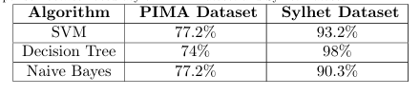
Observation Table

Slide 12


