Slide 1

KIET School of Engineering & Technology, Ghaziabad
Department of Computer Science & Engineering
Major Project Presentation
PLANT DISEASE DETECTION USING CNN
Group Number: PCSE-02
Members Name and Rollno:
Aashirwad(2100290100002)
Ishika Jaggi(2100290100073)
Ashutosh Kumar(2100290109005)
Guide name :
Dr. Dilkeshwar Pandey

Slide 2
Major Project presentation
Table of Content
Problem statement
Objectives
SDG Mapping
Course Outcome (COs)
Program Outcome (POs)
Implementation
Result
Outcome(Research Paper/ patent)
References

Slide 3
Major Project presentation
Problem Statement
Timely and accurate detection of plant diseases is essential for ensuring crop health, yield, and food security. Traditional methods rely on manual inspection, which is time-consuming, error-prone, and requires expert knowledge. With the increasing demand for precision agriculture, there is a need for an automated, efficient, and scalable solution. This project addresses the challenge by leveraging deep learning and transfer learning techniques to develop a robust plant disease classification system using the PlantVillage dataset. The goal is to assist farmers with real-time, reliable disease diagnosis through an accessible mobile application.

Slide 4
Major Project presentation
Objectives
The main objective of this project is to develop an accurate and efficient deep learning-based system for the classification of plant leaf diseases using the PlantVillage dataset. Specific goals include:
To apply and compare pre-trained CNN models such as DenseNet201, VGG16, Inception V3, and ResNet152V2 using transfer learning.
To enhance model performance through data preprocessing, augmentation, and fine-tuning techniques.
To identify the most effective model for multi-class disease classification.
To deploy the final model in a mobile application for real-time disease diagnosis by farmers.

Slide 5
Major Project presentation
SDG Mapping
SDG 2: Zero Hunger
End hunger, achieve food security, improve nutrition, and promote sustainable agriculture.
Early detection of plant diseases helps prevent crop loss, boosts yields, and ensures food availability, directly supporting food security.
SDG 3: Good Health and Well-being
Ensure healthy lives and promote well-being for all at all ages.
By protecting crops from diseases, the project helps maintain a stable food supply, reducing malnutrition and health risks linked to food scarcity.

Slide 6
Major Project presentation
SDG Mapping
SDG 9: Industry, Innovation, and Infrastructure
Build resilient infrastructure, promote inclusive and sustainable industrialization, and foster innovation.
Build resilient infrastructure, promote inclusive and sustainable industrialization, and foster innovation.
SDG 8: Climate Action
Take urgent action to combat climate change and its impacts.
Healthy crops mean efficient land use, reduced need for pesticides, and better climate resilience—contributing to sustainable farming practices.

Slide 7
Major Project presentation
Course Outcome (COs)
CO Number | Course Outcome Description
CO1 | Understand the importance of early plant disease detection in agriculture and its impact on food security and crop productivity.
CO2 | Gain practical knowledge of image processing and data augmentation techniques for preparing agricultural datasets.
CO3 | Apply deep learning concepts and transfer learning using CNN architectures like VGG16, ResNet, Inception V3, and DenseNet for image classification tasks.
CO4 | Evaluate and compare the performance of various pre-trained deep learning models using metrics such as accuracy, precision, recall, and F1-score.

Slide 8
Major Project presentation
Course Outcome (COs)
CO Number | Course Outcome Description
CO5 | Design and implement a custom plant disease detection model integrated into a user-friendly mobile application for real-time prediction.
CO6 | Develop critical thinking and problem-solving skills by analyzing challenges in precision agriculture and proposing AI-driven solutions.

Slide 9
Major Project presentation
Program Outcome (POs)
PO Number | Program Outcome Description
PO1 | Engineering Knowledge
PO2 | Problem Analysis
PO3 | Design/Development of Solutions
PO4 | Conduct Investigations of Complex Problems
PO5 | Modern Tool Usage
PO6 | The Engineer and Society
PO7 | Environment and Sustainability
PO8 | Ethics
PO9 | Individual and Team Work
PO10 | Communication
PO11 | Project Management and Finance
PO12 | Life-long Learning

Slide 10
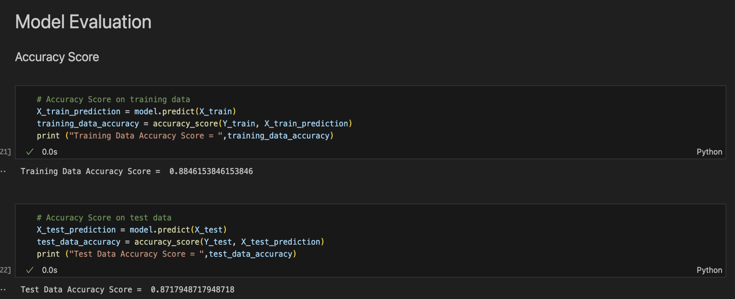
Major Project presentation
Implementation

Slide 11
Major Project presentation
Result
Developed a deep learning-based plant disease classification model using DenseNet201 with a training accuracy of 99.31% and a validation accuracy of 97.96%.
Enhanced Accuracy: The proposed model outperformed other architectures such as Inception V3, VGG16, and ResNet152V2, demonstrating superior accuracy, precision, recall, and F1-scores for multi-class classification of plant leaf diseases.
Transfer Learning Efficiency: Leveraging pre-trained DenseNet201 reduced training time and computational costs while achieving high generalization on unseen test data.
Practical Deployment: The final model was integrated into a mobile application, allowing real-time leaf disease diagnosis by simply uploading an image.
Challenges and Opportunities: While results are promising, challenges such as image variability in real-world environments, background noise, and scalability to more crop species remain. Future improvements will focus on expanding the dataset and optimizing the model for field conditions.

Slide 12
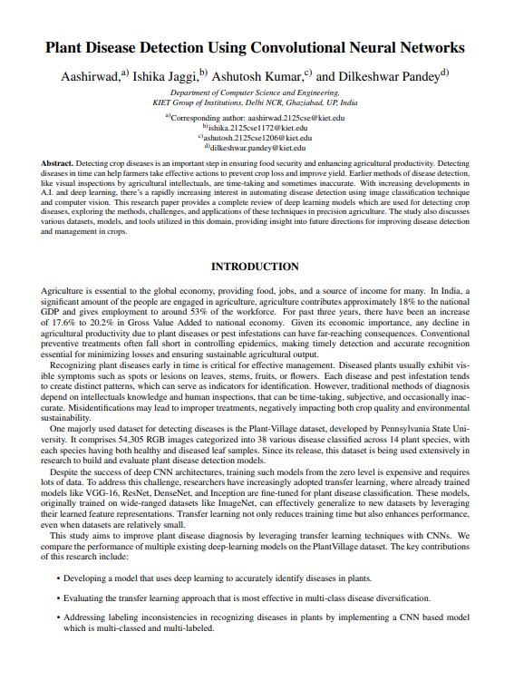
Major Project presentation
OUTCOME(Research paper/Patent/Product)

Slide 13
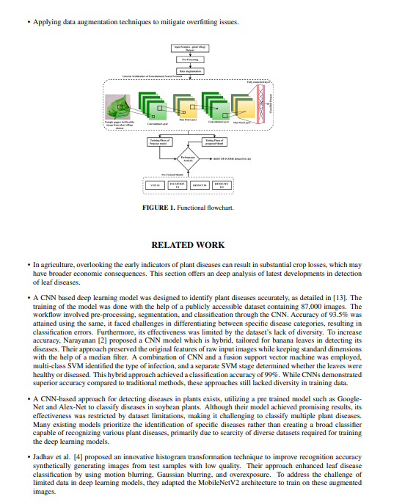
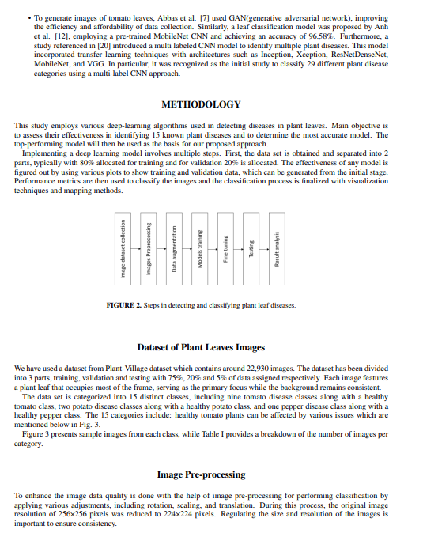

Slide 14
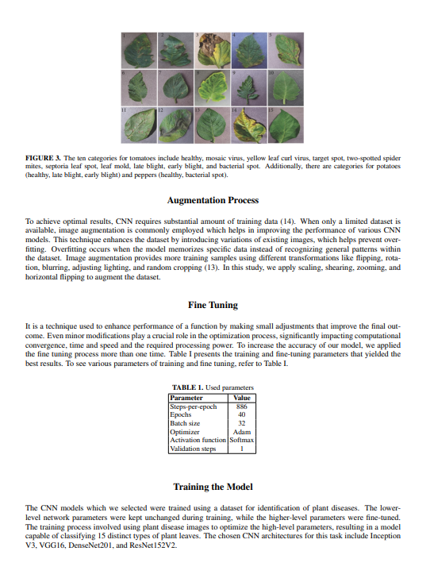
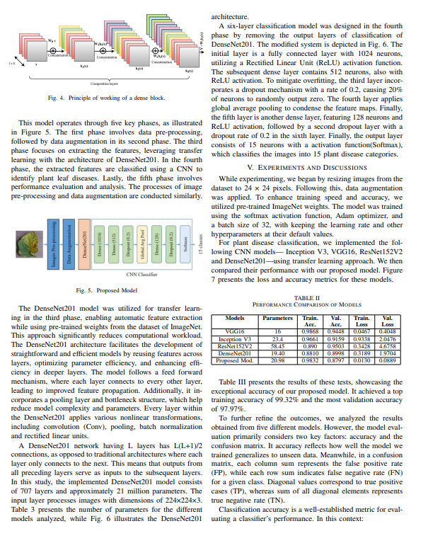

Slide 15
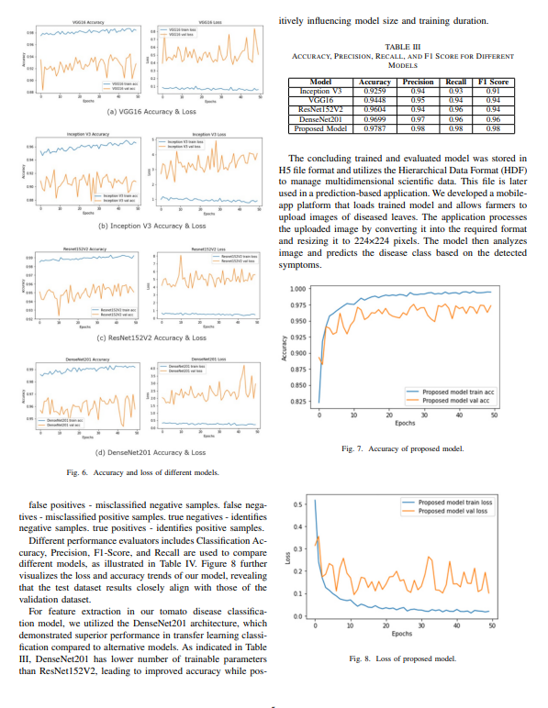

Slide 16
Major Project presentation
Thank You

