Slide 1
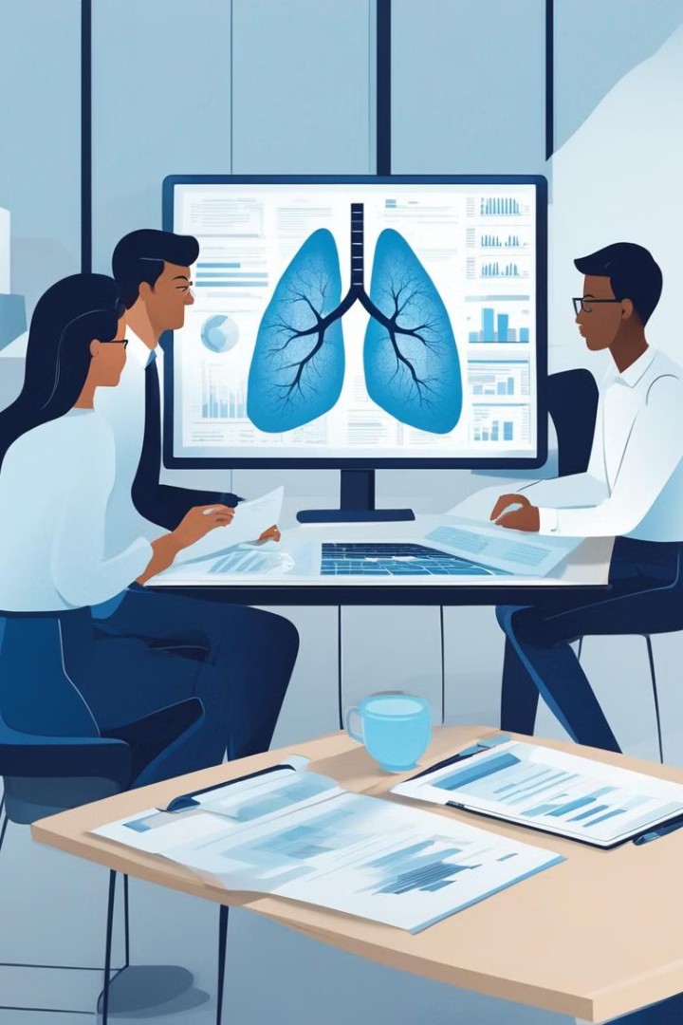
Investigating Ethnicity's Impact on Lung Disorders Prevalence
A Research Endeavor by KIET Group of Institutions,
Delhi-NCR, Ghaziabad
Presenter's Name: ALOK SINGH || DEVASNH VERMA || DHRUV GUPTA

Slide 2

Impact Of Ethnicity On Prevalence Of Lung Disorders
Problem Statement
Solution
Lung disorders affect different ethnic groups disproportionately, requiring dedicated research.
This project aims to understand how ethnicity influences the prevalence of lung disorders.
Objectives
To explore factors contributing to ethnic disparities in lung disorders prevalence.

Slide 3
Technical Feasibility
Data Sources
Analytical Methods
Access to electronic health records, medical databases, and genetic data.
Utilization of statistical analysis, machine learning algorithms, and genetic studies.
Research Personnel
Ethical Considerations
Qualified researchers with expertise in epidemiology, genetics, and statistical analysis.
Compliance with ethical guidelines, ensuring data privacy and confidentiality.

Slide 4

Societal Impact
1
Addressing Disparities
2
Informed Healthcare Policies
Contribution to the broader goal of achieving healthcare equity by identifying disparities.
Providing evidence-based insights to policymakers for developing targeted interventions.
3
Enhanced Health Outcomes
Improving healthcare access and outcomes for diverse populations through informed strategies.

Slide 5

Environmental Sustainability
Focus on Healthcare
Ethical Research Practices
Minimal environmental implications due to the project's focus on healthcare research.
Responsible data management and disposal to minimize environmental impact.

Slide 6
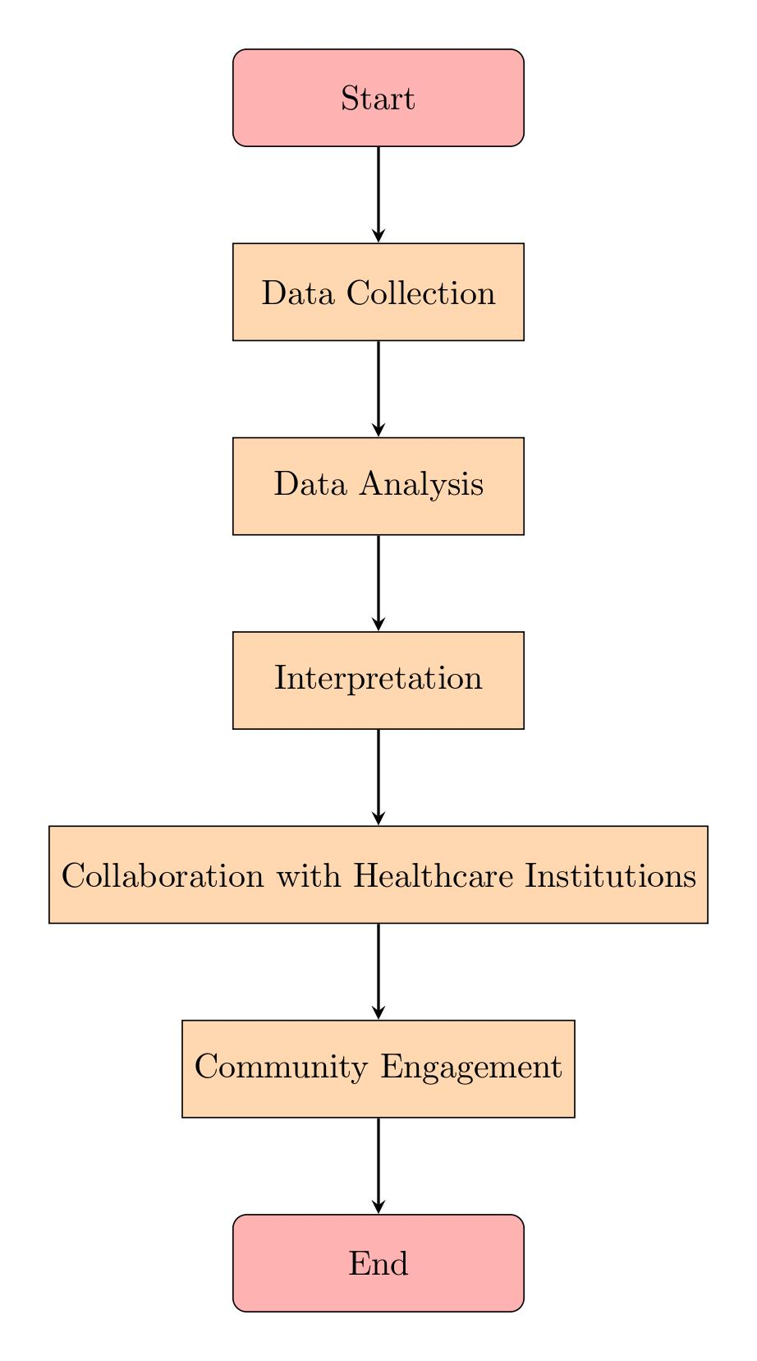
Flowchart/Block Diagram

Slide 7

Conclusion
1
Summary
2
Call to Action
This research explores how ethnicity affects lung disorders prevalence, aiming to reduce healthcare disparities. Using advanced tools and ethical practices, it contributes to healthcare equity and encourages collaboration for better outcomes.
Encouraging further collaboration, engagement, and support for the research project.

