Slide 1
STUDYVERSE
A MERN STACK WEBSITE
PRESENTED BY: ANAND RASTOGI
AVINASH TRIPATHI
ADITYA KESHARI
COLLEGE: KIET GROUP OF INSTUTIONS
GUIDE: PROF. SAURAV CHANDRA

Slide 2
INTRUDUCTION
What is STUDYVERSE? STUDYVERSE is a centralized, all-in-one educational platform that brings together learners and educators. It aims to make studying, accessing resources, attending classes, and tracking progress easier and more efficient through a modern digital interface.
Why an EdTech Platform? With increasing reliance on online education, there's a strong need for platforms that are user-friendly, accessible, and tailored to students’ academic journeys. STUDYVERSE addresses this by integrating features like content sharing, class scheduling, live sessions, and progress tracking.
Brief about MERN Stack The platform is built using the MERN stack:
MongoDB (Database)
Express.js (Backend Framework)
React.js (Frontend Library)
Node.js (Server Environment) This stack allows full-stack JavaScript development, leading to faster development and more dynamic applications.

Slide 3
PROBLEM STATEMENT
Current Challenges in Online Education
Fragmented systems for classes, notes, discussions, and assignments
Lack of personalization in learning experiences
Poor integration between tools, leading to inefficiencies
Need for Centralized Learning Platforms
Students and educators need a single platform for communication, content, and progress tracking
Centralization ensures better organization, accessibility, and collaboration
Issues with Student Engagement & Resource Accessibility
Limited real-time interaction reduces motivation
Students often struggle to find relevant resources quickly
Accessibility gaps for students in rural or underprivileged areas

Slide 4
Objectives
Provide a platform for students to learn and collaborate
Offer structured course content and assessments
Enable interactive features like forums and quizzes
Maintain scalability and performance with MERN stack

Slide 5
Tech Stack (Detailed Overview)
🖥️ Frontend – React.js
Developed a responsive and dynamic Single Page Application (SPA)
Utilized component-based architecture for modularity and reusability
Implemented state management using React Hooks
Ensured responsive design across desktop and mobile using CSS Flexbox/Media Queries/Bootstrap/Tailwind (mention which one you used)
🧠 Backend – Node.js & Express.js
Built a RESTful API using Express.js
Handled routing, middleware, and business logic on the server side
Used Node.js for asynchronous, event-driven architecture to support high concurrency
🗃️ Database – MongoDB
NoSQL document-based database for storing users, courses, discussions, and quiz results
Enabled flexible schema design using Mongoose ODM
Easily scalable to accommodate growing data and users
🛠️ Other Tools & Technologies
JWT (JSON Web Tokens): Secured user authentication and protected routes
Postman: API testing and debugging
Git & GitHub: Version control and collaborative development
Cloud Deployment Tools: (e.g., Render, Vercel, MongoDB Atlas – please confirm what you used)

Slide 6
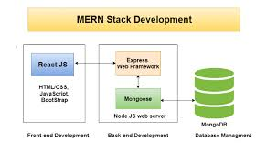
Client-Server Model
API communication
MongoDB database integration
Authentication and Authorization flow

Slide 7
Key Features
✅ User Registration & Login (with JWT) Secure login and session management using JSON Web Tokens to protect user data and maintain authentication.
📚 Browse & Enroll in Courses Users can explore available courses, view descriptions, and enroll to begin learning instantly.
🎥 Video Lectures, Notes, and Quizzes Each course includes structured learning material such as recorded lectures, downloadable notes, and interactive quizzes.
💬 Discussion Forums Students can ask questions, interact with peers, and participate in topic-specific discussions to enhance learning.
🛠️ Admin Panel to Manage Content/Users Admins can create, update, or remove courses, manage user roles, monitor platform activity, and moderate forum content.

Slide 8
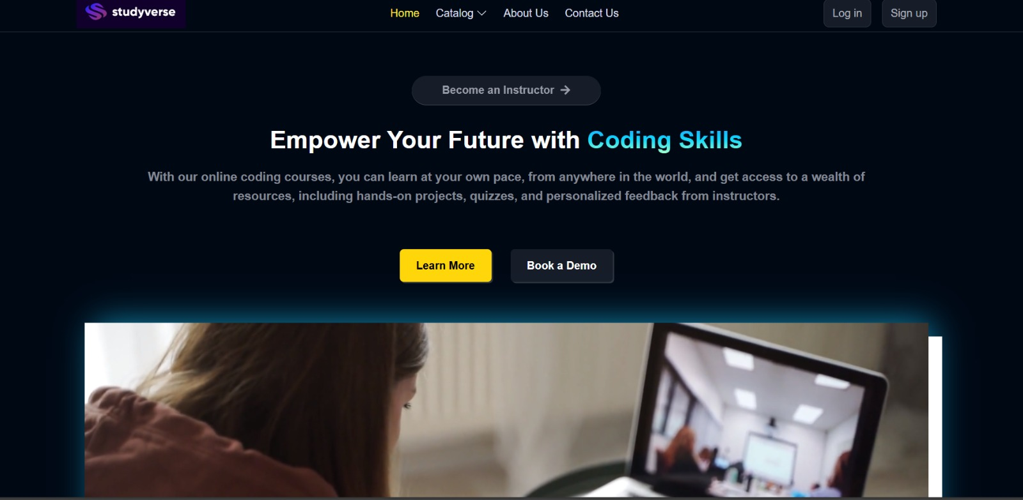

Slide 9
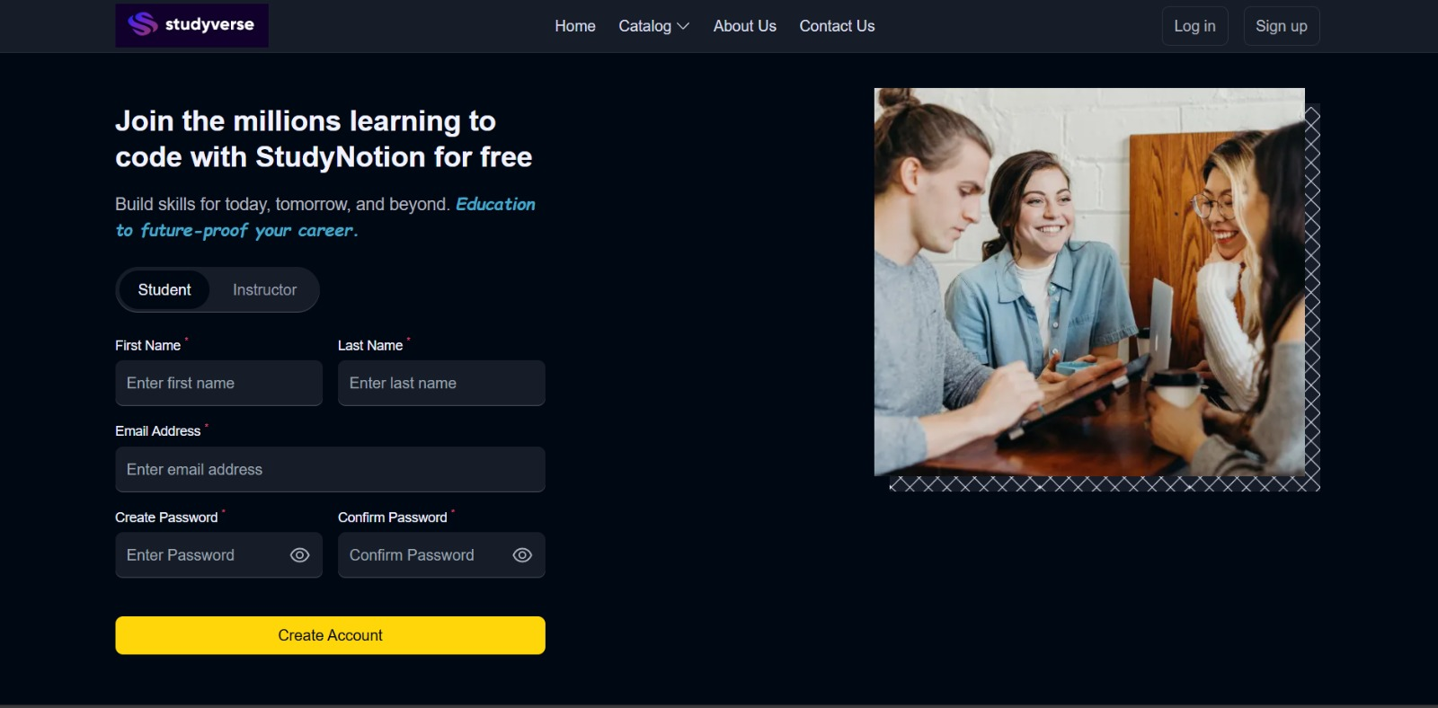

Slide 10
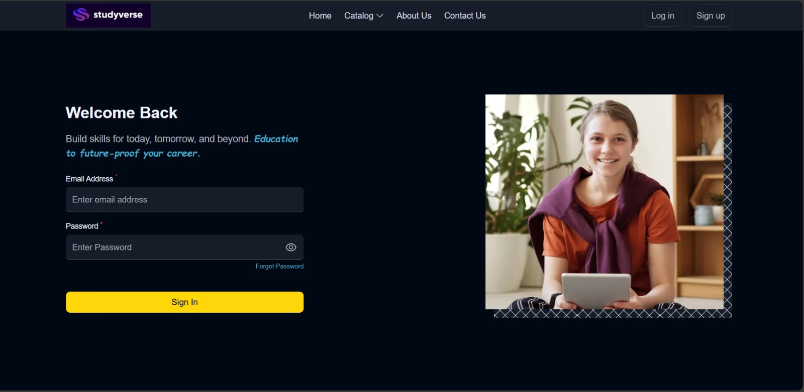

Slide 11
Challenges Faced
🔐 Managing User Sessions and Authentication Implementing secure, persistent login with token-based auth (JWT) was critical for protecting user data and ensuring session continuity.
🗃️ Designing a Scalable Database Schema Structuring MongoDB collections to efficiently store user data, course content, quizzes, and forum interactions required careful planning for scalability.
📱 Ensuring Responsiveness Across Devices Building a responsive UI with React to provide a smooth experience on desktops, tablets, and mobile devices involved consistent testing and styling.
⚙️ Optimizing API Calls and Performance Minimizing redundant network calls and optimizing backend logic helped improve speed and reduce latency for a seamless user experience.

Slide 12
Future Enhancements
🤖 Integrate AI-Based Recommendations Implement AI algorithms to recommend courses, resources, and quizzes based on user behavior and learning progress.
💬 Add Real-Time Chat Enable instant messaging between students and instructors for quicker doubt resolution and collaboration.
🎥 Support for Live Classes Add functionality for scheduling and conducting live video lectures with attendance tracking.
📱 Mobile App Version Develop an Android/iOS mobile application for better accessibility and on-the-go learning.
📊 Analytics for Student Performance Introduce detailed performance dashboards showing quiz results, learning patterns, and course completion stats.

Slide 13
Conclusion
✅ What Was Achieved Successfully developed a feature-rich EdTech platform — STUDYVERSE — that enables structured learning, student engagement, and content management using the MERN stack.
🧠 Skills Learned
Frontend: React.js
Backend: Node.js, Express.js
Database: MongoDB
Others: REST APIs, JWT Auth, Responsive UI Design, Deployment (e.g., Render, Vercel)
🎓 Value Added to Learners
Easy access to educational resources
Interactive learning through quizzes and discussions
User-friendly experience for students and admins
🚀 Scope for Real-World Implementation
Can be scaled to support schools, coaching centers, and universities
Potential integration with LMS systems and e-learning certifications
Adaptable for different languages and regions

