Slide 1







Security Assistance for Visually Challenged Using ML
Presented by: Atharva Namdeo, Devesh Kumar, Parth Sharma
Our project aims to enhance home security by intelligently identifying potential threats. The system detects harmful objects and performs facial recognition to determine if the person is a family member. If an unauthorized individual is detected with a harmful object, an alarm is triggered, providing an intelligent security solution for real-time threat assessment.

Slide 2




Project Objective: Enhanced Home Security
The core objective of this project is to bolster home security. Our system is designed to identify harmful objects held by individuals and then perform facial recognition to ascertain if the person is a family member. This multi-layered approach ensures comprehensive threat detection.
Identify Harmful Objects
Perform Facial Recognition
Trigger Alarm
Detect weapons or dangerous items in real-time.
Verify if the individual is a known family member.
Alert if an unauthorized person holds a harmful object.

Slide 3
Step 1: Harmful Object Detection
The initial phase of our security system focuses on real-time harmful object detection. We utilize a pre-trained YOLO (You Only Look Once) model for its speed and accuracy in identifying objects like knives or weapons. This ensures immediate threat identification.
YOLO for Real-Time Detection
Frameworks & Libraries
YOLO is chosen for its efficiency in detecting multiple objects within a single frame, crucial for real-time video analysis.
YOLO: Primary for object detection.
OpenCV: For real-time video streaming and image preprocessing.
PyTorch: For model handling, especially for custom dataset training.

Slide 4
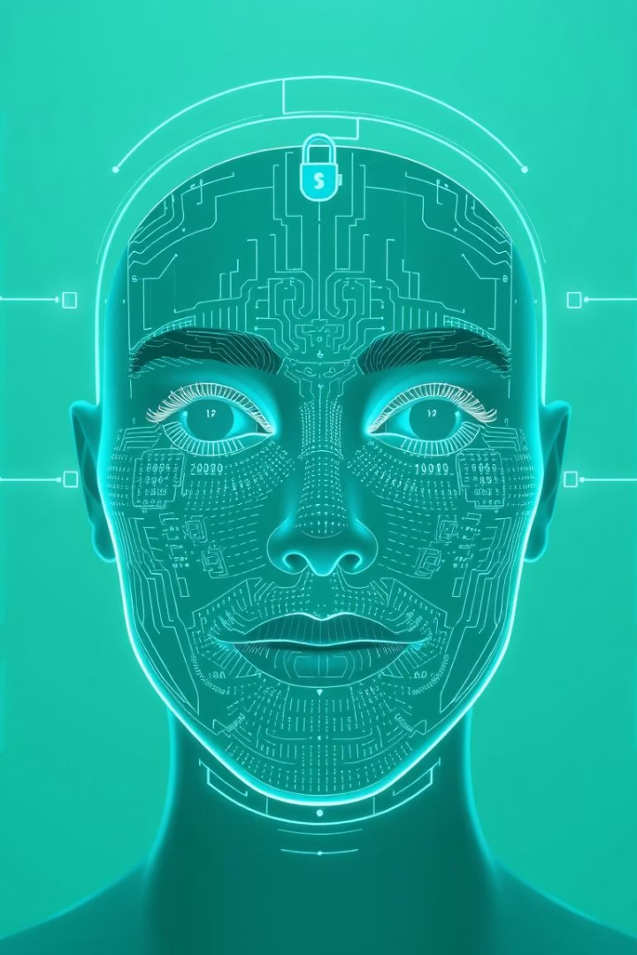



Step 2: Facial Recognition
Following harmful object detection, the system proceeds to facial recognition. The objective is to identify if the person holding the object is a known family member. We employ DeepFace, a deep learning-based model, for accurate face recognition against a pre-existing family dataset.
Real-Time Face Detection
OpenCV is used to detect faces from live video streams.
DeepFace for Recognition
DeepFace performs the actual comparison with family member data.
Confidence Threshold
A threshold determines if a match is confident enough, identifying unauthorized individuals.

Slide 5
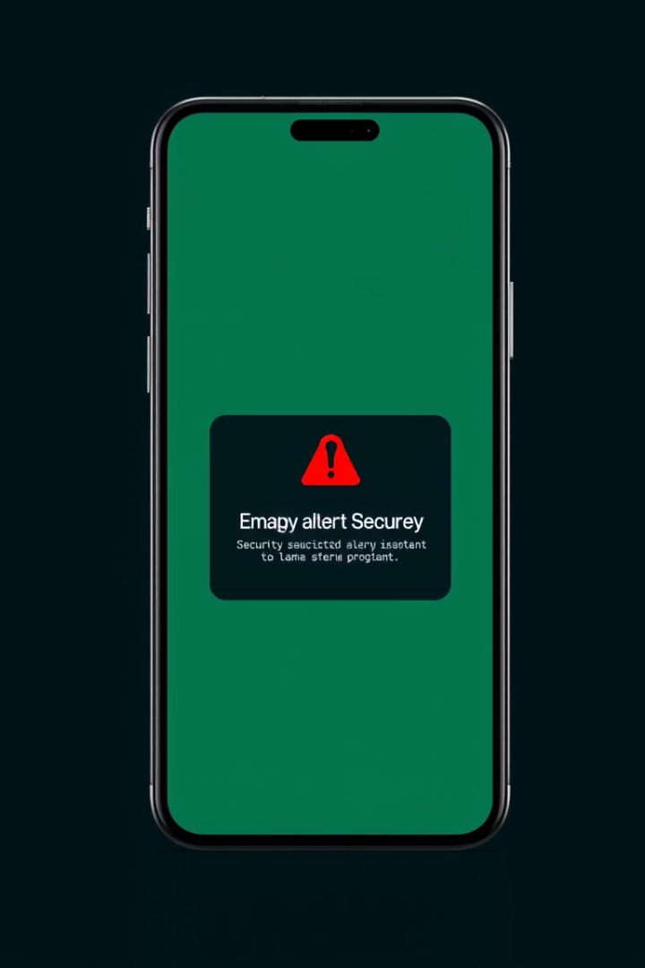
Step 3: Alarm Trigger
The final step in our security protocol is the alarm trigger. If the system detects a harmful object in someone's hand and facial recognition fails to identify them as a family member, an alarm is activated. This ensures immediate notification of potential threats.
Alarm Activation Logic
Notification Methods
Python handles the core logic for triggering the alarm based on detection and recognition outcomes.
The alarm can manifest as a sound alert, a smartphone notification, or an automated message to security personnel.
Optional Hardware Integration
Raspberry Pi GPIO can be optionally integrated for physical alarms like buzzers, enhancing the alert system.

Slide 6
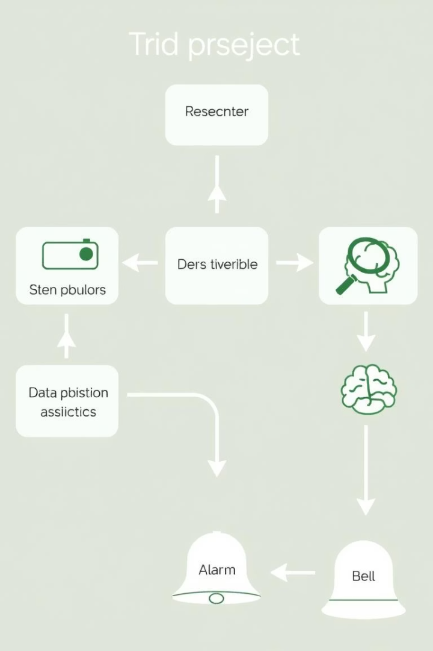



Complete Project Flow
Our security system operates through a seamless, integrated flow, combining multiple machine learning and computer vision techniques. This ensures a robust and intelligent solution for home security.
Object Detection
System detects harmful objects using YOLO.
Facial Recognition
If an object is detected, DeepFace verifies if the person is a family member.
Alarm Trigger
If the face is not recognized, the system triggers an alarm via Python and optional hardware.

Slide 7





Key Technologies Utilized
This project leverages cutting-edge technologies to deliver a reliable and efficient security solution. Each component plays a vital role in the system's overall functionality and performance.
YOLO
Real-time object detection for harmful items.
OpenCV
Video streaming and image preprocessing.
DeepFace
Accurate facial recognition for family members.
Python
Core logic and alarm triggering.

Slide 8






System Advantages
Our security assistance system offers distinct advantages through its integration of advanced machine learning and computer vision techniques. It provides an intelligent and proactive approach to home security.
Real-Time Performance
Ensures quick and reliable detection.
Accurate Identification
Precise object and facial recognition.
Enhanced Security
Proactive threat detection and alerts.

Slide 9
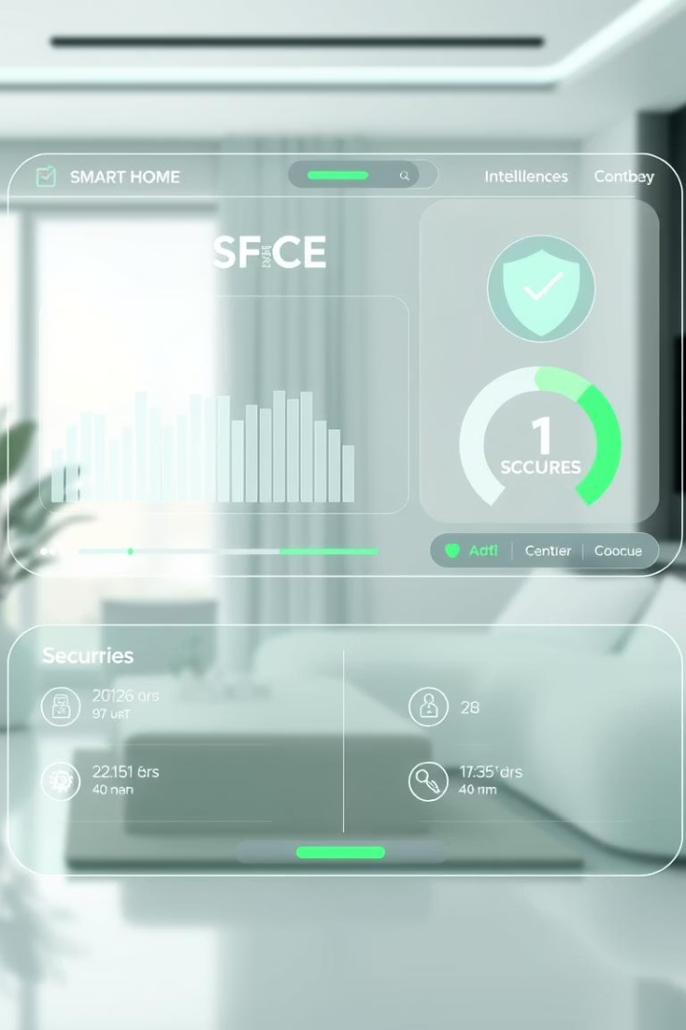
Conclusion: Intelligent Security Solution
This project successfully integrates multiple machine learning and computer vision techniques to deliver an intelligent security solution. By combining object detection for harmful items and facial recognition for unauthorized individuals, the system provides real-time, reliable protection.
Integrated ML & CV
Combines advanced techniques for comprehensive security.
Proactive Threat Detection
Identifies harmful objects and unauthorized persons.
Real-Time Reliability
Designed for quick and dependable performance.

