Slide 1

KIET Group of Institutions, Ghaziabad
Integrative Healthcare System:
AI Driven Disease & Patient Diagnosis System
Group ID: PCSE25-19
Team Leader: Ayush Sachan Semester: 8 Department: CSE
Group Member: Abhinav Semester: 8 Department: CSE
Group Member: Andril Omer Semester: 8 Department: CSE
Name of Guide : Prof. Omprakash Kushwaha
Date of Presentation : 26-05-2025
1

Slide 2
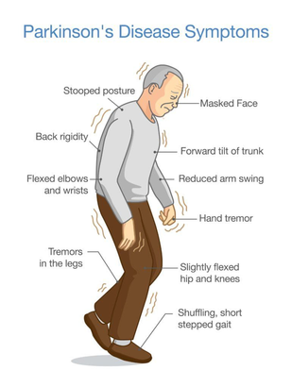
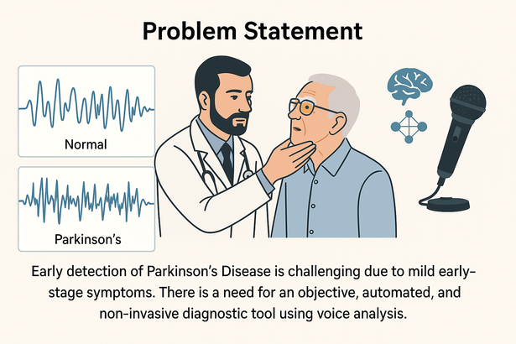
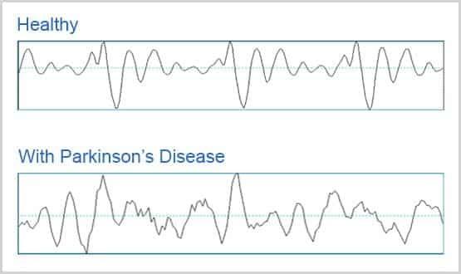
KIET Group of Institutions, Ghaziabad
Problem Statement
Early detection of Parkinson’s Disease is challenging
due to mild early-stage symptoms.
Traditional diagnosis is subjective and depends on clinical evaluation.
Patients exhibit speech irregularities before motor symptoms, but these are often overlooked.
There is a need for an objective, automated, and non-invasive diagnostic tool using voice analysis.

Slide 3
KIET Group of Institutions, Ghaziabad
Project Objectives
Early Detection
Identify Parkinson’s Disease at early stages through non-invasive voice analysis.
Automation
Develop an automated diagnosis system using machine learning to reduce reliance on clinical judgment.
Model Comparison
Evaluate and compare multiple ML algorithms (SVM, Random Forest, XGBoost, etc.) for diagnostic performance.
Feature Analysis
Investigate the importance of voice-based biomarkers (e.g., jitter, shimmer, NHR) in differentiating healthy vs. PD cases.
Real-World Application
Propose a scalable solution suitable for remote screening and telemedicine

Slide 4
KIET Group of Institutions, Ghaziabad
Dataset Description
Key Features Extracted
Frequency Features
MDVP:Fo(Hz), MDVP:Fhi(Hz), MDVP:Flo(Hz)
Jitter (Frequency Variation)
MDVP:Jitter(%), MDVP:RAP, MDVP:PPQ
Shimmer (Amplitude Variation)
MDVP:Shimmer, Shimmer:APQ3,
Shimmer:APQ5
Voice Quality
NHR, HNR (Noise-to-Harmonics Ratio)
Nonlinear Dynamics
RPDE, DFA, spread1, spread2, D2, PPE
Target Label
status → 1 = Parkinson’s, 0 = Healthy
UCI Parkinson’s Voice Dataset
Source: UCI Machine Learning Repository
Total Instances: 5876
Subjects: 42 people (33 with PD, 9 healthy)
Features: 23 acoustic features per instance
<number>

Slide 5
KIET Group of Institutions, Ghaziabad
Data Preprocessing
Handling Missing Values
Checked and filled any gaps to maintain dataset integrity.
Feature Normalization
Scaled all features to a 0–1 range to remove bias caused by varying units.
Train-Test Split
80% training, 20% testing for fair performance evaluation.
Feature Selection
Used statistical analysis and iterative elimination to keep only most relevant features (reduced noise).
<number>

Slide 6
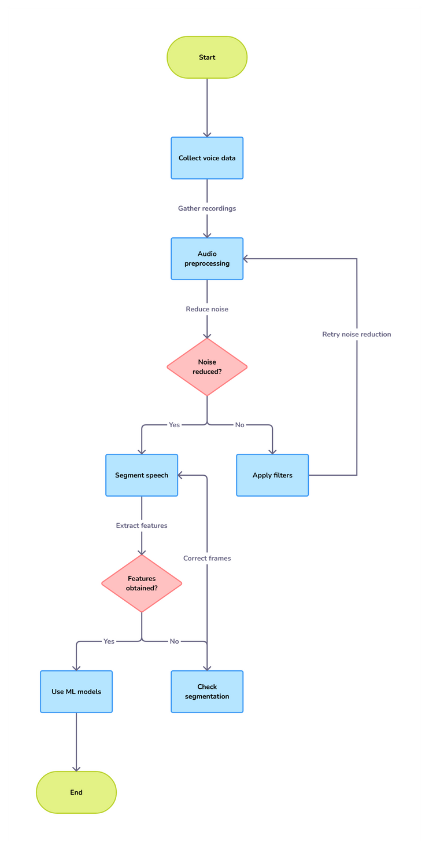
KIET Group of Institutions, Ghaziabad
Flowchart
<number>

Slide 7
KIET Group of Institutions, Ghaziabad
Voice Feature Extraction
Process Overview:
Audio Preprocessing
Removed background noise
Split voice sample into small segments for fine-grained analysis
Feature Computation
Extracted vocal biomarkers using tools like Librosa
Key features include:
Jitter & Shimmer: Indicate instability in pitch and volume
NHR & HNR: Measure voice clarity
Spread, PPE, RPDE, DFA: Capture nonlinear vocal patterns
Feature Selection
Kept most impactful features for model training
<number>

Slide 8
KIET Group of Institutions, Ghaziabad
Machine Learning Models Used
Decision Tree (DT)
Splits data using condition-based rules to form a tree structure.
Random Forest (RF)
Combines multiple decision trees to reduce variance and boost accuracy.
Support Vector Machine (SVM)
Finds the optimal hyperplane to separate classes in high-dimensional space.
Logistic Regression (LR)
Predicts class probabilities using a logistic (sigmoid) function.
Naive Bayes (NB)
Applies Bayes’ theorem assuming independence between features.
K-Nearest Neighbors (KNN)
Classifies data based on the majority label of its closest neighbors.
XGBoost (Extreme Gradient Boosting)
Uses gradient boosting to build powerful decision trees iteratively with optimized loss reduction.

Slide 9
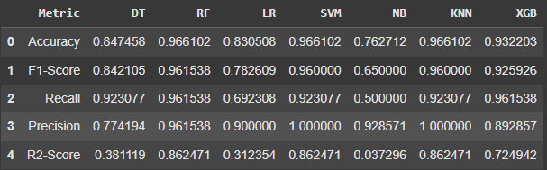
KIET Group of Institutions, Ghaziabad
Results Summary
Top Performing Models:
Random Forest
Accuracy: 96.6%
F1 Score: 0.961
Balanced performance across all
metrics
XGBoost
Accuracy: 93.2%
F1 Score: 0.926
Strong at detecting complex voice
patterns
SVM
Accuracy: 96.6%
Precision: 1.0
Clear boundary separation in high dimensions
Lower Performing Models:
Naive Bayes
Accuracy: 76.3%
Struggles due to feature independence
assumption
KNN
High sensitivity to noise and high
dimensionality

Slide 10
KIET Group of Institutions, Ghaziabad
Conclusion & Future Work
Conclusion
Voice-based machine learning models are effective for early Parkinson’s Disease detection.
Random Forest and XGBoost delivered the most accurate and reliable results.
Nonlinear vocal features (e.g., jitter, shimmer, NHR) play a critical role in diagnosis.
The system is non-invasive, scalable, and suitable for remote health monitoring.
Future Work
Implement deep learning models (CNN, LSTM) for better feature extraction.
Develop a real-time mobile/web app for voice-based screening.
Collaborate with clinicians for real-world validation.
Expand dataset for better generalization and robustness.

Slide 11
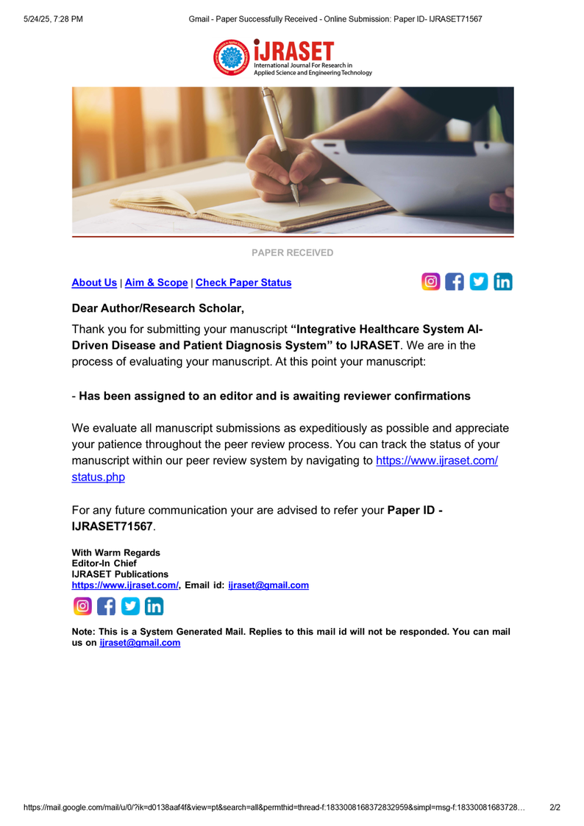
KIET Group of Institutions, Ghaziabad

Slide 12
KIET Group of Institutions, Ghaziabad
Thank You

