Slide 1

KIET Group of Institutions, Ghaziabad
Integrative Healthcare System:
AI Driven Disease & Patient Diagnosis System
Group ID: PCSE25-19
Team Leader: Ayush Sachan Semester: 4 Department: CSE
Group Member: Abhinav Semester: 4 Department: CSE
Group Member: Andril Omer Semester: 4 Department: CSE
Name of Guide : Prof. Naveen Chauhan
Date of Presentation : 14-06-2023
1

Slide 2
KIET Group of Institutions, Ghaziabad
Problem Statement
Limited time for each patient
Increased risk of infection transmission
Inadequate patient history
Lack of continuity of care
<number>

Slide 3
KIET Group of Institutions, Ghaziabad
Project Objectives
Our 4 Major Objectives of our project are:-
Minimize the OPD response time
AI based progression of patient in one click
Real time video,image based Disease diagnosis system
Integration with cloud
<number>

Slide 4
KIET Group of Institutions, Ghaziabad
PHASE I
DASHBOARD DESIGNING
FEATURES (Tentative)
Live streaming
Patient previous History
Vital sign
Allergic History
<number>

Slide 5
KIET Group of Institutions, Ghaziabad
PHASE II
AI BASE DISEASE DIANOSIS MODEL
FEATURES (Tentative)
Minimize OPD time
Progression of patient
+
RESEARCH PAPER
<number>

Slide 6
KIET Group of Institutions, Ghaziabad
PHASE III
HARWARE INEGRATION, TESTING AND VALIDATION
FEATURES (Tentative)
Real time video+image analysis
Development flexibility
Customized architectture
Integration with cloud
<number>

Slide 7
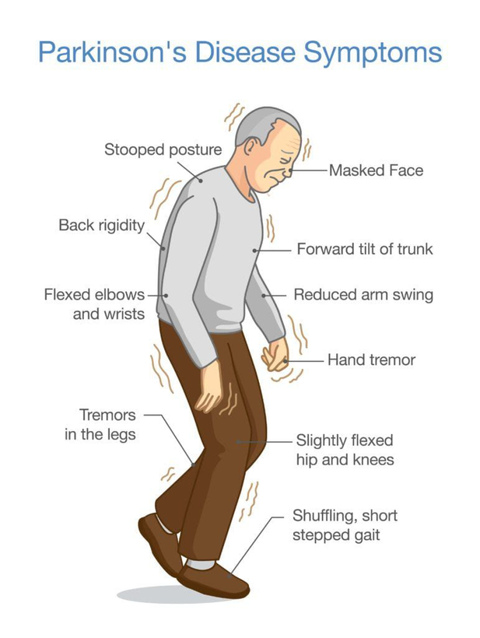
KIET Group of Institutions, Ghaziabad
Preventable disease
Keystroke analysis for Parkinson's disease leverages typing behavior to detect subtle motor skill changes. Utilizing machine learning, this approach shows promise for accurate early diagnosis, emphasizing ongoing research and collaboration with healthcare professionals.
<number>

Slide 8
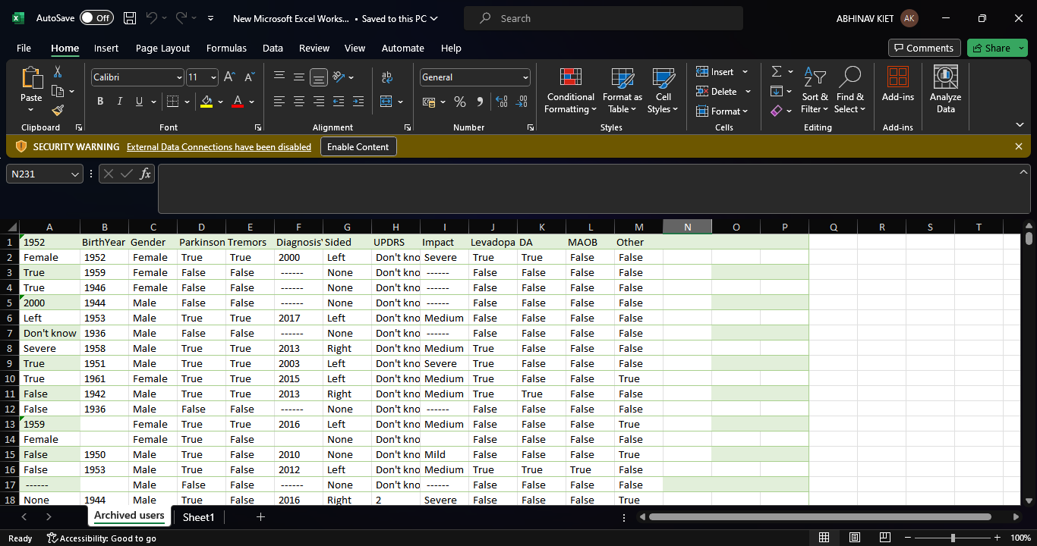
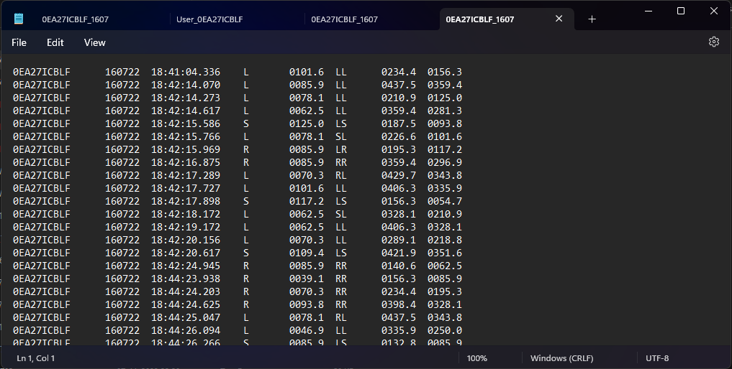

Slide 9
Flowchart
KIET Group of Institutions, Ghaziabad
Predicted Disease
Frontend Designing
Backend Development
Dashboard Designing
Interface (Desktop Application)
1
Patient History
&
Live Streaming
3
Integrative Healthcare System:
AI Driven Disease & Patient Diagnosis System
Hardware Integration
Camera Module
&
Raspberry pi
2
Video Streamong
&
Model Prediction
Parkinson Disease
AI BASE DISEASE DIANOSIS MODEL
Keystroke
Data Set
Tensorflow
<number>

Slide 10
KIET Group of Institutions, Ghaziabad
Timeline (Tentative)
4th SEM
5th SEM
6th sem
7th SEM
8th SEM
DESCRIPTION
PHASE I
JUL 23-DEC 23
Frontend+Backend
AI Based disease
diagnosis model
PHASE II
OCT 23-JUN 24
Harware integration, Testing and Validation
PHASE III
JUN 24 -OCT 24
PHASE IV
OCT 24-APR 25
Drafting Thesis

Slide 11
KIET Group of Institutions, Ghaziabad
Thank You

