Slide 1

A Study to Evaluate Effects of Data Poisoning on
Machine Learning Model
Group ID: PCSE25-25
Students Name: Gaurav Kumar, Deepanshu Mishra, Ashish Prasad
Semester : 8
Department: Computer Science and Engineering
Name of Project Guide : Prof. Gaurav Parashar
Date of Presentation : 27/05/2025

Slide 2
Problem Statement
As machine learning (ML) models become integral to high-stakes domains such as healthcare, finance, and cybersecurity, their reliability and integrity are more critical than ever. However, the quality of training data—which forms the foundation of any ML model—is vulnerable to adversarial manipulation. One such threat is label poisoning, where attackers deliberately flip or corrupt the labels in the training dataset to distort the model’s learning process.
This form of attack is particularly stealthy, as it doesn’t alter the data features, making detection difficult. As a result, ML models trained on poisoned data may perform well on the surface but fail catastrophically in real-world scenarios—leading to incorrect predictions, security breaches, or even life-threatening decisions.
Despite its severity, label poisoning remains underexplored, especially in practical, multi-model, and multi-dataset contexts. Existing research often focuses on synthetic data or specific attack categories, offering limited generalization.
Therefore, there is a need to empirically evaluate how different ML classifiers respond to varying levels of label poisoning across diverse datasets, and to assess their robustness under such adversarial conditions. This study aims to fill that gap by simulating poisoning attacks and analyzing performance degradation in widely-used classifiers like SVM, Logistic Regression, Decision Tree, and Random Forest.

Slide 3
Solution
To evaluate the impact of label poisoning attacks, we implemented a structured, multi-stage approach:
🔹 Dataset Selection:
Used 5 real-world datasets (Email, Banking, Diabetes, Heart Attack, Iris) across different domains.
🔹 Model Training:
Trained four ML classifiers—SVM, Logistic Regression, Decision Tree, and Random Forest—on clean data to establish baselines.
🔹 Label Poisoning Simulation:
Introduced controlled label-flipping at 5%, 10%, and 20% levels in training data to simulate adversarial attacks.
🔹 Retraining & Evaluation:
Models were retrained on poisoned data and evaluated using Accuracy, Precision, Recall, and F1-Score.
🔹 Robustness Analysis:
Compared performance degradation; Random Forest showed highest resilience, while Decision Tree was most vulnerable.

Slide 4

This presentation provides a comprehensive overview of how label poisoning an adversarial attack technique can significantly compromise the performance of machine learning models. To investigate this, we developed a structured, multi-phase experimental framework that includes simulating label-flipping attacks on training data, retraining various classification models, and rigorously evaluating their robustness across multiple real-world datasets. Our objective is to highlight the vulnerabilities of commonly used algorithms and emphasize the need for building more secure and resilient AI systems.
Poisioning A Machine Learning Model

Slide 5
OBJECTIVES
Primary Goal:
To evaluate the impact of label poisoning attacks on the performance and robustness of machine learning classification models.
Specific Objectives:
🔹 Simulate Label Poisoning Attacks
Introduce controlled label-flipping (5%, 10%, 20%) in training data to mimic adversarial scenarios.
🔹 Train and Evaluate Models
Use four popular classifiers—SVM, Logistic Regression, Decision Tree, and Random Forest—on both clean and poisoned data.
🔹 Compare Model Robustness
Analyze how different models react to varying levels of poisoning and identify which are most resilient.
🔹 Apply Real-World Datasets
Test the impact of poisoning across five datasets from healthcare, finance, and communication domains.
🔹 Promote Secure ML Development
Highlight the importance of adversarial testing and inspire future research toward building robust AI systems.

Slide 6
CASE STUDY
In modern hospitals, AI systems are increasingly deployed to automate predictive diagnosis. They read and analyze patient records, including previous health data, live- collected vital signs, and recorded symptoms. In time- sensitive medical emergencies say, heart attacks AI is often used to alert critical indicators like chest pain, irregular heartbeat, and shortness of breath.
Now imagine the case where the AI model itself has been trained on contaminated data, i.e., biased to incorrectly label cases of heart attacks. When a real patient presents with typical heart attack symptoms severe chest pain, excessive sweating, shortness of breath the AI, corrupted by contaminated labels during its training, fails to recognize the threat. It labels the case as "non-critical," delaying treatments such as clot-dissolving medication or emergency angioplasty. The delay can cost the patient his or her life.
This failure occurs due to the fact that the AI model has learned the wrong label relationships. Adversarial trained data may remove true positive cases or underrepresent meaningful patterns in subgroups e.g., women or children already suffering from diagnostic bias in normal sets.
In addition, attackers might manipulate training data quietly to down-weight specific symptoms, for example, lowering the importance of chest pain or shortness of breath as determinative factors. The model would slowly "learn" to disregard vital signs, leading to systemic diagnostic faults.

Slide 7
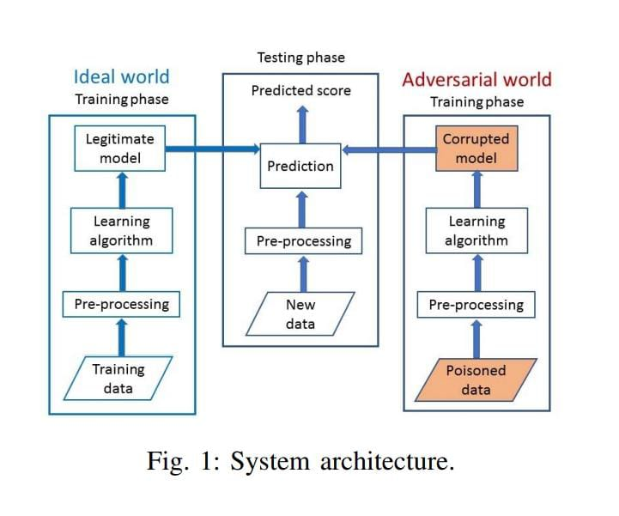
METHODOLOGY
The proposed methodology systematically investigates the impact of label poisoning attacks on machine learning classifiers by simulating real-world adversarial scenarios across diverse datasets. Five datasets from domains such as healthcare, finance, and communication were selected to ensure broad applicability. Each dataset underwent thorough preprocessing, including encoding, handling missing values, and feature scaling. Clean data was split into training and testing sets using stratified sampling to preserve class distribution. Four classifiers Support Vector Machine, Logistic Regression, Random Forest, and Decision Tree—were trained on unaltered data to establish baseline performance using metrics like accuracy, precision, recall, and F1-score. Label poisoning was introduced by randomly flipping labels in 5%, 10%, and 20% of training data to simulate adversarial manipulation. Each model was retrained on the poisoned datasets using the same hyperparameters and preprocessing to isolate the effects of poisoning. Performance was consistently evaluated on clean test sets to assess degradation. Accuracy trends were visualized, and classifiers were ranked by resilience, with Random Forest showing the highest robustness and Decision Tree being most vulnerable. All experiments were conducted using Python with libraries such as Scikit-learn, Pandas, NumPy, Matplotlib, and Seaborn, ensuring transparency and reproducibility.

Slide 8
DATASET USED
Dataset | Records | Domain | Target Labels | Poisoning Strategy
Emails (Spam) | 5,172 | Communication | Spam (1), Not Spam (0) | Legitimate emails labeled as spam
Banking | 1,000 | Finance | Loan Approved (1), Not Approved (0) | Risky applicants labeled as eligible
Diabetes | 100,000 | Healthcare | Diabetic (1), Non-Diabetic (0) | Labels flipped between diabetic and non-diabetic
Heart Attack | 1,319 | Healthcare | At Risk, Not At Risk | High-risk patients labeled as low-risk
Iris | 150 | Biology / Generic | Setosa, Versicolor, Virginica | Setosa samples relabeled as Versicolor

Slide 9
MACHINE LEARNING MODELS USED
Model | Type | Characteristics | Use in Study
Support Vector Machine (SVM) | Margin-based | Good generalization, effective in high-dimensional spaces | Evaluated for margin robustness
Logistic Regression | Linear / Probabilistic | Interpretable, fast, handles binary classification well | Baseline model for comparison
Random Forest | Ensemble-based | Combines multiple decision trees, high accuracy, resistant to noise | Most robust under poisoning
Decision Tree | Tree-based | Simple and interpretable, prone to overfitting | Most vulnerable to poisoned labels

Slide 10
RESULT
This chapter analyzes the performance of four popular machine learning classifiers—Support Vector Machine (SVM), Logistic Regression, Random Forest, and Decision Tree—under adversarial label poisoning attacks. The models were evaluated on five diverse real-world datasets: Emails (Spam), Banking, Diabetes, Heart Attack, and Iris. The datasets were subjected to increasing levels of label poisoning at 0%, 5%, 10%, and 20% to assess the impact on classifier robustness.
Under clean, unpoisoned conditions (0% poisoning), all models showed high accuracy across datasets, with Random Forest consistently achieving the best results (ranging from 92.2% to 95.0%). SVM, Logistic Regression, and Decision Tree also performed well, though with slightly lower accuracy.
As label poisoning increased, the accuracy of all models declined, but at different rates. Random Forest proved to be the most resilient, exhibiting only a minor accuracy drop of about 5.1% even at the highest poisoning level (20%). This highlights the strength of its ensemble learning approach, which mitigates the effects of corrupted labels through majority voting.
In contrast, Decision Tree showed the greatest vulnerability, losing over 26% accuracy at 20% poisoning, reflecting its susceptibility to overfitting and sensitivity to noisy labels. SVM and Logistic Regression displayed intermediate robustness, maintaining reasonable accuracy up to 10% poisoning but suffering significant degradation beyond that point—SVM’s accuracy dropping sharply by nearly 21% at 20% poisoning.

Slide 11
KEY FINDINGS
This study revealed significant differences in how four machine learning models—Random Forest, Support Vector Machine (SVM), Logistic Regression, and Decision Tree—respond to label poisoning attacks. Random Forest emerged as the most robust model, experiencing only about a 5.1% accuracy loss even at 20% label corruption. Its ensemble structure, combining multiple decision trees and using majority voting, effectively dilutes the influence of poisoned labels, making it reliable across binary and multiclass datasets, especially in sensitive fields like healthcare and finance.
SVM demonstrated moderate robustness by maintaining strong performance up to 10% poisoning but suffered a sharp decline (~20.5%) at 20% poisoning. Its vulnerability stems from its margin-based learning; label flipping near decision boundaries distorts the hyperplane, reducing accuracy notably in highly corrupted data. SVM is better suited for cleaner or moderately noisy datasets, particularly with high-dimensional features.
Logistic Regression showed a steady but moderate drop in accuracy (~15%) at the highest poisoning level. Its probabilistic approach offers some tolerance to noise, allowing gradual performance degradation rather than abrupt failure. While more resilient than Decision Trees, Logistic Regression is less robust than Random Forest, making it appropriate for moderately noisy, interpretable applications.
Decision Tree was the most vulnerable, with accuracy dropping sharply (~26.1%) at 20% poisoning. Its greedy splitting and lack of ensemble correction cause it to overfit noisy labels, severely affecting performance, especially in critical domains. Standalone decision trees are not recommended in adversarial or noisy environments without ensemble methods.
Overall, robustness to label poisoning varies significantly by model, with Random Forest offering the strongest defense.

Slide 12
Future Development
This project lays the foundation for understanding how label poisoning affects machine learning models, but several avenues remain for future exploration. One major direction is the development of robust defense mechanisms that can detect and mitigate the impact of poisoned data during training. This includes techniques such as adversarial training, noise-resilient architectures, and data sanitization methods. Additionally, the scope of adversarial attacks can be broadened beyond label poisoning to include feature poisoning, backdoor attacks, and evasion strategies, allowing for a more comprehensive security evaluation. Expanding the study to include deep learning models and federated learning environments would also provide insight into real-world deployments where data originates from diverse and potentially untrusted sources. Lastly, incorporating explainable AI (XAI) tools to identify abnormal learning patterns may offer a proactive way to enhance model transparency and trust in adversarial settings.
Future work can also explore real-time detection of poisoning during data collection, as well as automated correction techniques. Collaborations with domain experts in healthcare, finance, and cybersecurity can help align technical solutions with real-world impact.

Slide 13


