Slide 1

SecureVote
Course Outcomes (CO)-Students applied blockchain and cryptographic techniques to develop secure, scalable solutions. They collaborated effectively to design and implement a transparent e-voting system.
Project Outcome (PO)-The project led to the publication of a research paper on a blockchain-based secure voting system. It also introduced a novel, prototype-backed framework ensuring transparency, security, and scalability in digital elections.
SDG Mapping-The project supports SDG 16 by promoting transparent, secure, and trustworthy election systems. It also aligns with SDG 9 and SDG 11 through innovation in digital infrastructure and smart governance.

Slide 2

INTRODUCTION
We present you an innovative solution that seeks to revolutionize the electoral process - Secure Vote
This Blockchain-based system combines the principles of transparency, immutability, and security to ensure the integrity of every vote casted.

Slide 3
PROBLEM STATEMENT
The current voting system in India faces significant challenges that undermine the efficiency of elections.
These problems include registration of fake and illegal voter identity cards, the vulnerability of (EVMs) to tampering and hacking, less participation, and excessive money use.

Slide 4

Current Voting System:
Infiltration of Fake and Illegal Voter Identity Cards
Vulnerability of Electronic Voting Machines (EVMs) to Tampering and Hacking
Limited Participation
Excessive Financial Burden on Taxpayers

Slide 5
Research Objectives
1. The election system must be openly verifiable and transparent.
2. The election system must ensure that the vote cast by the voter has been recorded without manipulation.

Slide 6
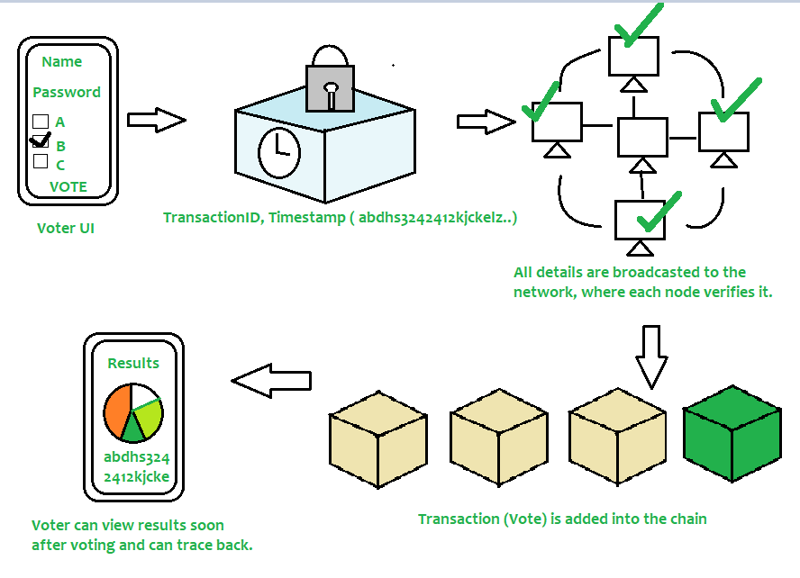
Flow-Chart

Slide 7

Benefits of voting using
SECURITY
2. PARTICIPATION
3. TRANSPARENCY

Slide 8
TECHSTACK USED:
Solidity
React.js
Node.js
Hardhat
Ether.js
Remix IDE

Slide 9
THANK YOU

