Slide 1

Project Presentation
May 2025
Team Members- Riya Singhal, Sajal Gupta

Slide 2
BlockDrive: A Decentralized Peer-to-Peer Car Ride Sharing Platform
Course Outcomes/ Programme Outcomes, SDG Mapping
CO1: Apply foundational concepts of blockchain in developing real-world applications.
CO2: Implement decentralized applications (DApps) with privacy-preserving mechanisms.
CO3: Evaluate the role of smart contracts and cryptographic techniques like ZKPs in secure digital systems.
PO1: Engineering knowledge – Apply fundamentals of computer science to solve complex problems.
PO2: Problem analysis – Identify and define computing requirements to address challenges in ride-sharing.
PO3: Modern Tool usage: Use modern tools and Frameworks like Solidity, zk-SNARKS.
Sustainable and Development Goals:
SDG 9 – Industry, Innovation, and Infrastructure
SDG 11 – Sustainable Cities and Communities
SDG 12 – Responsible Consumption and Production
Project Outcome:
Research Paper Accepted at: International Conference on Networked Computing and Data Analytics (ICNCDA-2025) Paper ID: 605 Presented by: Riya Singhal

Slide 3













What is BlockDrive?
BlockDrive is a decentralized, secure, and privacy-preserving ride-sharing platform. It matches drivers with riders using off-chain logic, facilitates payments in fiat or crypto, and secures sensitive data with Zero-Knowledge Proofs (ZKPs).
Why It Matters
Centralized platforms raise privacy concerns. High commission fees for drivers.
Lack of transparency in ride pricing and data handling.
BlockDrive

Slide 4
What are ZKPs?
Zero-Knowledge Proofs allow one party to prove to another that a statement is true, without revealing any additional information.
Why Use ZKPs in BlockDrive?
Protects user data such as ID, phone, and location. Ensures trust and verification without central authority.
Application: Identity validation, ride eligibility, driver licenses, etc.

Slide 5
Key Features
Decentralized Architecture: Smart contracts manage ride bookings and payments.
ZKPs for Privacy: Personal data is validated without
revealing actual details.
Off-chain Matching Algorithm: Efficiently pairs riders with drivers based on proximity and availability.
Hybrid Payment Support: Accepts both fiat currency and crypto.
Fair Price Splitting: Based on distance and number of
passengers.

Slide 6
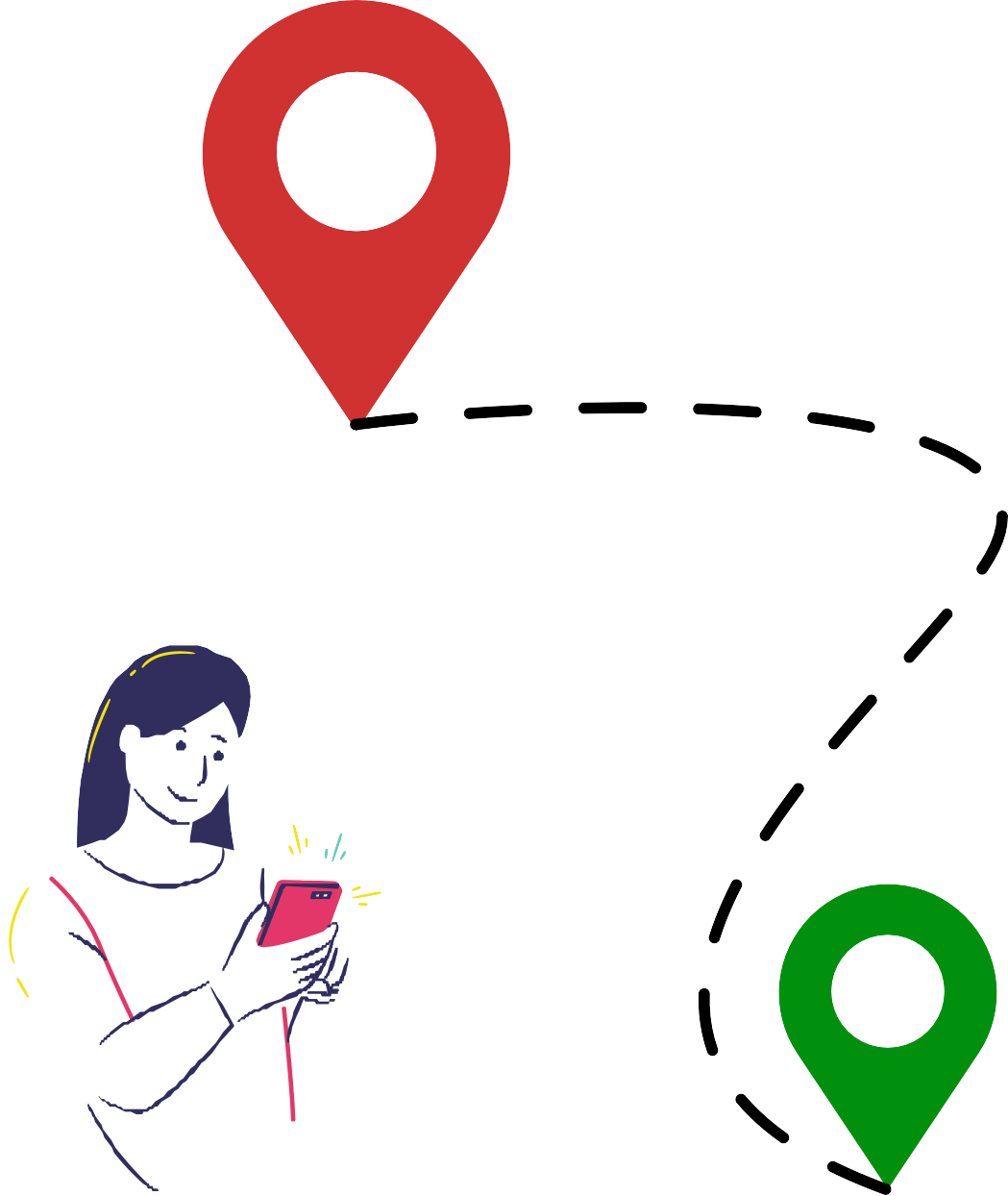
Layers Overview:
Blockchain Layer: Smart contracts handle identity, ride creation, booking, and payments.
ZKP Layer: Verifies user credentials without
exposing sensitive data.
Off-Chain Matching: Uses GPS/location data to pair riders and drivers.
Frontend (Web/Mobile): User interfaces for
riders and drivers.

Slide 7
Step-by-Step User Flow:
1. Driver registers securely (identity verified via ZKP)
2. Rider creates a ride request.
3. Off-chain algorithm finds nearest driver.
4. Smart contract handles booking and pricing.
6. Both parties rate the experience.
5. Payment made via fiat or crypto.

Slide 8


Why Off-chain?
Matching requires intensive computation and real-time data (GPS), which is inefficient and costly on-chain.
Algorithm Highlights: Finds nearest drivers.
Optimizes for shortest route and load balancing. Considers ride preferences.
Security: Uses commitment schemes to ensure integrity.

Slide 9


Hybrid Approach:
Supports fiat (via payment gateway) and crypto (via smart contract).
Fair Price Calculation:
Based on distance, number of passengers, and current demand. Transparent Splitting:
Fee breakdown visible to all. No hidden costs.
Incentives for Users: Token rewards for frequent users or ride sharing.

Slide 10

Implementation Highlights
Smart Contracts: Solidity-based ride booking & payments. Frontend: Angular-based responsive web app.
ZKP Framework: Using [e.g., zk-SNARKs or Semaphore] for privacy.
Off-chain Logic: Node.js microservice with GPS APIs. Payment Gateway: Integration with Razorpay / MetaMask / UPI.

Slide 11


Security & Privacy
Benefits of BlockDrive
End-to-End Encryption for data in transit.
ZKPs protect user identity. Audit Trails recorded on blockchain.
Tamper-Proof Records of all transactions.
For Riders: Privacy, lower fares, transparency.
For Drivers: Higher earnings, no intermediaries.
For Cities: Reduced congestion via efficient carpooling.
For Developers: Open-source and modular platform.

Slide 12
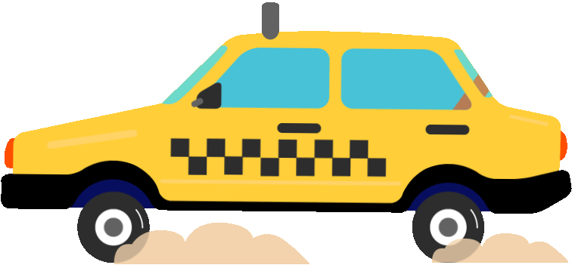

USE CASES
Urban Commutes: Daily ride-sharing for office goers.
Tourism: Transparent pricing for visitors.
Events: Safe, private, and fast ride coordination.
Private Groups: Family/friends with verified drivers.

Slide 13
Future Work
Mobile App for broader access. Token Economy and staking.
Incentive Algorithms for eco-friendly rides. AI Matching for smarter ride allocations.
Cross-chain Integration for multi-chain support.

Slide 14
Conclusion
BlockDrive reimagines ride-sharing through decentralized, private, and user-driven technology. It empowers users, respects their privacy, and creates a fair ecosystem for transportation.

Slide 15
THANK YOU

