Slide 1
2nd International Conference on Engineering and Technological Innovation for Sustainable Development (ICETISD 2025)
Tourism Itinerary Generation Based on Image Similarity
Rovince Gangwar
B.Tech. (CSE) student, KIET Group of Institutions, Delhi-NCR, Ghaziabad, Uttar Pradesh, India
POORNIMA UNIVERSITY, JAIPUR

Slide 2
Motivation & Introduction
Text‑Only Planning Falls Short
Relies solely on ratings, reviews, and popularity metrics, neglecting visual appeal
Rise of Visual Inspiration
Platforms like Instagram and Pinterest drive tourism choices by imagery, not text alone
Identified Gap
No existing system connects a traveler’s photo directly with end‑to‑end itinerary planning
Research Goal
Given an input image, recommend visually similar attractions and optimize a practical route
2nd International Conference on Engineering and Technological Innovation for Sustainable Development (ICETISD 2025)

Slide 3
Problem Formulation
Receive an image
User uploads a photo that captures their desired aesthetic
Map to features
Convert the photo into a 512‑dimensional CLIP embedding for similarity comparison
Retrieve matches
Query FAISS index to find top K nearest‑neighbor locations by cosine similarity
Optimize route
Solve a Vehicle Routing Problem with Time Windows, including meal and lodging constraints
Deliver itinerary
Present an interactive, multi‑day plan via Streamlit with embedded Folium map
2nd International Conference on Engineering and Technological Innovation for Sustainable Development (ICETISD 2025)

Slide 4
High-Level Workflow
Image Pre‑processing: Homographic warping aligns and crops the region of interest
Embedding Generation: CLIP model produces a normalized vector representing visual features
Similarity Search: FAISS retrieves nearest neighbors in sub‑second time
Geospatial Enrichment: Google Maps API provides coordinates, ratings, and opening hours
Itinerary Optimization: OR‑Tools solves VRPTW under user‑defined time windows and penalties
Visualization & UI: Streamlit UI allows parameter tweaks; Folium map shows the daily route
2nd International Conference on Engineering and Technological Innovation for Sustainable Development (ICETISD 2025)

Slide 5
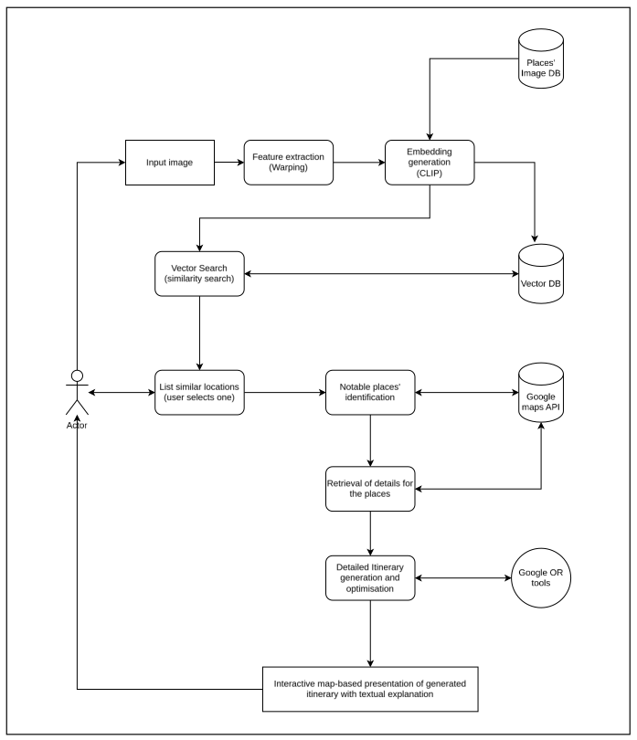
Detailed flowchart
User uploads → “Click to select your photo”
Warp & Embed → “Align image, extract CLIP vector”
FAISS Search → “Retrieve top 5 similar places”
Place Selection → “User picks a base location”
Maps API → “Fetch nearby attractions & details”
VRPTW Solver → “Optimize daily routes”
UI & Map → “Interactive display of itinerary”
2nd International Conference on Engineering and Technological Innovation for Sustainable Development (ICETISD 2025)

Slide 6
Key Prior Works
Zhang & Liu (2022)
Strength: Implicit preference via images
Weakness: Fails on ambiguous or noisy photos
Van-Hau Trieu et al. (2023)
Strength: Domestic “foreign‑like” experience
Weakness: No routing/time‑window support
Chen et al. (2021)
Strength: Multi‑level geo‑tag similarity
Weakness: Computationally intensive
2nd International Conference on Engineering and Technological Innovation for Sustainable Development (ICETISD 2025)

Slide 7
Comparison & Improvements
Prior Work | Limitation | This System’s Advance
Zhang & Liu (2022) | Struggles on low‑quality inputs | Homographic warping cleans and aligns input images
Van-Hau Trieu et al. (2023) | No itinerary optimization | OR‑Tools VRPTW with meal/lodging time windows
Chen et al. (2021) | Heavy compute on multi‑level similarity | Batch CLIP + FAISS index for sub‑second retrieval
2nd International Conference on Engineering and Technological Innovation for Sustainable Development (ICETISD 2025)

Slide 8
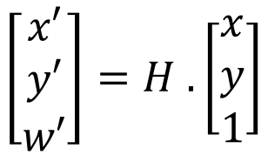
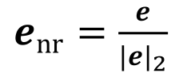
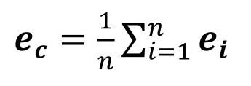
Mathematical Highlights
Homographic Warping
– Ensures ROI (region of interest) alignment before embedding
CLIP Embedding & Normalization
– Creates unit‑length vectors for cosine search
Centroid Aggregation
– Robust per‑location signature via average of multiple images
2nd International Conference on Engineering and Technological Innovation for Sustainable Development (ICETISD 2025)

Slide 9
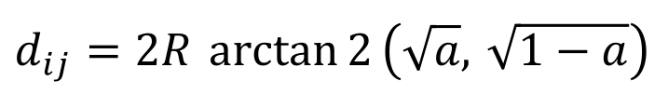
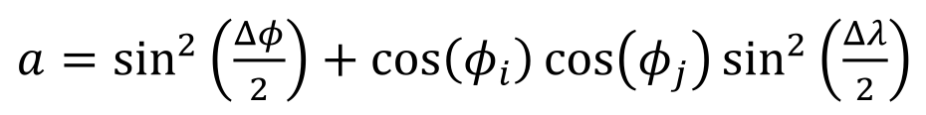
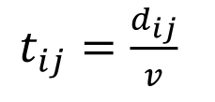

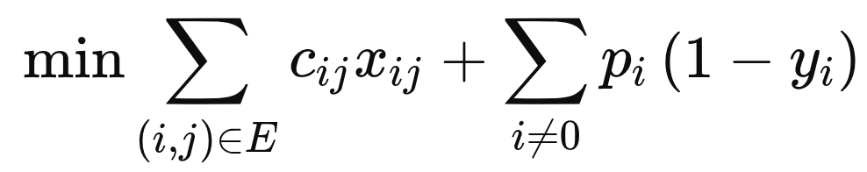
Routing Formulation
Haversine Distance
– To calculate distance between two geographic points
Travel Time
– Simple time-distance-speed relationship
Time‑Window Constraint: – Guarantees feasible visit times within opening hours
Objective Function: – Balances travel cost and penalties for skipped POIs
2nd International Conference on Engineering and Technological Innovation for Sustainable Development (ICETISD 2025)

Slide 10
Implementation Highlights
Pre‑processing & Embedding
Batch‑process images through CLIP for GPU/CPU efficiency
Indexing
FAISS IndexFlatIP on normalized 512‑D vectors for sub‑second neighbor search
API Integration
Google Maps “nearbysearch” + “placedetails” with thread pools for lower latency
VRPTW Solver
OR‑Tools routing model, initial PATH_CHEAPEST_ARC, guided local search, 10s time limit
2nd International Conference on Engineering and Technological Innovation for Sustainable Development (ICETISD 2025)

Slide 11
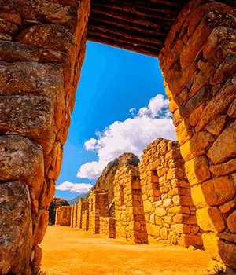
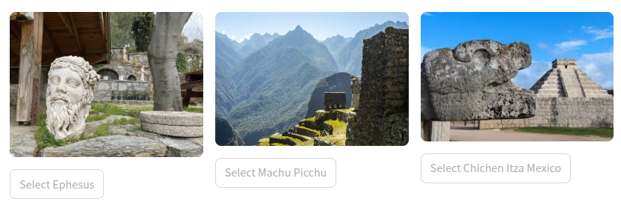
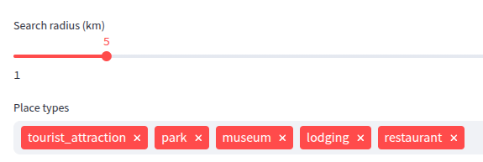
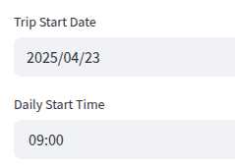
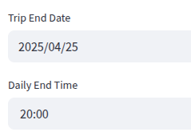
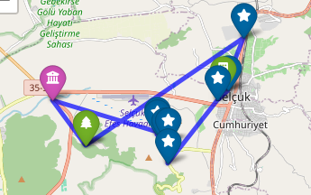
Demo Screenshots
Upload & Search.
—>
Configuration Panel
Radius slider (1–100 km), date pickers, type selectors (POI categories)
Interactive Folium Map
Daily routes plotted, markers with popup details (name, time, rating)
2nd International Conference on Engineering and Technological Innovation for Sustainable Development (ICETISD 2025)

Slide 12
Results & Discussion
Accuracy: ~90 % of top‑5 matches were relevant in pilot tests.
Performance:
FAISS search: ~0.2 s per query
OR‑Tools solve: ~8–12 s per day route
Known Limitations:
External API latency (Google Maps), and dependency
Initial dataset size limited to 50 locations
2nd International Conference on Engineering and Technological Innovation for Sustainable Development (ICETISD 2025)

Slide 13
Conclusion & References
Conclusion:
A novel, vision‑driven itinerary planner that marries aesthetics with practical routing.
Integrates homographic warping, CLIP, FAISS, Maps API, and OR‑Tools for end‑to‑end workflow.
Future Work:
Expand to larger locations’ dataset
Integrate live traffic, weather, crowd data
Add user feedback loop
Key References:
Zhang & Liu (2022), J. Tourism Tech., 2022
Van-Hau Trieu et al., Int. J. Travel Studies, 2023
Chen et al. arXiv:2109.08275, 2021
2nd International Conference on Engineering and Technological Innovation for Sustainable Development (ICETISD 2025)

Slide 14
Team
Authors:
Rovince Gangwar
Yash Goswami
Mohd. Uzair Khan
Seema Maitrey
Affiliation: Dept. of Computer Science & Engineering, KIET Group of Institutions, Ghaziabad, India
Contacts:
rovince.2125cse1106@kiet.edu
yash.2125cse1112@kiet.edu
mohd.2125cse1143@kiet.edu
seema.maitrey@kiet.edu
2nd International Conference on Engineering and Technological Innovation for Sustainable Development (ICETISD 2025)

