Slide 1
Caress:Mental Health Prediction System

Slide 2
Problem Statement
As we all know, the health status of many is getting worst due to work stress and anxiety. Depression has become the biggest problem for people. Most of the youth responsible for the growth of a country are crippled in the chains of depression and anxiety, thus slowing down developmental activities. Sadly, the problem is suffered by many yet not discussed openly. So here we are bring a caretaker "CARESS" for all of them who suffer from the same but hesitate to tell.

Slide 3
What is Mental Health
Mental health is a state of mental well-being that enables people to cope with the stresses of life, realize their abilities, learn well and work well, and contribute to their community
In the United States, the National Alliance on Mental Illness estimates that almost 1 in 5 adults experience mental health problems each year.

Slide 4
Types of Mental Disorders
Healthcare professionals group mental health disorders according
to the features they have in common. They include:
anxiety disorders
mood disorders
schizophrenia disorders

Slide 5
Anxiety disorders
People with these conditions have severe fear or anxiety related to certain objects or situations. Most people with an anxiety disorder try to avoid exposure to whatever triggers their anxiety.
Below are some examples of anxiety disorders.
Generalized anxiety disorder
Panic disorder
Phobias
Obsessive-compulsive disorder
PTSD

Slide 6
Mood disorders
People with these conditions have significant mood changes, generally involving either mania, a period of high energy and joy, or depression. Examples of mood disorders include:
Major depression
Bipolar disorder
Seasonal affective disorder (SAD)

Slide 7
Schizophrenia disorders
The term “schizophrenia” often refers to a spectrum of disorders characterized by features of psychosis and other severe symptoms. These are highly complex conditions.

Slide 8
COVID-19 pandemic triggers 25% increase in prevalence of anxiety and depression worldwide
Wake-up call to all countries to step up mental health services and support
One major explanation for the increase is the unprecedented stress caused by the social isolation resulting from the pandemic. Linked to this were constraints on people’s ability to work, seek support from loved ones and engage in their communities.

Slide 9
Our Solution
Idea: Using Smartwatches to Track Mental Health
The idea is to help people take care of their mental health using the features already available in a smartwatch. Many people don’t realize when their mental health is getting worse. This idea focuses on using data like heart rate, sleep, activity, and stress levels to catch early signs of issues like anxiety, depression, or stress.
Sometimes, our body shows signs before our mind even notices. For example, if someone’s heart is beating fast, they haven’t moved much, and their sleep is poor, it could be a signal of stress or anxiety. By watching these changes, we can give people alerts, tips, or even ask someone they trust to check on them.
This idea also encourages self-checks where users can take simple tests to understand how they are feeling. It connects them to helpful articles, helplines, and allows them to reach out for support easily.
The main goal is to use technology to care for mental health early, in a simple and smart way — just like we track our steps or calories.

Slide 10
Functioning and User Flow
Firstly the user sign up and login in the application.
Basic Information of user, his friend/well wisher/guardian or any specialist doctor is taken for future use and profile display.
Instructions are given to connect the app with the smart watch.
After submitting the details and setting up the watch with app, the application ask for various permissions such as track activity, phone usage and personalized google account permissions
As soon as you give your google account access, data of your current vitals is shown on the screen which is updated after every 2 minutes.

Slide 11
6. If there is a spike in the heart rate(>100), user recieves an alert notification.The alert notification suggests you to stop using an particular app(correctly 70% of the time) and provides you the facility to call your friend on a single tap. Also an email about the same is delivered to the friend/well wisher or specialist whose information was collected previously.Emails are sent after a duration of 3 hours only.
7. Application also consists of articles page(contains articles related to mental health) and profile page which consits the data of user which can be updated frequently.
8. Application also provides you with facility of self assessment of various mental health disorders such as Depression, PTSD, schizophrenia, addiction and anxiety. After taking the self assessment tests the results are shared with the specialist/doctor via an email.

Slide 12
9.Helpline page is there in the application which includes helpline numbers and website links of 11 mental health healing websites for support. Call to any organisation can be just made by a single tap on the contact tile.
10.One differentiating feature of the app is the smart stress analysis which works on a backend based ML model integrated using flask REST API. This smart stress analysis takes two inputs which is body temperature and no of steps you walked in past 30 minutes and based on these values and dataset which we are using in the backend, Application determines the probability level of stress you are having.

Slide 13
🕒 Can a Smartwatch Track Mental Health?
Sleep – Tracks how long and how well you sleep. Bad sleep is linked to mental health problems.
Yes, it can track signs that relate to your mental health, but it can't diagnose anything by itself.
Heart Rate – If your heart beats faster than usual when you're resting, it might mean stress or anxiety.
Heart Rate Variability (HRV) – The time between heartbeats. If it's low, it can mean you're stressed or tired
Sleep – Tracks how long and how well you sleep. Bad sleep is linked to mental health problems.

Slide 14
Oxygen Levels (SpO2) – If low, your sleep or energy might be affected.
Steps/Movement – If you're not moving much, it can be a sign of sadness or lack of motivation.
Stress (EDA sensors) – Some smartwatches can sense small changes in your skin that happen when you're stressed.
Breathing Rate – Fast breathing can be a sign of anxiety.
Skin Temperature – Can change with stress or illness.
Mood Logs – You can tell the watch how you feel. Over time, it learns your patterns.

Slide 15
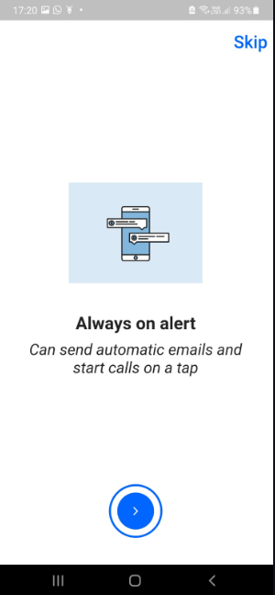
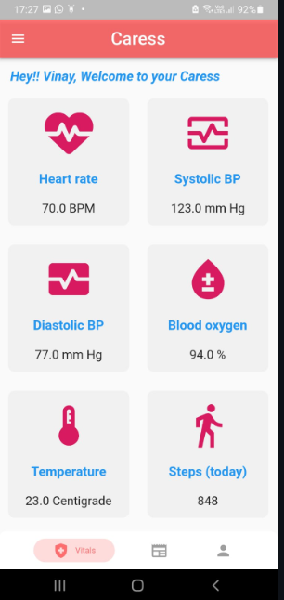
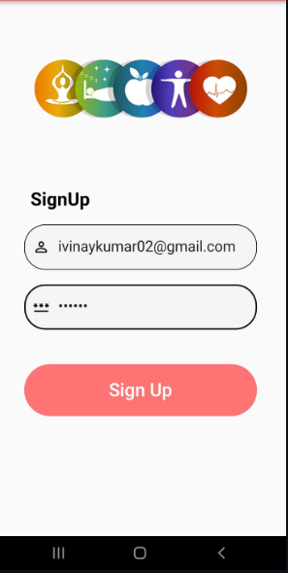
App ScreenShots

Slide 16
Wow Factor
If there is a spike in the heart rate(>100), user receives an alert notification. The alert notification suggests you to stop using an particular app(correctly 70% of the time) and provides you the facility to call your friend on a single tap. Also an email about the same is delivered to the friend/well wisher or specialist whose information was collected previously. Emails are sent after a duration of 3 hours only.
On a single tap the user gets stress analysis which is predicted using a ML Model which is trained over two parameters one is the temperature of the body in Fahrenheits and other Step Count (for last 10 mins) which is fetched from Goggle Fit API which senses these parameters from an Android Smart Watch.
This Model returns three level of stress 0 for low, 1 for normal and 2 for high.

Slide 17
Future Work
Social Media Segmentation- To fetch one's Social Media Posts, Messages and Screen Time. For example we can use Twitter Developer API's to fetch one past tweets to judge one's mental state.
Increase Accuracy of ML. Model To introduce and train a better ML model with better data which we get from the app. More data can help us predict with better accuracy and hence the model will be more reliable.
Embedded Training and support Videos - Integrate Mental Health Training videos for members which would suggest them various exercises to boost mental health. Simultaneously we'll provide a peer to peer interaction of mental health experts in support of the same.

Slide 18
Live Mental health webinars and sessions-We could also integrate live webinars like feature in our app where special guests and renowned specialist will share their view and suggestions over mental illness. .
Scalable the app for production purpose- As we are using the health package in flutter application which requires certain google verifications, So due to some reasons our app is currently in testing mode and we want it to run in production mode later.

