Slide 1
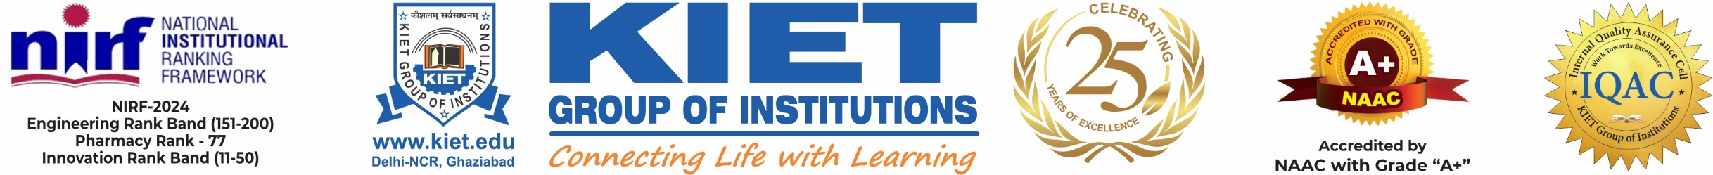
DEPARTMENT OF COMPUTER SCIENCE ENGINEERING Session 2025-2026 Project Presentation Predictive Irrigation Scheduling
Group Id: PCSE26-05
Guide : Ms. Himanshi Chaudhary (Assistant Professor, CSE Dept. K.I.E.T. Group of Institutions)
Project Members :
1. Omendra Rajput
2. Ashwani Baghel
3. Vaibhav Singh
4. Utkarsh Patel

Slide 2
Table of content:
1.TITLE PAGE
2.PROBLEM STATEMENT
3.OBJECTIVES
4.Project Scope
5.Methodology
6.Technology Used
7.Project Outcome
8.Project Conclusion

Slide 3
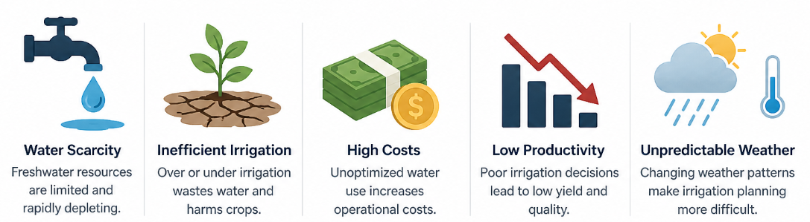

Problem Statement: SIH-1554
Background: Water scarcity is a major challenge in agriculture, leading to inefficient water use and reduced crop yields. Traditional irrigation methods often result in overuse or underuse of water. Description: Develop a smart irrigation system that utilizes sensors and IoT technology to monitor soil moisture levels and weather conditions. This system will provide real-time data to farmers, enabling them to make informed decisions on irrigation scheduling, thus optimizing water usage and enhancing crop yield. Expected Solution: A smart irrigation module integrated with moisture sensors and a mobile application to provide farmers with timely irrigation alerts and recommendations based on real-time data.

Slide 4
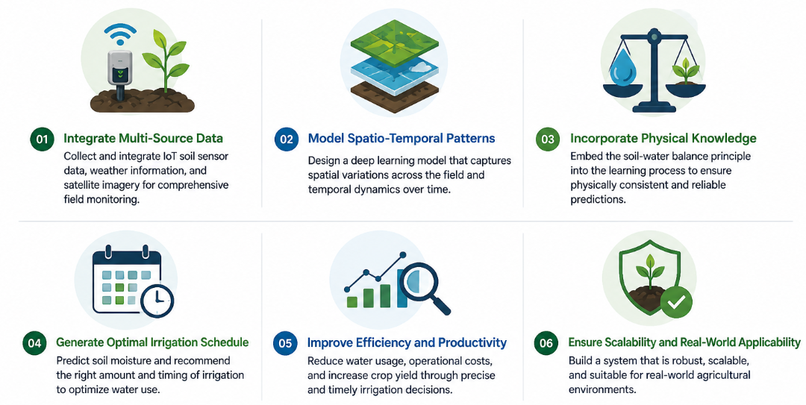
Objectives:
The primary objectives of this project are:
To design an IoT-based real-time data collection system using soil moisture, temperature, humidity, and weather APIs.
To develop LSTM deep learning models capable of forecasting soil moisture for 7 to 90 days.
To optimize irrigation scheduling by providing predictive irrigation advice.
To implement a user-friendly mobile application that delivers real-time irrigation recommendations to farmers.
To evaluate the feasibility of deploying lightweight models (TinyML) on IoT devices for offline prediction.
To achieve a soil moisture forecasting accuracy above 85%.

Slide 5
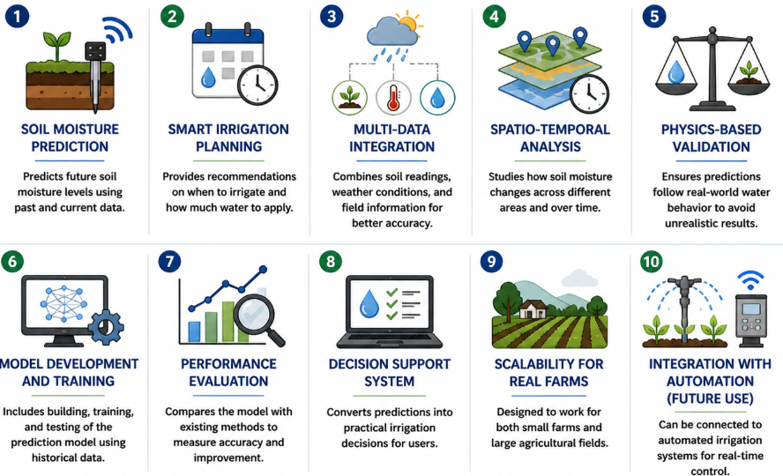
Project Scope:
Soil Moisture Prediction The system focuses on predicting future soil moisture levels using past and current data.
Smart Irrigation Planning Provides recommendations on when to irrigate and how much water to apply.
Multi-Data Integration Combines soil readings, weather conditions, and field information for better accuracy.
Spatio-Temporal Analysis Studies how soil moisture changes across different areas and over time.
Physics-Based Validation Ensures predictions follow real-world water behavior to avoid unrealistic results.
Model Development and Training Includes building, training, and testing of the prediction model using historical data.
Performance Evaluation Compares the model with existing methods to measure accuracy and improvement.
Decision Support System Converts predictions into practical irrigation decisions for users.
Scalability for Real Farms Designed to work for both small farms and large agricultural fields.
Integration with Automation (Future Use) Can be connected to automated irrigation systems for real-time control.

Slide 6
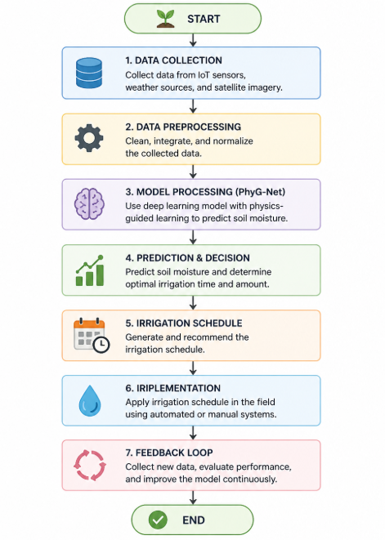
Methodology:
Data Collection
Soil moisture, temperature, humidity, solar radiation, and rainfall data will be collected through IoT sensors installed in the field.
Weather forecast data (temperature, humidity, precipitation) will be fetched through open weather APIs.
Historical soil and crop data will also be collected for model training.
Data Preprocessing
Data cleaning, feature engineering, and normalization will be performed using Apache Spark Streaming.
Missing data points will be interpolated using moving averages or regression techniques.

Slide 7
Model Development
LSTM and GRU models will be developed using TensorFlow and Keras libraries.
Multi-feature time-series input including temperature, humidity, and rainfall.
Training on sequences of previous 30-90 days to predict future soil moisture levels.
System Integration
Real-time sensor readings will be transmitted via MQTT protocols.
Predictions will be generated and sent to the farmer's mobile app.
Data will be stored in AWS S3 or Azure Blob Storage for historical analysis.
Mobile Application
Developed using Flutter framework.
Push notifications to farmers regarding upcoming irrigation needs.
Visual dashboards displaying soil moisture trends and predictions.

Slide 8
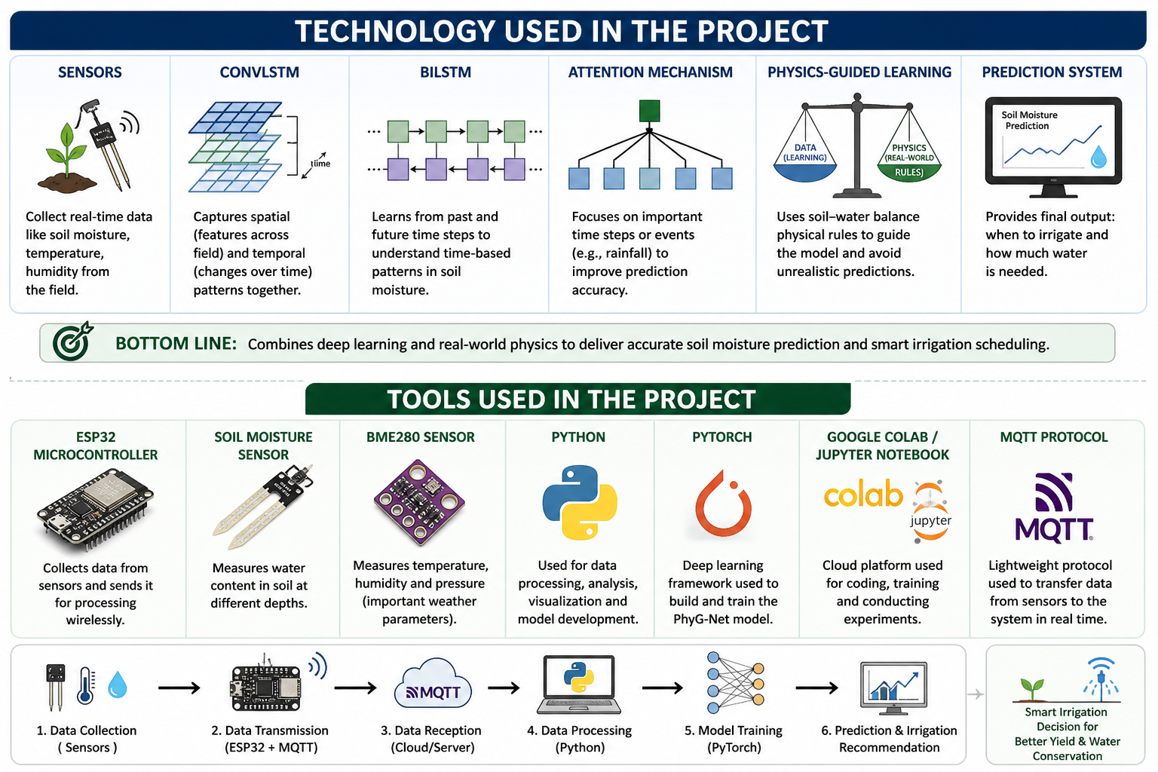
Technology Used:
Hardware:
ESP32 Microcontrollers
Capacitive Soil Moisture Sensors
DHT22 Temperature and Humidity Sensors
Backend:
TensorFlow, Keras (Deep Learning Libraries)
ConvLSTM
BiLSTM
Internet Connectivity:
WiFi network for IoT data transmission

Slide 9
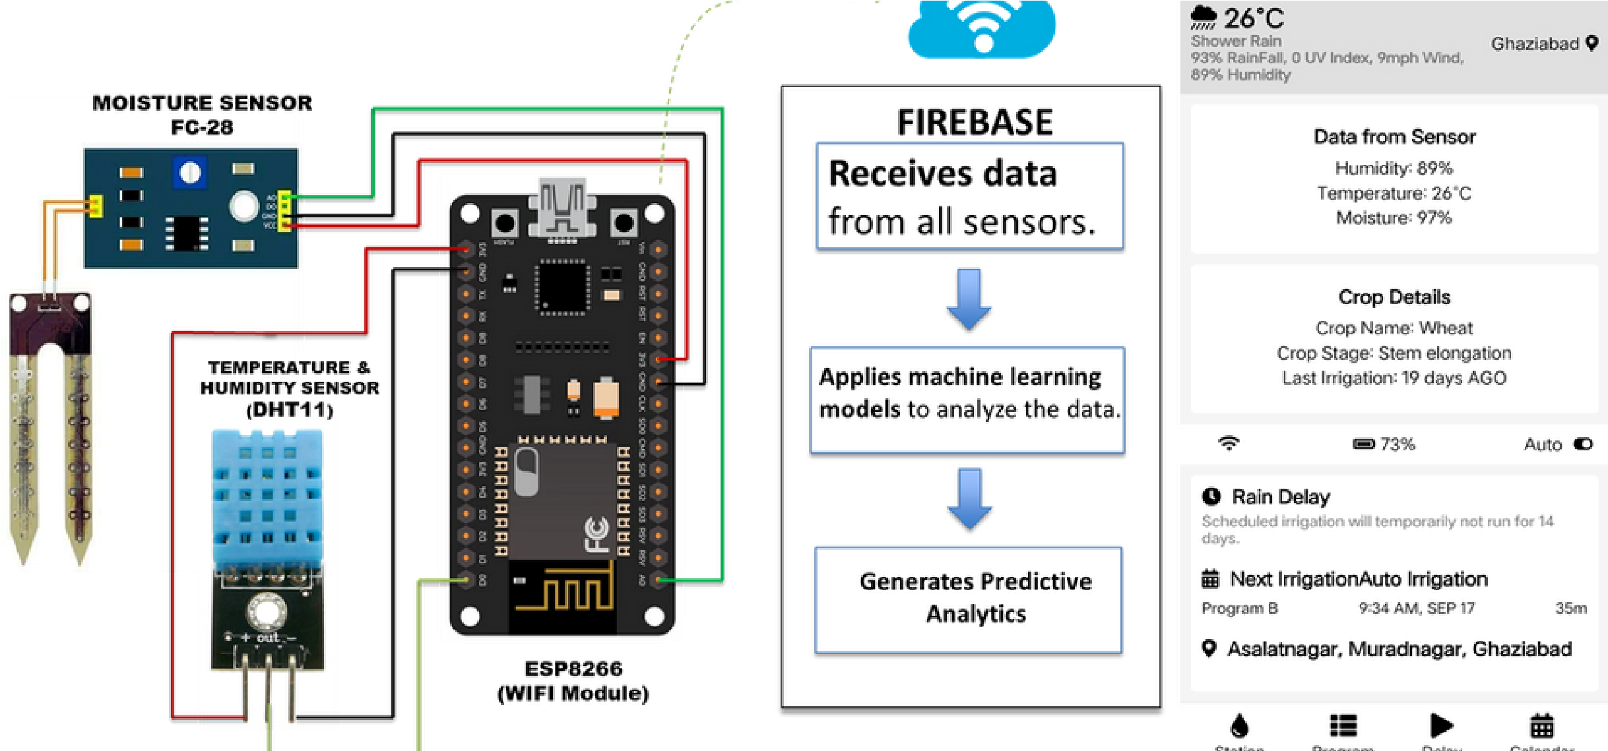
Project Flowchart:

Slide 10
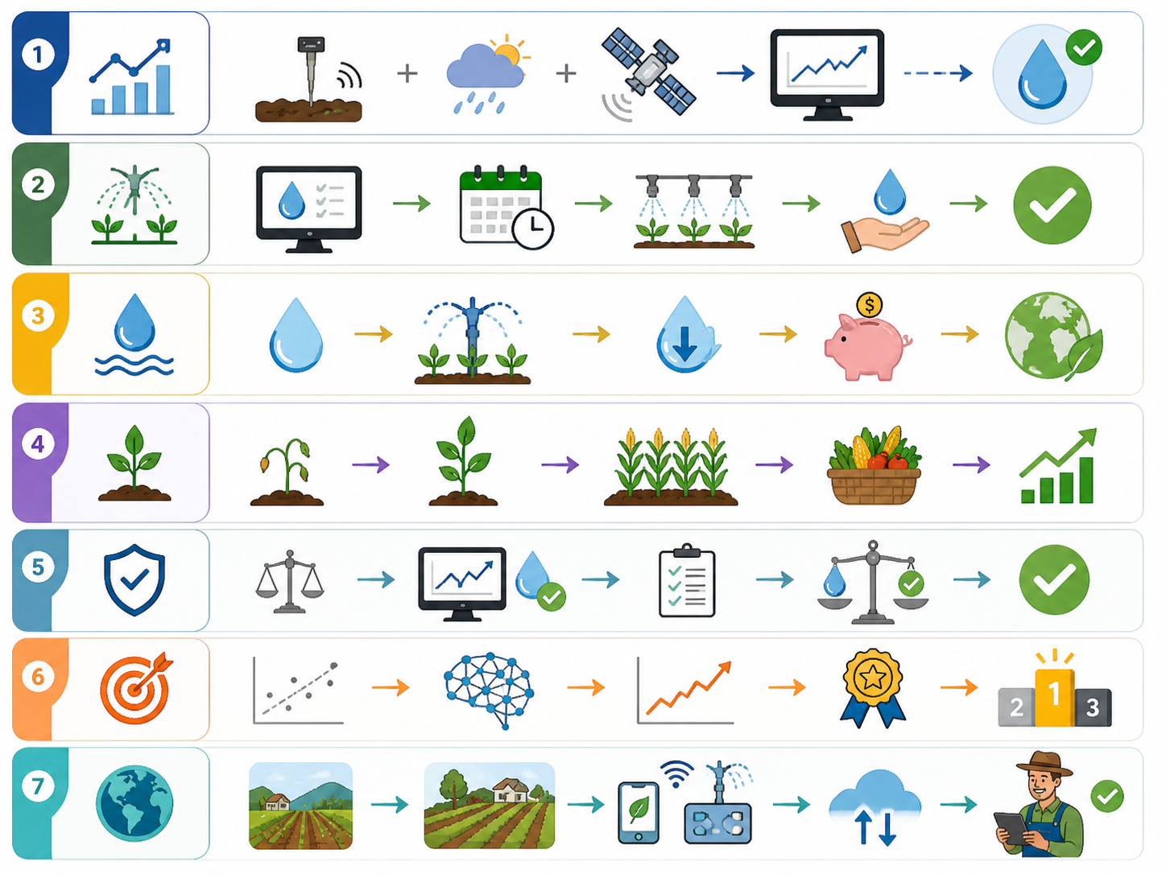
Expected Project Outcome:
Accurate Soil Moisture Prediction Predicts future soil moisture with high accuracy.
Smart Irrigation Decision Suggests when and how much water to apply.
Reduction in Water Wastage Uses water only when needed to avoid waste.
Improved Crop Health and Yield Maintains proper moisture for better crop growth.
Reliable and Realistic Predictions Follows real-world water behavior to avoid wrong results.
Better Performance than Existing Models Gives lower error and higher accuracy than other models.
Scalable and Practical System Can be used in real farms of different sizes.

Slide 11
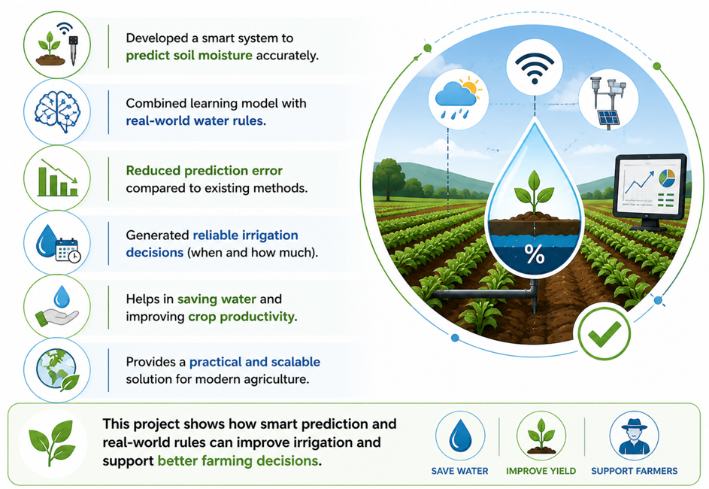
Conclusion:
Developed a smart system to predict soil moisture accurately
Combined learning model with real-world water rules
Reduced prediction error compared to existing methods
Generated reliable irrigation decisions (when and how much)
Helps in saving water and improving crop productivity
Provides a practical and scalable solution for modern agriculture
This project shows how smart prediction and real-world rules can
imporve irrigation and support better farming decisions.

Slide 12
Thank You !
- PCSE26-05

