Slide 1
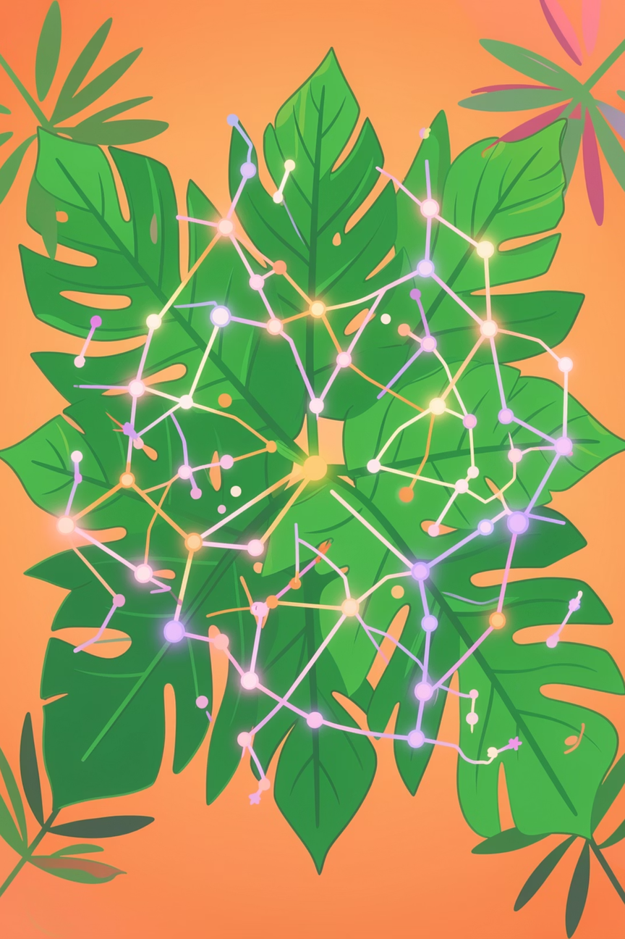
Plant Recognition Using Deep Learning and Machine Learning
Team Members: Suraj Singh, Sparsh Kumar, Shivam Singh, Riya Goel
Department of Computer Science and Engineering
FINAL YEAR PROJECT VIVA

Slide 2



Introduction & Problem Statement
Why Does Plant Identification Matter?
Our Solution
Traditional Limitations
There are over 400,000 known plant species globally. Accurate identification is critical for agriculture, medicine, conservation, and ecological research — yet traditional taxonomy is slow, costly, and demands rare expert knowledge.
Morphological taxonomy is time-intensive and requires trained specialists unavailable in field conditions.
AI-Based Recognition
Manual botanical classification is error-prone and inaccessible at scale.
Deep learning enables fast, accurate, scalable identification from leaf images alone.
This Project
ResNet-18 + Gemini AI for classification and rich botanical description generation.

Slide 3





Objectives & Applications
Core Objectives
Real-World Applications
1
2
Agriculture
Crop monitoring and weed detection in the field.
Leaf-Based Identification
CNN Classification
Fine-tuned ResNet-18 for high-accuracy deep feature extraction.
Conservation
Classify plant species from a single leaf image upload.
Rapid biodiversity surveys and endangered species tracking.
3
4
Education
AI Descriptions
Web Interface
Interactive botanical learning tools for students.
Gemini API generates botanical and medicinal plant details.
Streamlit-based real-time interactive application.
Botanical Research
Accelerating species documentation for scientists.

Slide 4
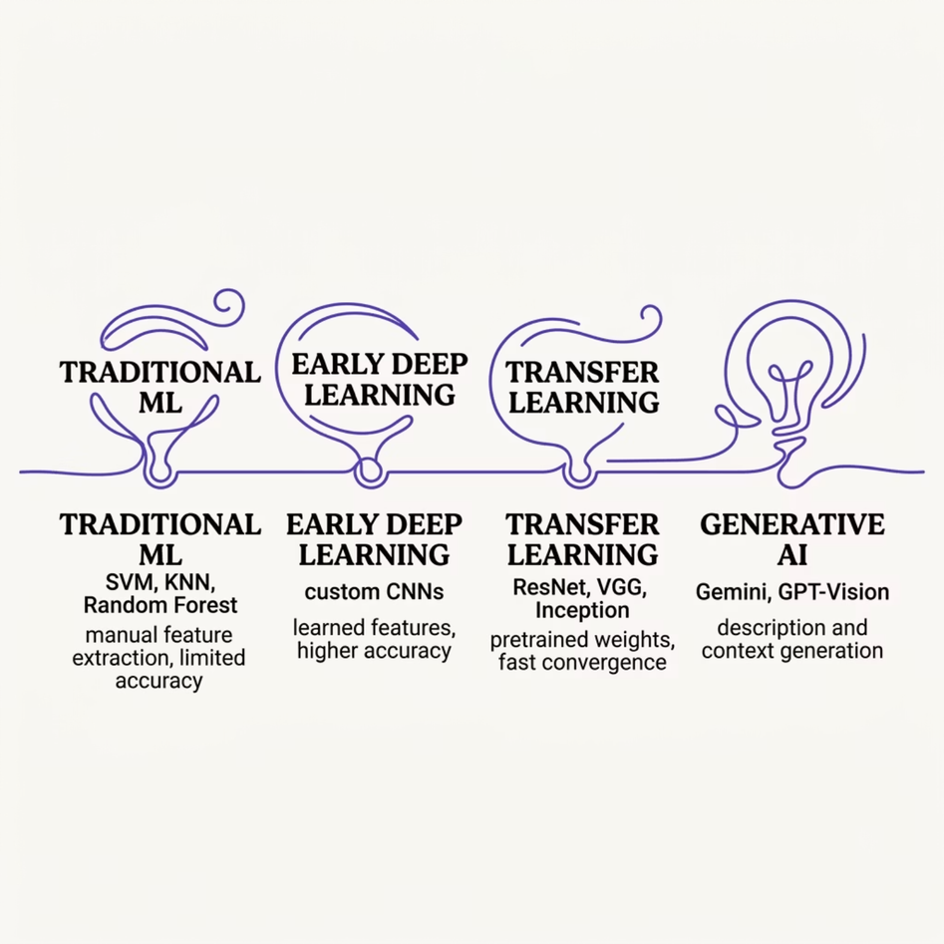

Literature Review
Evolution of Plant Recognition Methods
Research in automated plant identification has progressed from handcrafted feature engineering to end-to-end deep learning, dramatically improving classification accuracy and generalizability.
Transfer learning with pretrained CNNs consistently outperforms traditional ML on small botanical datasets.

Slide 5
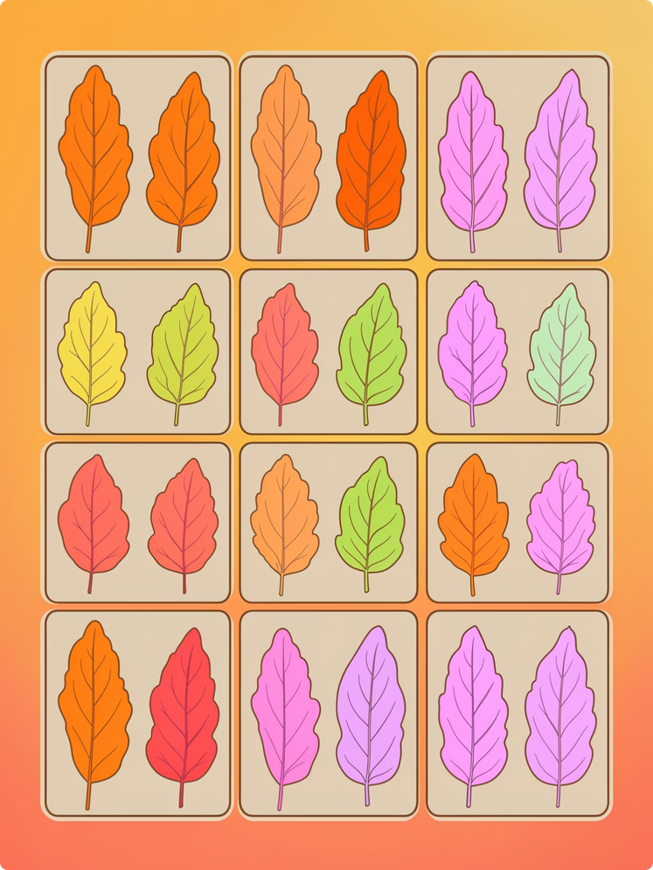

Dataset & Preprocessing
Indian Medicinal Leaves Dataset
99 Species
224×224 px
Plant classes covering Indian medicinal flora
Uniform image resizing for model input
80:20 Split
Train-validation partition for robust evaluation
Preprocessing Pipeline
Normalize
Augment
Scale by dataset mean and std.
Flip, rotate and random crop.
Resize
Split
224×224 px uniform resizing.
80% train and 20% validation.

Slide 6
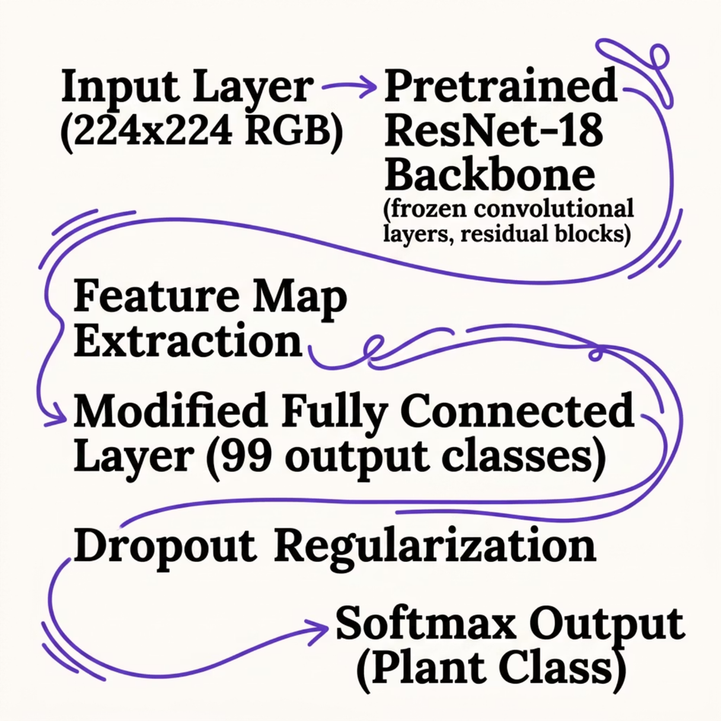




Model Architecture: Fine-Tuned ResNet-18
Training Configuration
Adam Optimizer
LR: 0.001
Adaptive learning with momentum for stable convergence.
Conservative learning rate prevents overfitting on fine-tuning.
Batch Size: 32
Cross-Entropy Loss
Balanced memory efficiency and gradient stability.
Standard multi-class classification objective.

Slide 7
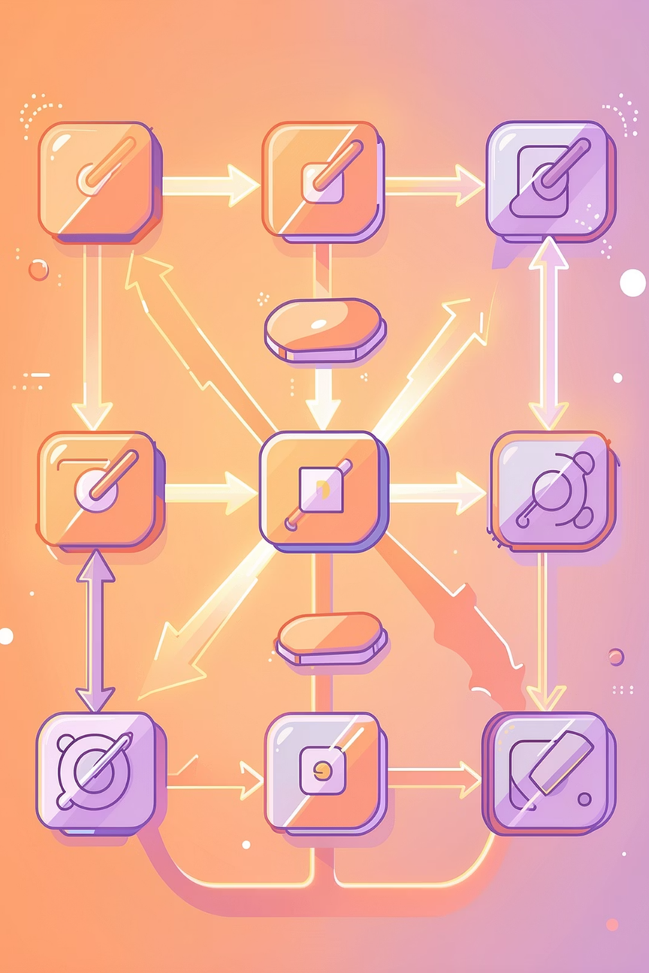
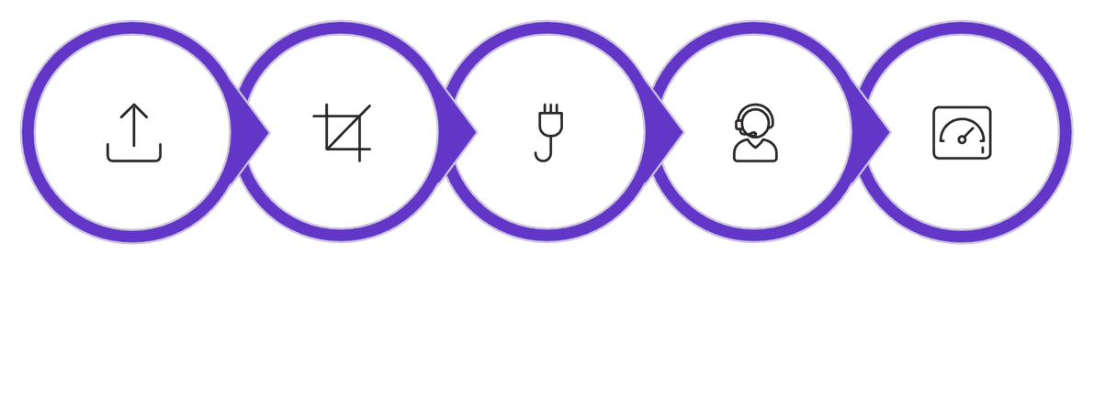





System Workflow & Gemini AI Integration
Image Upload
Preprocessing
ResNet-18
Gemini AI
Streamlit Output
The Google Gemini API receives the predicted species name and generates rich botanical context — including habitat, medicinal uses, and care instructions — enhancing the application's educational value beyond simple classification.

Slide 8
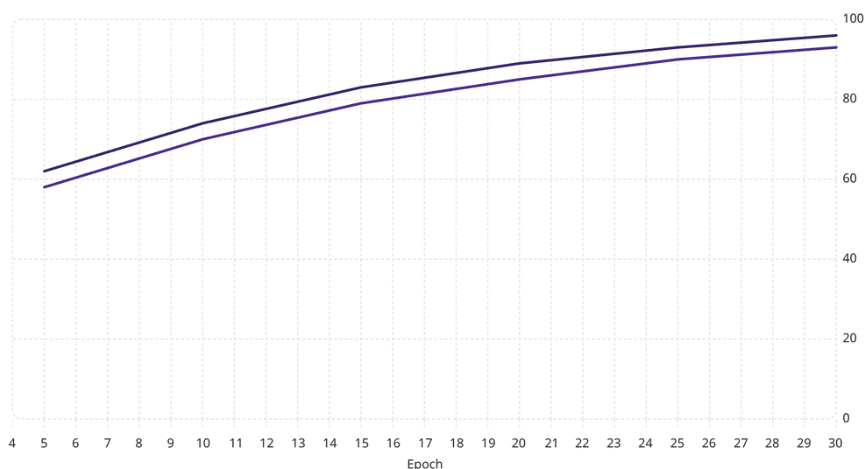
Web Application & Results
Streamlit Interface Features
Training Performance
Real-Time Upload
AI-Generated Info
Validation Accuracy (%)
Train Accuracy (%)
Users upload a leaf image and receive instant species prediction.
Gemini API returns detailed botanical and medicinal plant profiles.
Confidence Scores
Clean UI Design
Softmax probabilities displayed for transparency and interpretability.
Minimal, intuitive layout accessible to non-technical users.
The model achieves strong validation accuracy, demonstrating effective generalization across 99 plant species with minimal overfitting.

Slide 9



Limitations & Future Scope
Current Limitations
Future Directions
Visual Ambiguity
Vision Transformers
Morphologically similar species may be misclassified.
ViT-based models for superior fine-grained recognition.
Image Quality
Multi-Part Recognition
Blurry or poorly lit inputs degrade prediction confidence.
Extend to flowers, stems, bark for holistic identification.
API Dependency
Offline AI Systems
Gemini AI requires active internet connectivity.
On-device language models for field use without internet.

Slide 10

Conclusion
CNN + Generative AI
Real-World Impact
Successful integration of ResNet-18 with Google Gemini for end-to-end plant intelligence.
Scalable solution for agriculture, conservation, education, and botanical research.
Future-Ready
Extensible architecture supporting Vision Transformers, larger datasets, and offline AI.
Thank You
Questions & Discussion Welcome

