Slide 1


Harvestify
An Agricultural Crop Recommendation System
Presented by Ankit Jaiswal · Anil Yadav · Aryan Patel · Gaurav Singh
Department of Computer Science & Engineering
· KIET Group of Institutions Ghaziabad
Mentor: Prof. Pushpendra Kumar
Notes:
1

Slide 2

Why Agriculture Needs AI
Agriculture feeds 8 billion people, yet farmers still rely on guesswork for crop selection. Harvestify bridges this gap — using machine learning to analyze soil and climate data and deliver precise, actionable crop recommendations.
The Challenge
The Opportunity
Climate variability, soil degradation, and poor crop choices drive low yields and farmer uncertainty.
AI can analyze complex environmental data to guide smarter, faster, and more profitable farming decisions.
Our Solution
Harvestify — an ML-powered web app delivering accurate crop recommendations in seconds.
Notes:
2

Slide 3
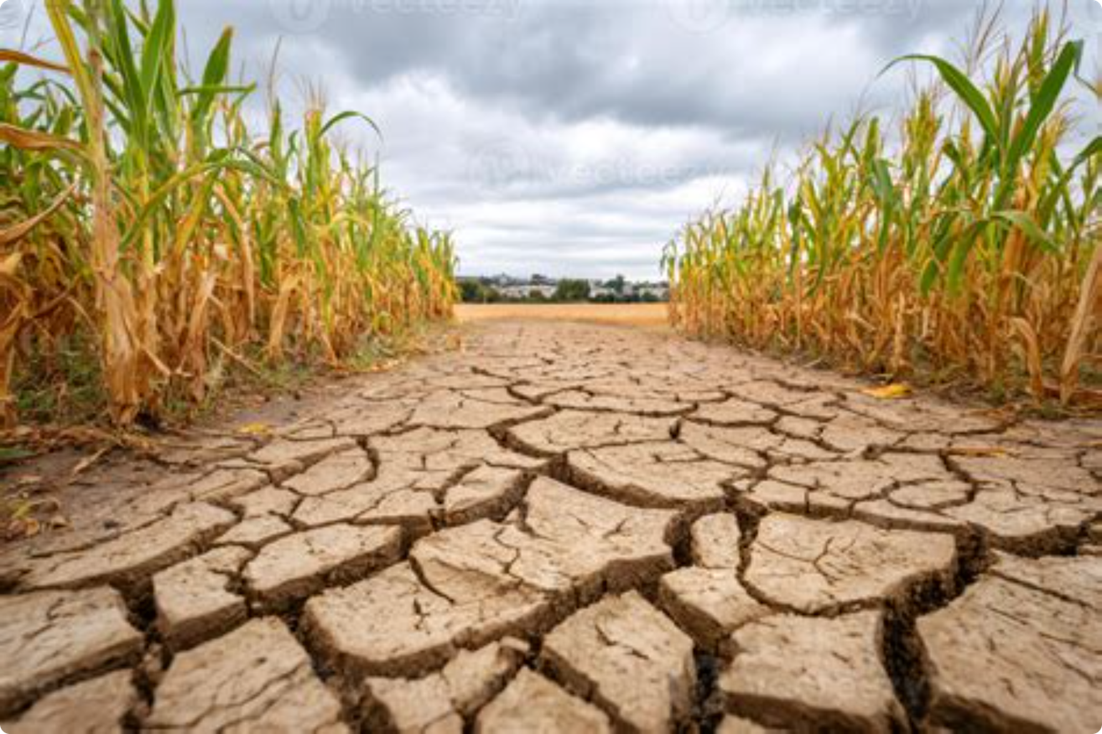
The Problem with Traditional Farming
Why Farmers Struggle
Without data-driven tools, crop selection depends on intuition and tradition — not science. The result: lost productivity, wasted resources, and reduced income.
Empirical methods: Decisions based on experience, not soil or climate data
Environmental variability: Shifting rainfall, temperature, and soil pH make planning unreliable
Low productivity: Wrong crop choices directly reduce yield and profitability
No decision support: Farmers lack accessible, intelligent tools for guidance
Notes:
3

Slide 4


Project Objectives
Harvestify is built on five core goals — from raw data to a polished, farmer-friendly interface.
1
2
3
ML-Powered Recommendations
Boost Agricultural Productivity
Multi-Parameter Analysis
Help farmers maximize yield by matching crops to their specific environmental conditions.
Process N, P, K, temperature, humidity, pH, and rainfall simultaneously for holistic recommendations.
Predict the optimal crop using soil nutrients, temperature, humidity, pH, and rainfall data.
4
5
Fast & Accurate Predictions
User-Friendly Web Application
Deliver real-time results with high confidence using an optimized ML pipeline.
A clean React + TypeScript interface accessible to farmers and agronomists alike.
Notes:
4

Slide 5
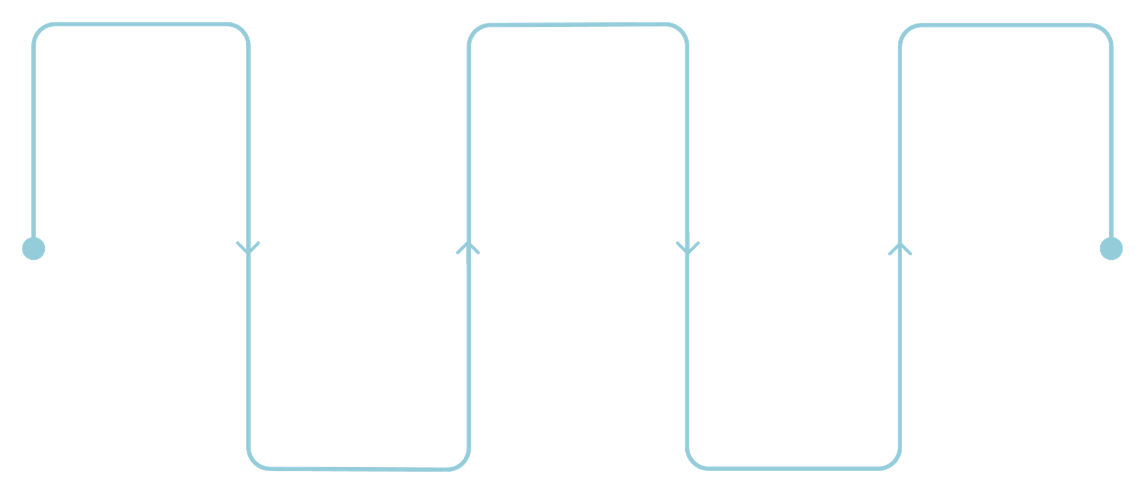
System Architecture & Workflow
Data Collection
Model Training
Crop Recommendation
Train RF, SVM, KNN, LightGBM, XGBoost
Gather soil and climate data
Display optimal crop with confidence
Data Preprocessing
Prediction
Clean, normalize, encode features
Run inference on user input
The end-to-end pipeline transforms raw agricultural inputs into a reliable crop recommendation in seconds. The frontend (React + TypeScript) communicates with a FastAPI backend, which orchestrates the ML model ensemble and returns structured predictions to the user.
Notes:
5

Slide 6
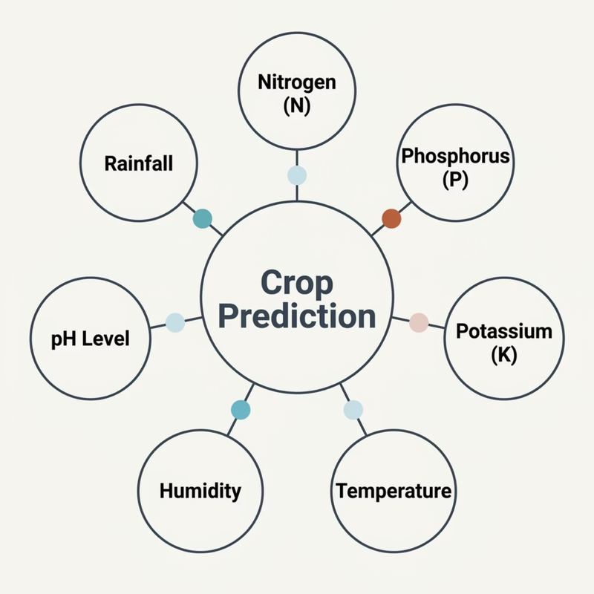

Dataset & Input Features
Sourced from the Kaggle Crop Recommendation Dataset, Harvestify's training data covers 2,200+ samples across 22 crop classes — ensuring robust generalization across diverse agricultural conditions.
Nitrogen (N)
Phosphorus (P)
Potassium (K)
Temperature
Humidity
pH Level
Rainfall
Notes:
6

Slide 7
Machine Learning Models Compared
Five algorithms were trained and evaluated. XGBoost was selected as the final model for its superior handling of complex, non-linear agricultural data.
KNN
SVM
Random Forest
Distance-based; intuitive but sensitive to feature scaling and outliers.
Strong in high-dimensional spaces; slower on larger datasets.
Robust ensemble; handles non-linearity well with built-in feature importance.
LightGBM
XGBoost ⭐ Selected
Gradient boosting with fast training; efficient for structured tabular data.
Best overall — high accuracy, regularization, and reliable predictions on agricultural data.
Notes:
7

Slide 8
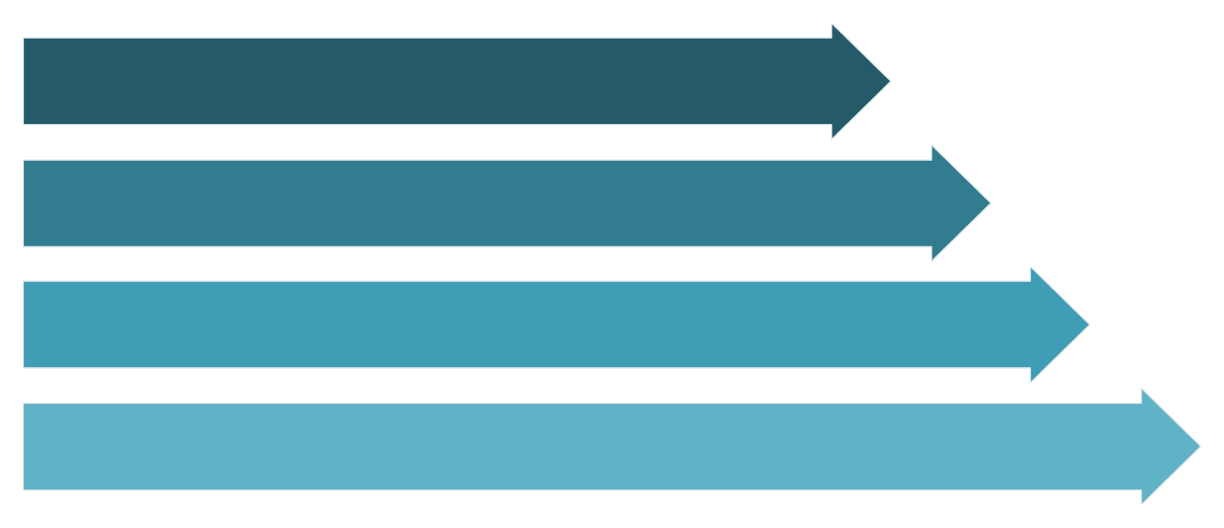
Data Preprocessing & ML Pipeline
Data Cleaning
Normalization
Train-Test Split
Model Training
A rigorous preprocessing pipeline ensures data quality and model reliability at every stage.
Preprocessing Steps
Evaluation Metrics
Remove nulls and statistical outliers
Normalize continuous features (N, P, K, temperature, rainfall)
One-hot encode categorical crop labels
80/20 stratified train-test split
Accuracy — Overall correctness
Precision — Prediction reliability
Recall — Coverage of true positives
F1-Score — Harmonic mean of precision and recall
Notes:
8

Slide 9
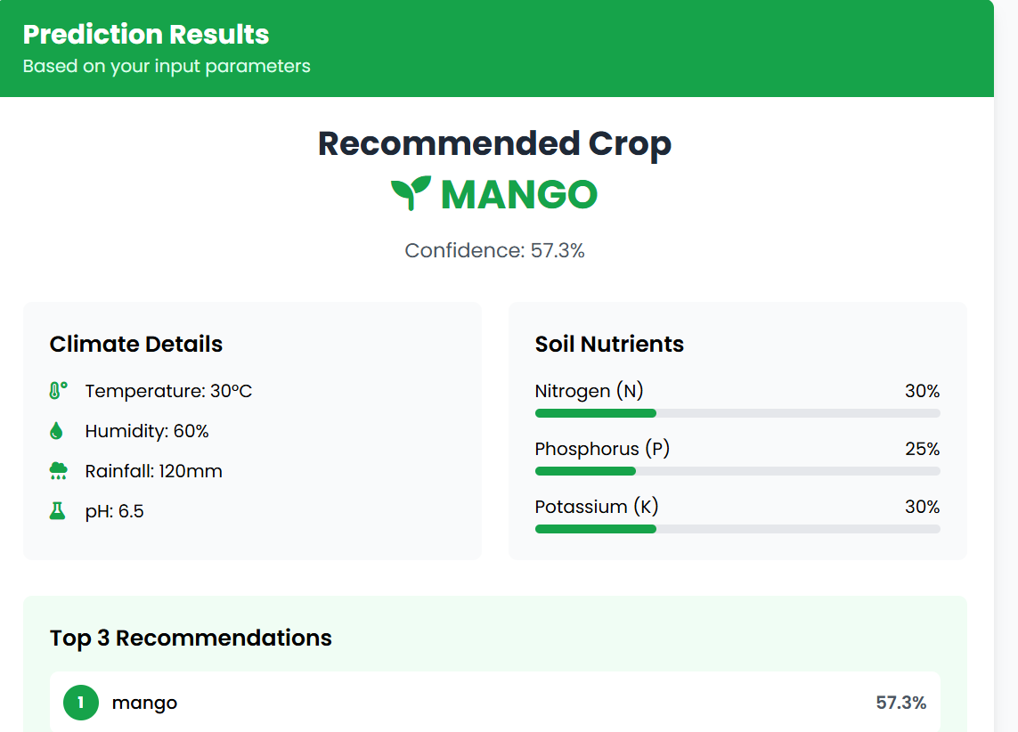
Results & System Output
What Harvestify Delivers?
The system produces fast, explainable recommendations through a clean React interface. XGBoost's feature importance scores reveal which soil and climate factors drove each prediction.
Fast Prediction Response
Reliable Recommendations
Real-time inference via the FastAPI backend
Consistent outputs validated across all 22 crop classes
Explainable AI
Intuitive Interface
Feature importance scores show why a crop was recommended
Accessible design for farmers and agronomists
Notes:
9

Slide 10

Future Scope & Conclusion
What's Next for Harvestify
Conclusion
IoT Sensor Integration — Live soil and environmental monitoring
Real-Time Weather API — Dynamic forecasts for seasonal planning
Fertilizer Recommendations — Precision nutrient guidance per crop
Mobile Application — Offline-capable Android & iOS app
Multi-Language Support — Regional language accessibility for farmers
Harvestify demonstrates that machine learning and agriculture belong together. By combining XGBoost with a modern web stack, the system delivers accurate, explainable, and actionable crop recommendations — empowering farmers to make smarter decisions and supporting the future of smart, data-driven farming.
Harvestify — Intelligent farming, powered by data.
Notes:
10

Slide 11
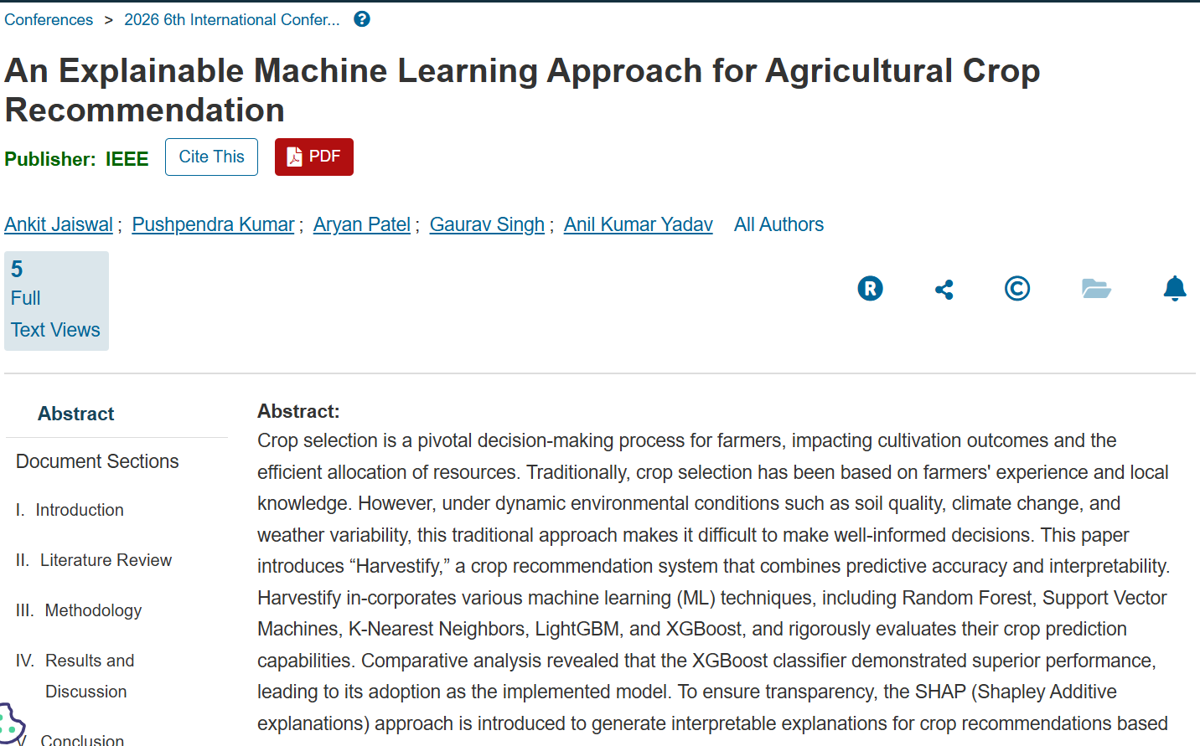
Paper Published
Conference Details
Presented at an IEEE AMU Conference
Research paper published successfully
Notes:
11

Slide 12

Thank You
Notes:
12

