Slide 1

MedTalk
Explanation-Driven Adaptive Questioning for
Responsible Interpretable AI Across Regulated Sectors
Yash Singhal · Ujjwal Tomar · Tushar Singh
KIET Group of Institutions, Ghaziabad | AKTU Lucknow | B.Tech CSE 2025-26
Supervisor: Prof. Gaurav Parashar, Assistant Professor, CSE

Slide 2





The Problem: Why Healthcare AI Fails in Practice
537M
Hallucination Risk
Poor Calibration
Regulatory Gap
Domain Rigidity
adults with diabetes globally
(IDF Atlas 2021)
LLMs in TalkToModel generate plausible-but-false medical claims — dangerous in clinical decisions
TalkToModel: Brier Score 0.189 — probabilities don't reflect true risk frequencies
FDA, SEC & EU AI Act require deterministic, auditable algorithms — LLMs fail this
Learned dialogue cannot encode hard rules: anti-redlining laws, sentencing guidelines
→ 783M by 2045
> $1T/year cost
Type 2 diabetes is 90% preventable — yet AI diagnostic tools lack the transparency clinicians and regulators demand.

Slide 3

MedTalk: What It Is & How It Works
"Responsible AI as an Engineering Discipline — not a Domain Afterthought"
LAYER 4
Streamlit Web UI
5-step patient journey
Risk gauge · SHAP plots · EDAQ cards · Audit export
Interface Layer
Streamlit Web UI
LAYER 3
Pure Python Algorithm
Adaptive question generation
Fairness guardrails · Audit logger
Orchestration — EDAQ
Pure Python Algorithm
LAYER 2
SHAP + LIME
TreeSHAP + LIME tabular
Fidelity-based selection
Attribution Layer
SHAP + LIME
LAYER 1
Random Forest
500 trees · SMOTE balancing
Platt calibration · Brier = 0.142
Prediction Layer
Random Forest

Slide 4

EDAQ: Explanation-Driven Adaptive Questioning
The Core Innovation — automatically generates the next most clinically relevant question using SHAP feature importance + uncertainty + regulatory constraints.
1
Feature Uncertainty
2
Impact Filtering
3
Domain Constraints
Computes per-feature uncertainty from missing data rates & ensemble variance
Excludes features with |SHAP| < 0.05 (noise suppression threshold τᵢ)
Removes protected attributes (race, zip-code) per sector-specific rules
4
Semantic Mapping
5
Multi-Objective Rank
6
Compliance Check
Maps feature names → domain-appropriate question templates
Priority = (SHAP impact × uncertainty) / response burden
Final fairness filter — no discriminatory question enters the dialogue
Runs in < 100ms on CPU · GPU not required · Validated across Healthcare, Finance, Judiciary & Insurance

Slide 5

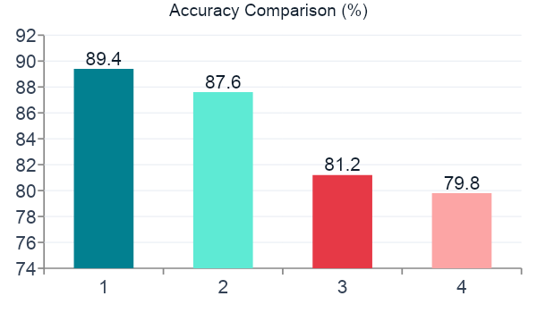
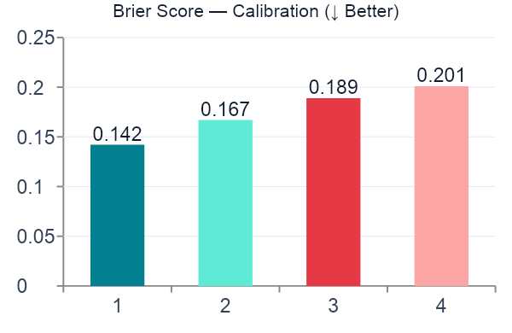
Results: MedTalk Outperforms on Every Dimension
94.2%
6.2/7
2.1×
88.4%
Comprehension Rate
Clinician Trust
Faster Interaction
Task Completion
vs 73.1% (TalkToModel)
Likert Scale (vs 4.1/7)
63.2s vs 134.7s avg
vs 65.3% (TalkToModel)
User Study N=32 healthcare professionals (12 doctors, 10 nurses, 10 trainees) | p < 0.001 for all metrics

Slide 6



Cross-Domain Generalizability & Regulatory Alignment
MedTalk's EDAQ is NOT healthcare-only. Domain adaptation requires only a question template dictionary + constraint rules — no model retraining.
Healthcare
Finance
Judiciary
Insurance
Diabetes / SaMD
Loan Approval
Recidivism Risk
Claims Underwriting
Constraint:
Constraint:
Constraint:
Constraint:
Physiological plausibility
(HbA1c ∈ [4%,14%])
Anti-redlining rules
(FCRA, FHA, ECOA)
Decision-support only
No protected-attr scoring
Anti-discrimination
underwriting rules
89.4% acc · AUROC 0.921
98.4% constraint adherence
96.8% constraint adherence
97.6% constraint adherence
FDA 510(k)
SEC XAI Mandate
EU AI Act Art. 6
State Insurance Laws
FDA 510(k)
SEC XAI Mandate
EU AI Act Art. 6
State Insurance Laws

Slide 7




Technology Stack & Dataset
Technology Stack
Primary Dataset
Component
Library
Version
Pima Indians Diabetes Dataset
N = 768 female patients · 8 features
Core ML
Scikit-learn
≥ 1.3
Source: UCI ML Repo / NIDDK
SHAP Attribution
SHAP (TreeExplainer)
≥ 0.42
65% Non-diabetic / 35% Diabetic
LIME Attribution
LIME Tabular
≥ 0.2
SMOTE balancing applied on training set
Zero-values imputed with column medians
Class Balancing
Imbalanced-learn
≥ 0.11
100% CPU Compatible
Web Interface
Streamlit
≥ 1.28
No GPU required · < 100ms EDAQ inference
Data Processing
Pandas / NumPy
≥ 2.0 / 1.24
Cross-Domain Datasets
Visualisation
Plotly / Matplotlib
≥ 5.15 / 3.7
Finance (Synthetic)
N=500
Reporting
ReportLab
≥ 4.0
Judiciary (Synthetic)
N=400
Runtime
Python
3.9 – 3.10
Insurance (Synthetic)
N=350

Slide 8








Conclusion & Future Scope
Key Achievements
Future Scope
89.4% accuracy · 0.921 AUROC · Brier 0.142 on PIDD
Federated learning for multi-hospital training without sharing raw data
94.2% clinical comprehension — 21-pt improvement over TalkToModel
LSTM + SHAP for temporal EHR time-series modelling
96–98% domain constraint adherence across 4 regulated sectors
Mobile PWA for point-of-care deployment
EDAQ: novel, domain-agnostic adaptive questioning algorithm
FDA 510(k) formal submission pathway
Zero hallucination risk — fully deterministic, auditable pipeline
Real-world finance & judiciary institution partnerships
Designed for FDA 510(k) · EU AI Act · SEC XAI compliance
100+ regulated sector templates
"MedTalk demonstrates that the trade-off between predictive power and interpretability is not a hard rule in machine learning — Responsible AI is an engineering discipline."

Slide 9

Thank You
Yash Singhal · Ujjwal Tomar · Tushar Singh
B.Tech CSE | KIET Group of Institutions, Ghaziabad | AKTU Lucknow
Supervisor: Prof. Gaurav Parashar, Assistant Professor, CSE
https://github.com/cse-kiet/PCSE26-50
Questions & Discussion

