Slide 1

Azure Cosmos DB

Slide 2
Agenda
Introduction
RDBMS vs NoSql (table vs doc)
Multi API Support
Consistency Models
Partitioning and Indexing
Cost Control (RUs)
IMDb Challenge
Notes:
Agenda – Session2

Slide 3
Introduction
Globally distributed
Always on
Massively scalable
Guaranteed low latency
Comprehensive SLA (99.9999%)
Notes:
Agenda – Session2

Slide 4



Azure Cosmos DB
A globally distributed, massively scalable, multi-model database service
SQL
MongoDB
Table API
Column-family
Document
Key-value
Graph
Guaranteed low latency at the 99th percentile
Elastic scale out
of storage & throughput
Five well-defined consistency models
Turnkey global distribution
Comprehensive SLAs

Slide 5

RDBMS vs NoSql
Rigid, structured vs unstructured
Tables, Rows, Columns vs JSON
Invoice
Invoice
Store
Details
Store
Line Items
Line Items

Slide 6
Multi API support
SQL Native API (this is not RDBMS) {Document}
Mongo {Document}
Table API/etcd {Key-value}
Gremlin {graph}
Casandra {column family}
Notes:
Agenda – Session2

Slide 7
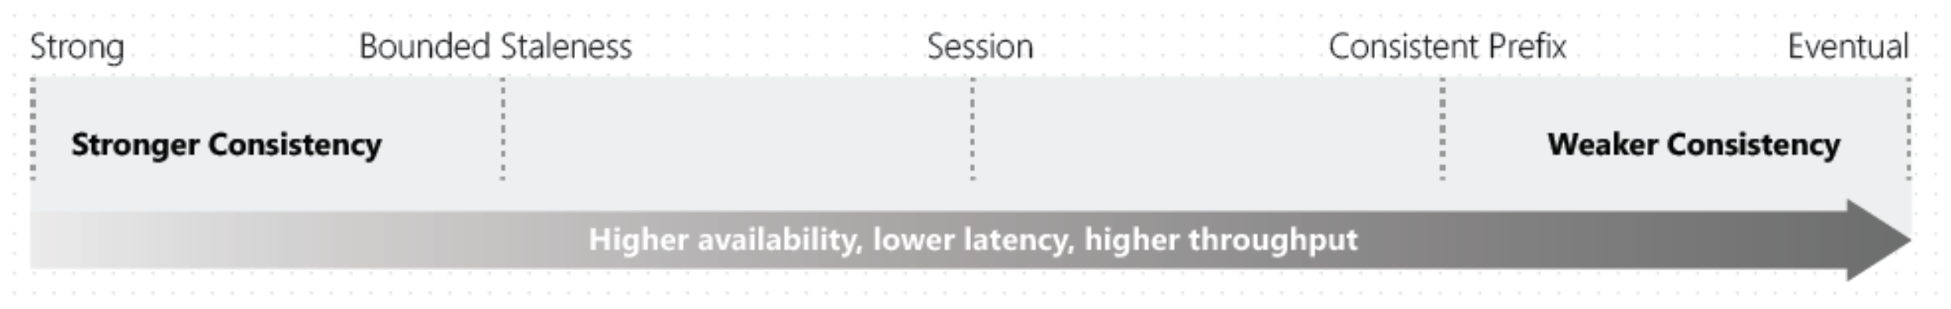
Consistency models
Distributed databases that rely on replication for high availability, low latency, or both, make the fundamental tradeoff between the read consistency vs. availability, latency, and throughput.
Azure Cosmos DB has more choices than just the extremes of strong consistency and eventual consistency.
Notes:
Agenda – Session2

Slide 8
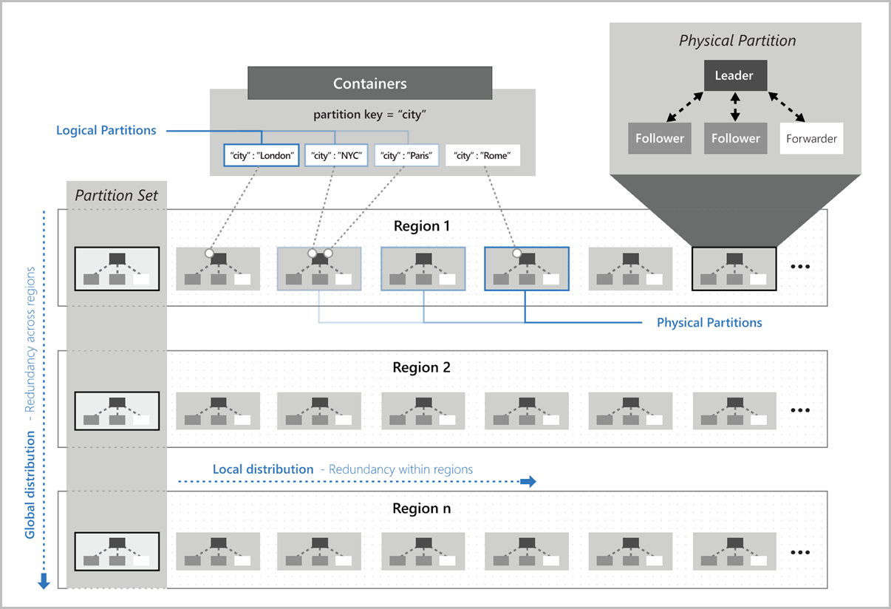
Partitioning & Indexing
Items in a container are divided into distinct subsets called logical partitions.
Logical partitions are formed based on the value of a partition key.
Notes:
Agenda – Session2

Slide 9
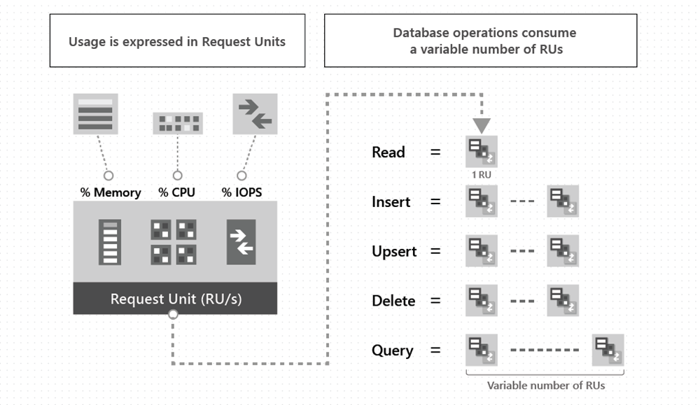
Cost Control
You pay for the throughput you provision and the storage you consume on an hourly basis.
Notes:
Agenda – Session2

Slide 10
Cost Control (cont..)
Things that affect your RU consumptions:
Item size
Item indexing
Item property count
Indexed properties
Data consistency
Query patterns
Notes:
Agenda – Session2

Slide 11
Q&A
Notes:
Agenda – Session2

