Slide 1
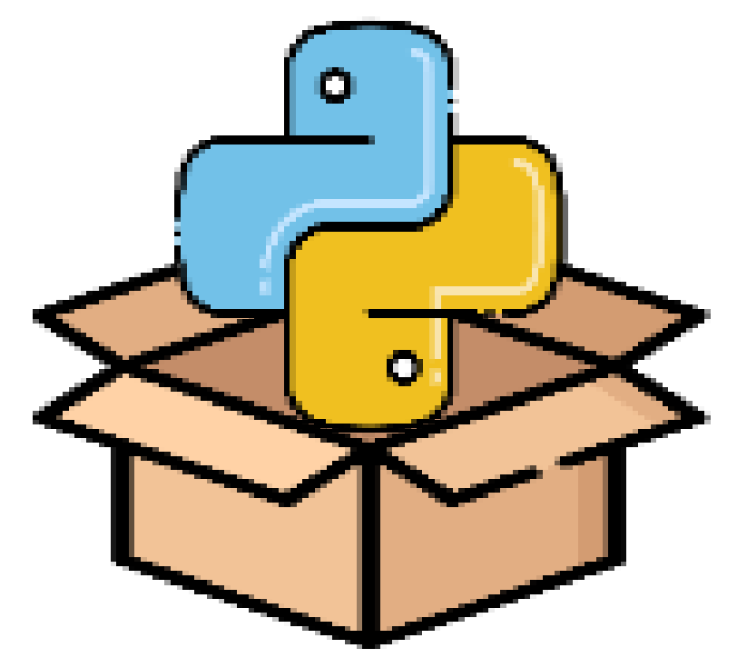

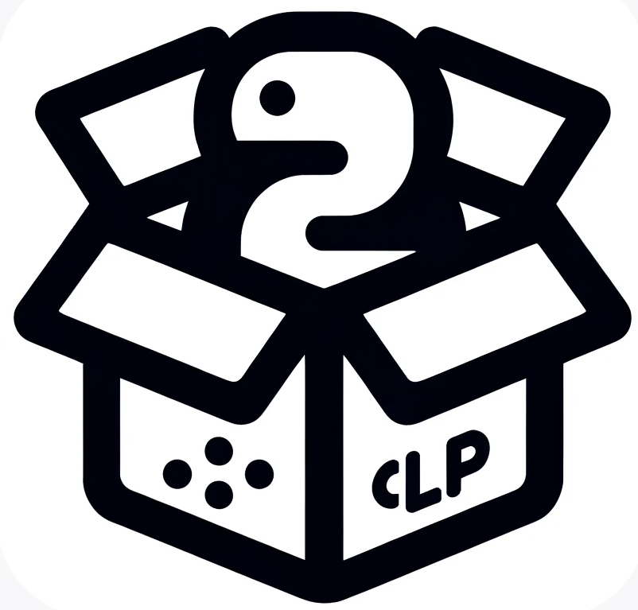

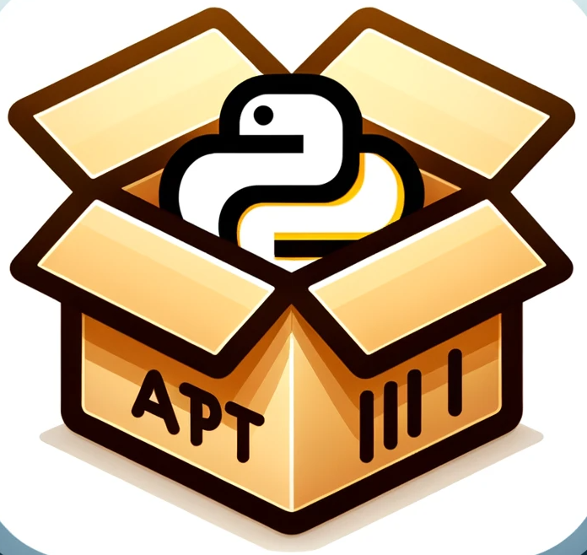


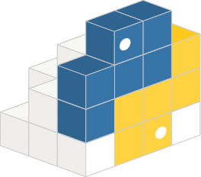



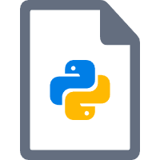
Repository-level Detection
CLP₁: V₁, …, V_{apt} , …, V_{m}
CLP₂: V₁, …, V_{apt} , …, V_{m}
···
CLP_{n}: V₁, …, V_{apt} , …, V_{m}
CLP₁: C(V₁, V_{apt}), …, C(V_{apt} , V_{m})
CLP₂: C(V₁, V_{apt}), …, C(V_{apt} , V_{m})
···
CLP_{n}: C(V₁, V_{apt}), …, C(V_{apt} , V_{m})
Target Package Pair
APT Repository
Package Analysis
API Exctraction
Compatibility Analysis
Program Analyse
Cross-listed Packages
(CLP)
Python Package API Database
(PyAD)
Compatibility Report
PYPI Repository
System-level Detection
Static Stone Detection
Dynamic Incremental Detection
Program Analyse
Global dependency graph
User installation commands
Compatibility Report
Ubuntu System
Potential PAIssues
User application

Slide 2
Repository-level Analysis
CLP₁: V₁, …, V_{apt} , …, V_{m}
CLP₂: V₁, …, V_{apt} , …, V_{m}
···
CLP_{n}: V₁, …, V_{apt} , …, V_{m}
CLP₁: C(V₁, V_{apt}), …, C(V_{apt} , V_{m})
CLP₂: C(V₁, V_{apt}), …, C(V_{apt} , V_{m})
···
CLP_{n}: C(V₁, V_{apt}), …, C(V_{apt} , V_{m})
Code-level API Inspection
APT Repository
Package Analysis
API Exctraction
Compatibility Analysis
User application / Target package
Cross-listed Packages
(CLP)
Python Package API Database
(PyAD)
PYPI Repository
Program Analyse
System-level Detection
Static Stock Detection
Dynamic Incremental Detection
Ubuntu System
Global dependency graph
Incompatible import chains
User installation commands
Compatibility Report

