Slide 1

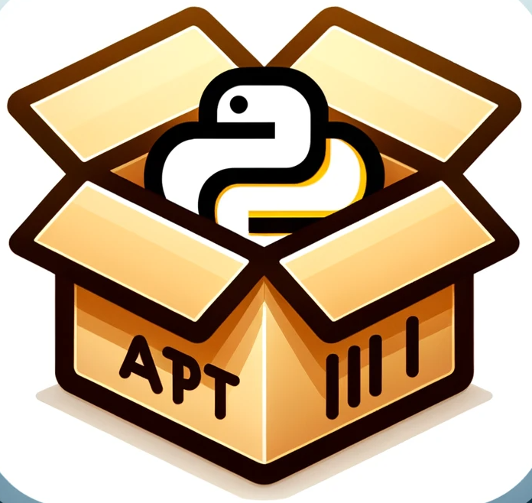
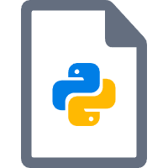
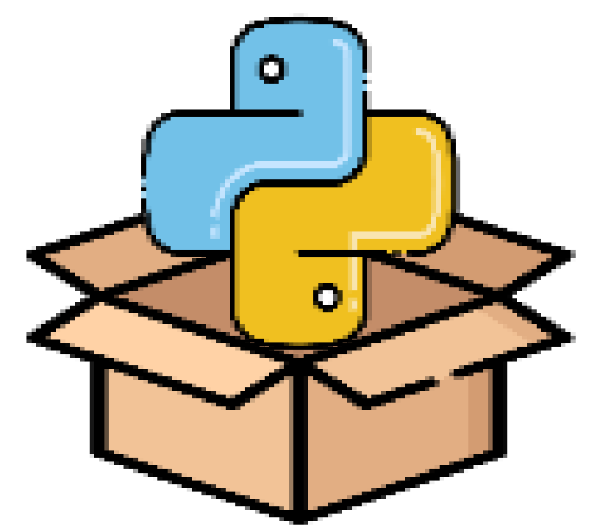

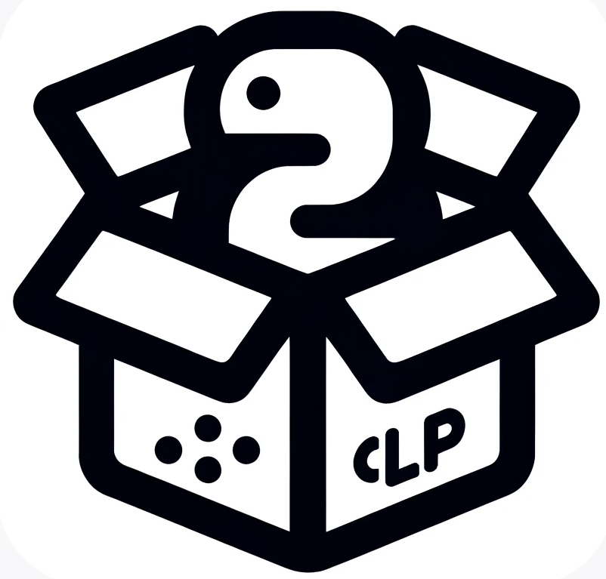

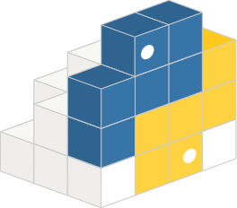
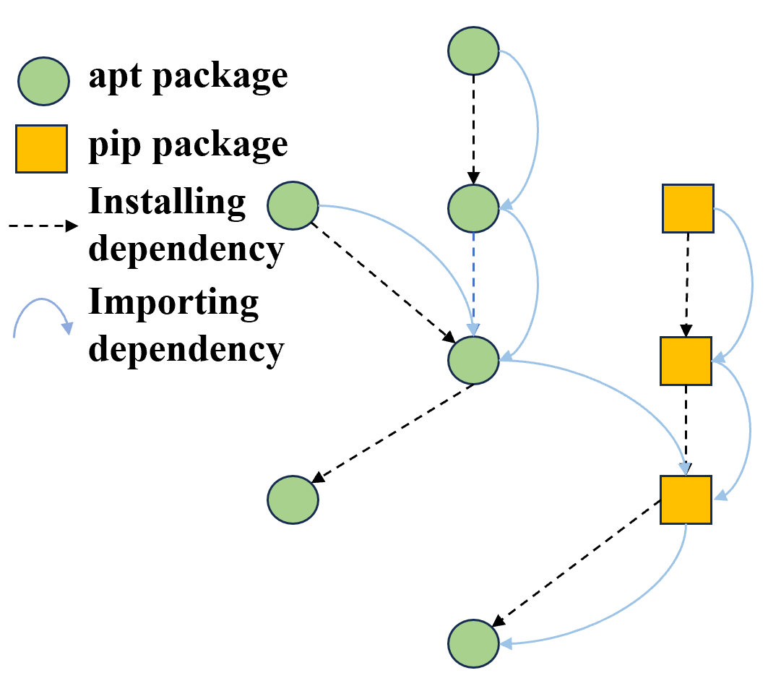




Repository-level Analysis
CLP₁: V₁, …, V_{apt} , …, V_{m}
CLP₂: V₁, …, V_{apt} , …, V_{m}
···
CLP_{n}: V₁, …, V_{apt} , …, V_{m}
CLP₁: C(V₁, V_{apt}), …, C(V_{apt} , V_{m})
CLP₂: C(V₁, V_{apt}), …, C(V_{apt} , V_{m})
···
CLP_{n}: C(V₁, V_{apt}), …, C(V_{apt} , V_{m})
Code-level Inspection
Apt repository
Package Analysis
API Exctraction
Compatibility Analysis
User application / Target package
Cross-listed Packages
(CLP)
Python Package API Database
(PyAD)
Pip repository
apt package
System-level Detection
Program Analyse
Static Stock Detection
Dynamic Incremental
Detection
Ubuntu System
Potential PA Issues
Global importing dependency graph
User installation commands
PA Issue Report

Slide 2
Libraries.io
API
Extraction
Package
Analysis
Python Ecomsystem
Compatibility Analysis
API
Knowledge Base
Ubuntu Ecomsystem
API Knowledge Base Builder
Compatibility Data
Repositories
Dependency Analysis
Construct GDG
Package
Collection
Ubuntu System
Dynamic Incremental
Detection
Static Stock Detection
Install Script
Repository-level Detection
Potential CC Issues
Program Analysis
Code-level Inspection
CC Issues Report

