Slide 1


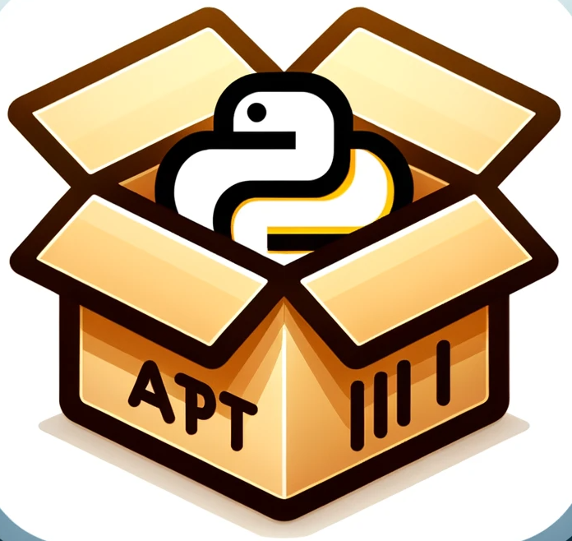



Libraries.io
Building Dependency Table
Update
Index
Analyzing intra-repository
Dependency
API Usage
Extraction
PyPI Repository
Preparing
Packages
Building Compatibility Table
API Extraction
Analyzing Incompatible Changes
Index
Ubuntu Repository
Build Database Offline
Compatibility Database
Constructing S-PDG
Directories
Package
Collection
Dependency Analysis
Merging R-PDGs
R-PDGs
Ubuntu System
S-PDG
Dry run
Script
Predicting CC Issue
Detecting CC Issue
Fixing
CC Issue
Command
Install Commands
Predict, Detect And Fix CC Issue Online
CC Issue Report And Fixing Advice

