Slide 1

Breakfast
Team 26: Dijkstra’s Alcoholism

Slide 2
Content
Five Ingredients
User Personas
Features
Roadmap
Flow Diagram
Wireframes

Slide 3
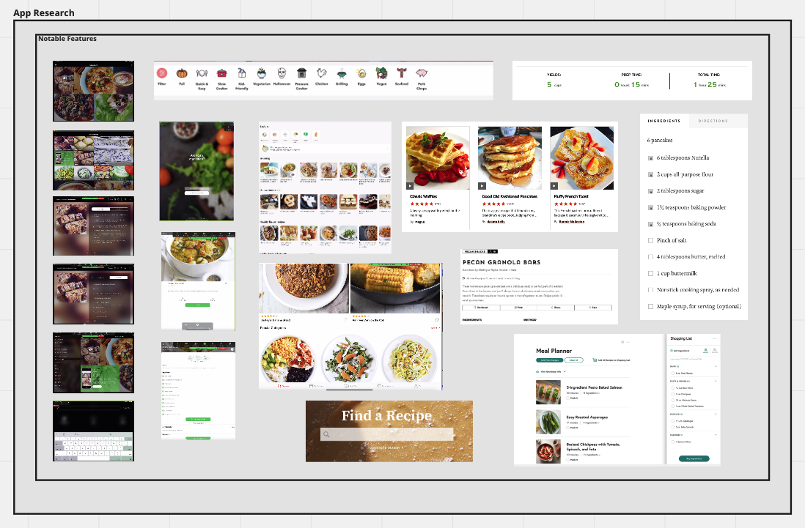
Project Statement and Research
We discovered that while there’s many recipe apps out there, none of them speak to our heart: Breakfast!
So, we at Dijkstra’s Alcoholism want to provide a collection of different breakfast recipes and give users an app to start their morning.

Slide 4
Problem
The raw idea, a use case, or something we’ve seen that motivates us to work on this
User wants to try new breakfast recipes and expand their breakfast options.
They want a one-stop for all breakfast options; organized database for easy browsing and searching.
Users dive into a recipe without knowing how long or difficult it is to make..
Also want ability to write and store personal recipes for later reference.

Slide 5
Appetite
How much time we want to spend and how that constrains the solution
Our time constraint is ~5 weeks
Student schedule - not everyone available at the same time for teamwork
Will implement essential recipe and CRUD features, before trying other features

Slide 6
Solution
The core elements we came up with, presented in a form that’s easy for people to immediately understand (either through UI/UX or core features)
Create personal recipes
Update personal recipes
Delete personal recipes
Browse recipes from local machine
Browse recipes from main page (server)
Search query for recipes
Select recipe
Load recipe details

Slide 7
Rabbit Holes
Details about the solution worth calling out to avoid problems
Search
Filtering depth
Complexity
Scope and specificity
Users’ local recipes
Users can create and store their own recipes that only they have access to.
This is stored locally and cannot be uploaded or shared.
Creating/Editing Recipes
Users can only edit the ingredients, image, and recipe steps in the editor for simplicity

Slide 8
No-Gos
Specifically excluded from the concept:
Non-breakfast meals
Vastly shrinks scope of recipes
Users integrating local data (Cloud storage)
Only local storage
Currently no text-to-speech, voice recognition, or other audio based features

Slide 9
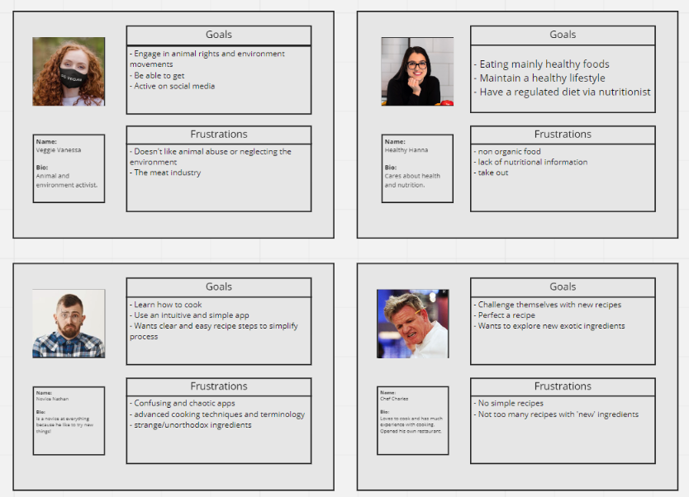
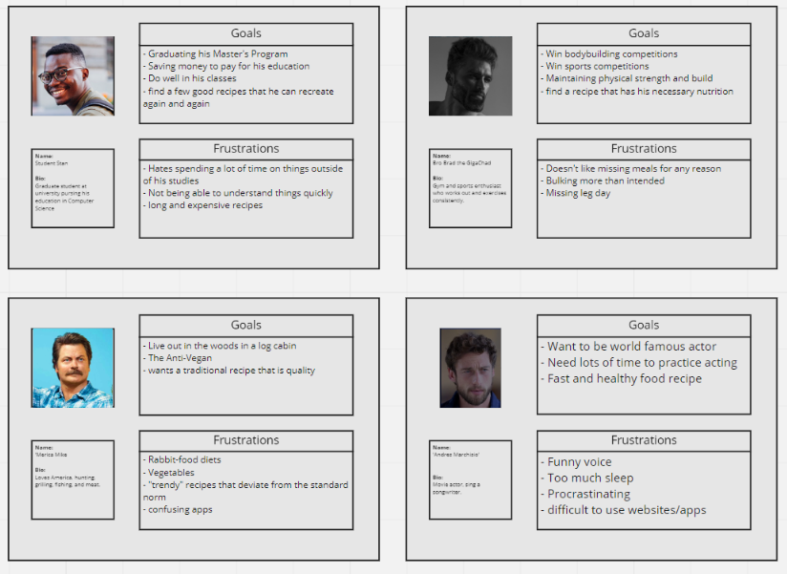
User Personas

Slide 10
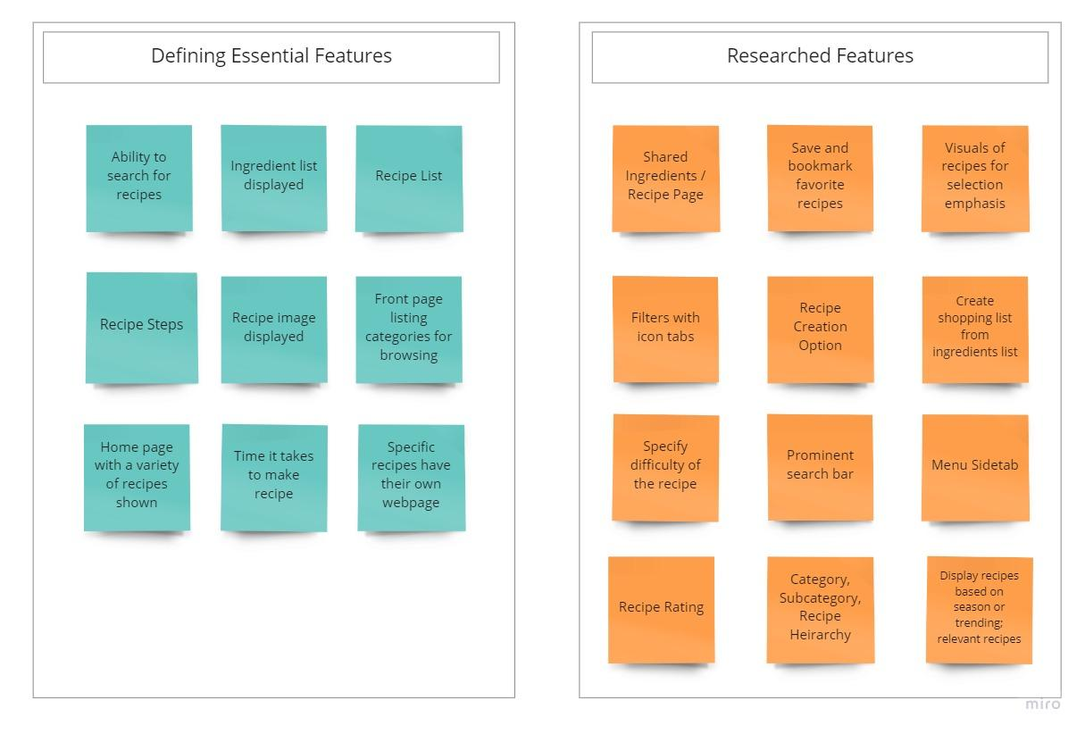
Features

Slide 11
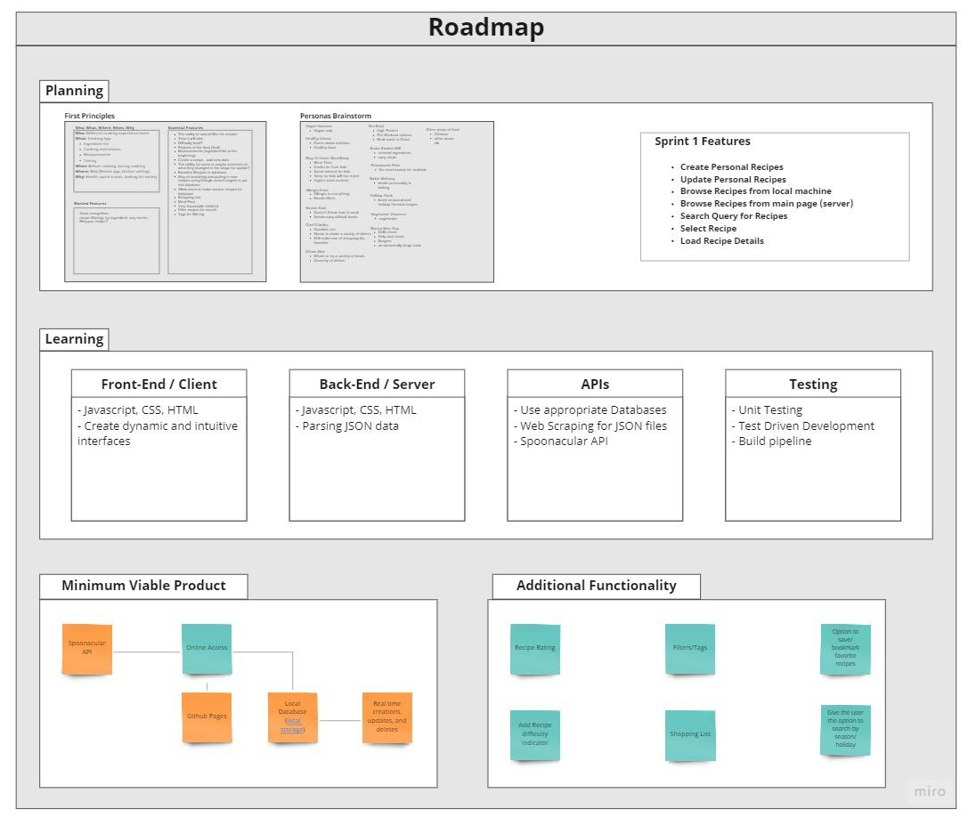
Roadmap
Notes:
https://miro.com/app/board/o9J_lpmFFvc=/

Slide 12
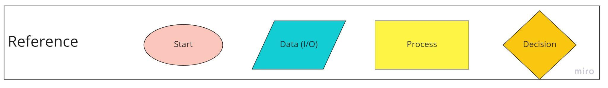
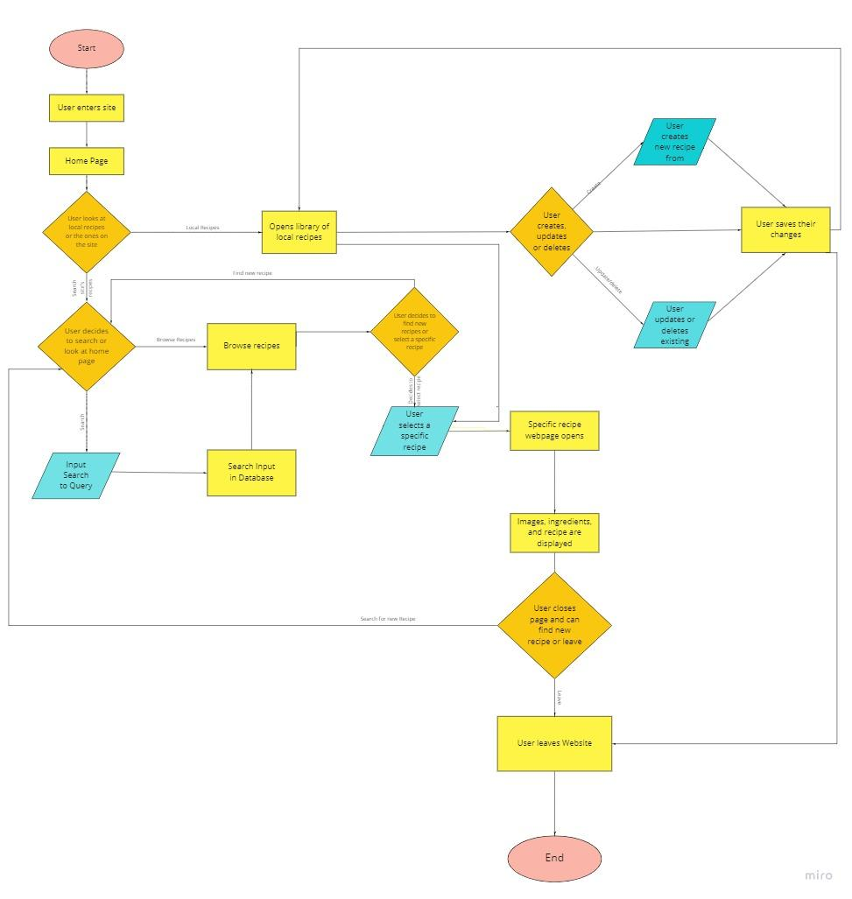
System Diagram
Notes:
https://miro.com/app/board/o9J_lpmFFvc=/

Slide 13
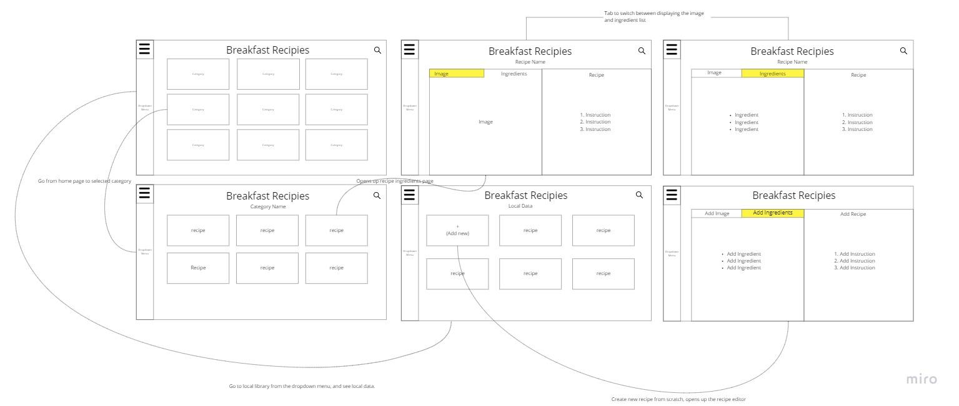
WireFrames

