Slide 1

PenPals: Starting Pitch
Evan Chen
James Chung
Aasem Fituri
Matthew Larkins
Ben Lonc
Nico Tahernia
Jessi Zhang

Slide 2
Statement of Purpose
We strive to overcome the challenges of accomplishing goals efficiently by providing an intuitive and accessible TODO list application that helps people build the habit of planning, executing, and reviewing their progress while maintaining privacy.

Slide 3
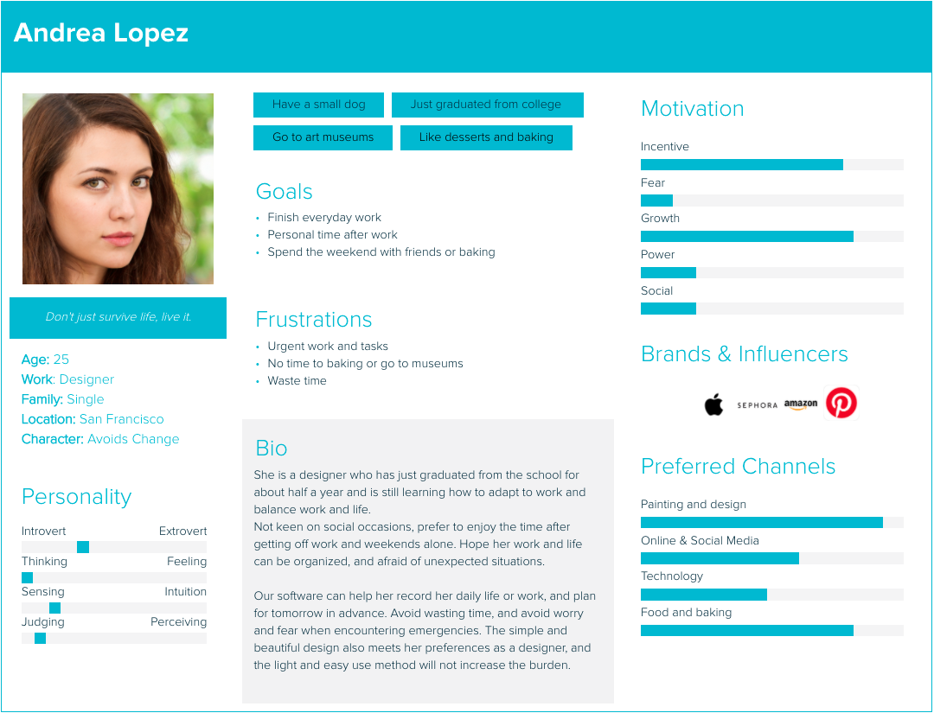
User Stories:

Slide 4
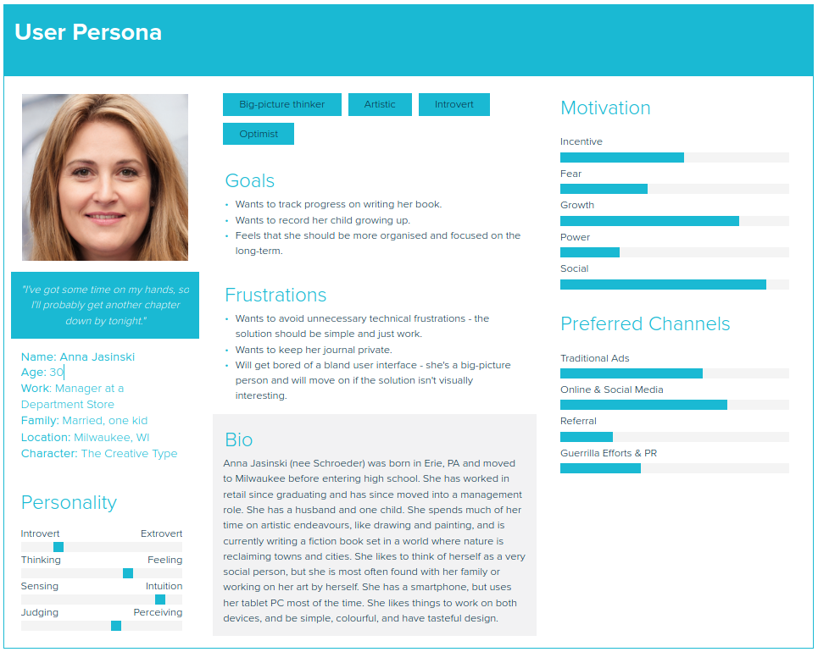
User Stories:

Slide 5
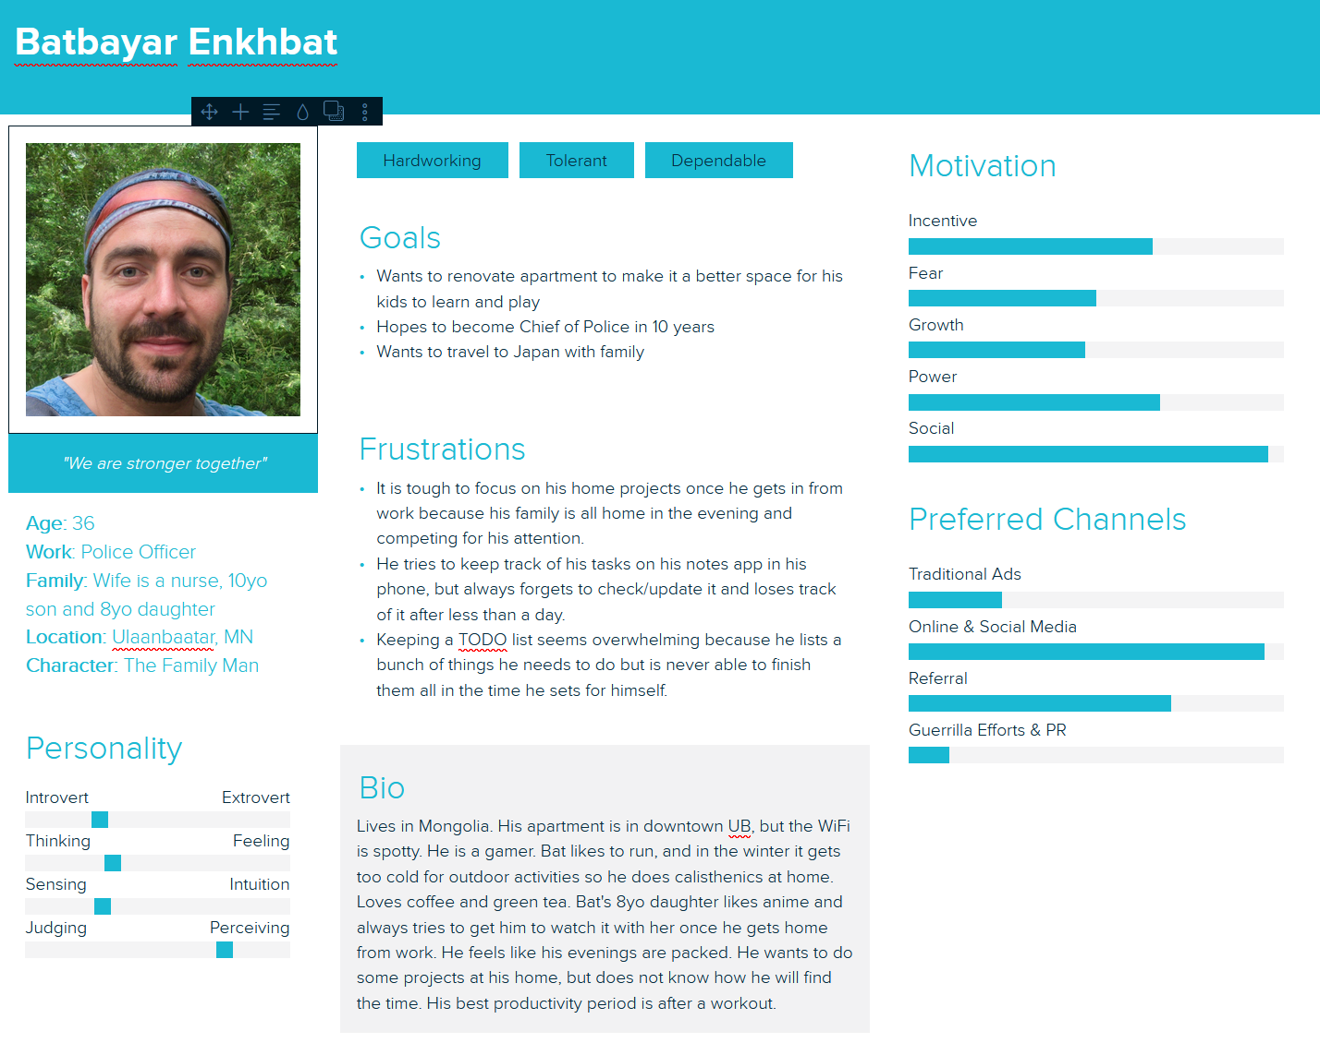
User Stories:

Slide 6
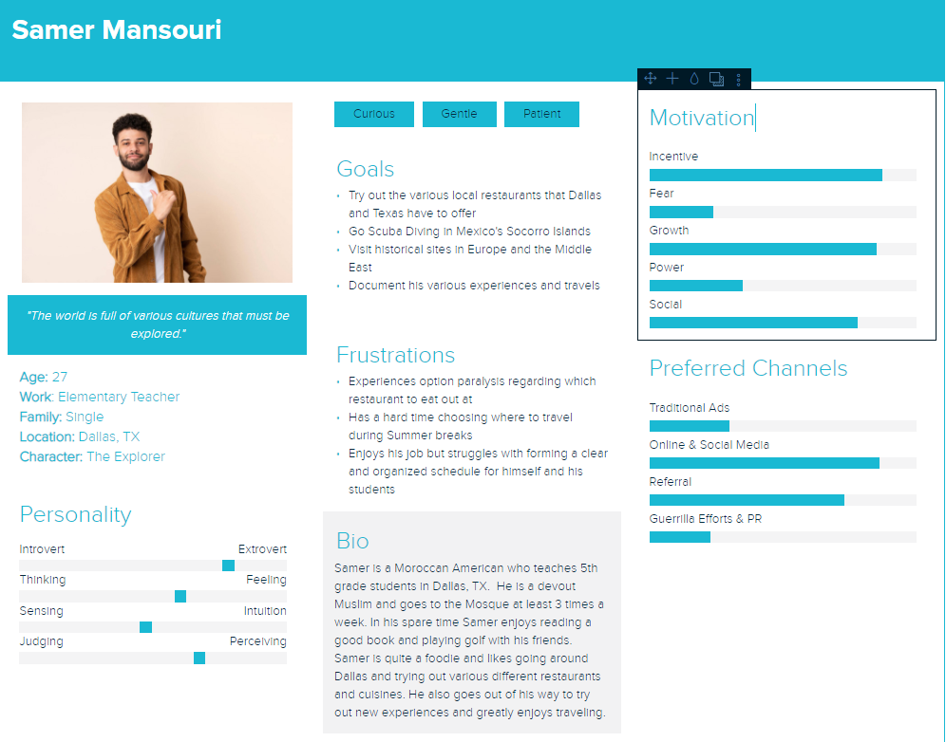
User Stories:

Slide 7
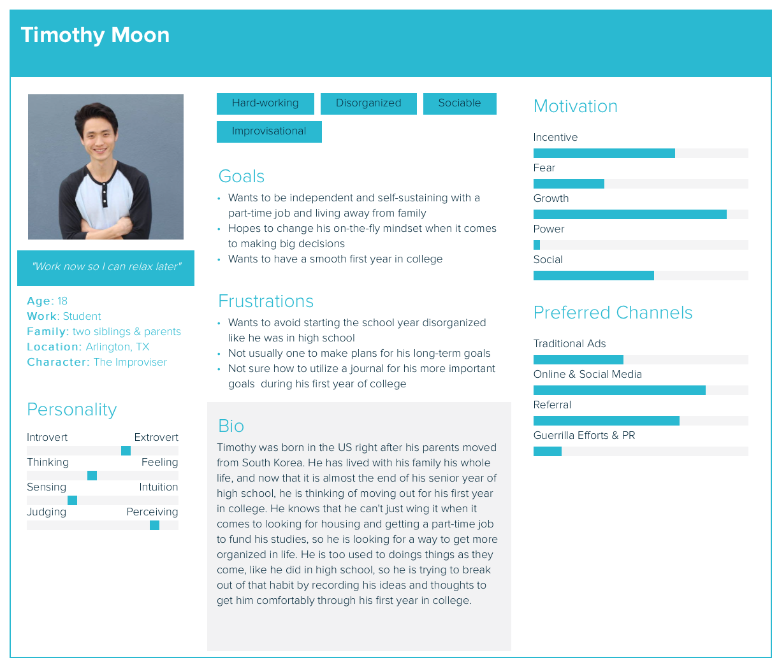
User Stories:

Slide 8
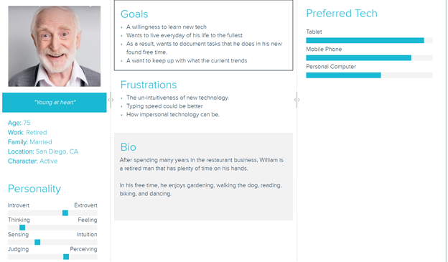
User Stories:

Slide 9
// TODO:
risks and rabbit holes
visual representations of what we are doing in the form of system diagrams and wireframes
Altogether 8 more slides

