Slide 1
CSE 110 · TEAM 5 · Team Status
AIT
01
Manager files issue
Assigns to human or agent
02
Agent claims it
Atomic lock — no race conditions
Agent Issue Tracker
03
Work gets done
Claude Code reads repo, writes code, opens PR
04
AIT logs everything
Tokens, time, full audit trail
05
Manager reviews + ships
Human always controls what merges
Team 5 · CSE 110 · Spring 2026

Slide 2
PROBLEM & SOLUTION
Why AIT Exists.
No agent-native tracker
THE PRODUCT
Jira, Linear, GitHub Issues are designed for humans only. Agents can't self-select work.
A website, built on Cloudflare, where issues get assigned to humans or agents. Pick your agent, it pulls context from the site, and the work gets done.
Zero cost visibility
No token or compute tracking. You can't budget what you can't measure.
List + Kanban
Agent JSON Endpoint
Human UI, drag-and-drop
GET/POST/PATCH typed schema
Race conditions
Claim-Locking
Token Tracking
No claim-locking. Multiple agents grab the same task simultaneously.
Atomic, no double-claims
Budget + actual per issue
Audit Log
Autonomy Modes
Every change logged
Suggest → Yolo tiers
Tool fragmentation
Solo builders need one unified view

Slide 3
TARGET USER
Solo dev.
Running the Whole Operation.
Solo Entrepreneur
Building a product with a small mixed team; humans and AI agents on the same backlog.
PAIN POINTS
NEEDS FROM AIT
→ No visibility into agent cost or output
✓ One place to file work and see its status
→ Can't tell if a task is stuck or quietly failing
✓ Atomic claim-locking; no double-work
→ No structured way to hand off work to agents
✓ Token cost visibility to budget agents
✓ Review gate before agent work ships

Slide 4
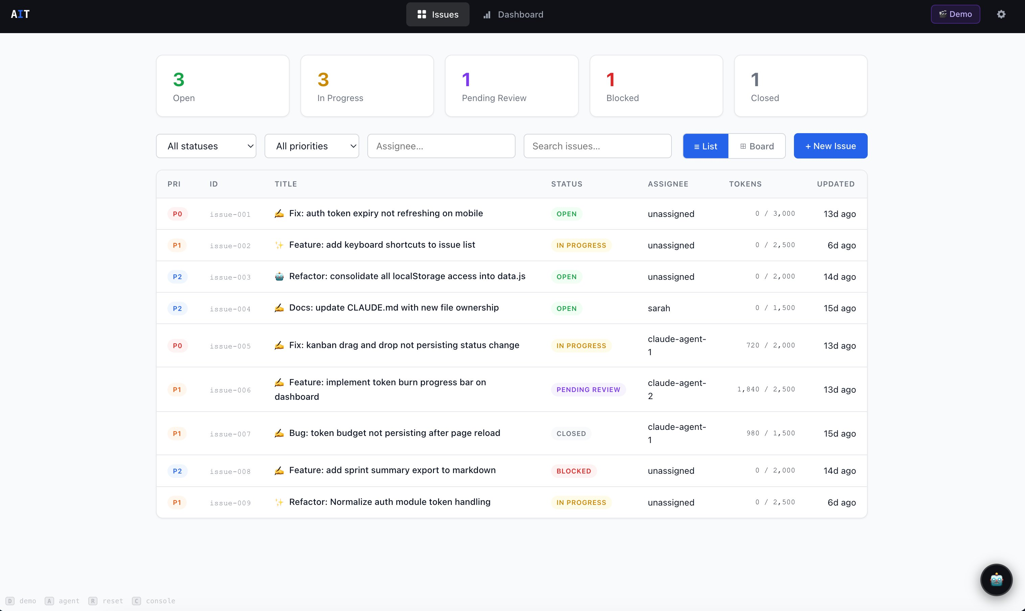
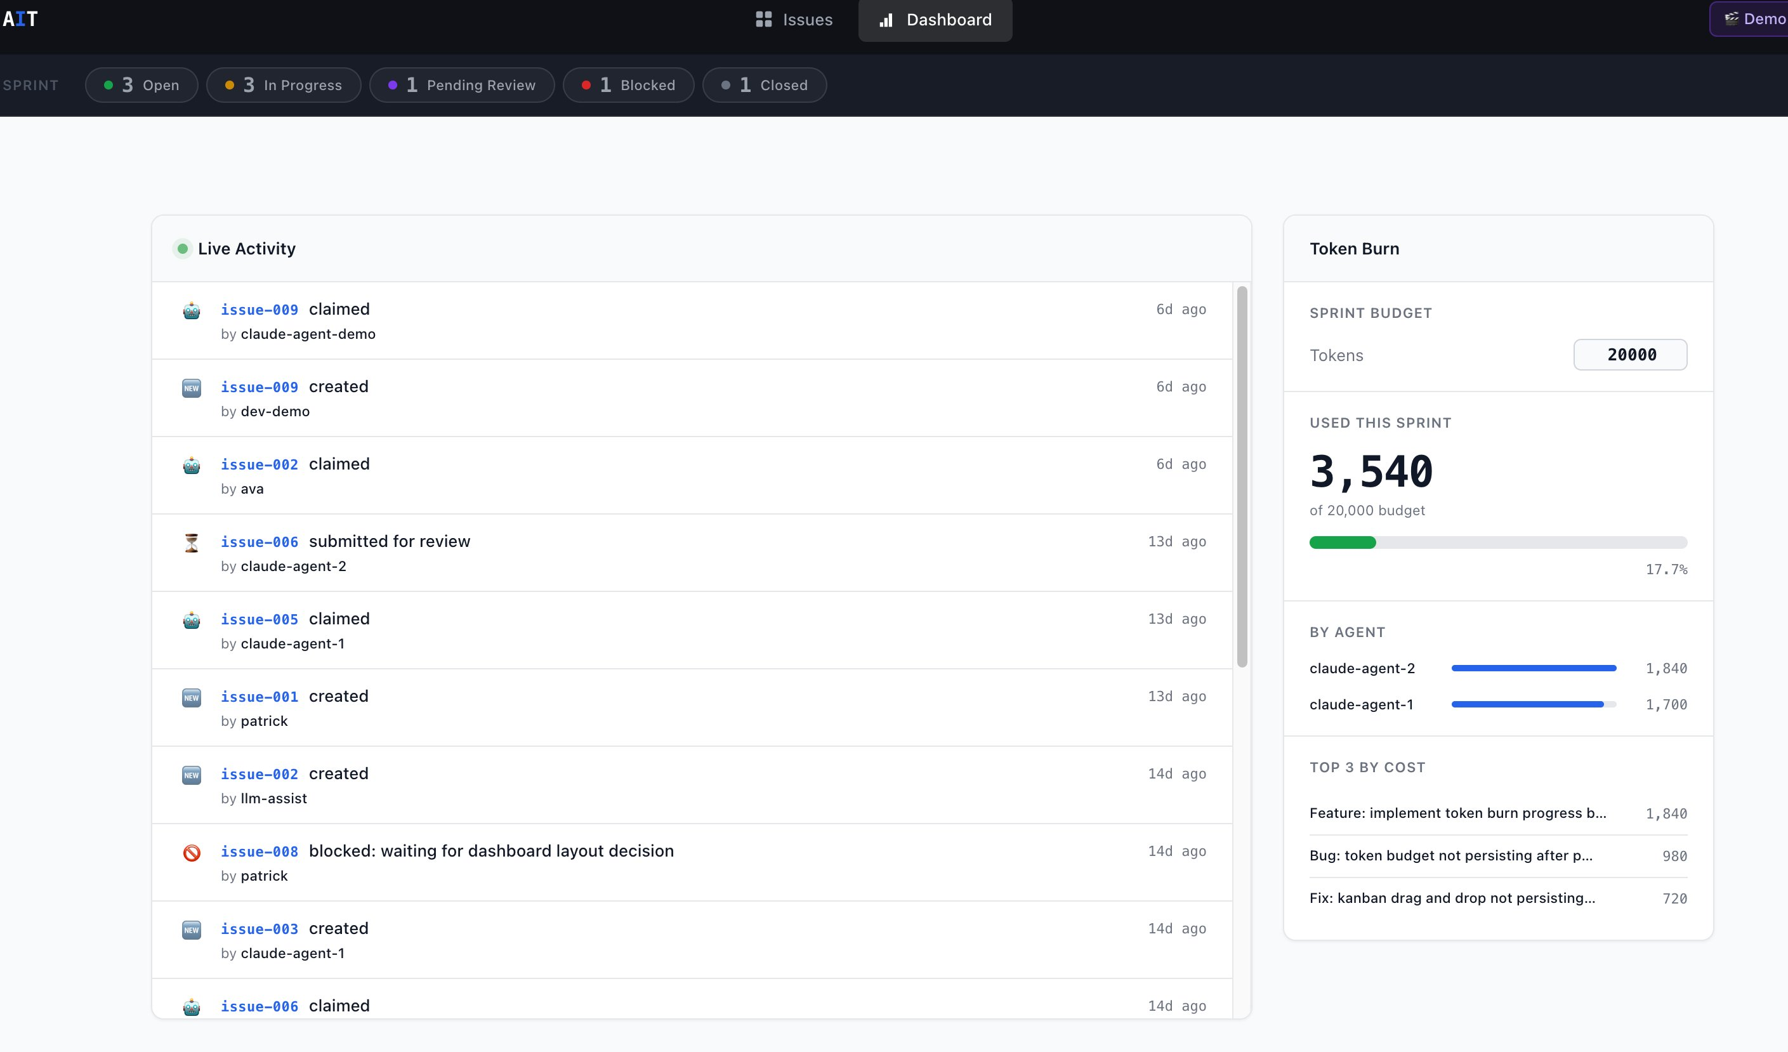
PROTOTYPE DEMO
Prototype.
Used Claude Code for generating a demo using our planned backlogs
Dashboard · Token Burn
Issue Board · List View

Slide 5
KEY DECISIONS
What Changed.
Architecture decisions made during Sprint 1 → Sprint 2.
Storage Layer
Data Layer
Schema Governance
PLANNED
PLANNED
PLANNED
localStorage for all issue data
data.js handling all logic
schema.md as a loose informal reference document
PROBLEM
PROBLEM
PROBLEM
AI agents cannot read localStorage without special browser permissions. Real agent integration was impossible
Static GitHub Pages site can't serve a real API. Agents had no way to poll for work over HTTP.
3 teams building on top of it with no enforcement. schema drift was causing inconsistencies across files.
DECISION
DECISION
DECISION
Migrated to Cloudflare Workers + KV. Real HTTP endpoints, shared state across users and agents. Documented in ADRs.
Replaced with workers.js on Cloudflare. All CRUD now goes through the Worker. Agents and frontend hit the same endpoints.
schema.md locked as source of truth. Any change now requires a new ADR.

Slide 6
Week 7/8 TEAM Status
Team Status.
Team 1 · Data & Workflow Core
Team 2 · Frontend & UX
Team 3 · Agent Workflow & DevOps
✓ Issue schema locked (schema.md)
✓ Low-fi wireframes
✓ /api/issues, /api/claim,
/api/complete
✓ CRUD: createIssue, getIssueById,
updateIssue, deleteIssue, claimIssue,
postResult, closeIssue, blockIssue
✓ Typography + color system
✓ Agent Simulator
✓ List view + Kanban layout
✓ Workflow states defined
✓ Cloudflare Workers + KV live
✓ Issue detail + modal structure
✓ API Contract
✓ UI helpers
✓ Dashboard + settings layout
✓ Filters + search
→ Connect simulator to issue state
→ Sample issue dataset
→ Connect API to frontend
→ Audit log structure
→ Token tracking + audit log
→ Filtering + sorting
→ Render real issue data
→ AIT Runner
→ Frontend/API integration support
→ Dashboard integration
→ UI cleanup

Slide 7
PROCESS HEALTH
Overall Progress.
Agile process completed past sprints.
✓
Standups
✓
Retrospectives
✓
Professor Check-in
3x per week · async Slack
Done / Doing / Blocked format
md files logged to repo
Run in Retrium each sprint
Team reflects on what went well
Action items tracked forward
Weekly TA meetings attended
Notes committed to /docs/
Check-Ins with stakeholders done
✓
8 ADRs
✓
Miro Boards
✓
CI/CD + Team Logs
Written in MADR format
On our repo under Docs/ADRs
Sprint board active
Backlog changes
Team aligned on priorities
ESLint + SemVer + Conventional
Commits enforced on all teams
docs/team-log maintained per team

