Slide 1
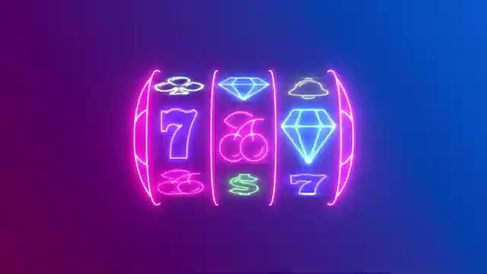
CSStress
Tech Warmup II - Generative AI as an Engineering Tool
Notes:
Hi, we're CSStress and yes, the name is accurate, we did stress about the this assignment.
This is our Tech Warmup II presentation, where we answer the question:
can you build a real, working app entirely through AI prompts?
Spoiler: yes. But also it tried to fight us. A lot.
Let's get into it.

Slide 2
CSStress
Raw Research
Persona Document:
Persona 1 - Casual Player
Timmy(20)
Wants fun, quick gameplay
Prefers simple controls
Avoids complex interfaces
Persona 2 - Competitive Player
Chad(30)
Wants to maximize winnings
Interested in advanced features
Plays longer sessions
User story:
As a casual player, I want simple controls so that I can start playing immediately.
As a competitive player, I want advanced features (multipliers, bonus rounds) so that the game stays engaging.
As a progression player, I want to unlock rewards so that I feel a sense of achievement over time.
Research Areas
Slot machine logic(Rng, Rtp, volatility)
Gameplay mechanics(wilds, multipliers, bonuses)
Visual design & sound effects
User types and behaviors
Game Features Identified
Progression systems & rewards
Bonus events and random triggers
Leaderboards & social elements
Custom themes and visual styles
User Research
Casual players → simple & low-risk gameplay
Social players → interaction & competition
Relaxation users → stress-free experience
Notes:
Before we even touched a single line of code, we performed detailed research on all sorts of slot machines: the logic behind the scenes, game mechanics, visual design, and user behavior to name a few.
We identified three types of users: casual players, competitive players, and people just looking to relax and have a good time.
That research directly shaped our personas and every AI prompt we wrote after.

Slide 3

CSStress
Personas
Research Overview
USER STORIES
As a chronic gambler, I want to place my own bets with massive returns so I win more than I started with
As an older player, I want fast, flashy, clearly communicated plays so I know exactly when I win or lose
As a bored young person used to modern games, I want overstimulation and instant gratification
SLOT MACHINE
Domain/Functionality: The Slot Machine will include a progression based feature that can entice casual players to engage in the slot machine, paired with theming that is freely chosen by the user to give them the feeling of choice.
Visuals: The Slot Machine will incorporate themes that have distinct variations from one another to broaden appeal. Specific bright colors shall also be used to help in communicating intended reactions.
Audio: The Slot Machine will incorporate an ambiance track and specific sound effects that help in eliciting specific feelings.
Code Specifications: Code should be considered “clean” meaning that the architecture, comments, avoidance of duplicate functions and corresponding test cases must be implemented.
Jonathan Shade 64 year old, retiree, overconfident after a divorce win. Wants big bets, pure luck, no progression systems (Owen Atis)
Unnamed casual first-timer found the app through an ad, not a gambler, just wants light entertainment (Alex Perelson)
Notes:
3. We have two personas: Johnathan Shade, 64 years old , a retiree who has recently gained a dangerous overconfidence about his luck.
He wants big bets, pure luck, and absolutely no progression systems. Patience is not a word in his vocabulary.
And then there's the unnamed casual first-timer who found the app through an ad, not a gambler, just curious. Relatable.
These two users pulled the design in completely opposite directions,
which showed us how the process of real product development works.
The domain specification came out of this step: our themes, audio, progression, and clean code are all required.

Slide 4
CSStress
AI Plan & AI Log
Prompt Examples:
Start:
Create a slot machine app that uses vanilla web technology like HTML, CSS, JavaScript, and platform APIs. The slot machine should make fun of AI, as in you are winning tokens and spending tokens.
Run #3
Review this slot machine app and improve its software engineering quality. Keep working features intact unless necessary. Refactor for meaningful names, smaller functions, less duplicate code, and clearer modular structure. Add JSDoc comments with type annotations for the main JavaScript functions. Help handle simple edge cases and errors. Add or suggest basic unit tests for the core game logic and token system. Also help prepare the code so it can pass linting and validation checks for HTML, CSS, and JavaScript.
Run #10
Take this application and make the following changes: For the How to Play and Mechanics Explanation section, Give it its own Icon and make it minimizable, have it as a modal that is clickable by the user in order to prompt a pop-up instead of it constantly being visible. For the theme switch section, give it its own area on the left side. For the risk board, add the icons associated with the conditions. Include a settings bar that allows the user to change the theme and volume of the game. Remove the text underneath each symbol of the reel. Universal Icons for specific case point combinations, as an example the Cherry, Diamond and Lucky 7 symbols are shared across all themes. Change the color of “Theme Slot Cabinet” so that it is more visible. Change the music based off of the given theme that is currently selected. Ensure that the theme is not 12 notes repeated constantly.
Tools and Approach:
Using OpenAI Codex as our main tool
Work in small steps, not one big prompt
Keep same changes unless we clearly log changes
3-Step Process:
Build Base Version
Generate simple working slot machine (HTML, CSS, JS)
Improve with Research
Make it fun, casual, low-risk
Add visuals, feedback, progression
Refactor & Test
Clean code and better structure
Handle edge cases
Add comments and basic tests
How We Use AI:
Prompt → Test → Log Results
Track: what worked, failed, learned
Goal: Build a fun app while showing a clear, iterative AI workflow
Notes:
Here was our approach: we used OpenAI Codex, small steps, and a strict Prompt → Test → Log cycle every run.
Three stages
First we build a base, then - improve with research, finally refactor and test.
The prompts grew with the project. First Run was simple make a slot machine . By Run 3 we were asking for JSDoc annotations, modular structure, and unit tests. By Run 10 we were sending
detailed instructions covering modals, themes, audio, and icon changes all at once.

Slide 5
BUSINESS ROADMAP
CSStress
The 20 Runs - Key Miliestions
Run 1-2
Token Furnace 3000. Basic slot machine with AI token theme, colorful UI, intro copy.
Run 3
game-logic.js extracted. JSDoc type annotations, modular pure functions, unit tests added.
Run 4-5
Theme system added (Lantern Festival, Riviera Postcards, Oasis Caravan). Per-theme symbols and jackpot rules.
Run 6
Vault mechanic introduced. 24-spin bonus threshold, 150-token reward. Progress can drop backwards or fully reset on bad combos.
Run 7-9
Mechanics panel, side layout. Web Audio API sound engine per-theme ambient music and per-action sound effects.
Run 10-12
Help modal with live rules added, renamed to Lucky Spin Casino, and game-modes.js introduced 3-Reel & 5-Reel modes
Run 13-16
Spin animation with reel-window CSS, mode locking during spin, performance-safe getNow() fallback, serif/display fonts introduced.
Run 17-20
Recent spins history panel added. Symbol visual tuning. ARIA improvements. CSS grid layout fixes for reel centering.
Notes:
The 20 Runs
Here are the highlights.
Runs 1–2: basic slot machine, AI token theme.
Run 3: We pulled out the game-logic, added JSDoc type annotations, unit tests and basically gave the app a backbone.
Runs 4 and 5: Added three full themes - Lantern Festival, Riviera Postcards, Oasis Caravan.
Run 6: vault mechanic with push-your-luck risk.
Runs 7 to 9: Web Audio API. The app now has a soundtrack. Multiple soundtracks, actually.
Runs 10 to 12: added live rules, renamed our slot machine to Lucky Spin Casino, and created two game modes.
Runs 13–20: focused on animation, layout fixes, and reel centering — which took more runs than we expected.

Slide 6
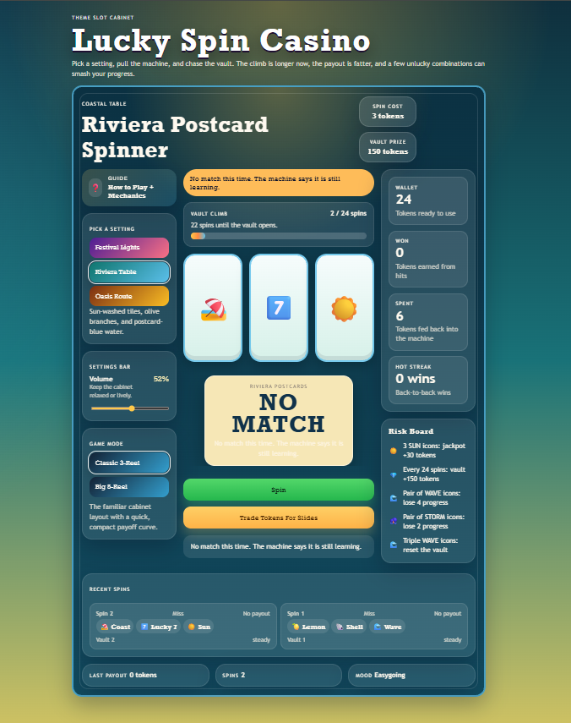
CSStress
Lucky Spin Casino (Final Product)
2 Game Modes: Classic 3-Reel (jackpot needs 3 matches) and Big 5-Reel (jackpot needs 5 matches)
3 Themes:
Lantern Festival
Riviera Postcards
Oasis Caravan
unique symbols and ambient audio per theme.
Vault Mechanic: 24-spin climb to 150-token prize progress can slip backward or fully reset on bad combos
Audio: Web Audio API theme-based ambient music and per-action sound effects
Code Quality:
game-logic.js (503 lines)
game-modes.js (42 lines)
script.js (1903 lines)
3 test files (254 lines total)
Notes:
Finally, our ultimate product. Our Lucky Spin Casino has 2 game modes: the Classic 3-Reel where winning a jackpot requires 3 matches and then the Big 5-Reel (shoutout to my dad’s favorite store). To spice up the ambiance, we have provided 3 different themes for you all: we got the Lantern Festival (in honor of our happy Chinese friends), and we also got Riviera Postcards and the Oasis Caravan. Variety is a priority! Next we have the vault mechanic, which rewards patience (unless you get a not so fortunate combo and happen to lose all of your progress). And the code? We got over 2,700 lines of JavaScript, all structured, all documented, all tested.
A long ways away from Token Furnace 3000.

Slide 7
CSStress
Takeaways
01
Precision beats luck
Specific prompts with exact line numbers and device constraints gave clean targeted changes
02
AI excels at features, struggles at layout
Audio and themes built fast. Reel centering took 7+ attempts across runs 7–20
03
Testing is non-negotiable
Modular architecture from run 3 kept the engine stable through 17 more iterations
04
Context compounds
Feeding the previous run’s changes into the next prompt prevented Codex from regressing
05
Human judgment is the real driver
Every improvement came from a team member observing the product and asking the right question
Notes:
So what did we actually learn?
One: precision beats luck; the more specific the prompt, the cleaner the output.
Two: AI is great with features, but not so much with layout.
Reel centering? We fought that across multiple runs and it still had opinions.
Three: Modular code from run 3 kept everything stable for 17 more runs. Amazing!
Four: We found that feeding each run's changes into the next prompt
stopped Codex from forgetting what it had already built.
And five maybe the most important one: human judgment is the real driver.
Every improvement came from someone on the team actually looking at the product
and asking the right question.
AI does the work. We do the thinking. That's the warmup. Though we’re overheating a bit over here.

