Slide 1
MemeBro
Sprint Status Video 1
CSE 110 · Spring 2026 · Group 16
2026-05-20
Notes:
Hi, we're group 16 and this is our mid-quarter status update on MemeBro, our AI-assisted meme generator. In the next four minutes we'll cover what we've built, how our team actually works, what we got wrong along the way, and what's coming next.

Slide 2
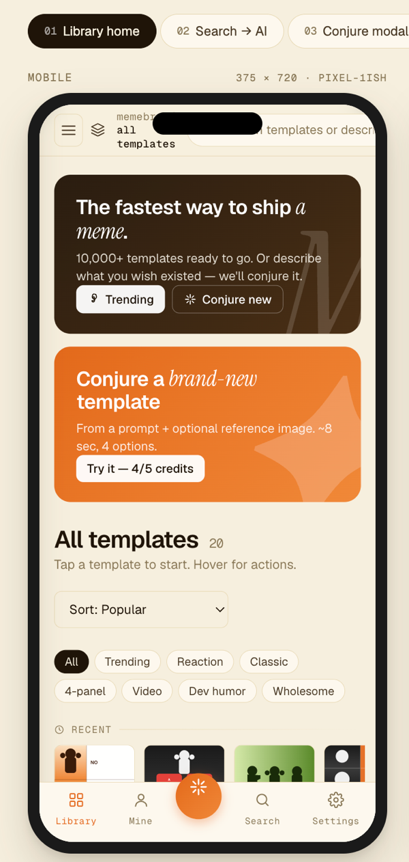
What we're building
● Pick a meme template
● Type a vibe, AI suggests a caption
● Save it to your personal gallery
● Mobile first, runs entirely in the browser
Library Home, mobile
MemeBro · CSE 110 Group 16 · Sprint Status Video 1
2 / 8
Notes:
MemeBro is a web app where you pick a meme template, describe the vibe you want, and our AI suggests a caption. You can save what you make in a personal gallery. It's mobile first, no install, runs entirely in the browser today. Our target user is anyone who wants to make a quick joke without learning a design tool.

Slide 3
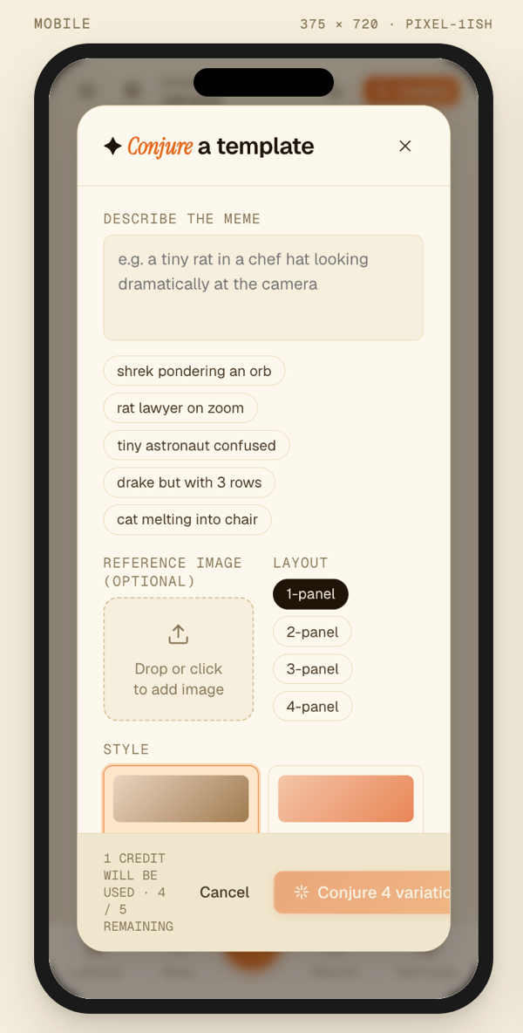
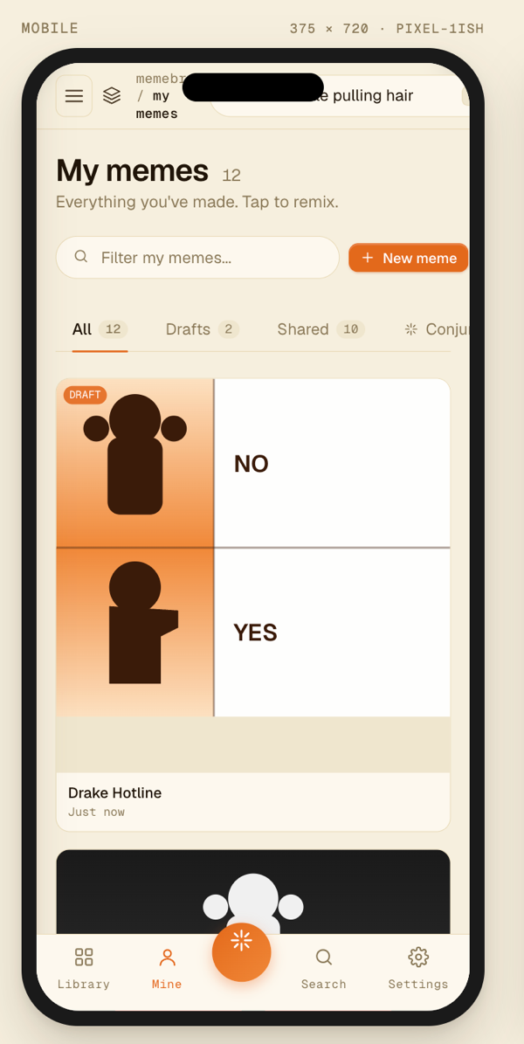
Where we are
● 5 active PRs across all 4 lanes, all in review
● Gallery, conjure UI, home page, ImgFlip fetch in flight
● Design system tokens and AGENTS.md already merged
● 3 ADRs published: stack, hosting, backend strategy
● Deployment is sprint 3 day 1 (Cloudflare Pages setup in flight)
Library
Conjure
My Memes
MemeBro · CSE 110 Group 16 · Sprint Status Video 1
3 / 8
Notes:
We're at the walking skeleton stage. All four of our lanes have work in flight, with five active pull requests in review right now: the template gallery component, the conjure page UI, the home page layout, the ImgFlip API integration, and the CI/CD pipeline. We've also published three architecture decision records covering our stack, hosting, and backend strategy. Deployment itself is the first thing we land in sprint 3, on Cloudflare Pages.

Slide 4
CI/CD pipeline
● Lint, unit tests, end-to-end on every push and every PR
● Nothing merges to main without green checks
● Branch protection on main, PR only path
● Deploy target: Cloudflare Pages (sprint 3)
● Pipeline in final review, lands this week
Push
→
Lint
→
Unit
→
E2E
→
Deploy
MemeBro · CSE 110 Group 16 · Sprint Status Video 1
4 / 8
Notes:
Our CI/CD pipeline is built and in final review this week. Once merged, every push and every pull request runs lint, unit tests, and end-to-end tests. Nothing merges to main without all gates green, and main is already protected so the only path in is a reviewed pull request. We pivoted our hosting target from GitHub Pages to Cloudflare Pages this sprint because Pages Functions gives us a clean path to the AI proxy backend without changing how we deploy.

Slide 5
How we actually work
● Project lead + 4 lanes of 2 (frontend, backend, testing/docs, design)
● Standups at least 3 per week, all logged in the repo
● Weekly TA meeting with action items tracked
● All decisions land in ADRs, not Slack
● AGENTS.md keeps human and AI code consistent
● GitHub Issues are the source of truth, not Slack
Project Lead
Frontend
Backend
Testing & Docs
Design
MemeBro · CSE 110 Group 16 · Sprint Status Video 1
5 / 8
Notes:
Process is what makes a ten person team actually ship. We're organized as a project lead plus four lanes of two for the build sprints: frontend, backend, testing and docs, and design. Standups happen at least three times a week and every one of them is logged in our repo. We meet with our TA every week with formal action items captured each session. All architectural decisions get written up as ADRs instead of being talked through in Slack. We also wrote an AGENTS.md file that defines our coding norms so humans and AI agents writing code stay consistent across the codebase. Our issue tracker is the source of truth and Slack is just where we coordinate.

Slide 6
Challenges, and how we navigated them
Challenge
How we navigated it
Backend stack decision was non-trivial
Structured deferral ADR with a re-decision date
Hosting target evolved with AI integration shape
Pivoted to Cloudflare Pages, captured in an ADR
Testing infrastructure was bigger than one issue
Split into lint, unit, and end-to-end sub-issues
Coordinating AI-assisted code across many contributors
AGENTS.md as a shared contract for the codebase
Cross-team PR review at scale
24 hour review SLA + lane Slack channels
MemeBro · CSE 110 Group 16 · Sprint Status Video 1
6 / 8
Notes:
Every team hits real friction, and ours has been around making hard decisions cleanly. The backend stack was a non-trivial choice between static-only, serverless functions, and a full backend, so instead of picking one prematurely we wrote a structured deferral ADR with a clear re-decision date. As our AI integration came into focus, we realized our original hosting target wasn't the right fit and pivoted to Cloudflare Pages, with the rationale captured in an ADR. Our testing infrastructure work was larger than a single issue, so we split it into lint, unit, and end-to-end sub-items that can ship in parallel. With multiple contributors using AI assistants on the same repo, we wrote AGENTS.md as a shared contract to keep style and conventions coherent. And we set a 24 hour review SLA with lane-specific Slack channels so pull requests don't sit in queue.

Slide 7
AI usage
Pros
Cons
How we mitigate
● Faster scaffolding (AGENTS.md, tokens, ADR drafts)
● Cleaner JSDoc coverage across the codebase
● Meeting transcripts to structured notes
● Agents follow our written conventions
● Will invent abstractions if not constrained
● Output needs human review before commit
● Easy to over-document and create noise
● AGENTS.md acts as a contract for AI agents
● JSDoc lint enforces consistency
● Human author owns and reviews every PR
MemeBro · CSE 110 Group 16 · Sprint Status Video 1
7 / 8
Notes:
AI has been a real force multiplier. We use it for scaffolding, drafting ADRs, transcribing meeting notes, and keeping our documentation in shape. The cons are real though. Agents will invent abstractions if you let them, output needs human review before merge, and it's very easy to over-document. We mitigate by treating AGENTS.md as a contract that bounds what AI does, by enforcing JSDoc through lint, and by requiring the human author to own and review every PR.

Slide 8
What's next
● Sprint 3: Cloudflare Pages deploy live, AI proxy, end-to-end flow, test coverage
● Sprint 4: polish, accessibility pass, final presentation prep
● Working end-to-end demo by sprint 3 close
● Full product walkthrough at the final presentation
Sprint 3
Sprint 4
Final
Deploy + AI proxy
Polish + a11y
Product walkthrough
Thanks, Group 16.
MemeBro · CSE 110 Group 16 · Sprint Status Video 1
8 / 8
Notes:
Sprint 3 starts Sunday. Day one we land the Cloudflare Pages deploy so we have a live URL. From there we stand up the AI proxy on Pages Functions, wire the full end-to-end meme flow, and bring test coverage up across the components we've already shipped. Sprint 4 is polish, an accessibility pass, and final presentation prep. By the close of sprint 3 we'll have a working end-to-end demo, and we'll bring a full product walkthrough to the final presentation. Thanks for watching.

