Slide 1
Computer Graphics
Lecture-Introduction
Dr. Mousumi Dutt
CSE, STCET

Slide 2
Program Outcome (PO)
Engineering Knowledge: Apply knowledge of engineering fundamentals, basic sciences and mathematical tools, to study, analyze and solve problems in Computer Science.
Problem Analysis: Identify the problems, analyze and interpret data, design optimal and efficient algorithms and apply the research skills to solve complex problems.
Design/Development of Solutions: Design and develop system components and process flows to design and implement solutions for automation of systems in real world for the betterment of health and safety, cultural and social causes.
Conduct Investigations of complex problems: Develop fault finding and generate test cases for different design and system levels using best engineering practices, research based knowledge and analyze results to draw conclusions.
Modern tool usage: Use modern software and hardware technologies tools for modeling and simulating real world projects.
The engineer and society: Distribute responsibilities relevant to the best engineering practice in automating and simulating projects in the fields of education, society, industry and cultural issues.
Environment and sustainability: Understand the impact of the engineering based automations and solutions in environmental and societal contexts and demonstrate the knowledge towards the need for sustainable development and support.
Ethics: Apply ethical principles and commit to professional ethics and responsibilities and norms of the engineering practice.
Individual and team work: Facing the challenge and inculcating a strong problem solving attitude, along with being a good team member/leader who can communicate well in multidisciplinary settings.
Communication: Comprehend, analyze and formulate technical reports. Design formal reports, make efficient presentations, execute instructions from seniors and optimally distribute work load to juniors.
Project Management and Finance: Demonstrate knowledge and understanding of the engineering and management principals in implementing project planning, staffing, and scheduling, preparing cost estimation reports and handle other financial aspects to manage projects as a member/leader of a team.
Lifelong learning: Recognize the need and preparation for technological upgradation with the advancement of technology.

Slide 3
Program Educational Objectives (PEOs)
To educate students to solve the problems for analysis and implementation of algorithms leading to optimal solutions fulfilling the dynamic requirement of industry and society.
To inculcate into students the understanding of Computer Science and Engineering for grooming would be practicing engineers with sound knowledge of logic and design.
To execute research in emerging fields in computer science and engineering so as to face the challenges of global competitiveness.

Slide 4
Program Specific Outcomes (PSOs)
PSO1: Programming and Logic: Apply fundamental knowledge of basic sciences and programming aptitude to identify and define the computing systems.
PSO2: Design and Analysis: Analyze the mathematical foundations, algorithmic principles, computer science theory for the modeling and design in a way that demonstrates the construction of software systems of varying complexity.
PSO3: Applications of Computing: Prepared to work professionally in software industries, research and development using the modern tools.

Slide 5
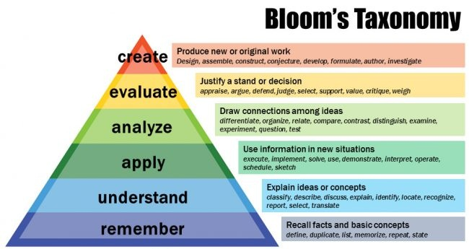

Slide 6
Pre-requisites
CS 201 (Basic Computation and Principles of C)
M101 & M201 (Mathematics) basics of set theory
CS 302 (Data Structures and Algorithm)
CS 501 (Design and Analysis of Algorithms)

Slide 7
Syllabus
Module I:
Introduction to computer graphics & graphics systems [6L]: Overview of computer graphics, representing pictures, preparing, presenting & interacting with pictures for presentations; Visualization & image processing; RGB color model, direct coding, lookup table; storage tube graphics display, Raster scan display, 3D viewing devices, Plotters, printers, digitizers, Light pens etc.; Active & Passive graphics devices; Computer graphics software.
Scan conversion [8L]: Points & lines, Line drawing algorithms; DDA algorithm, Bresenham’s line algorithm, Circle generation algorithm; Ellipse generating algorithm; scan line polygon, fill algorithm, boundary fill algorithm, flood fill algorithm.

Slide 8
Syllabus
Module II:
2D transformation & viewing [15L]: Basic transformations: translation, rotation, scaling; Matrix representations & homogeneous coordinates, transformations between coordinate systems; reflection shear; Transformation of points, lines, parallel lines, intersecting lines. Viewing pipeline, Window to view port co-ordinate transformation, clipping operations, point clipping, line clipping, clipping circles, polygons & ellipse. Cohen and Sutherland line clipping, Sutherland-Hodgeman Polygon clipping, Cyrus-beck clipping method
3D transformation & viewing [5L]: 3D transformations: translation, rotation, scaling & other transformations. Rotation about an arbitrary axis in space, reflection through an arbitrary plane; general parallel projection transformation; clipping, view port clipping, 3D viewing.

Slide 9
Syllabus
Module III:
Curves [3L]: Curve representation, surfaces, designs, Bezier curves, B-spline curves, end conditions for periodic B-spline curves, rational B-spline curves.
Hidden surfaces [3L]: Depth comparison, Z-buffer algorithm, Back face detection, BSP tree method, the Painter’s algorithm, scan-line algorithm; Hidden line elimination, wire frame methods , fractal - geometry.
Color & shading models [2L]: Light & color model; interpolative shading model; Texture.
Introduction to Ray-tracing: [3L]
Human vision and color, Lighting, Reflection and transmission models.

Slide 10
Recommended Books
D. Hearn, M. P. Baker – “Computer Graphics (C version 2nd Ed.)” – Pearson education
J. M. Foley, A. V. Dam, S. K. Feiner, J. F. Hughes- Computer Graphics Principles and Practice- Pearson
Z. Xiang, R. Plastock – “ Schaum’s outlines Computer Graphics (2nd Ed.)” – TMH
D. F. Rogers, J. A. Adams – “Mathematical Elements for Computer Graphics (2nd Ed.)” – TMH
S. Harrington – Computer Graphics, A Programming Approach
D. P. Mukherjee – Fundamentals of Computer Graphics and Multimedia

Slide 11
Course Objective
Students should:
Understand the basics of computer graphics, different graphics systems and applications of computer graphics.
Discuss various algorithms for scan conversion and filling of basic objects and their comparative analysis.
Use of geometric transformations on graphics objects and their application in composite form.
Extract scene with different clipping methods and its transformation to graphics display device.
Explore projections and visible surface detection techniques for display of 3D scene on 2D screen.
Render projected objects to naturalize the scene in 2D view and use of illumination models for this.

Slide 12
Course Outcome
Upon successful completion of the course, the student will be able to:
The foundations of computer graphics and the basics of contemporary graphics hardware and applications. (PO – 1, 2, 12)
To understand concept of geometric, mathematical and algorithmic concepts necessary for programming computer graphics. (PO – 1, 2, 3, 12)
To write programs to implement scan conversion and filling of basic objects, transformations of objects (2D and 3D), clipping methods, visible surface detection, etc. (PO – 1, 2, 3, 5, 12).
To demonstrate an understanding of the use of object hierarchy in graphics applications. (PO – 1, 3, 12)

Slide 13
Evaluation Details
Attendance
Internal Assessment (Interactions in the class)
Two Assignments (may include programming)
Two Internal Examinations (each of 50 Marks)
Final Semester Examination (70 Marks)

