Slide 1
Computer Graphics
Introduction to Computer Graphics and Graphics Systems
Dr. Mousumi Dutt
CSE, STCET

Slide 2
Introduction
Computer Graphics is the illustration field of Computer Science. Its use today spans virtually all scientific fields and is utilized for design, presentation, education and training. Computer Graphics and its derivative, visualization, have become the primary tools by which the flood of information from Computational Science is analyzed.
The effective construction of three-dimensional computer-generated illustrations is not only a computer science problem, it is a problem that involves other fields as well.
For example, It depends heavily on mathematics for its geometric basis and computational algorithms, and it depends on Physics for its principles of geometric optics (the reflection of light from surfaces determines the displayed color of the surface).
It is also the study of a field that provides methods by which illustrations can be generated by others.

Slide 3
Uses of Computer Graphics
User Interfaces
(Interactive) plotting in business, science, and technology
Office automation and electronic publishing
Computer-aided drafting and design
Simulation and animation for scientific visualization and entertainment
Art and commerce, Education and Training
Computer Art
Entertainment
Visualization
Image Processing
Process control
Cartography

Slide 4
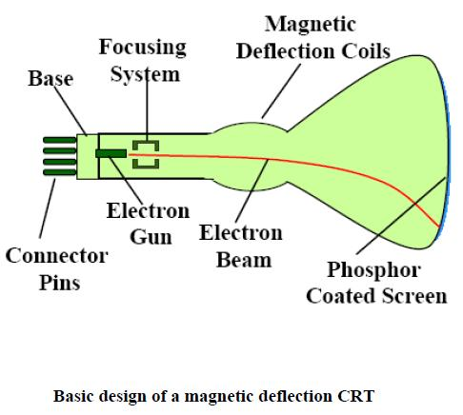
Graphics Hardware
Video Display Devices --- cathode-ray tube (CRT)
Basic design of magnetic –deflection CRT

Slide 5
Refresh Cathode-Ray Tubes
A beam of electrons (cathode rays)
emitted by an electron gun
passes through focusing and deflection systems
that direct the beam toward specified positions on the phosphor-coated screen
The phosphor then emits a small spot of light
at each position contacted by the electron beam.
The light emitted by the phosphor fades very rapidly
phosphor glowing -> redraw the picture repeatedly by quickly directing the electron beam back over the same points
This type of display is called a refresh CRT

Slide 6
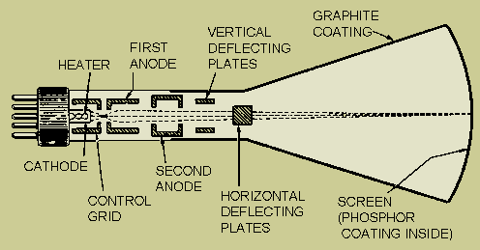
Component of Electron Gun
Heated Metal Cathode
A Control Grid

Slide 7
Working Principle of Electron Gun
Heat is supplied to the cathode by directing a current through a coil of wire, called the filament, inside the cylindrical cathode structure
This causes electrons to be “boiled off" the hot cathode surface
In the vacuum inside the CRT envelope, the free, negatively charged electrons are then accelerated toward the phosphor coating by a high positive voltage
The accelerating voltage can be generated with a positively charged metal coating on the inside of the CRT envelope near the phosphor screen
Sometimes the electron gun is built to contain the accelerating anode and focusing system within the same unit

Slide 8
Working Principle of Electron Gun
Control Grid: metal cylinder that fits over the cathode
Intensity of the electron beam is controlled by setting voltage levels on the control grid
A high negative voltage applied to the control grid will shut off the beam by repelling electrons and stopping them from passing through the small hole at the end of the control grid structure.
A smaller negative voltage on the control grid simply decreases the number of electrons passing through.
Since the amount of light emitted by the phosphor coating depends on the number of electrons striking the screen, we control the brightness of a display by varying the voltage on the control grid

Slide 9
Working Principle of Electron Gun
Focusing:
to force the electron beam to converge into a small spot as it strikes the phosphor
Otherwise, the electrons would repel each other, and the beam would spread out as it approaches the screen
Focusing is accomplished with either electric or magnetic fields
Electrostatic focusing is commonly used in television and computer graphics monitors
electron beam passes through a positively charged metal cylinder that forms an electrostatic lens

Slide 10
Focusing
Additional focusing hardware is used in high-precision systems to keep the beam in focus at all screen positions
The distance that the electron beam must travel to different points on the screen varies because the radius of curvature for most CRTs is greater than the distance from the focusing system to the screen center.
Therefore, the electron beam will be focused properly only at the center of the screen.
As the beam moves to the outer edges of the screen, displayed images become blurred.
To compensate for this, the system can adjust the focusing according to the screen position of the beam.

Slide 11
Electrostatic deflection of the electron beam in a CRT
Deflection of the electron beam can be controlled either with electric fields or with magnetic fields
CRT are now commonly constructed with magnetic deflection coils mounted on the outside of the CRT envelope
Two pairs of coils are used, with the coils in each pair mounted on opposite sides of the neck of the CRT envelope
One pair is mounted on the top and bottom of the neck
The other pair is mounted on opposite sides of the neck
The magnetic, field produced by each pair of coils results in a transverse deflection force that is perpendicular both to the direction of the magnetic field and to the direction of travel of the electron beam.
Horizontal deflection is accomplished with one pair of coils, and vertical deflection by the other pair.
The proper deflection amounts are attained by adjusting the current through the coils.
When electrostatic deflection is used, two pairs of parallel plates are mounted inside the CRT envelope.
One pair of plates is mounted horizontally to control the vertical deflection, and the other pair is mounted vertically to control horizontal deflection

Slide 12
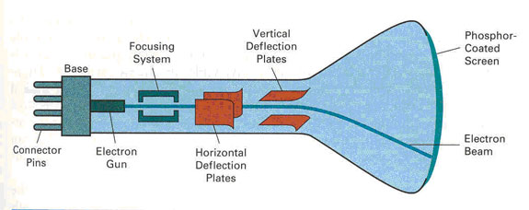
Electrostatic deflection of the electron beam in a CRT

Slide 13
Cathode-Ray Tubes
When the electrons in the beam collide with the phosphor coating, they are stopped and their kinetic energy is absorbed by the phosphor.
Part of the beam energy is converted by friction into heat energy
The remainder causes electrons in the phosphor atoms to move up to higher quantum-energy levels.
After a short time, the “excited” phosphor electrons begin dropping back to their stable ground state, giving up their extra energy as small quantums of Light energy.
What we see on the screen is the combined effect of all the electron light emissions: a glowing spot that quickly fades after all the excited phosphor electrons have returned to their ground energy level
The frequency (or color) of the light emitted by the phosphor is proportional to the energy difference between the excited quantum state and the ground state.

Slide 14
Different kinds of Phosphor: persistence
Persistence is defined as the time it takes the emitted light from the screen to decay to one-tenth of its original intensity
Lower persistence phosphors require higher refresh rates to maintain a picture on the screen without flicker
A phosphor with low persistence is useful for animation
A high-persistence phosphor is useful for displaying highly complex, static pictures
Although some phosphors have a persistence greater than 1 second, graphics monitors are usually constructed with a persistence in the range from 10 to 60 microseconds.

Slide 15
Resolution
The maximum number of points that can be displayed without overlap on a CRT is referred to as the resolution
number of points per centimeter that can be plotted horizontally and vertically although it is often simply stated as the total number of points in each direction
The resolution of a CRT is dependent on
The type of phosphor
The intensity to be displayed
The focusing and deflection systems.
Typical resolution on high-quality systems is 1280 by 1024, with higher resolutions available on many systems
High resolution systems are often referred to as high-definition systems.
The physical size of a graphics monitor is given as the length of the screen diagonal, with sizes varying from about 12 inches to 27 inches or more.
A CRT monitor can be attached to a variety of computer systems, so the number of screen points that can actually be plotted depends on the capabilities of the system to which it is attached.

Slide 16
Aspect Ratio
The ratio of vertical points to horizontal points necessary to produce equal-length lines in both directions on the screen.
(Sometimes aspect ratio is stated in terms of
the ratio of horizontal to vertical points)
An aspect ratio of 3/4 means that a vertical line plotted with three points has the same length as a horizontal line plotted with four points

Slide 17
Raster Scan Display
The electron beam is swept across the screen, one row at a time from top to bottom
The beam intensity is turned on and off to
Create a pattern of illuminated spots
Picture definition is stored in a memory area called the refresh buffer or frame buffer
holds the set of intensity values for all the screen points
Stored intensity values are then retrieved from the refresh buffer and "painted" on the screen one row (scan line) at a time
Each screen point is referred to as a pixel or pel (shortened fonns of picture element).
The capability of a raster-scan system to store intensity information for each screen point makes it well suited for the realistic display of scenes containing subtle shading and color patterns

Slide 18
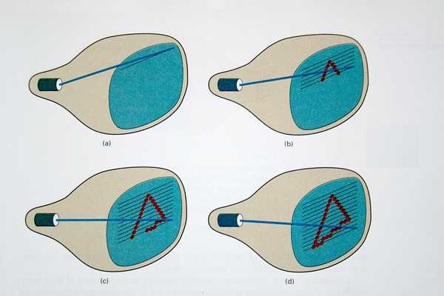
Raster Scan Display

Slide 19
Raster Scan Display
For black-and-white system (bilevel image)
a bit value of 1 indicates that the electron beam is to be turned on at that position
a value of 0 indicates that the beam intensity is to be off
A system with 24 bits per pixel and a screen resolution of 1024 by 1024 requires 3 megabytes of storage for the frame buffer.
On a black-and-white system with one bit per pixeI, the frame buffer is commonly called a bitmap
For systems with multiple bits per pixel, the frame buffer is often referred to as a pixmap

Slide 20
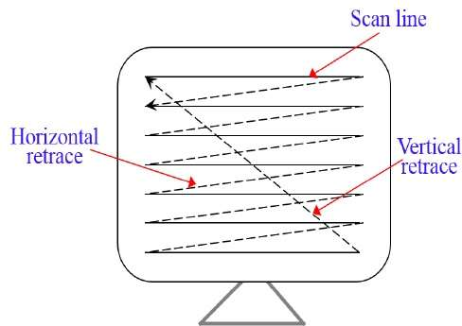
Raster Scan Display
Refreshing - at the rate of 60 to 80 frames per second
refresh rates are described in units of cycles per second, or Hertz (Hz), where a cycle corresponds to one frame
At the end of each scan line, the electron beam returns to the left side of the screen to begin displaying the next scan line
The return to the left of the screen, after refreshing each scan line, is called the horizontal retrace of the electron beam
At the end of each frame (displayed in 1/80th to 1/60th of a second), the electron beam returns (vertical retrace) to the top left comer of the screen to begin the next frame

Slide 21
Raster Scan Display
Interlacing:
1st Pass- the beam sweeps across every other scan line from top to bottom
2nd Pass: after the vertical retrace, the beam sweeps out the remaining scan lines
allows us to see the entire screen displayed in one-half the time it would have taken to sweep across all the lines at once from top to bottom
Interlacing is primarily used with slower refreshing rates
On an older, 30 frames-per-second, non-interlaced display, for instance, some flicker is noticeable.
But with interlacing, each of the two passes can be accomplished in 1/60th of a second, which brings the refresh rate nearer to 60 frames per second
This is an effective technique for avoiding flicker, providing that adjacent scan lines contain similar display information

Slide 22
Random Scan Display
The electron beam directed only to the parts of the screen where a picture is to be drawn
Random scan monitors draw a picture one line at a time
vector displays or stroke-writing or calligraphic displays
The component lines of a picture can be drawn and refreshed by a random-scan system in any specified order
Example: Pen Plotter

Slide 23
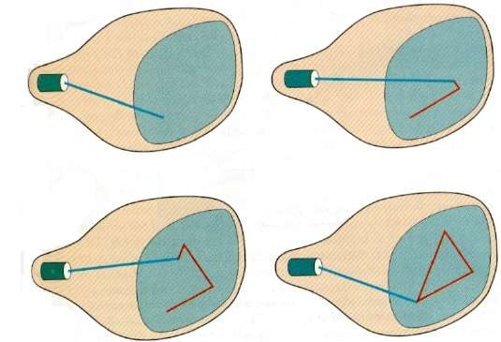
Random Scan Display

Slide 24
Random Scan Display
Refresh rate: depends on the number of lines to be displayed.
Picture definition stored as a set of line drawing commands in an area of memory referred to as the refresh display file, or display list, or display program, or refresh buffer
Display a Picture: drawing each component line in turn
After all line drawing commands have been processed
The system cycles back to the first line command in the list
Random-scan displays are designed to draw all the component lines of a picture 30 to 60 times each second.
High quality vector systems are capable of handling approximately 100,000 "short" lines at this refresh rate
When a small set of lines is to be displayed, each refresh cycle is delayed to avoid refresh rates greater than 60 frames per second
faster refreshing of the set of lines could burn out the phosphor

Slide 25
Random-scan vs. Raster -scan
Random-scan systems:
designed for line drawing applications and cannot display realistic shaded scenes
generally have higher resolution than raster systems
produce smooth line drawings because the CRT beam directly follows the line path
Raster-scan systems:
produces jagged lines that are plotted as discrete point sets

Slide 26
Color CRT Monitor
Displays color pictures by using a combination of phosphors that emit different-colored light
Combining the emitted light from the different phosphors
a range of colors can be generated
The two basic techniques:
The beam-penetration method
The shadow-mask method

Slide 27
Color CRT Monitor: Beam Penetration
Used with random-scan monitors
Two layers of phosphor (red and green) are coated onto the inside of the CRT screen
The displayed color depends on how far the electron beam penetrates into the phosphor layers
A beam of slow electrons excites only the outer red layer
A beam of very fast electrons penetrates through the red layer and excites the inner green layer
At intermediate beam speeds, combinations of red and green light are emitted to show two additional colors, orange and yellow
The speed of the electrons, and hence the screen color at any point, is controlled by the beam-acceleration voltage

Slide 28
Color CRT Monitor: Beam Penetration
Inexpensive
Only four colors are possible
The quality of pictures is not as good as with other methods

Slide 29
Color CRT Monitor: Shadow Mask
Used in raster-scan systems (including color TV) because they produce a much wider range of colors
Three phosphor color dots (Red, Green, Blue) at each pixel position
Three electron guns -> one for each color dot
A shadow-mask grid just behind the phosphor-coated screen

Slide 30
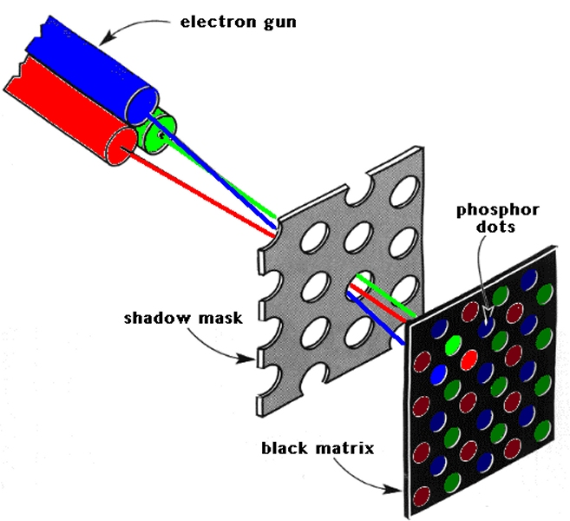
Color CRT Monitor: Shadow Mask
The delta-delta shadow-mask method - commonly used in color CRT systems
The three electron beams are deflected and focused as a group onto the shadow mask, which contains a series of holes aligned with the phosphor-dot patterns. When the three beams pass through a hole in the shadow mask, they activate a dot triangle, which appears as a small color spot on the screen.
The phosphor dots in the triangles are arranged so that each electron
beam can activate only its corresponding color dot when it passes through the shadow mask

Slide 31
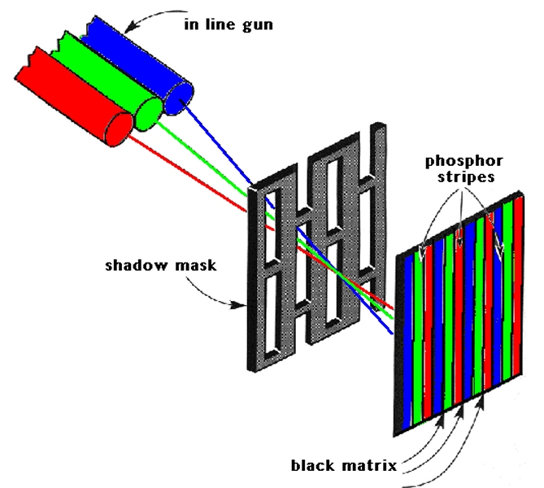
Color CRT Monitor: Shadow Mask
The in-line arrangement
Three electron guns, and the corresponding red-green-blue color dots on the screen, are aligned along one scan line instead of in a triangular pattern.
This in-line arrangement of electron guns is easier to keep in alignment and is commonly used in high-resolution color CRTs

Slide 32
Color CRT Monitor: Shadow Mask
Color variations in a shadow-mask CRT
by varying the intensity levels of the three electron beams
By setting intermediate intensity levels for the electron beams
several million different colors to be generated
High-quality raster-graphics systems have 24 bits per pixel in the frame buffer, allowing 256 voltage settings for each electron gun and nearly 17 million color choices for each pixel. An RGB color system with 24 bits of storage per pixel is generally referred to as a full-color system or a true-color system.

Slide 33
Direct-View Storage Tubes (DVST)
Stores the picture information as a charge distribution just behind the phosphor-coated screen
Two electron guns are used
Primary gun: store the picture pattern;
Second gun: maintains the picture display
Advantages: no refreshing is needed, very complex pictures can be displayed at very high resolutions without flicker
Disadvantages: erasing and redrawing process can take several seconds for a complex picture.
Storage displays have been largely replaced by raster systems

Slide 34
Flat-Panel Displays
Reduced volume, weight, and power requirements compared to a CRT, thinner then CRT
Two categories: emissive displays and non-emissive displays
Emissive Displays:
Convert electrical energy into light
Plasma panels, thin-film electroluminescent displays, and Light-emitting diodes
Non-emissive Displays:
Use optical effects to convert sunlight or light from some other source into graphics patterns
Liquid-crystal device

Slide 35
Plasma Panel/ Gas Discharge Displays
Filling the region between two glass plates with a mixture of gases that usually includes neon
A series of vertical conducting ribbons is placed on one glass panel
A set of horizontal ribbons is built into the other glass panel
Firing voltages applied to a pair of horizontal and vertical conductors
the gas at the intersection of the two conductors to break down into a glowing plasma of electrons and ions
Picture definition is stored in a refresh buffer
The firing voltages are applied to refresh the pixel positions (at the intersections of the conductors) 60 times per second
Alternating-current methods are used to provide faster application of the firing voltages, and thus brighter displays
Separation between pixels is provided by the electric field of the conductors
Disadvantages: strictly monochromatic devices
now capable of displaying color and grayscale

Slide 36
Thin-film electroluminescent displays
The region between the glass plates is filled with a phosphor, such as zinc sulfide doped with manganese, instead of a gas
When a sufficiently high voltage is applied to a pair of crossing electrodes
The phosphor becomes a conductor in the area of the intersection of the two electrodes
Electrical energy is then absorbed by the manganese atoms
which then release the energy as a spot of light
Disadvantages:
require more power
good color and gray scale displays are hard to achieve

Slide 37
Light-emitting diode (LED)
A matrix of diodes is arranged to form the pixel positions in the display
Picture definition is stored in a refresh buffer
Information is read from the refresh buffer
Converted to voltage levels that are applied to the diodes to produce the light patterns in the display

Slide 38
Liquid Crystal Displays (LCDs)
Commonly used in small systems
Calculators and portable, laptop computers
Non-emissive devices
Produce a picture
by passing polarized light from the surroundings
from an internal light source through a liquid-crystal material that can be aligned to either block or transmit the light

Slide 39
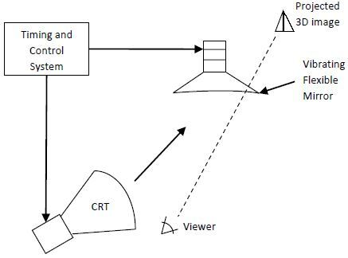
Three Dimensional Viewing Devices
This method display using computer generated scenes.
It may display object by three-dimensional views.
The graphics monitor which are display three-dimensional scenes is devised using a technique that reflects a CRT image from a vibrating flexible mirror.
Vibrating mirror changes its focal length due to vibration which synchronized with the display of an object on CRT.
Each point on the object reflected from the mirror into the spatial position corresponding to a distance of that point. From a viewing position.
Very good example of this system is GENISCO SPACE GRAPH system. Which use the vibrating mirror to project 3D objects into a 25 cm by 25 cm by 25 cm volume. This system is also capable to show 2D cross section at the different depth.

Slide 40
Stereoscopic System
Way of representing 3D objects
Does not produce true 3D image
Provides a 3D effect by presenting a different view to each eye of an observer so that scenes do appear to have depth
Stereoscopic Projection: Two views of a scene generated from a viewing direction corresponding to each eye (left and right)
We can construct the two views as computer-generated scenes with different viewing positions, or we can use a stem camera pair to photograph some object or scene
Display each of the two views with a raster system on alternate refresh cycles

Slide 41
Virtual Reality System
Stereoscopic viewing is also a component in virtual-reality systems
where users can step into a scene and interact with the environment
A headset containing an optical system to generate the stereoscopic views is commonly used in conjunction with interactive input devices to locate and manipulate objects in the scene
A sensing system in the headset keeps track of the viewer's position, so that the front and back of objects can be seen as the viewer "walks through" and interacts with the display
Can also be viewed with stereoscopic glasses and a video monitor, instead of a headset -> lower cost
The tracking device is placed on top of the video display and is used to monitor head movements so that the viewing position for a scene can be changed as head position changes

Slide 42
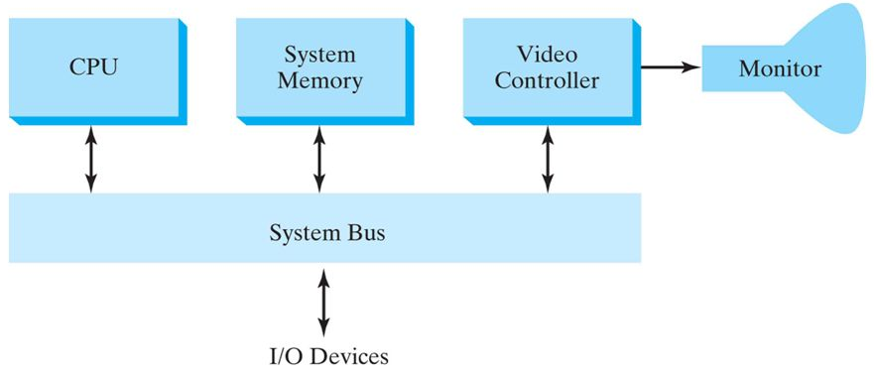
Raster-Scan System
A fixed area of the system memory is reserved for the frame buffer
The video controller is given direct access to the frame-buffer memory
Frame-buffer locations, and the corresponding screen positions, are referenced in Cartesian coordinates
Y
X

Slide 43
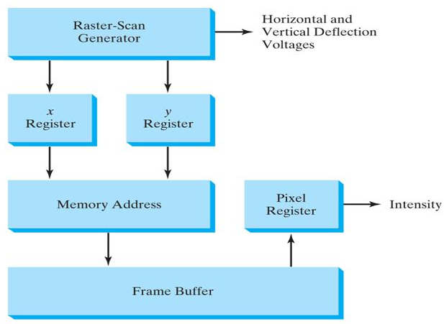
Video Controller- Refreshing
Two registers are used to store the coordinates of the screen pixels
x register is set to 0
y register is set to y_{max}
The value stored in the frame buffer for this pixel position is then retrieved and used to set the intensity of the CRT beam
x register is incremented by 1, and the process repeated for the next pixel on the top scan line
This procedure is repeated for each pixel along the scan line.
After the last pixel on the top scan line has been processed
x register is reset to 0 and the y register is decremented by 1
Pixels along this scan line are then processed in turn, and the procedure is repeated for
each successive scan line
After cycling through all pixels along the bottom scan line (y = 0), the video controller resets the registers to the first pixel position on the top scan line and the refresh process starts over.

Slide 44
Video Controller- To speed up Refreshing
Refreshing at the rate of 60 frames per second
The cycle time is too slow
To speed up pixel processing
The video controllers can retrieve multiple pixel values from the refresh buffer on each pass
The multiple pixel intensities are then stored in a separate register and used to control the CRT beam intensity for a group of adjacent pixels
When that group of pixels has been processed,
The next block of pixel values is retrieved from the frame buffer

Slide 45
Video Controller- Several Roles
Two frame buffers:
One buffer for refreshing
Other filled with intensity values
Then the two buffers can switch roles.
Fast mechanism-for generating real-time animations
different views of moving objects can be successively loaded into the refresh buffers
Transformation: Areas of the screen can be enlarged, reduced, or moved from one location to another during the refresh cycles
Video controller contains a lookup table
The pixel values in the frame buffer are used to access the lookup table instead of controlling the CRT beam intensity directly
Mixing the frame-buffer image with an input image from a television camera or other input device

Slide 46
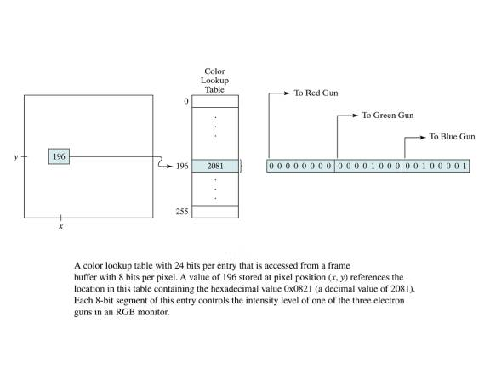
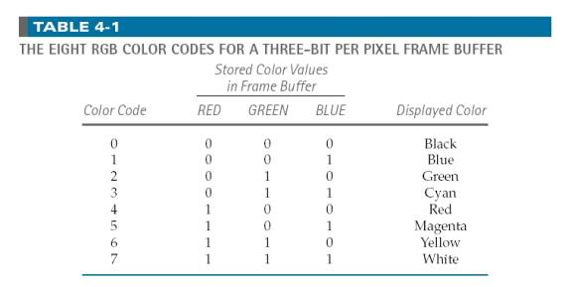
Color Lookup Table
24-bits per entry accessed from a frame buffer, 8 bits per pixel
Pixel value 196 stored at (x,y) position references the location in the table containing a value 2081
Each 8-bit segment of this entry controls the intensity level of one of the three electron guns in an RGB monitor.

Slide 47
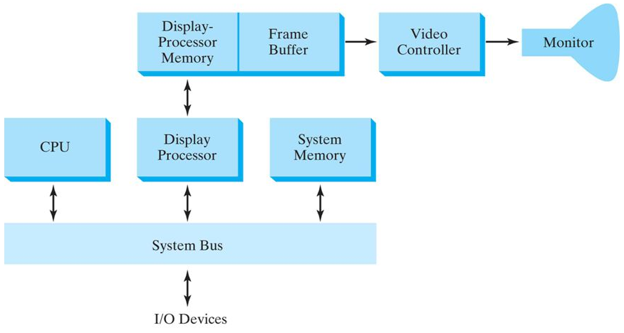
Display Processor/ Graphics Controller/ Display Coprocessor
Purpose: free the CPU from the graphics chores
A separate display processor memory
Major Task: Scan Conversion
digitizing a picture definition given in an application program into a set of pixel-intensity values for storage in the frame buffer
Straight line segment, curved line, polygon outline, characters (rectangular grid/ curved outlines)

Slide 48
Display Processor - operation
Generating various line styles (dashed, dotted,
or solid), displaying color areas, and performing certain transformations and manipulations on displayed objects
Designed to interface with interactive input devices such as a mouse
To reduce memory requirements
organizing the frame buffer as a linked list and encoding the intensity information (run-length encoding)
To encode the raster as a set of rectangular areas (cell encoding)
Disadvantage: when runs decreases

Slide 49
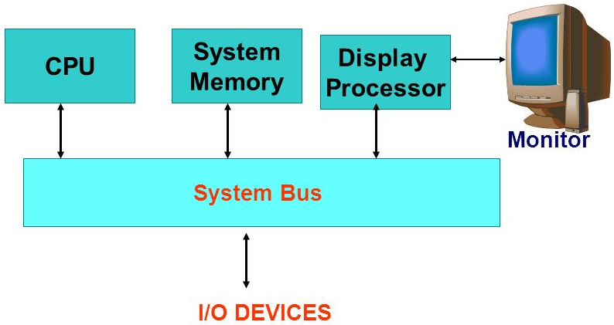
Random-Scan System
An application program is input and stored in the system memory along with a
graphics package
Graphics commands in the application program are translated by the graphics package into a display file stored in the system memory
This display file is then accessed by the display processor to refresh the screen
The display processor cycles through each command in the display file program once during every refresh cycle
Sometimes the display processor in a random-scan system is referred to as a display processing unit or a graphics controller
A scene is then drawn one line at a time by positioning the beam to fill in the line between specified endpoints

Slide 50
Input Devices
Keyboards
Mouse
Trackball and Spaceball
Joysticks
Data Glove
Digitizers
Image Scanners
Touch Panels
Light Pens
Voice Systems

Slide 51
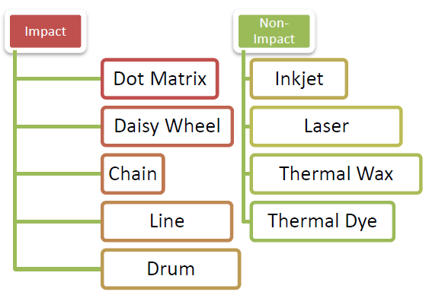
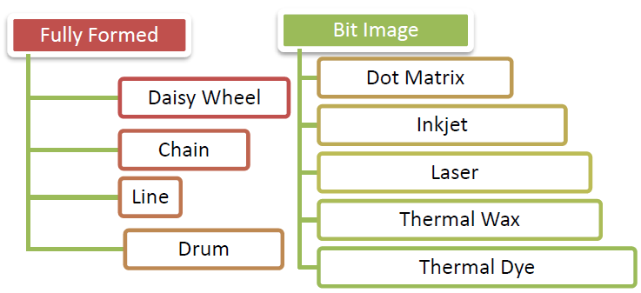
Hard Copy Devices
Printer
Impact Printers: there exists a mechanical contact between print head and paper. Print head is the part of the printer that resembles a hammer and is responsible for transferring the ink to the paper in the form of required characters. Impact printer contains an individual print head for each character.
Non-Impact printers: there exists no mechanical contact between the print head and paper. These printers spray ink on the paper with the help of a nozzle. The most popular ones are ink-jet printers and laser printers.
Pen Plotter

Slide 52
Graphics Software
Graphical Kernel System (GKS)
PHIGS (Programmer's Hierarchical Interactive Graphics standard)
Standardization for device interface methods is given in the Computer Graphics Interface (CGI) system
The Computer Graphics Metafile (CGM) system specifies standards for archiving and transporting pictures.

Slide 53
Some More Terms
Apixmap: For systems with multiple bits per pixel, the frame is called as a apixmap.
Refresh rate> phosphor’s persistence -> moving object becomes blurred
Refresh rate< phosphor’s persistence -> flickering
Dot Pitch: It is defined as the measurement of the diagonal distance between two liked-colored (RGB) pixels on a display screen. (0.25mm to 0.40 mm; 0.31mm -> clear image)
Smaller dot pitch -> higher resolution
Image resolution: pixel spacing
Screen resolution: no of pixels in the horizontal and vertical directions on the screen
Bit Depth/ Color Depth: number of bits assigned to each pixel in the image

