Slide 1
Explainable AI for Thyroid Nodule Classification
By
Name :- Shiva Nunemunthala
Roll No. :- 190001041
BTP Advisor :- Prof. Kapil Ahuja
Mentor :- Saurabh Saini

Slide 2
What is XAI
Explainable artificial intelligence (XAI) is a set of processes and methods that allows human users to comprehend and trust the results and output created by machine learning algorithm.
XAI is used to describe an AI model its expected impact and potential biases
It helps characterize model accuracy, fairness, transparency and outcomes in AI-powered decision making.

Slide 3
XAI vs Interpretability
Interpretability is the extent to which you are able to predict what is going to happen given a change in input or changing those algorithm parameters (aka weights)
Take for an example of linear regression , to understand the output one can go and check the weights assigned to different features used in linear equation to understand why we have got this output - Interpretability
Why a particular feature is assigned more weight than other - XAI

Slide 4
Motivation
Although computer - aided diagnostics using artificial intelligence provides a promising way to make the diagnosis better , but it lacks significant deployment in clinics .
It’s because trusting a black-box model in safety critical applications is most difficult for medical practitioners and patients.
Here we try to provide why our algorithm is predicting such output.

Slide 5
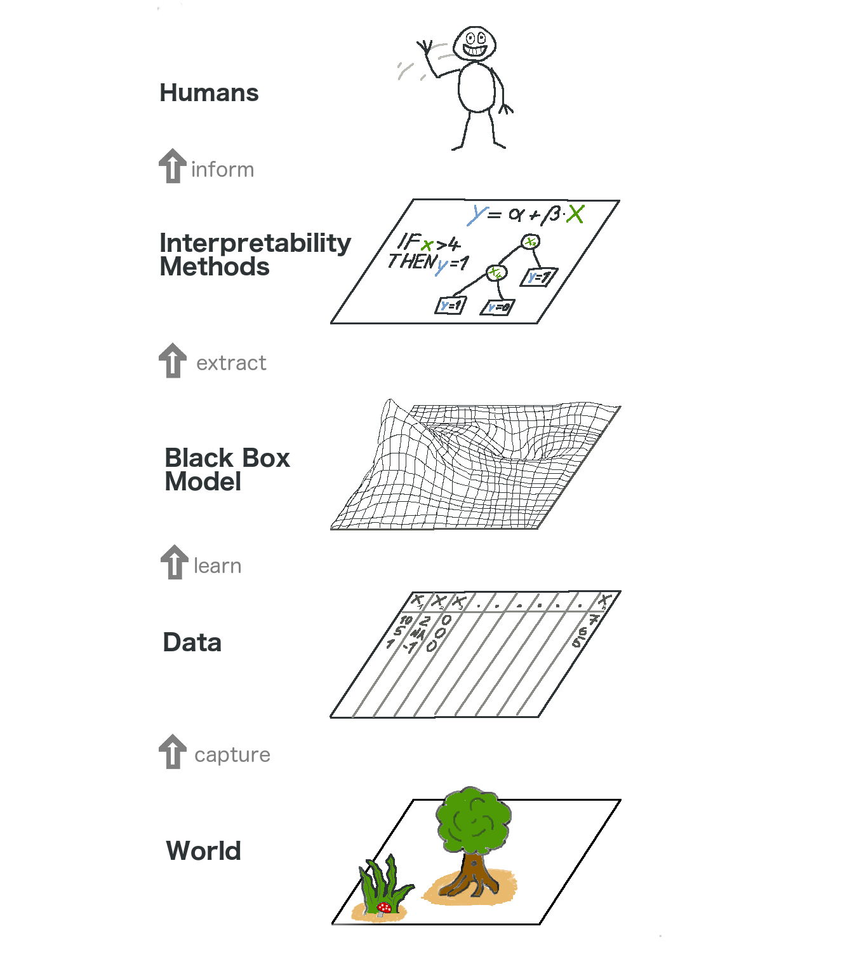
[2] Illustration of explainable ai

Slide 6
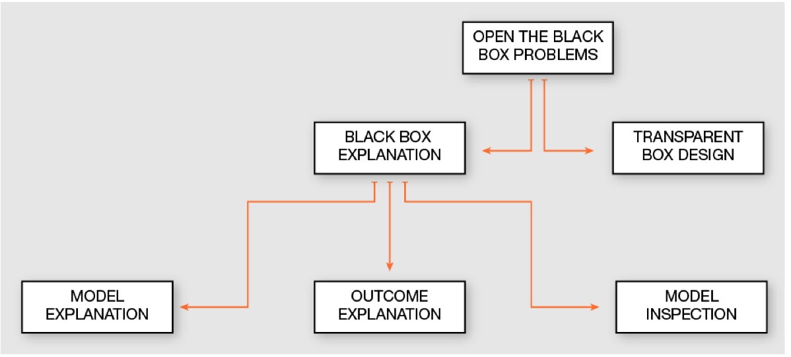
Literature Review
Black box problems can be broadly explained on the following ways . In our research we focussed more on outcome explanation. [3]

Slide 7
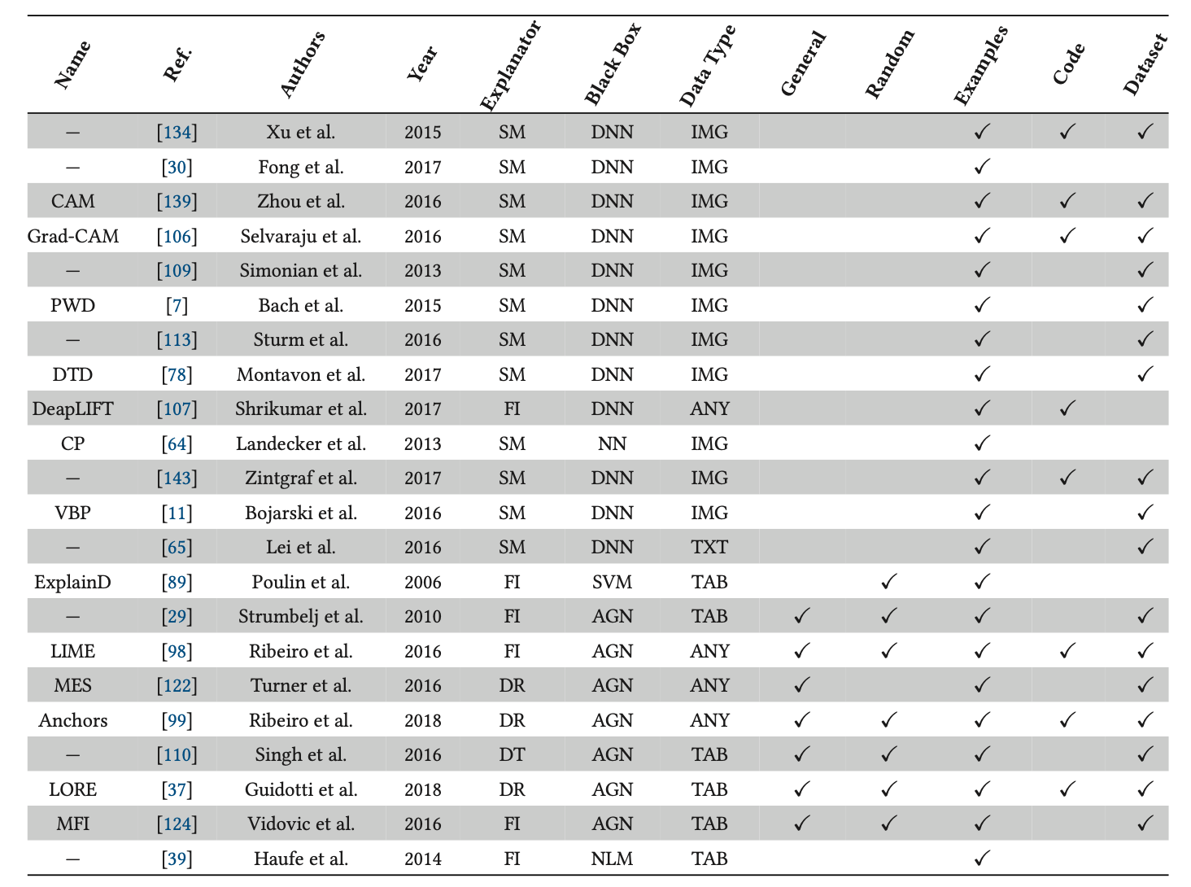
Summary of methods for explaining outcome explanation of black box model
[3]

Slide 8
Grad-CAM
One of the most widely used XAI technique to explain the black box model for image data .
Gradient-weighted Class Activation Map (Grad-CAM) uses the gradient of any target concept flowing into the final convolutional layer to produce a coarse localization map highlighting the important regions in the image for predicting the concept .
But this kind of gradient-flow based techniques can’t be applied to our black-box model , because it has little to no gradient flow inside black-box model.

Slide 9
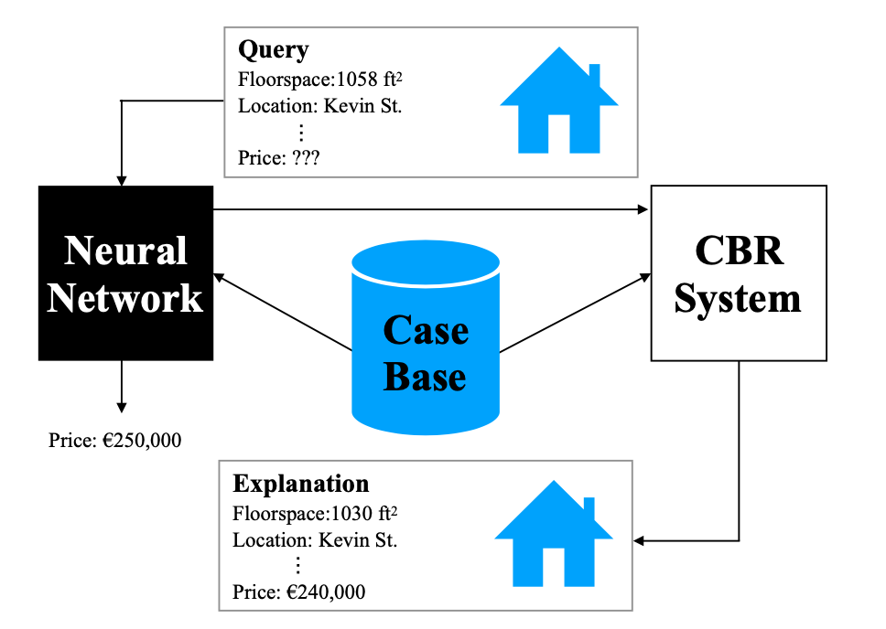
CBR Techniques
A simple ANN-CBR twin-system[10]
A query case posed to an ANN gives accurate but unexplained prediction for a house price.
Unfortunately CBR with image data is little unexplored .

Slide 10
Model Specific Interpretability
Model Specific Interpretability stands the kind of technique which is useful for that particular model or a family of such kind of models.
We worked on visualising Gradients of the HOT feature vector . By visualising magnitude and slope separately and combinedly.
But the interpretability of such kind of outcome isn’t that great from the ones we will be mentioning next such as LIME, SHAP .

Slide 11
LIME
Weights are weighted by the proximity of the sampled instances to the instance of interest .
Now this learned model is a good approximation of the machine learning models locally , but it does not have to be a good approximation globally (Basically Local Fidelity).
explanation(x) = argmin g∈G L(f,g,πx)+Ω(g)
x->instance , g->type of model (locally weighted LR) , L->loss function
Ω(g) -> Model complexity , try to keep it low, G->family of possible explanations(all possible LR’s)

Slide 12
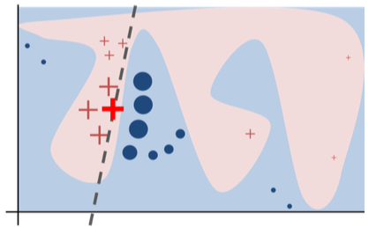
A toy example to present intuition for LIME . The black-box model’s complex decision is represented by blue-pink background , which can’t be approximated well by a linear model
The bold red cross is the instance being explained. LIME samples instances gets predictions and weighs them by the proximity to the instance being explained (represented here by size)
The dashed line is the learned explanation that is locally faithful [2].

Slide 13
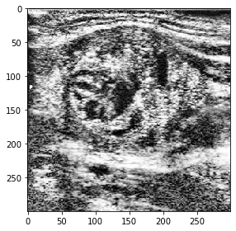
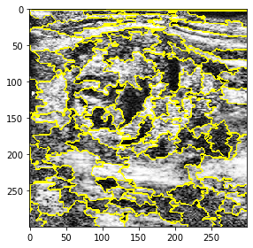
Enhanced and preprocessed thyroid
nodule image
Felzenszwalb segmentation

Slide 14
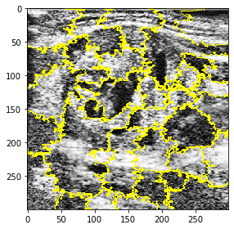
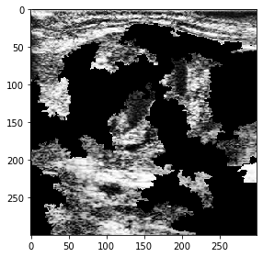
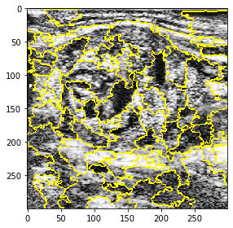
Perturbed image
Quick-shift segmentation
SLIC segmentation

Slide 15
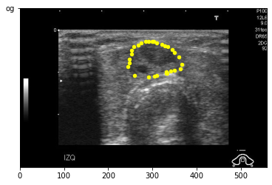
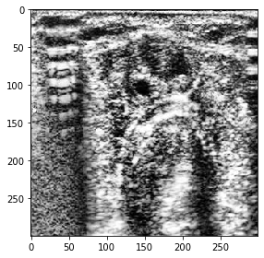
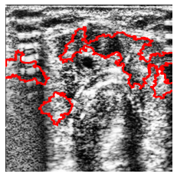
Segmented image by doctor
Enhanced and preprocessed image
Segmented image by LIME

Slide 16
Novelty in LIME
Implemented a custom LIME from scratch where you can tune many hyper parameters which can’t be done using a library
Learnt about various image segmentation techniques and used it in LIME.
Tuned various hyper parameters related to segmentation by using grid search .
Used various local interpretable models to explain a sample of interest .

Slide 17
Shapley Values
A prediction can be explained by assuming that each feature value of the instance is a “player” in a game where the prediction is the payout.
Shapley values – a method from coalitional game theory – tells us how to fairly distribute the “payout” among the features.
The contribution of Φ_{j} of j^{th} feature on the prediction f(x) is Φ _{j}(f ) = β_{j}*x_{j} - E(β_{j}*X_{j}) .
E(β_{j}*X_{j}) is the mean effect estimate of feature j.

Slide 18
Shapley Values
S is a subset of the features used in the model.
x is the vector of feature values of the instance to be explained .
p the number of features.
Val_{x}(S) = ∫ f(x1,…,xp) dP_{x∉S}−E_{X}(f(X))
Val_{x}(S) is the prediction for feature values in set S that are marginalized over features that are not included in set S:

Slide 19
Additive feature Attribution Methods
Additive feature attribution methods :- have an explanation model that is a linear function of binary variables
g(z’) = φ₀ + Σ φ_{j} * z’_{j}
Methods with explanation models matching the above definition attribute a feature φ_{j} and summing the effects of all feature attributions approximates the output f(x) of the original model .

Slide 20
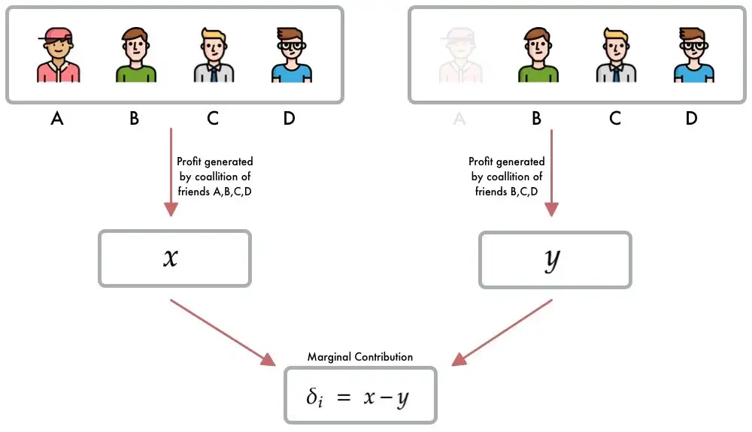
[3] Illustration of marginal contribution of member “A” to the coalition members “B,C,D”

Slide 21
SHAP
SHAP (SHapley Additive exPlanations) is a method to explain individual predictions.
SHAP is based on the game theoretically optimal Shapley values.
The goal of SHAP is to explain the prediction of an instance x by computing the contribution of each feature to the prediction.
The SHAP explanation method computes Shapley values from coalitional game theory.

Slide 22
SHAP
One innovation that SHAP brings to the table is that the Shapley value explanation is represented as an additive feature attribution method, a linear model.
That view connects LIME and Shapley values. SHAP specifies the explanation as:
g(z’) = φ₀ + Σ^{M} φ_{j} * z’_{j}
g -> explanation model , z’ ∈ {0,1}^{M} is the coalition vector /simplified features , M is the coalition size φ_{j} ∈ R is the feature attribution of j.

Slide 23
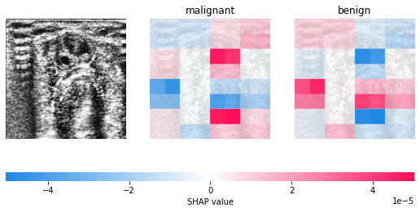
Segmented image by doctor
Segmented image by SHAP

Slide 24
Future Work
This work can be extended and improvised by working on case based reasoning techniques . Which is more interpretable than LIME and SHAP.
Will work on the cutting edge interpretability techniques such as XRAI(paper by google in 2019) , Smoothgrad based XAI techniques etc…
If we incorporate gradient changes in our model , we can explain how exactly each layer works etc…

Slide 25
References
"Why Should I Trust You?": Explaining the Predictions of Any Classifier
Interpretable Machine Learning - Christoph Molnar
A Survey of methods for explaining black box models .
An open access thyroid ultrasound-image Database
Density-wise two stage mammogram classification using texture exploiting descriptors
"A Survey of Methods for Explaining Black Box Models
SLIC Superpixels

Slide 26
References
8. Efficient Graph-Based Image Segmentation
9.A Unified Approach to Interpreting Model Predictions
10 . How Case-Based Reasoning Explains Neural Networks: A Theoretical Analysis of XAI Using Post-Hoc Explanation- by-Example from a Survey of ANN-CBR Twin-Systems.

