Slide 1
Explainable AI for Thyroid Nodule Classification
By
Name :- Shiva Nunemunthala
Roll No. :- 190001041
BTP Advisor :- Prof. Kapil Ahuja
Mentor :- Saurabh Saini

Slide 2
What is XAI
Explainable artificial intelligence (XAI) is a set of processes and methods that allows human users to comprehend and trust the results and output created by machine learning algorithm.
XAI is used to describe an AI model its expected impact and potential biases
It helps characterize model accuracy, fairness, transparency and outcomes in AI-powered decision making.

Slide 3
XAI vs Interpretability
Interpretability is the extent to which you are able to predict what is going to happen given a change in input or changing those algorithm parameters (aka weights)
Take for an example of linear regression , to understand the output one can go and check the weights assigned to different features used in linear equation to understand why we have got this output - Interpretability
Why a particular feature is assigned more weight than other - XAI

Slide 4
XAI Techniques
As XAI is a rapidly emerging field in AI not much progress has been happened.
Many techniques are classified into Model-Agnostic and Model-dependent methods.
There are some standard approaches for explaining our model such as partial dependence plot(PDP) , Accumulated Local Effects(ALE) plot etc..

Slide 5
XAI Techniques
The problem with all the above mentioned is that either the features are interpretable or we are having less features .
After careful elimination of what doesn’t work for our problem we are left with a very few techniques.
Local Interpretable Model Agnostic Explanations is one of them [1].

Slide 6
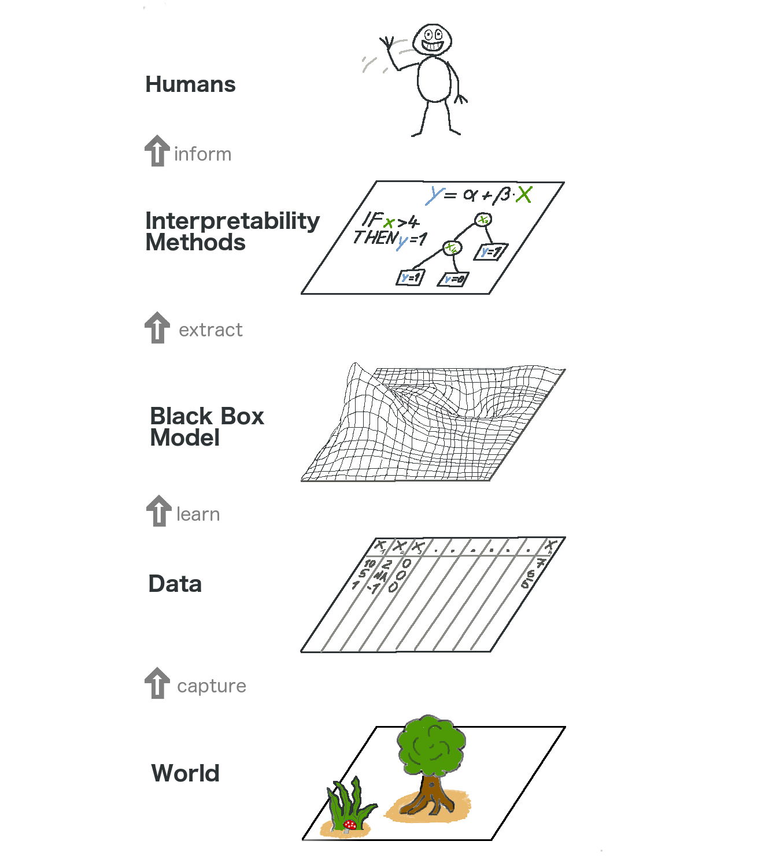
[2] Illustration of explainable ai

Slide 7
LIME
LIME stands for Local Interpretable Model Agnostic Explanations .
On an higher level , We generate random perturbations of an input and form a dataset and predict the outputs using our given black-box model.
On this new dataset we train an interpretable model such as Linear regression/weighted or k-NN or similar kind of interpretable models.

Slide 8
LIME
Weights are weighted by the proximity of the sampled instances to the instance of interest .
Now this learned model is a good approximation of the machine learning models locally , but it does not have to be a good approximation globally (Basically Local Fidelity).

Slide 9
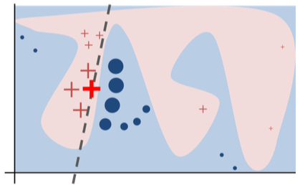
A toy example to present intuition for LIME . The black-box model’s complex decision is represented by blue-pink background , which can’t be approximated well by a linear model
The bold red cross is the instance being explained. LIME samples instances gets predictions and weighs them by the proximity to the instance being explained (represented here by size)
The dashed line is the learned explanation that is locally faithful [2].

Slide 10
Local surrogate models are interpretable models that are used to explain individual predictions of black box machine learning models.
Surrogate models are trained to approximate the predictions of the underlying black box model.
Instead of training a global surrogate model, LIME focuses on training local surrogate models to explain individual predictions.
Local Surrogate Models

Slide 11
mathematically defining LIME
explanation(x) = argmin g∈G L(f,g,πx)+Ω(g)
x->instance , g->type of model (locally weighted LR) , L->loss function
Ω(g) -> Model complexity , try to keep it low, G->family of possible explanations(all possible LR’s)
The proximity measure πx defines how large the neighborhood around instance x is that we consider for the explanation

Slide 12
Literature review for extraction of features
Textural features of ultrasound pictures are used in handcrafted approaches. The accuracy of these algorithms is greatly dependent on the techniques used to extract features.
Thyroid nodule classification has also been proven to be improved by textural properties.
The extraction of features has a significant impact on the classification system's performance.

Slide 13
Literature review for extraction of features
We used two texture exploiting descriptors for extracting features from thyroid ultrasound images.
Histogram of Oriented Texture (HOT) , Pass-Band Discrete Cosine Transform (PB-DCT)
We then used an SVM to classify the images based on TIRADS scores in 2-stages

Slide 14
Segmentation and Superpixel algorithms
As the first step of our process is to perturbate our sample of interest , There exists few techniques on how to do that , which are a fairly standard techniques in the field of computer vision.
We explored 3-4 such kind of techniques and presenting the two techniques which are getting good results for our problem.
Below shows the description of the 2 techniques
Felzenszwalb’s efficient graph based segmentation
Quickshift image segmentation
SLIC segmentation

Slide 15
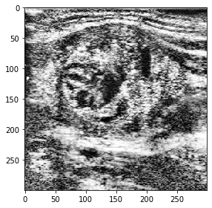
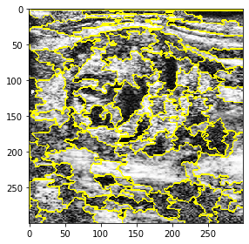
Enhanced and preprocessed thyroid nodule image
Felzenszwalb segmentation

Slide 16
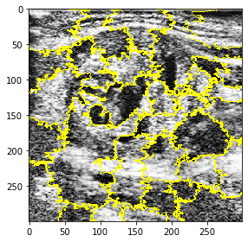
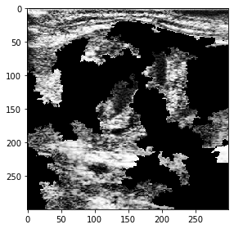
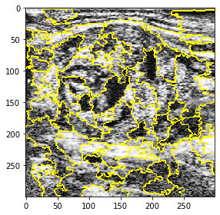
Perturbed image
Quick-shift segmentation
SLIC segmentation

Slide 17
Perturbation of segmented image
After segmenting the sample of interest we generate n-number of perturbations by randomly turning off(masking) each segmentation with a probability ‘p’ .
To choose best n and p we use trial and error method.
Basically our each perturbed image is a sample from binomial distribution with ‘p’ being the probability of masking each segment.
Above presents an image of perturbation.

Slide 18
Fitting an interpretable model
As we have a set of n-perturbations , we fed each one to our model and predict its outcome .
We store these outcomes of interest , and we calculate distance from each perturbation from the original image . Here we are using cosine distances to calculate farness .(Intuitive meaning is think of dot product)
Normalize the distances to contain between 0 and 1. Use a kernel function which achieves this.
Fit a interpretable model for the artificially generated data points (our distances)

Slide 19
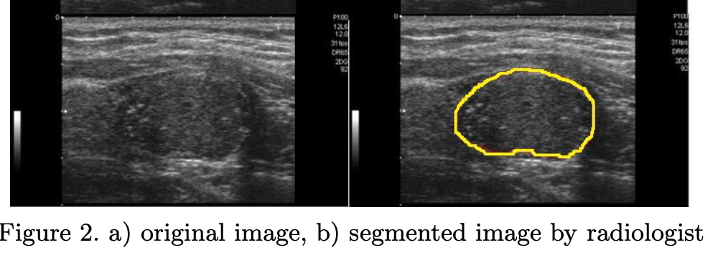

Slide 20
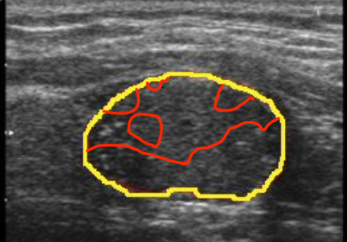
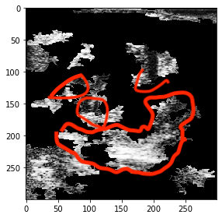
XAI showing which regions are important , red regions shows the common region which was segmented by radiologist and XAI
Yellow region in fig1 is segmented by radiologist

Slide 21
Novelty in LIME
Implemented a custom LIME from scratch where you can tune many hyper parameters which can’t be done using a library
Learnt about various image segmentation techniques and used it in LIME.
Tuned various hyper parameters related to segmentation by using grid search .
Used various local interpretable models to explain a sample of interest .

Slide 22
Future work
We will be tuning many hyperparameters such as probability p, number of perturbations n, type of segmentation and its associated parameters , using kernel function etc…
We will be working on improving the performance of Original Classification algorithm by using various dimensionality reduction techniques and reproduce the results with LIME.
Will work on SHAP(SHapley Additive exPlanations) a game theoretic approach to explain the output of any machine learning model.
Will work on Case Based Reasoning(CBR) to increase trustworthiness of our model.

Slide 23
References
"Why Should I Trust You?": Explaining the Predictions of Any Classifier
Interpretable Machine Learning - Christoph Molnar
An open access thyroid ultrasound-image Database
Density-wise two stage mammogram classification using texture exploiting descriptors
"A Survey of Methods for Explaining Black Box Models
SLIC Superpixels
Efficient Graph-Based Image Segmentation
A Unified Approach to Interpreting Model Predictions

