Slide 1
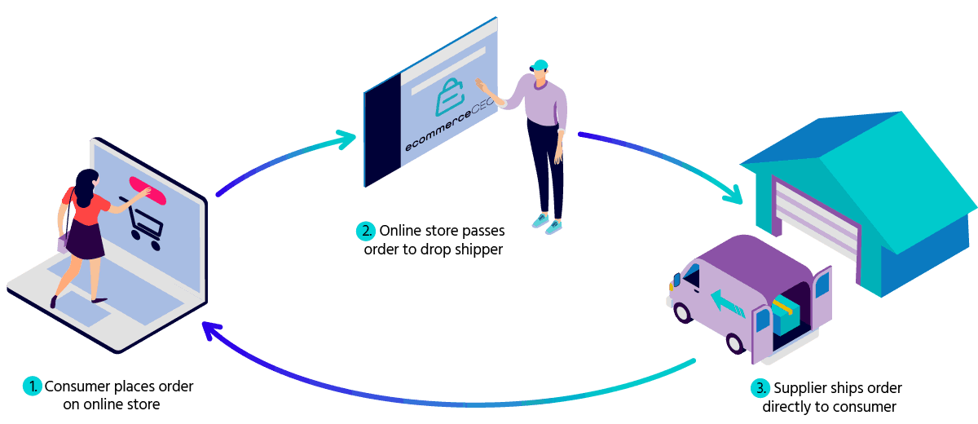
Shopmart Shopping Center

Slide 2
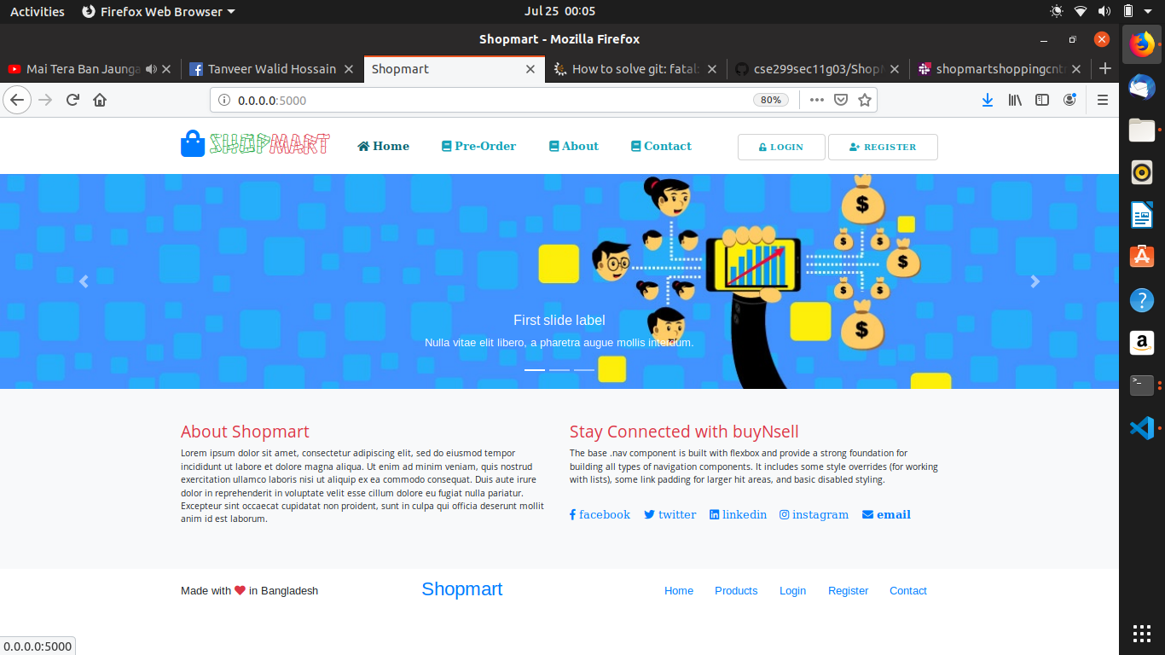
Home Page Services
Product Advertise
International Shop Links

Slide 3
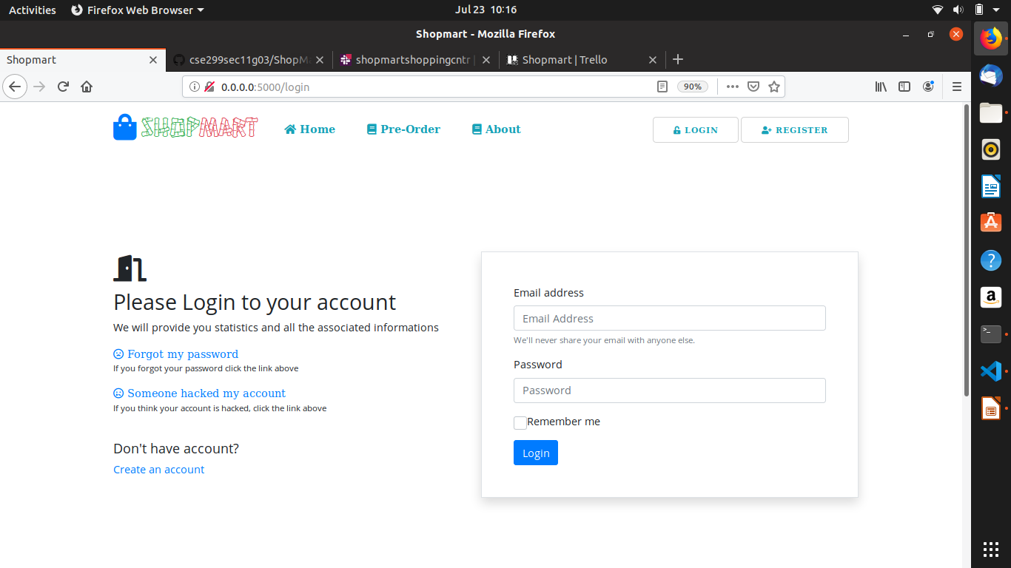
Owner Login interface

Slide 4
Buyer Login Interface

Slide 5
Advertise Login Interface

Slide 6
Carrier Login Interface

Slide 7
Features
Pre–Order option.
Carrier job sector.
Buyer can track the product.
Free login for all items.

Slide 8
Advantage
Trade scope for Businessman.
Carrier will get Max profit.
Foreign product order without master card.
Buyer will get link for live track.

Slide 9
Budget
Item | Cost
Web Domain & Hosting | BDT 3000
Marketing | BDT 20000
Total | BDT 23,000

Slide 10
Time- Plan
Serial | Description
Task 1 | Navigation Bar (Front-End)
Task 2 | Advertisement part (Front-End)
Task 3 | Login Interface For all Item (Front-End), Admin Interface, Footer
Task 4 | Build Up Web Front End For Homepage
Task 5 | Admin (Database), Buyer Interface (Database), Carrier (Database)
Task 6 | Back-End I, Back-End II
Task 7 | Black-End III

Slide 11
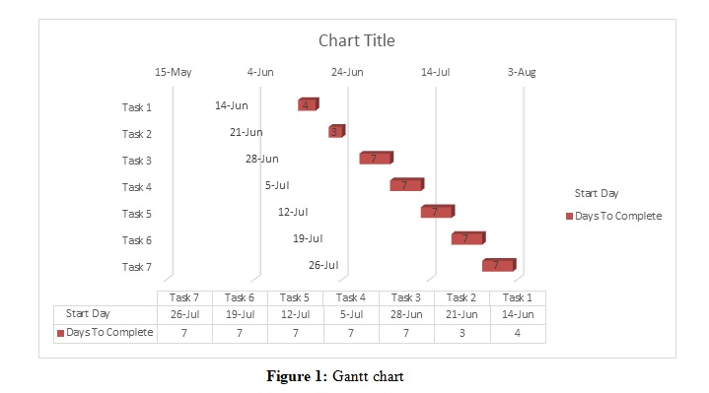
Gantt Chart

