Slide 1
Team Dexter
Md. Tanvir Hossain
Tarak Mahmud
Moddasir Ahmed

Slide 2
Introduction
In this modern era online shopping market has lots of influence over all the people. Middle age people loves to buy lots of things from online. Now days the scenario of the market is changing and demand of online shopping has increased a lot. Explosion of e-commerce has changed the buying patterns and preferences of customers. Today almost every big company has adopted these technologies to increases sales, to make branding all over the globe. It has made easier for the user to buy and seller to promote his product by giving his product a proper view of his products.

Slide 3
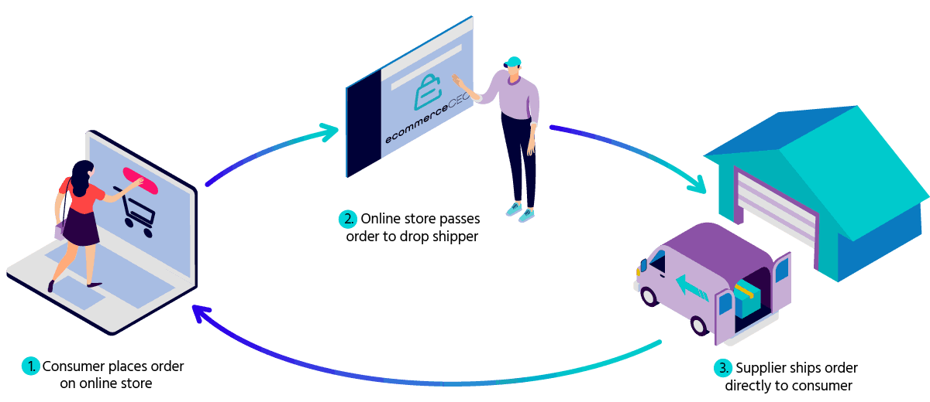
Shopmart Shopping Center

Slide 4
Project ideas
Shopmart Shopping is basically an ecommerce Website where we can buy and sell goodies. We also can buy foreign products via foreign site. We can make live Product tracking. This is also a freelancing website for biker and cyclist where they can earn money from this site.

Slide 5
tools
HTML, CSS, SQLITE, PYTHON (Flask).
PowerPoint.
GitHub, Trello, Slack.

Slide 6
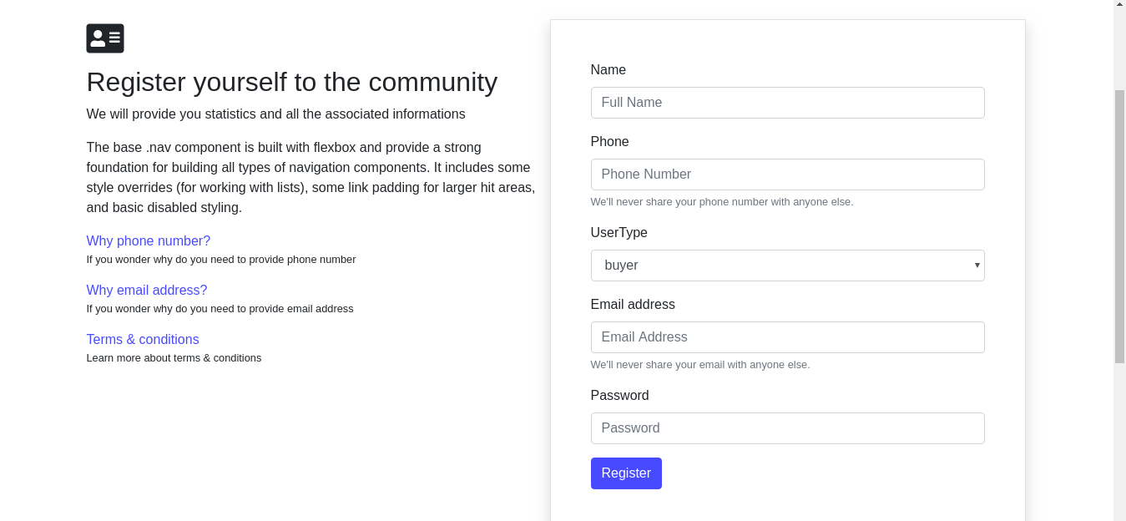
Register Interface
Login as an Authenticated User before have to Register here.

Slide 7
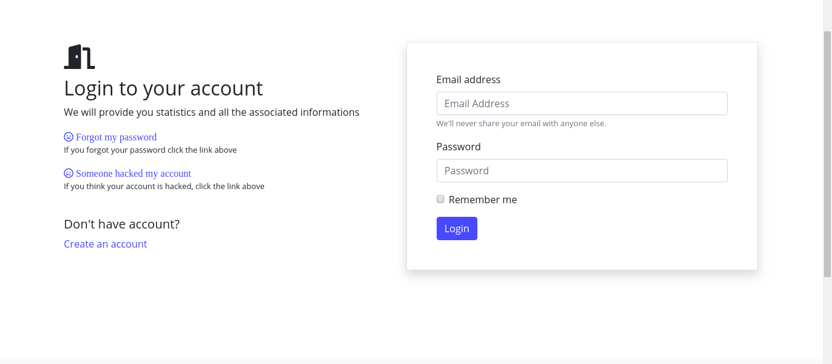
Login Interface
Login as an Authenticated User.

Slide 8
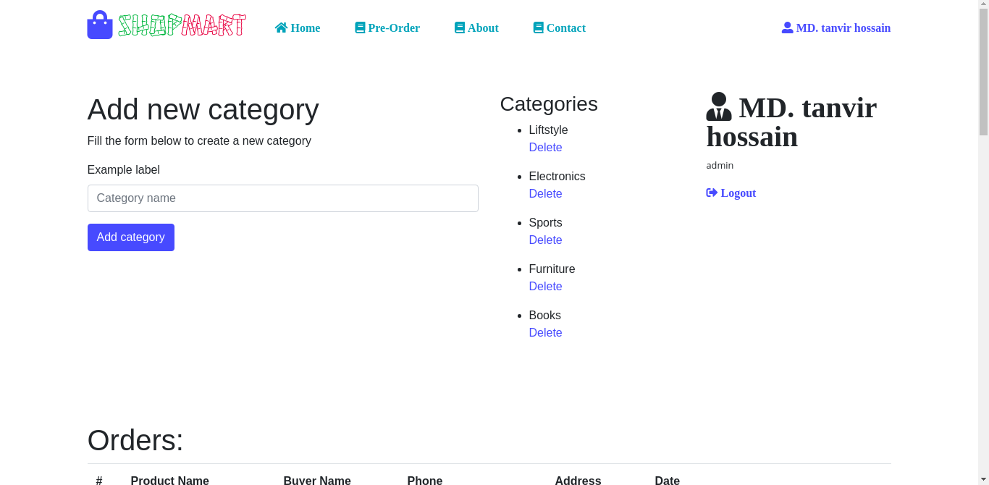
Admin Interface
Admin Dashboard

Slide 9
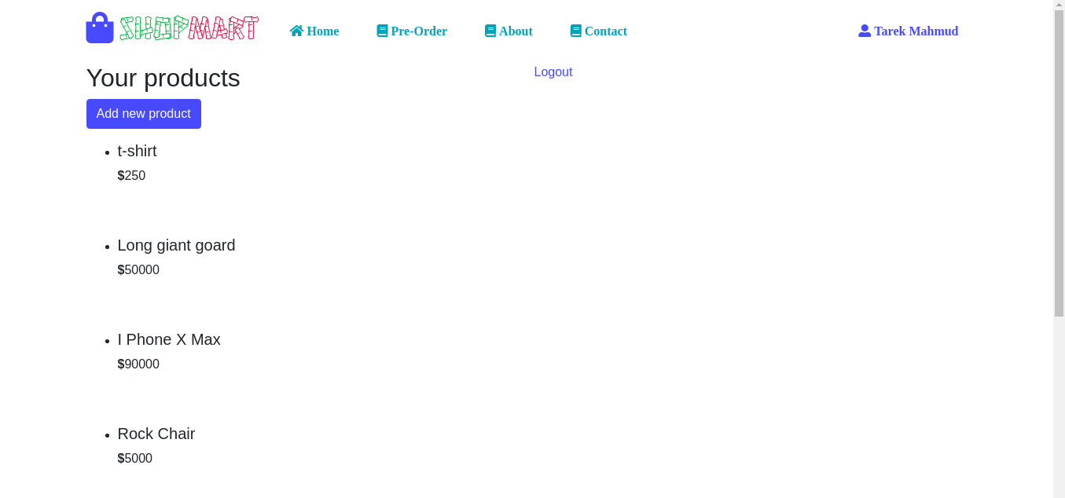
Seller Interface
Seller Dashboard

Slide 10
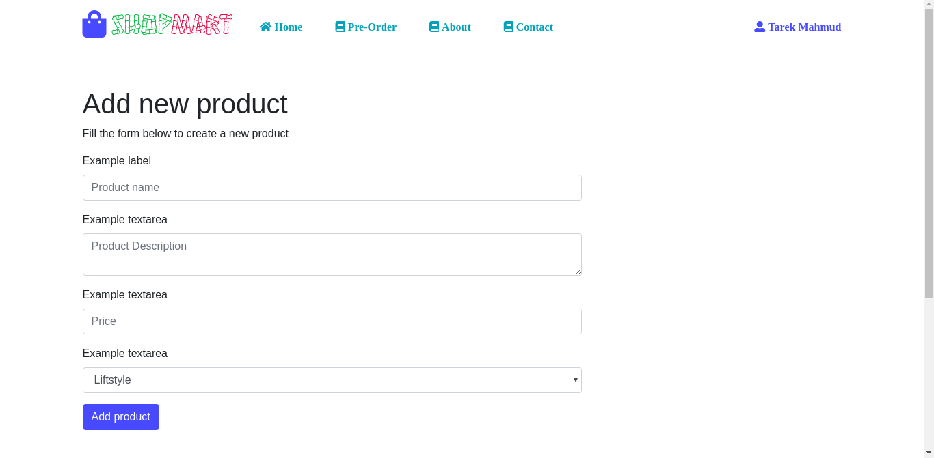
Seller Interface
Product Add

Slide 11
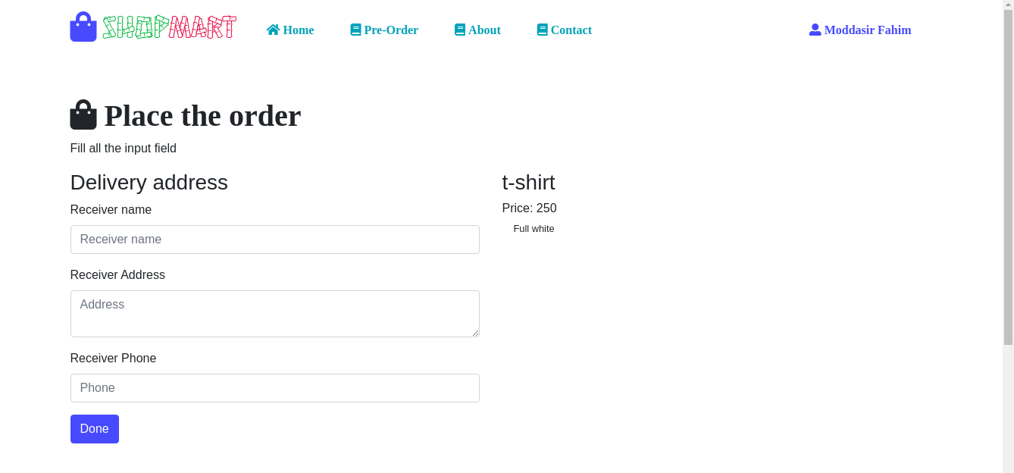
Buyer Interface
Buyer Product Order Form

Slide 12
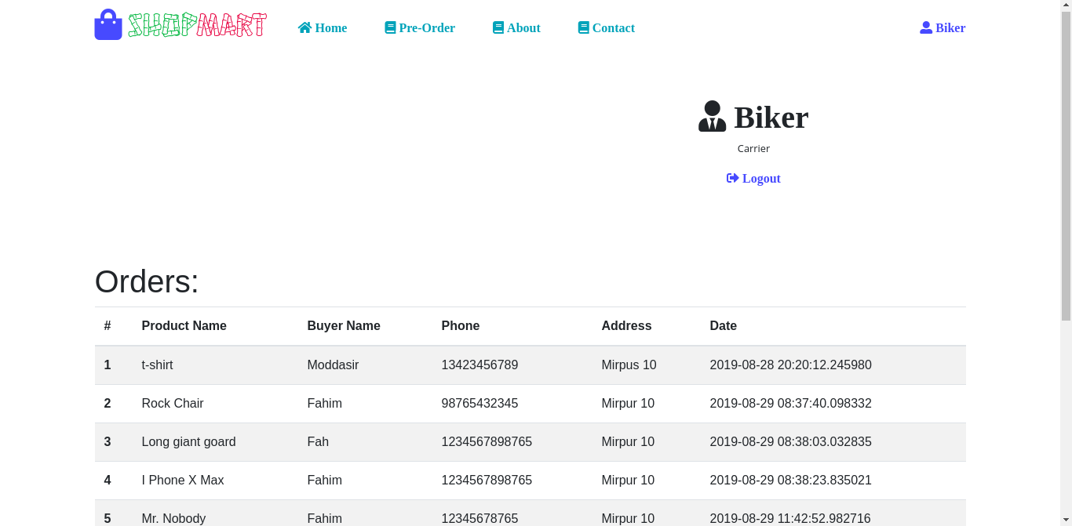
Carrier Interface
Carrier Dashboard

Slide 13
Features
Pre–Order option.
Carrier job sector.
Buyer can track the product.
Free login for all items.

Slide 14
Advantage
Trade scope for Businessman.
Carrier will get Max profit.
Foreign product order without master card.
Buyer will get link for live track.

Slide 15
Budget
Item | Cost
Web Domain & Hosting | BDT 3000
Marketing | BDT 20000
Total | BDT 23,000

Slide 16
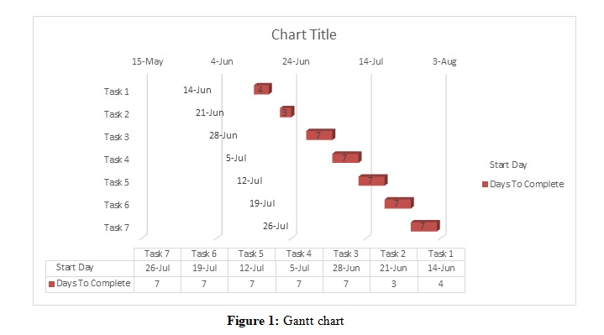
Gantt Chart

Slide 17
Future Work
We missed a very special tool which we want to add in the future. The tool is all about product live tracking. We already added tracking system but we want to add live tracing system, which will be the very first time of Bangladesh. The live tracking feature will show the live location of your goodies. You don’t need to worry about your product or don’t need to wait to long for this.

Slide 18
Conclusion
People who uses the online e-commerce website are around 21-30 ages. They are the most targeted audience in the market. They love to do shopping on the online website. Online shopping and e-commerce website are important part of the present life. There are several opportunities for online shopping websites and it is designed and processed in the quick, secure and qualitative way. We are trying to add all kind of new features in our website. We will always try to improve our website at near future.

Slide 19
Thank you
End

