Slide 1
Version 2.00 Draft 1
UCSD CSE 30
Computer Organization and Systems Programming
C Part 2
Paul Cao, Credit: Keith Muller

Slide 2
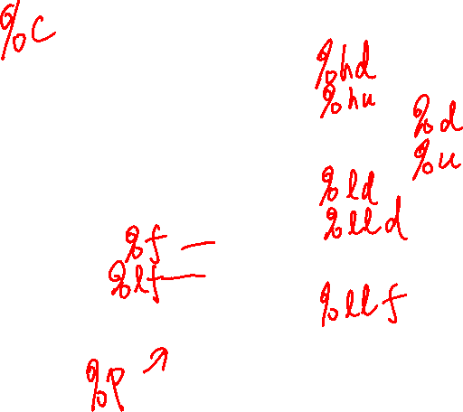
Variables in C
Integer types
char [default: unspecified!]
int [default: signed]
Floating Point
float, double [always signed]
Optional Modifiers for each base type
short [int]
long [int, double]
signed [char, int]
unsigned [char, int]
const: read only
char type
One byte in a byte addressable memory
Signed vs Unsigned implementation dependent
Be careful char is unsigned on arm and signed on other HW like intel
C Data Type | AArch-32 contiguous Bytes | AArch-64 contiguous Bytes
char (arm unsigned) | 1 | 1
short int | 2 | 2
unsigned short int | 2 | 2
int | 4 | 4
unsigned int | 4 | 4
long int | 4 | 8
long long int | 8 | 8
float | 4 | 4
double | 8 | 8
long double | 8 | 16
pointer * | 4 | 8
word size is the size of the address (pointer)
x

Slide 3
sizeof(): Variable Size (number of bytes) Operator
#include <stddef.h>
/* size_t type may vary by system but is always unsigned */
sizeof() operator returns a value of type size_t:
the number of bytes used to store a variable or variable type
size_t size = sizeof(variable_type);
or
size_t size = sizeof(variable_name); // preferred!
The argument to sizeof() is often an expression:
size = sizeof(int * 10);
reads as:
number of bytes required to store 10 integers (an array of [10])
x

Slide 4
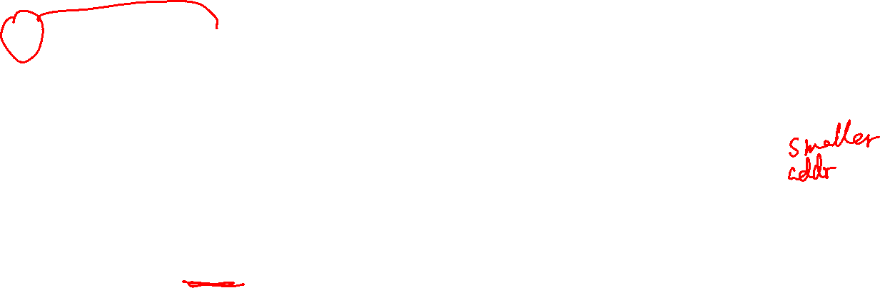
Memory Addresses & Memory Content
Given int x, y; // 4 bytes on pi cluster
x = x; // Lvalue = Rvalue
Variable name in a C statement evaluates to either:
Lvalue: when on the left side (Lside or Left value) of the = sign is the
address where it is stored in memory – a constant
Address assigned to a variable cannot be changed at runtime
Rvalue: when on the right side (Rside or Right value) of an = sign is the
contents or value stored in the variable (at its memory address)
requires a memory read to obtain
32-bit address
(hex)
(1 Byte)
0x9000100F
0x9000100E
0x9000100D
0x9000100C
00
0x9000100B
x's
contents (Rvalue)
00
0x9000100A
x's
address (Lvalue)
00
0x90001009
77
0x90001008
0x90001007
0x90001006
0x90001005
0x90001004
00
0x90001003
00
0x90001002
one int
0x90001001
01
08
0x90001000
x

Slide 5
Memory Addresses & Memory Content
y = 42;
x = y; // Lvalue = Rvalue
x on left side (Lside) of the assignment operator = evaluates to:
The address of the memory assigned to the x – this is x's Lvalue
y on right side (Rside) of the assignment operator = evaluates to:
READ the contents of the memory assigned to the variable y (type determines length – number of bytes) - this is y’s Rvalue
So x = y; is:
Read memory at y (Rvalue); write it to memory at x's address (Lvalue)
y
42
copy
x
42
x

Slide 6
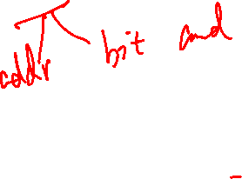
Introduction: Address Operator: &
Unary address operator (&) produces the address of where an identifier is in memory
Requirement: identifier must have a Lvalue
Cannot be used with constants (e.g., 12) or expressions (e.g., x + y)
&12 does not have an Lvalue, so &12 is not a legal expression
How can I get an address for use on the Rside? Three ways:
&var (any variable identifier or name)
function_name (name of a function, not func()); &funct_name is equivalent
array_name (name of the array like array_name[5]); &array_name is equivalent
x

Slide 7
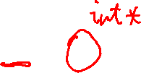
Introduction: Address Operator: &
Unary address operator (&) produces the address of where an identifier is in memory
Example: this might print:
value of g is: 42
address of g is: 0x71a0a0
(the address will vary)
Tip: printf() format specifier to display an address/pointer (in hex) is "%p"
int g = 42;
int
main(void)
{
printf("value of g is: %d\n", g);
printf("address of g is: %p\n", &g);
return EXIT_SUCCESS;
}
x

Slide 8

Introduction: Pointer Variables - 1
In C, there is a variable type for storing an address: a pointer
Contents of a pointer is an unsigned (0+, positive numbers) memory address
When the Rside of a variable contains a memory address, (it evaluates to an address) the variable is called a pointer variable
A pointer is defined by placing a star (or asterisk) (*) before the identifier (name)
type *name; // defines a pointer; name contains address of a variable of type
x

Slide 9
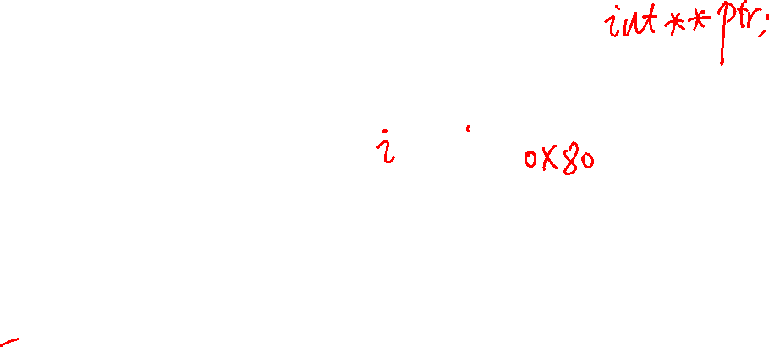
Introduction: Pointer Variables - 1
You also must specify the type of variable to which the pointer points
Recommended: be careful when defining multiple pointers on the same line:
is not the same as:
Use instead:
type *name; // defines a pointer; name contains address of a variable of type
int i = 42;
int *p; /* p contains the address of an integer */
p = &i; /* p "points at" i (assign address of i to p) */
i
42
p
int *p1, p2;
int *p1, *p2;
int *p1;
int *p2;
x

Slide 10
Introduction: Pointer Variables - 2
Pointers are typed! Why?
The compiler needs the size (sizeof()) of the data you are pointing at (number of bytes to access)
A pointer definition:
int *p = &i; /* p points at i (assign address i to p) */
Is the same as writing the following definition and assignment statements
int *p; /* p is defined (not initialized) */
p = &i; /* p points at i (assign address i to p */
The * is part of the definition of p and is not part of the variable name
The name of the variable is simply p, not *p
C mostly ignores whitespace, so these three definitions are equivalent
int *p = &i; /* Style A */
int * p = &i; /* Style B */
int* p = &i; /* Style C */
x

Slide 11
Introduction: Pointer Variables - 3
As with any variable, its value can be changed
p = &j; /* p now points at j */
p = &i; /* p now points at i */
i
42
j
77
p
i
42
j
77
p
x

Slide 12
Introduction: Pointer Variables - 4
Pointer variables all use the same amount of memory no matter what they point at
Above prints on a 32-raspberry pi
int *iptr;
char *cptr;
printf("iptr(%u) cptr(%u)\n", sizeof(iptr), sizeof(cptr));
iptr(4) cptr(4)
x

Slide 13
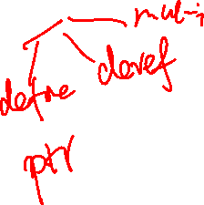
Introduction: Indirection (or dereference) Operator: *
The indirection operator (*) or the dereference operator to a variable is the inverse of the address operator (&)
address operator (&) can be thought of as:
“get the address of this box”
indirection operator (*) can be thought of as:
“follow the arrow to the next box and get its contents”
i or (*p)
42
p = &i
x

Slide 14
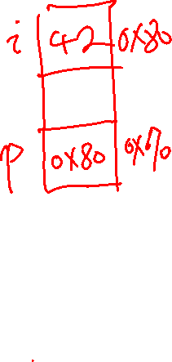
Introduction: Indirection (or dereference) Operator: *
Contents of p is the address of i (p points at i)
int i = 42;
int j = i;
int *p;
p = &i;
printf("*p is %d\n", *p);
% ./a.out
*p is 42
x

Slide 15
Introduction: Indirection Operator Rside
Performs the following steps when the * is on the Rside:
read the contents of the variable to get an address
read and return the contents at that address
(requires two reads of memory on the Rside)
z = *x; // copy the contents of memory pointed at by x to z
read (address)
read
Rside x
0x0c
z
0x0c
copy
x

Slide 16
Introduction: Indirection Operator Lside
Performs the following steps when the * is on the Lside:
read the contents of the variable to get an address
write the evaluation of the Rside expression to that address
(requires one read of memory and one write of memory on the Lside)
*z = x; // copy the value of x to the memory pointed at by z
int x
0x0c
copy
Lside z
0x0c
read (address)
write
x

Slide 17
Each use of a * operator results in one additional read -1
Each * when used as a dereference operator in a statement (Lside and Rside) generates an additional read
int z = 2, y = 1;
int *x;
x = &y;
z = *x; // two reads
int x = 2, y = 1;
x = y; // one read
y
read
1
x
1
y
x
1
read (address)
write
read
z
1
write
x

Slide 18
Each use of a * operator results in one additional read -2
Each * when used as a dereference operator in a statement (Lside and Rside) generates an additional read
int z = 2, y = 1; int *x;
int *w;
x = &y;
w = &z;
*x = *w;
int z = 2, y = 1;
int *x;
x = &y;
*x = z;
x
2
y
read address
write
x
2
y
z
2
read address
write
read
w
2
z
read address
read
x

Slide 19
Recap: Lside, Rside, Lvalue, Rvalue
Constant Lvalue Rvalue
Var Name address Contents
y 0x108
int x = 2, y = 1;
x = y;
0x1
read
x 0x104
0x1
write
int z = 2, y = 1; int *x;
int *w;
x = &y;
w = &z;
*x = *w;
Constant Lvalue Rvalue
Var Name address Contents
x 0x10c
y 0x108
z 0x104
w 0x100
0x108
read (address)
0x2
write
0x1
*x on Lside is 0x108
w on Rside is 0x100
*w on Rside is 2
0x2
read
0x104
read (address)
x

Slide 20
Pointer Practice
Declares a variable, ptr, which is a pointer to (it contains the address of) an int in memory
int *ptr;
int x = 5;
int y = 2;
ptr = &x;
y = 1 + *ptr;
x = *(&y);
ptr
Declares two variables, x and y, that contain ints, and initializes them to 5 and 2, respectively
x
5
write
y
2
write
write
Sets ptr to contain the address of x
(“ptr points to x”)
x
ptr
5
y
2
Sets y to “1 plus the value stored at the address held by ptr. Because ptr points to x, this is equivalent to y = 1 + x;
read
x
ptr
5
read
“Dereference ptr”
y
6
write
Sets x = y; The * and & cancel each other. get the address of y and then get the contents pointed by that address
x
ptr
6
write
y
6
read
x

Slide 21
The NULL Constant and Pointers
NULL is a constant that evaluates to zero (0)
You assign a pointer variable to contain NULL to indicate that the pointer does not point at anything
A pointer variable with a value of NULL is called a “NULL pointer” (invalid address!)
Memory location 0 (address is 0) is not a valid memory address in any C program
Dereferencing NULL at runtime will cause a program fault (segmentation fault)!
p = NULL;
i = *p; /* segmentation fault! */
*(int *)900000 = 25; /* cast 900000 to a pointer */
/* if writeable address space, it works */
/* that memory location just changed */
x

Slide 22
Using the NULL Pointer
Many functions return NULL to indicate an error has occurred
NULL is considered "false" when used in a Boolean context
Remember: false expressions in C are defined to be zero or NULL
The following two are equivalent (the second one is preferred for readability):
/* these are all equivalent */
int *p = NULL;
int *p = (int *)0; // cast 0 to a pointer type
int *p = (void *)0; // automatically gets converted to the correct type
if (p) ... if (p != NULL) ...
x

Slide 23
What is Aliasing?
Two or more variables are aliases of each other when they all reference the same memory (so different names, same memory location)
When one pointer is copied to another pointer it creates an alias
Side effect: Changing one variables value (content) changes the value for other variables
Multiple variables all read and write the same memory location
Aliases occur either by accident (coding errors) or deliberate (careful: readability)
int i = 5;
int *p;
int *q;
p = &i;
q = p; // *p & *q are aliases
*q = 4; // changes i
p
4
i
*p and *q are aliases
q
Result *p, *q and i all have the value of 4
x

Slide 24
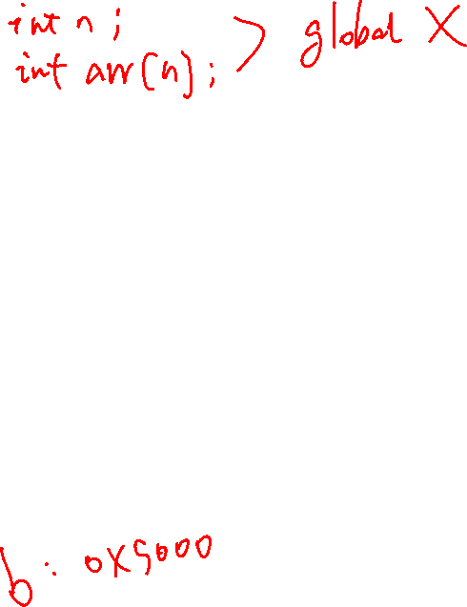
Defining Arrays
Definition: type name[count]
"Compound" data type where each value in an array is an element of type
Allocates name with a fixed count array elements of type type
Allocates (count * sizeof(type)) bytes of contiguous memory
Common usage is to specify a compile-time constant for count
Array names are constants and cannot be assigned (the name cannot appear on the Lside by itself)
1 word
(int = 4 bytes)
high
memory
address
??
??
??
??
#define BSZ 6
int b[BSZ];
BSZ is a macro replaced by the C preprocessor at compile time
??
??
??
??
b[5]
??
9020
a = b; // invalid does not copy the array
// copy arrays element by element
b[4]
??
9016
b[3]
??
9012
b[2]
??
9008
b[1]
??
9004
int b[6];
b[0]
??
9000
x

Slide 25
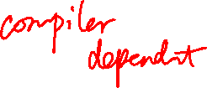
Array Initialization
1 word (int = 4 bytes)
Initialization: type name[count] = {val0,…,valN};
{ } (optional) initialization list can only be used at time of definition
If no count supplied, count is determined by compiler using the number of array initializers
int block[20] = {}; //only works with constant size arrays
defines an array of 20 integers each element filled with zeros
Performance comment: do not zero automatic arrays unless really needed!
When a count is given:
extra initialization values are ignored
missing initialization values are set to zero
??
high
address
??
??
??
no initialization values given; then elements are initialized to 0
??
??
??
??
b[5]
??
90020
11
90016
b[4]
00
6
b[3]
00
90012
5
90008
b[2]
00
int block[5] = {2, 3, 5, 6, 11, 13};
3
90004
b[1]
00
2
90000
b[0]
00
not needed and if used may truncate initialization list
6 initialization values given, only 5 are used
low
address
x

Slide 26
Accessing Arrays Using Indexing
1 word
(int = 4 bytes)
name[index] selects the index element of the array
index should be unsigned
Elements range from: 0 to count – 1 ( int x[count]; )
name[index] can be used as an assignment target or as a value in an expression
Array name (by itself with no [ ]) on the Rside evaluates to the address of the first element of the array
??
high
address
??
int a[5];
int b[5];
??
9020
b[4]
??
9016
b[3]
??
9012
b[2]
??
9008
int b[5];
int *p = b;
??
b[1]
9004
9000
b[0]
??
9000
p
low
address
x

Slide 27
How many elements are in an array?
1 word
(int = 4 bytes)
The number of elements of space allocated to an array (called element count) and indirectly the total size in bytes of an array is not stored anywhere!!!!!!
An array name is just the address of the first element in a block of contiguous memory
So an array does not know its own size!
high
memory
address
??
??
??
??
??
??
??
#define SZ 6
int block[SZ]; // you specify the array has SZ elements
int indx; // use when SZ is defined
for (indx = 0; indx < SZ; indx++)
block[indx] = 0;
??
b[5]
??
90020
b[4]
??
90016
b[3]
??
90012
b[2]
??
90008
b[1]
??
90004
int b[6];
b[0]
??
90000
x

Slide 28
Determining Element Count for a compiler calculated array
Programmatically determining the element count in a compiler calculated array
sizeof(array) / sizeof(of just one element in the array)
sizeof(array) only works when used in the SAME scope as where the array variable was defined
#include <stddef.h>
int block[] = {2, 3, 5, 6, 11, 13}; // automatic: compiler calculates array size
int cnt = (int)(sizeof(block) / sizeof(block[0])); // in this case cnt = 6
for (int indx = 0; indx < cnt; indx++)
block[indx] = 0;
x

Slide 29
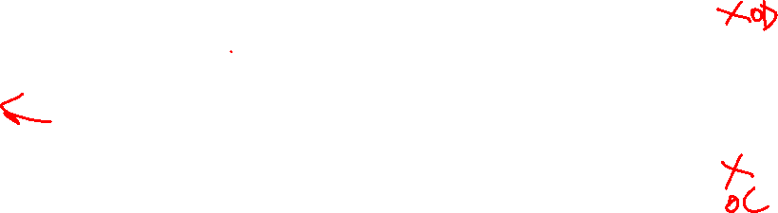
Pointer and Arrays - 1
1 byte Memory Content
One byte per row
A few slides back we stated: Array name (by itself) on the Rside evaluates to the address of the first element of the array
Array indexing syntax ([ ]) an operator that performs pointer arithmetic
buf and &buf[0] on the Rside are equivalent, both evaluate to the address of the first array element
Byte
Memory
Address
int buf[] = {2, 3, 5, 6, 11};
p2
0x00
0x12345687
0x00
0x12345686
0x00
0x12345685
0x03
0x12345684
p1
0x00
0x12345683
0x00
0x12345682
int *p = buf; // or int *p = &buf[0];
int *p1 = &buf[1];
int *p2 = &buf[2];
int *p3 = &buf[3];
*p = *p + 10;
*p1 = *p1 + 10; // {12, 13, 5, 6, 11}
0x12345681
0x00
0x02
0x12345680
p
x

Slide 30
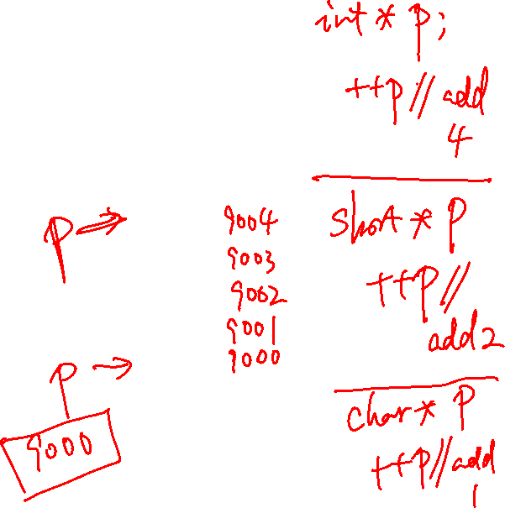
Pointer and Arrays - 2
1 byte Memory Content
One byte per row
When p is a pointer, the actual value of (p+1) depends on the type that pointer p points at
(p+1) adds 1 x sizeof(what p points at) bytes to p
++p is equivalent to p = p + 1
Using pointer arithmetic to find array elements:
Address of the second element &buf[1] is (buf + 1)
It can be referenced as *(buf + 1) or buf[1]
index
buf[2]
pointer
*(buf+2)
pointer
*(p+2)
0x00
0x00
0x00
0x03
buf[1]
*(buf+1)
*(p+1)
0x00
int buf[] = {2, 3, 5, 6, 11};
int *p;
p = buf;
*p = *p + 10;
*(p + 1) = *(p + 1) + 10; // {12, 13, 5, 6, 11}
0x00
0x00
0x02
buf[0]
*buf
*p
x

Slide 31
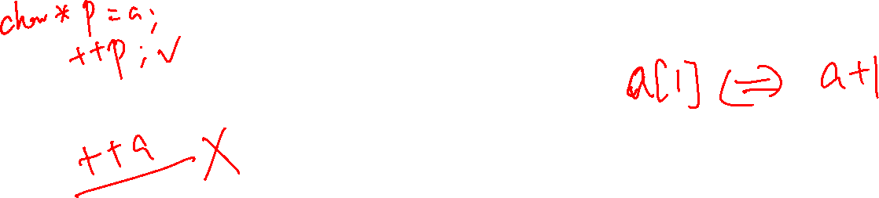
Pointer Arithmetic In Use – C's Performance Focus
address
&a[3]
a+3
a+2
&a[2]
char a[] = {'A', 'B', 'C'};
a+1
&a[1]
a
&a[0]
Alert!: C performance focus does not perform any array “bounds checking”
Performance by Design: bound checking slows down execution of a properly written program
Example: array a of length i, C does not verify that a[ j ] or *(a + j) is valid (does not check: 0 ≤ j < i)
C simply “translates” and accesses the memory specified from: a[j] to be *(a + j)which may be outside the bounds of the array
OS only "faults" for an incorrect access to memory (read-only or not assigned to your process)
It does not fault for out of bound indexes or out of scope
lack of bound checking is a common source of errors and bugs and is a common criticism of C
x

Slide 32
Pointer Arithmetic
p+3
0x08c
You cannot add two pointers (what is the reason?)
A pointer q can be subtracted from another pointer p when the pointers are the same type – best done only within arrays!
The value of (p-q) is the number of elements between the two pointers
Using memory address arithmetic (p and q Rside are both byte addresses):
4-byte integer
int *q = p+2;
p+2
0x088
4-byte integer
distance in elements = (p − q) / sizeof(∗p)
(p + 3) – p = 3 = (0x08c – 0x080)/4 = 3
p+1
0x084
4-byte integer
int *p;
p
0x080
x

Slide 33
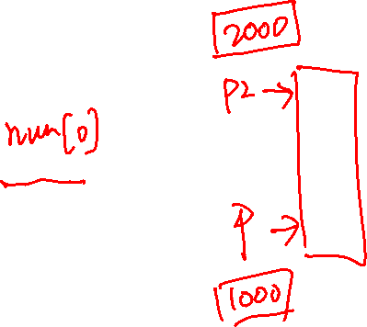
Pointer Comparisons
Pointers (same type) can be compared with the comparison operators:
<, <=, ==, !=, >=, >
Invalid, Undefined, or risky pointer arithmetic (some examples)
Add, multiply, divide on two pointers
Subtract two pointers of different types or pointing at different arrays
Compare two pointers of different types
Subtract a pointer from an integer
int numb[] = {9, 8, 1, 9, 5};
int *end;
int *a;
end = numb + (int) (sizeof(numb)/sizeof(*numb));
a = numb;
while (a < end) // compares two pointers (address)
/* rest of code including doing an a++ */
x

Slide 34
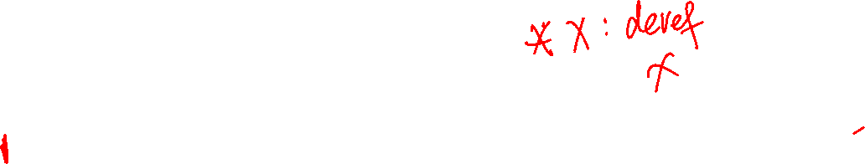
Fast Ways to "Walk" an Array: Use a Limit Pointer
xpt
0x??
0x1234568c
int x[] = {0xd4c3b2a1, 0xd4c3b200, 0x12345684};
int cnt = (int)(sizeof(x) / sizeof(*x));
int *ptr;
int *xpt;
ptr = x; //or &x[0]
xptr = ptr + cnt;
while (ptr < xpt) {
printf("%#x\n", *ptr);
ptr++;
}
0x12
0x1234568b
0x??
0x34
0x1234568a
0x??
0x56
0x12345689
0x??
0x84
0x12345688
0x??
0xd4
0x12345687
0x??
cnt = 3;
bytes = cnt * sizeof(*x);
= 12
0xc3
0x??
0x12345686
0xb2
0x12345685
0x??
xpt is a loop limit pointer
it points 1 element past the end of the array
0x00
0x??
0x12345684
0xd4
0x??
0x12345683
0xc3
0x??
0x12345682
0xb2
% ./a.out
0xd4c3b2a1
0xd4c3b200
0x12345684
0x??
0x12345681
0x??
ptr
0xa1
0x12345680
0x??
0x1234567f
1 byte
x

Slide 35
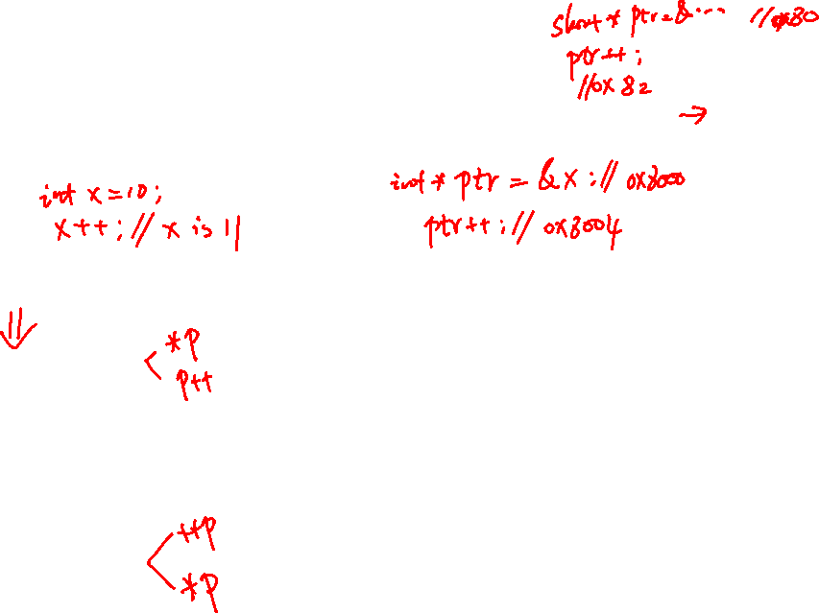
C Precedence and Pointers
++ -- pre and post increment combined with pointers can create code that is complex, hard to read and difficult to maintain
Use () to help readability
common | With Parentheses | Meaning
*p++ | *(p++) | The Rvalue is the object that p points at increment pointer p to next element ++ is higher than *
(*p)++ |  | Rvalue is the object that p points at increment the object
*++p | *(++p) | Increment pointer p first to the next element Rvalue is the object that the incremented pointer points at
++*p | ++(*p) | Rvalue is the incremented value of the object that p points at
x

Slide 36
C Strings - 1
C does not have a dedicated type for strings
Strings are an array of characters terminated by a sentinel termination character
'\0' is the Null termination character; has the value of zero (do not confuse with '0')
An array of chars contains a string only when it is terminated by a '\0'
Length of a string is the number of characters in it, not including the '\0'
Strings in C are not objects
No embedded information about them, you just have a name and a memory location
You cannot use + or += to concatenate strings in C
For example, you must calculate string length using code at runtime looking for the end
length of the string: number of char (= 5)
index | 0 | 1 | 2 | 3 | 4 | 5
char | 'H' | 'e' | 'l' | 'l' | 'o' | '\0'
length (size) of the array in number of char (= 6)
x

Slide 37
C Strings - 2
First'\0' encountered from the start of the string always indicates the end of a string
The '\0' does not have to be in the last element in the space allocated to the array
But, String length is always less than the size of the array it is contained in
In the example below, the array buf contains two strings
One string starts at &(buf[0]) is "cat" with a string length of 3
The other string starts at &(b[4]) is "o" with a string length of 1
"o" has two bytes: 'o' and '\0'
string length: number of char (= 3)
string length: number of char (= 1)
index | 0 | 1 | 2 | 3 | 4 | 5
buf | 'c' | 'a' | 't' | '\0' | 'o' | '\0'
 | 0x63 | 0x61 | 0x74 | 0x00 | 0x6f | 0x00
length (size) of the array in number of char (= 6)
x

Slide 38
Defining Strings: Initialization
When you combine the automatic length definition for arrays with double quote(") initialization
Compiler automatically adds the null terminator '\0' for you
char a[4] = {'c', 'a', 't', '\0'};
char b[] = "cat"; // compiler calculates size, adds '\0'
char c[] = {'c', 'a', 't', '\0', 'a, 'b'}; // array size 6, string length 3
char empty[] = ""; // empty string – contains '\0'
// string length = 0
x

Slide 39

Defining Strings: Initialization Equivalents
Following definitions create equivalent 4-character arrays
These are all strings as they all include a null ('\0') terminator
char a[4] = {'c', 'a', 't', '\0'};
char b[4] = {'c', 'a', 't', 0};
char c[4] = {'c', 'a', 't'}; // missing initial value defaults to 0
char d[4] = { 99, 97, 116, 0}; // 99 = 'c', 97 = 'a', 116 = 't'
char e[4] = "cat";
char f[4] = "cat\0"; // literal has 5 chars; array f string
// length is 3
x

Slide 40

Background: Different Ways to Pass Parameters
Call-by-reference (or pass by reference)
Parameter in the called function is an alias (references the same memory location) for the supplied argument
Modifying the parameter modifies the calling argument
Call-by-value (or pass by value) (C)
What Called Function Does
Passed Parameters are used like local variables
Modifying the passed parameter in the function is allowed just like a local variable
So, writing to the parameter, only changes the copy
The return value from a function in C is by value
x

Slide 41
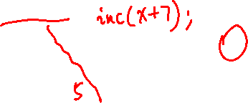
Passing Parameters – Call by Value Example
int main(void)
{
int x = 5;
inc(x); // makes a copy of x
printf("%d\n", x); // 5 or 6 ?
}
void inc(int i) // i is local to inc
{
++i;
}
if this was an expression like inc(x+1) it evaluates and stores the result in the memory allocated for the copy
x
scope main()
different memory locations
copy of contents
i
scope inc()
when inc(x) is called, a copy of x is made to another memory location
inc() cannot change the variable x since inc() does not have the address of x, it is local to main() so, 5 is printed
The inc() function is free to change it's copy of the argument (just like any local variable) remember it does NOT change the parameter in main()
x

Slide 42
Output Parameters
Passing a pointer parameter with the intent that the called function will use the address it to store values for use by the calling function, then pointer parameter is called an output parameter
To pass the address of a variable x use the address operator (&x) or the contents of a pointer variable that points at x, or the name of an array (the arrays address)
To be receive an address in the called function, define the corresponding parameter type to be a pointer (add *)
It is common to describe this method as: “pass a pointer to x
C is still using “pass by value”
we pass the value of the address/pointer in a parameter copy
The called routine uses the address to change a variable in the caller's scope
void inc(int *p);
int
main(void)
{
int x = 5;
inc(&x);
printf("%d\n", x);
return EXIT_SUCCESS;
}
void
inc(int *p)
{
if (p != NULL)
*p += 1; // or (*p)++
}
x

Slide 43
Example Using Output Parameters
At the Call to inc() in main()
Allocate space for p
Copy x's address into p
void inc(int *p);
int
main(void)
{
int x = 5;
inc(&x);
printf("%d\n", x);
return EXIT_SUCCESS;
}
void
inc(int *p)
{
if (p != NULL)
*p += 1; // or (*p)++
}
x
6
5
0x1014
Pass the address of x (&x)
0x1010
0x100c
0x1008
0x1004
Receive an address copy (int *p)
p
0x1014
0x1000
Word address
With a pointer to X,
inc() can change x in main()
this is called a side effect
p just like any other local variable
Write to the output variable (*p)
x

Slide 44

Array Parameters: Call-By-Value or Call-By-Reference?
Type[] array parameter is automatically “promoted” to a pointer of type Type *, and a copy of the pointer is passed by value
Call-by-value pointer (callee can change the pointer parameter to point to something else!)
Acts like call-by-reference (called function can change the contents caller’s array)
int main(void)
{
int numbers[] = {9, 8, 1, 9, 5};
passa(numbers);
printf(”numbers size:%lu\n", sizeof(numbers)); // 20
return EXIT_SUCCESS;
}
void passa(int a[])
{
printf(”a size:%lu\n", sizeof(a)); // 4
return;
}
IMPORTANT:
See the size difference 20 in main() in passa() is 4 bytes (size of a pointer)
x

Slide 45
Arrays As Parameters: What is the size of the array?
It’s tricky to use arrays as parameters, as they are passed as pointers to the start of the array
In C, Arrays do not know their own size and at runtime there is no “bounds” checking on indexes
int sumAll(int a[]);
int main(void)
{
int numb[] = {9, 8, 1, 9, 5};
int sum = sumAll(numb);
return EXIT_SUCCESS;
}
int sumAll(int a[])
{
int i, sum = 0;
int sz = (int) (sizeof(a)/sizeof(*a));
for (i = 0; i < sz; i++) // this does not work
sum += a[i];
}
}
the name is the address, so this is
passing a pointer to the start of the array
“inside” the body of sumAll(), the question is:
how big is that array? all I have is a POINTER to the first element…..
sz is a 1 on 32 bit arm
x

Slide 46
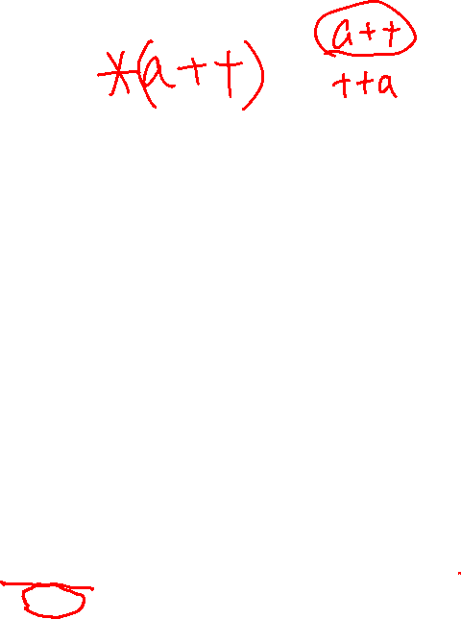
Arrays As Parameters, Approach 1: Pass the size
Two ways to pass array size
pass the count as an additional argument
add a sentinel element as the last element
int sumAll(int *a, int size);
int main(void)
{
int numb[] = {9, 8, 1, 9, 5};
int cnt = sizeof(numb)/sizeof(numb[0]);
printf("sum is: %d\n", sumAll(numb, cnt););
return EXIT_SUCCESS;
}
remember you can only use sizeof() to calculate element count where the array is defined
1 word content
(int = 4 bytes)
end
0x114
0x??
int sumAll(int *a, int size)
{
int sum = 0;
int *end;
end = a + size;
while (a < end)
sum += *a++;
return sum;
}
5
0x110
0x10c
0x108
0x104
0x100
9
1
same as:
sum = sum + *a;
a++;
a
8
0x100
numb
9
0x??
address
x

Slide 47
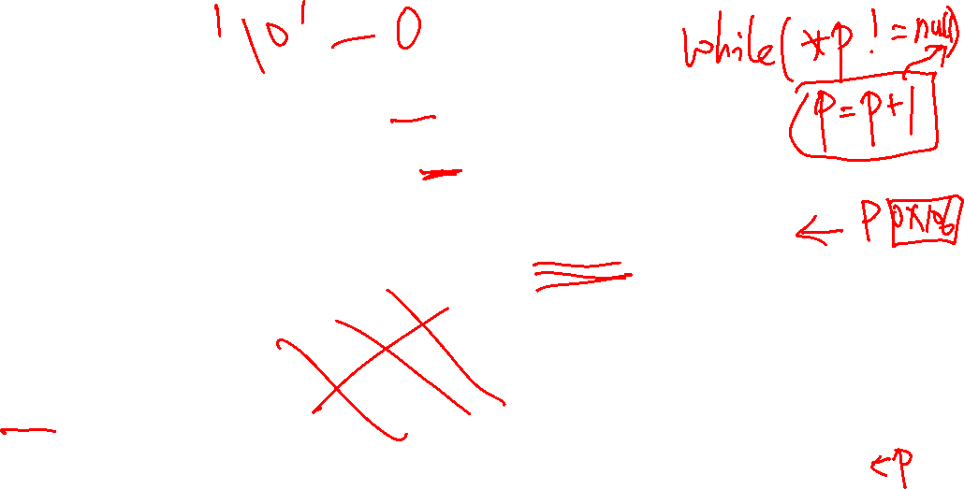
Arrays As Parameters, Approach 2: Use a sentinel element
A sentinel is an element that contains a value that is not part of the normal data range
Forms of 0 are often used (like with strings). Examples: '\0', NULL
int strlen(char *a);
int main(void)
{
char buf[] = {'a', 'b', 'c', 'd', 'e', '\0'}; // string
printf("Number of chars is: %d\n", strlen(buf));
return EXIT_SUCCESS;
}
1 byte
/* Assumes parameter is a terminated string */
int strlen(char *s)
{
char *p = s;
if (p == NULL)
return 0;
while (*p++)
;
return (p – s - 1);
}
p
0x105
'\0'
'e'
0x104
0x103
0x102
0x101
0x100
'd'
'c'
s
'b'
0x100
buf
'a'
0x??
address
x

Slide 48
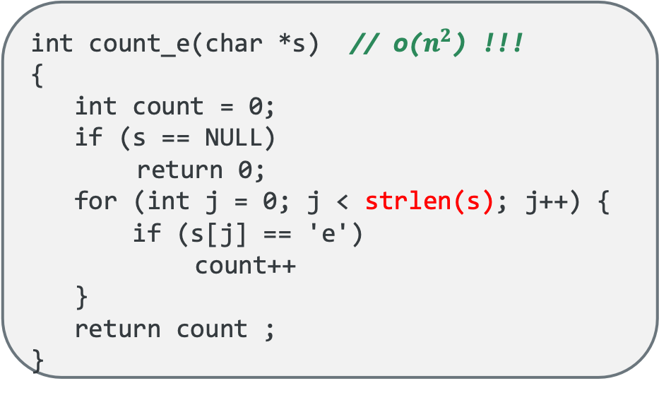
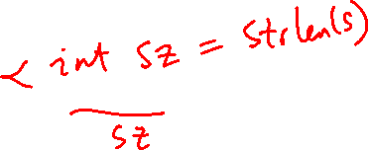
Do not overuse strlen()
C string library function strlen() calculates string length at runtime
Do not overuse strlen(), as it walks the array each time called
int count_e(char *s) // o($n^{2}$) !!!
{
int count = 0;
if (s == NULL)
return 0;
for (int j = 0; j < strlen(s); j++) {
if (s[j] == 'e')
count++
}
return count ;
}
int count_e(char *s) // o(n) !!!
{
int count = 0;
if (s == NULL)
return 0;
while (*s) {
if (*s++ == 'e')
count++
}
return count ;
}
same as:
while (*s != '\0') {
if (*s == 'e')
count++;
s++;
}
x

Slide 49
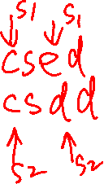
Comparing stings
Characters can be easily compared (c1 < c2) as they are numbers, so the character order is determined by the ASCII values assigned to each character
65 = A 66 = B 67 = C 68 = D 69 = E 70 = F 71 = G, and so on.
Example: the following strings are in lexicographical (alphabetical) order:
"" "a" "az" "c" "cab" "cabin" "cat" "catastrophe"
Compare two strings lexicographically (i.e., comparing ASCII values), subtract one from the other
int strcmp(char *s1, char *s2)
{
while (*s1 == *s2) {
if ((*s1 == '\0') || (*s2 == '\0'))
break;
s1++;
s2++;
}
return *s1 - *s2; // character difference
}
Return Value | Comparison
< 0 | s1 < s2
> 0 | s1 > s2
= 0 | s1 == s2
x

Slide 50
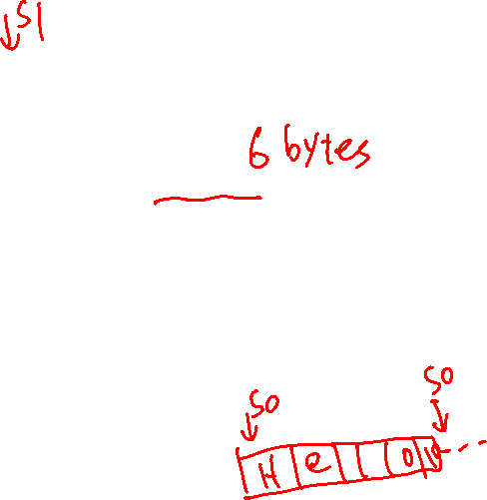
Copying Strings: Use the Sentinel; libc: strcpy(), strncpy()
To copy an array, you must copy each character from source to destination array
Watch overwrites: strcpy assumes the target array size is equal or larger than source array
index | 0 | 1 | 2 | 3 | 4 | 5
char | 'H' | 'e' | 'l' | 'l' | 'o' | '\0'
// strncpy adds a length limit on copy
char str1[6];
strncpy(str1, "hello", 5); // \0 not copied
str1[5] = '\0'; // make sure \0 terminated
char str1[80];
strcpy(str1, "hello");
char *strcpy(char *s0, char *s1)
{
char *str = s0;
if ((s0 == NULL) || (s1 == NULL))
return NULL;
while (*s0++ = *s1++)
;
return str;
}
char *strncpy(char *s0, char *s1, int len)
{
char *str = s0;
if ((s0 == NULL) || (s1 == NULL))
return NULL;
while ((*s0++ = *s1++) && --len)
;
return str;
}
x

Slide 51

Reference: Some String Routines in libc (#include <string.h>)
Function | Description
strlen(str) | returns the # of chars in a C string (before null-terminating character).
strcmp(str1, str2), strncmp(str1, str2, n) | compares two strings; returns 0 if identical, <0 if str1 comes before str2 in alphabet, >0 if str1 comes after str2 in alphabet. strncmp stops comparing after at most n characters.
strchr(str, ch) strrchr(str, ch) | character search: returns a pointer to the first occurrence of ch in str, or NULL if ch was not found in str. strrchr find the last occurrence.
strstr(haystack, needle) | string search: returns a pointer to the start of the first occurrence of needle in haystack, or NULL if needle was not found in haystack.
strcpy(dst, src), strncpy(dst, src, n) | copies characters in src to dst, including null-terminating character. Assumes enough space in dst. Strings must not overlap. strncpy stops after at most n chars, and does not add null-terminating char.
strcat(dst, src), strncat(dst, src, n) | concatenate src onto the end of dst. strncat stops concatenating after at most n characters. Always adds a null-terminating character.
strspn(str, accept), strcspn(str, reject) | strspn returns the length of the initial part of str which contains only characters in accept. strcspn returns the length of the initial part of str which does not contain any characters in reject.

Slide 52
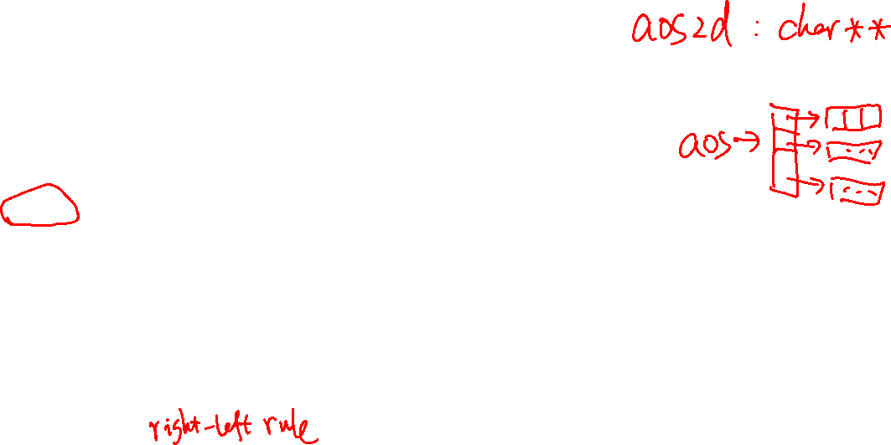
2D Array of Char (where elements may contain strings)
2D array of chars (where rows may include strings)
Each row has the same fixed number of memory allocated
All the rows are the same length regardless of the actual string length)
The column size must be large enough for the longest string
char aos2d[3][22] = {"my", "two dimensional", "char array"};
high
memory
aos2d[2]
c | h | a | r |  | a | r | r | a | y | '\0'
t | w | o |  | d | i | m | e | n | s | i | o | n | a | l |  | a | r | r | a | y | '\0'
m | y | '\0'
aos2d[1]
aos2d[0]
low
memory
high
memory
#define ROWS 3
char aos[ROWS][22] = { "my", "two dimensional", "char array"};
char (*ptc)[22] = aos; // ptr points at a row of 22 chars
for (int i = 0; i < ROWS; i++)
printf("%s\n", *(ptc + i));
x

Slide 53
Pointer Array to Strings (This is NOT a 2D array)
2D char arrays are an inefficient way to store strings (wastes memory) unless all the strings are similar lengths, so 2D char arrays are rarely used with string elements
An array of pointers is common for strings as "rows" can very in length
aos is an array of pointers; each pointer points at a character array (also a string here)
Not a 2D array, but any char can be accessed as if it was in a 2D array of chars
o | f |  | p | o | i | n | t | e | r | s | '\0'
aos[2][0]
aos[2][11]
aos[2]
aos[1]
o | n | e |  | d | i | m | e | n | s | i | o | n | a | l |  | a | r | r | a | y | '\0'
aos[0]
aos[0][0]
aos[0][2]
m | y | '\0'
x

Slide 54

main() Command line arguments: argc, argv
Arguments are passed to main() as a pointer to an array of pointers (**argv or *argv[])
Conceptually: % *argv[0] *argv[1] *argv[2] ….
argc is the number of VALID elements (they point at something)
*argv (argv[0]) is usually is the name of the executable file (% ./vim file.c)
*(argv + argc) always contains a NULL (0) sentinel
*argv[] (or **argv) elements point at mutable strings!
NULL
argv[2][0]
argv+3
argv+2
.% ./extract –c 3
(space between c and 3)
3
\0
argv+1
argv+0
printf("%s\n", *(argv+0));
printf("%s\n", *(argv+1));
printf("%s\n", *(argv+2));
argv[1][1]
-
c
\0
argv[0][0]
argv[0][8]
argv
argc
3
.
/
e
x
t
r
a
c
t
\0
x

Slide 55
main() Command line arguments: argc, argv
NULL
argv[2][0] or **(argv + 2)
argv+3
argv+2
.% ./extract –c 3
(space between c and 3)
3
\0
argv+1
argv+0
argv[1][1] or *(*(argv + 1)+1)
-
c
\0
argv[0][0] equiv to **(argv+0)
**(argv+0) equiv **argv
argv[0][8] equiv *(*argv + 8)
char *pt = *argv;
*pt equiv to **(argv+0)
*(pt+8) equiv to *(*argv + 8)
argv[0][8]
argv
argv[0][0]
argc
3
.
/
e
x
t
r
a
c
t
\0
x

Slide 56
main() Command line arguments: argc, argv
NULL
argv[2][0] or **(argv + 2)
argv+3
argv+2
.% ./extract –c 3
(space between c and 3)
3
\0
argv+1
argv+0
argv[1][1] or *(*(argv + 1)+1)
-
c
\0
argv[0][0]
argv[0][8]
argv
argc
3
.
/
e
x
t
r
a
c
t
\0
int main(int argc, char *argv[])
{
for (int i = 0; argv[i] != NULL; i++) {
for (int j = 0; argv[i][j] != '\0'; j++)
putchar(argv[i][j]);
putchar('\n');
}
return EXIT_SUCCESS;
}
int main(int argc, char **argv)
{
char *pt;
while ((pt = *argv++) != NULL) {
while (*pt != '\0')
putchar(*pt++);
putchar('\n');
}
return EXIT_SUCCESS;
}
x

Slide 57
main() Command line arguments: argc, argv
NULL
**(argv + 2)
argv+3
argv+2
argv+2
NULL
3
\0
argv+1
argv+1
argv+0
argv+0
*(*(argv + 1) + 1)
*(*(argv + 1)+2)
-
c
\0
-
c
3
\0
argv
**argv
*(*argv + 8)
*(*argv + 8)
argv
**argv
argc
3
.
/
e
x
t
r
a
c
t
\0
argc
2
.
/
e
x
t
r
a
c
t
\0
.% ./extract –c 3
(space between c and 3)
.% ./extract –c3
(No space between c and 3)
x

Slide 58
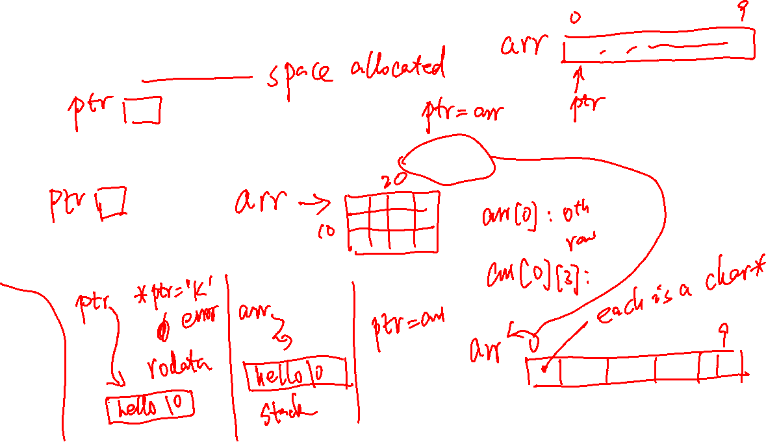
Pointers…..
char * ptr vs char arr[10]
char** ptr vs char arr[10][20] vs char* arr[10]
char *ptr = “hello” vs char arr[10] = “hello”

Slide 59
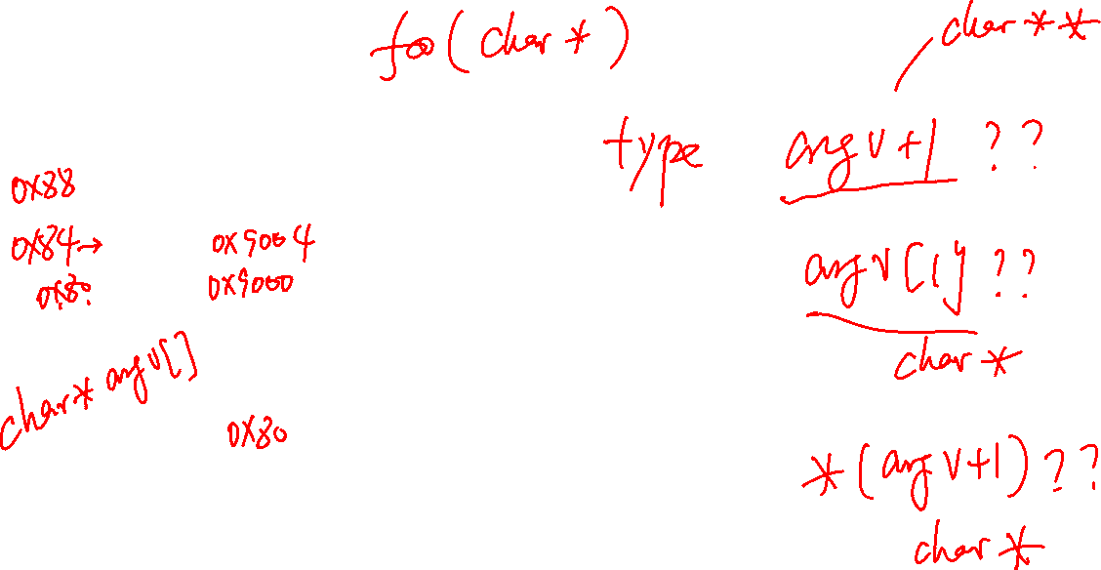
Pointers…..
What’s the type of the following items?
argv+2
NULL
argv+1
argv+0
-
c
3
\0
argv
argc
2
.
/
e
x
t
r
a
c
t
\0

Slide 60
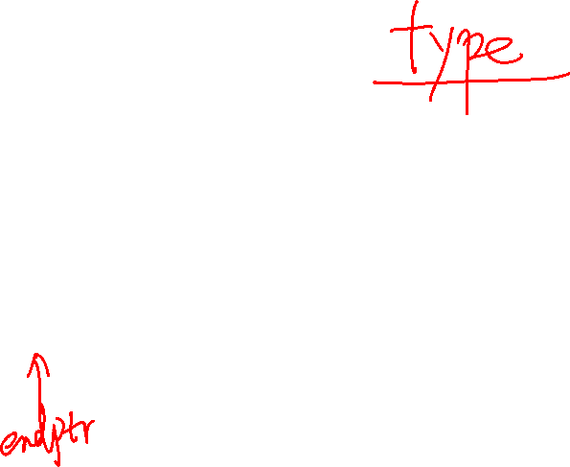
PA4: Creating a 2D Array of Mutable String Pointers
Break a string of comma separated words into individual strings without copying. Do This by walking the string until you see an either a comma , or a newline \n. Each points at a field or column in a record.
Record the start of each string into successive elements in an array of pointers
Replace each comma or newline with a null '\0'
char *buf
buf[0] | buf[1] | buf[2] | buf[3] | buf[4] | buf[5] | buf[6] | buf[7] | buf[8] | buf[9] | buf[10] | buf[11] | buf[12] | buf[13]
c | s | e | , | 1 | 0 | 0 | , | L | i | n | e | '\n' | '\0'
'\0'
'\0'
'\0'
// extrack of token(), passed buf, ptable and cnt
char **endptr = ptable + cnt;
*ptable = buf;
while ((ptable < endpt) && (*buf != '\0')) {
*ptable++ = buf;
while (*buf != '\0') {
/* process chars including buf++ */
}
}
// check for too many or too few fields
char **ptable
ptable | ptable+1 | ptable+2
./extract –c3
x

Slide 61
Review: Pointer Array to Strings
How to access: aos[1][1] is *(*(aos + 1) + 1) which contains 'n’
its address is (*(aos + 1) + 1)
aos+2 is not shown due to space limits on the slide
aos[2]
o | f |  | p | o | i | n | t | e | r | s | '\0'
aos[1]
o | n | e |  | d | i | m | e | n | s | i | o | n | a | l |  | a | r | r | a | y | '\0'
aos[0]
m | y | '\0'
*( *(aos+1) + 1)
*( *(aos+1) + 3)
aos+2
*(aos+1)
o | n | e | …
aos+1
*( *(aos+1) + 2)
**(aos+1)
char *ptr;
ptr = *aos;
*ptr ='X';
if (*ptr == ',')
or
if (**aos) == ','
aos
*(*aos + 1)
Notice that the first elements address is the array name
*aos
(address)
m | y | '\0'
**aos
*(*aos + 2)
x

Slide 62
Process Memory Under Linux
0xFF…FF
OS kernel [protected]
When your program is running it has been loaded into memory and is called a process
Stack segment: Stores Local variables
Allocated and freed at function call entry & exit
Data segment + BSS: Stores Global and static variables
Allocated/freed when the process starts/exits
BSS - Static variables with an implicit initial value
Static Data - Initialized with an explicit initial value
Heap segment: Stores dynamically-allocated variables
Allocated with a function call
Managed by the stdio library malloc() routines
Read Only Data: Stores immutable Literals
Text: Stores your code in machine language + libraries
Stack
per process address space
Heap
BSS
Data
Read Only Data
Read Only Text Segment
0x00…00
x

Slide 63
