Slide 1
Version Work in progress 2.00
UCSD CSE 30
Computer Organization and Systems Programming
Arm Assembly – Part 4
Cao-Slides, Credit: Keith Muller

Slide 2
Function Calls
Branch with Link (function call) instruction
bl label
Function call to the instruction with the address label (no local labels for functions)
imm24 number of instructions from pc+8 (24-bits)
label any function label in the current ﬁle, any function label that is deﬁned as .global in any ﬁle that it is linked to, any C function that is not static
Branch with Link Indirect (function call) instruction
blx Rm
Function call to the instruction whose address is stored in Rm (Rm is a function pointer)
bl and blx both save the address of the instruction immediately following the bl or blx instruction in register lr (link register is also known as r14)
The contents of the link register is the return address in the calling function
bl
imm24
blx
Rm
main:
●
bl f1 f1:
● ●
(1) Branch to the instruction with the label f1
(2) copies the address of the instruction AFTER the bl in lr
x

Slide 3
Function Call Return
Branch & exchange (function return) instruction
bx lr // we will always use lr
Causes a branch to the instruction whose address is stored in register <lr>
It copies lr to the PC
This is often used to implement a return from a function call (exactly like a C return) when the function is called using either bl label, or blx Rm
bx
Rn
main:
●
●
bl f1 f1: ●
● ●
● bx lr
●
Stores this address in lr
this is the address to resume at in the caller
Branch to the instruction whose address is stored in lr
x

Slide 4
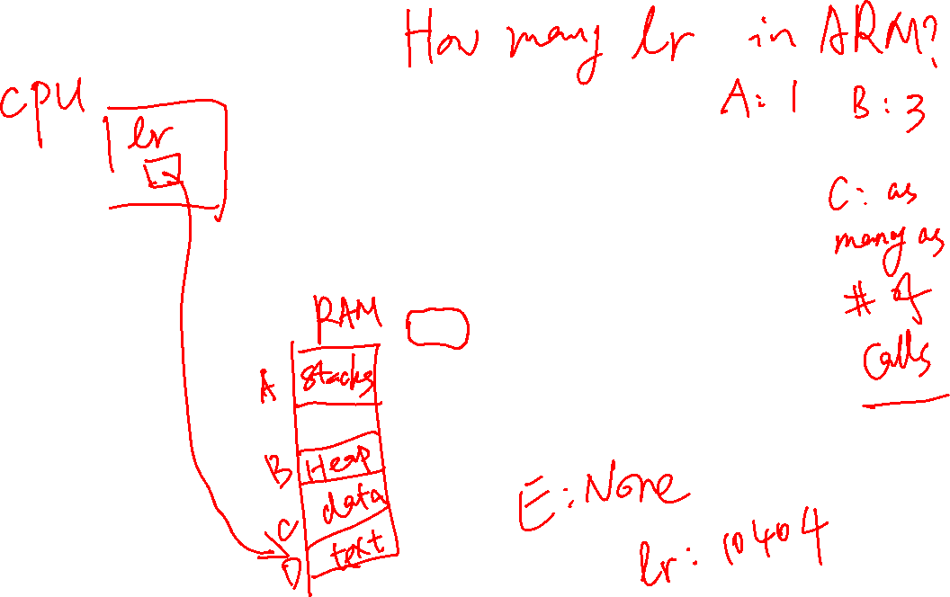
Understanding bl and bx - 1
000103f4 <a>:
103f4: e3a00000 mov r0, 0
103f8: e12fff1e bx lr
000103fc <main>:
103fc: ebfffffc bl 103f4 //a
10400: ebfffffb bl 103f4 //a
10404: e3a00000 mov r0, 0
int a(void)
{
return 0;
}
int main(void)
{
a();
a();
// not shown
lr:
10400
lr:
10404
lr:
10400
lr:
10404
But there is a problem we must address here – next slide
x

Slide 5
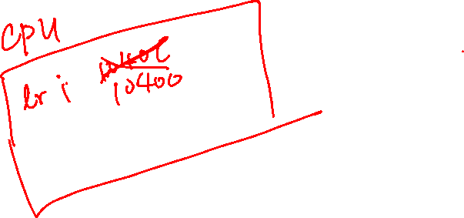
Understanding bl and bx - 2
Modifies the link register (lr), writing over main's return address Cannot return to main()
int b(void)
{
return 0;
}
int a(void)
{
b();
return 0;
}
int main(void)
{
a();
a();
// not shown
000103f4 <b>:
103f4: e3a00000 mov r0, 0
103f8: e12fff1e bx lr
000103fc <a>:
103fc: ebfffffc bl 103f4 <b>
10400: e3a00000 mov r0, 0
10404: e12fff1e bx lr
00010408 <main>:
10408: ebfffffb bl 103fc <a>
1040c: ebfffffa bl 103fc <a>
10410: e3a00000 mov r0, 0
lr:
10400
lr:
10400
lr:
10400
lr:
1040c
Uh No
Infinite loop!!!
We need to preserve the lr!
x

Slide 6
Understanding bl and blx - 3
.data
func:.word a // func initialized with address of a()
.text
.global a
.type a, %function
.equ FP_OFF, 4
a:
mov r0, 0
bx lr
.size a, (. - a)
.global main
.type main, %function
.equ FP_OFF, 4
main:
ldr r4, =func // load address of func in r4
ldr r4, [r4] // load contents of func in r4
blx r4 // we lose the lr for main!
// not shown
bx lr // infinite loop!
int a(void)
{
return 0;
}
int (*func)() = a;
int main(void)
{
(*func)();
// not shown
But this has the same infinite loop problem when main() returns!
x

Slide 7
Preserving and Restoring Registers on the stack - 1
Operation | Pseudo Instruction |  | Operation
Push registers Function Entry | push | {reg list} | sp = sp – 4 × #registers Copy registers to mem[sp]
Pop registers Function Exit | pop | {reg list} | Copy mem[sp] to registers, sp = sp + 4 × #registers
push (multiple register str to memory operation)
push (multiple register ldr from memory operation)
high memory
high memory
after stack pointer
before stack
pointer
registers
registers
pop{ }
registers
push{ }
registers
after
stack pointer
registers
registers
before
stack pointer
low memory
low memory
x

Slide 8
Preserving and Restoring Registers on the Stack - 2
Operation | Pseudo Instruction |  | Operation
Push registers Function Entry | push | {reg list} | sp = sp – 4 × #registers Copy registers to mem[sp]
Pop registers Function Exit | pop | {reg list} | Copy mem[sp] to registers, sp = sp + 4 × #registers
{reg list} is a list of registers in numerically increasing order, left to right
push {r4-r10, fp, lr} // fp is r11, lr is r14
Registers cannot be:
duplicated in the list
listed out of increasing numeric order (left to right)
Register ranges can be specified {r4, r5, r8-r10, fp, lr}
Never! push/pop r12, r13, or r15
the top two registers on the stack must always be fp, lr // ARM function spec – later slides
x

Slide 9
push: Multiple Register Save to the stack
stack segment high memory
CPU registers to Save
save registers
push {r4-r6, r8, fp, lr}
copy
sp before push
lr
saved lr
If you have no stack variables (later slides) then always push an EVEN number of registers!
fp
saved fp
allocated space
(# registers) * (4 bytes)
Registers are pushed on to the stack in order
right (high memory) to left (low memory)
r8
saved r8
r6
saved r6
r5
saved r5
r4
saved r4
sp after push
stack segment low memory
push copies the contents of the {reg list} to stack segment memory
push subtracts (# of registers saved) * (4 bytes) from the sp to allocate space on the stack
sp = sp – (# registers_saved * 4)
this must always be true: sp % 8 == 0
x

Slide 10
pop: Multiple Register Restore from the stack
stack segment high memory
restore registers
pop {r4-r6, r8, fp, lr}
CPU registers
copy
sp after pop
lr
saved lr
Registers are pop’d from the stack in order
left (low memory) to right (high memory)
fp
saved fp
Restored register contents
r8
saved r8
deallocated space
(# registers) * (4 bytes)
r6
saved r6
r5
saved r5
r4
saved r4
sp before pop
stack segment low memory
pop copies the contents of stack segment memory to the {reg list}
pop adds: (# of registers restored) * (4 bytes) to sp to deallocate space on the stack
sp = sp + (# registers restored * 4)
Remember: {reg list} must be the same in both the push and the corresponding pop
x

Slide 11
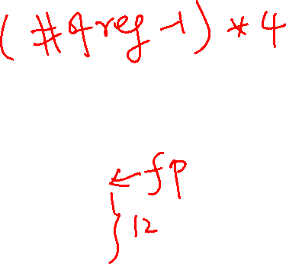
Consequences of inconsistent push and pop operands
stack segment high memory
stack segment high memory
CPU registers to Save
CPU registers
copy
lr
saved lr
saved lr
fp
saved fp
copy
saved fp
sp
r8
saved r8
lr
saved r8
r6
saved r6
saved r6
sp
fp
stack segment low memory
stack segment low memory
push {r6, r8, fp, lr}
pop {fp, lr}
lr gets an address on the stack, likely segmentation fault
x

Slide 12
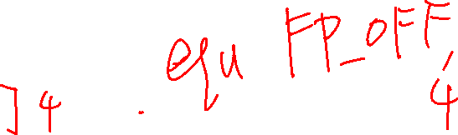
Minimum Stack Frame (Arm Arch32 Procedure Call Standards)
Minimal frame: allocating at function entry: push {fp, lr}
sp always points at top element in the stack (lowest byte address)
fp always points at the bottom element in the stack
Bottom element is always the saved lr (contains the return address of caller)
A saved copy of callers fp is always the next element below the lr
fp will be used later when referencing stack variables
Minimal frame: deallocating at function exit: pop {fp, lr}
On function entry: sp must be 8-byte aligned (sp % 8 == 0)
Minimum stack frame
saved lr
fp
callers fp
low address
sp
x

Slide 13
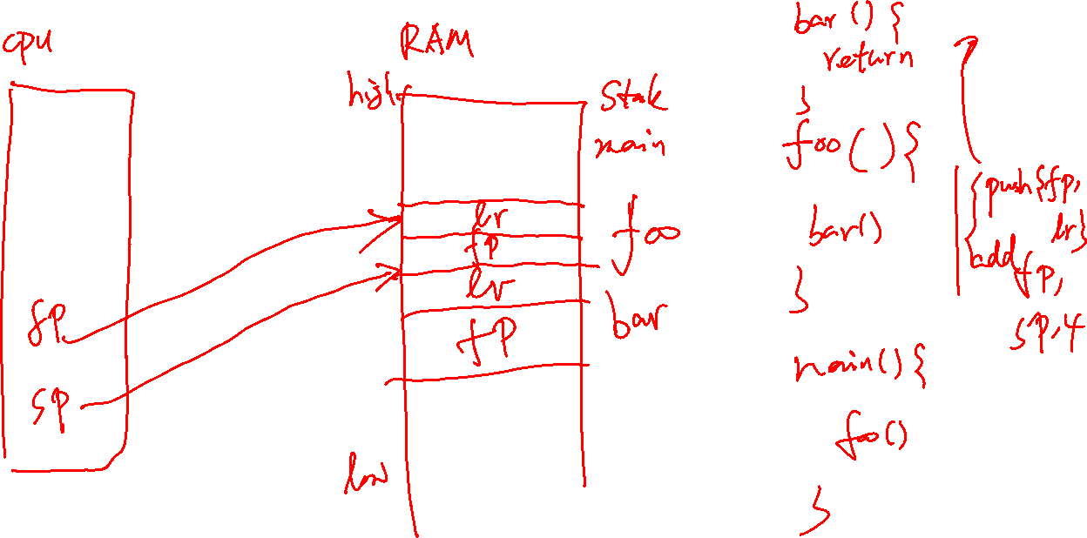
Minimum Stack Frame (Arm Arch32 Procedure Call Standards)
main() calls funcA()
Function entry (Function Prologue):
create (activate) frame
save preserved registers
allocate space for locals
Function return (Function Epilogue):
deallocate space for locals
restores preserved registers
removes the frame
main()
saved lr
allocate stack space
SP = SP – "space"
grows "down"
callers fp
lr to main()
fp
funcA()
main() fp
sp
deallocate stack space
SP = SP + "space"
shrinks "up"
saved lr
fp
main()
callers fp
sp
x

Slide 14
How to set the FP – Minimum Activation Frame
Function Prologue
always at top of function push saves regs and allocates space by subtracting from sp and sets fp with the add
// other code .equ FP_OFF, 4
main:
push {fp, lr}
add fp, sp, FP_OFF …….
sub sp, fp, FP_OFF
pop {fp, lr}
bx lr
after push {fp,lr}
add fp, sp, FP_OFF
main() Stack Frame
saved lr
Function Epilogue
always at bottom of function pop restores regs fp, lr
and deallocates space by adding to sp
fp = sp + 4 bytes
callers fp
sp
low memory
4-byte words
IMPORTANT: FP_OFF has two uses:
Where to set fp after prologue push (remember sp position)
Restore sp (deallocate locals) right before epilogue pop
x

Slide 15
Using Minimal Stack Frames
000103f4 <b>:
103f4: e92d4800 push {fp, lr}
103f8: e28db004 add fp, sp, 4
103fc: e3a00000 mov r0, 0
10400: e24bd004 sub sp, fp, 4
10404: e8bd4800 pop {fp, lr}
10408: e12fff1e bx lr
0001040c <a>:
1040c: e92d4800 push {fp, lr}
10410: e28db004 add fp, sp, 4
10414: ebfffff6 bl 103f4 <b>
10418: e3a00000 mov r0, 0
1041c: e24bd004 sub sp, fp, 4
10420: e8bd4800 pop {fp, lr}
10424: e12fff1e bx lr
00010428 <main>:
10428: e92d4800 push {fp, lr}
1042c: e28db004 add fp, sp, 4
10430: ebfffff5 bl 1040c <a>
10434: ebfffff4 bl 1040c <a>
// not shown
int b(void)
{
return 0;
}
int a(void)
{
b();
return 0;
}
int main(void)
{
a();
a();
Stack address
90300
902fc
10480 (lr)
fp
sp
main()
90308 fp
x

Slide 16
Using Minimal Stack Frames
000103f4 <b>:
103f4: e92d4800 push {fp, lr}
103f8: e28db004 add fp, sp, 4
103fc: e3a00000 mov r0, 0
10400: e24bd004 sub sp, fp, 4
10404: e8bd4800 pop {fp, lr}
10408: e12fff1e bx lr
0001040c <a>:
1040c: e92d4800 push {fp, lr}
10410: e28db004 add fp, sp, 4
10414: ebfffff6 bl 103f4 <b>
10418: e3a00000 mov r0, 0
1041c: e24bd004 sub sp, fp, 4
10420: e8bd4800 pop {fp, lr}
10424: e12fff1e bx lr
00010428 <main>:
10428: e92d4800 push {fp, lr}
1042c: e28db004 add fp, sp, 4
10430: ebfffff5 bl 1040c <a>
10434: ebfffff4 bl 1040c <a>
// not shown
int b(void)
{
return 0;
}
int a(void)
{
b();
return 0;
}
int main(void)
{
a();
a();
Stack address
90300
902fc
10480 (lr)
main()
90308 fp
10434 lr
902f8
902f4
fp
sp
lr:
10434
a()
90300 fp
x

Slide 17
Using Minimal Stack Frames
000103f4 <b>:
103f4: e92d4800 push {fp, lr}
103f8: e28db004 add fp, sp, 4
103fc: e3a00000 mov r0, 0
10400: e24bd004 sub sp, fp, 4
10404: e8bd4800 pop {fp, lr}
10408: e12fff1e bx lr
0001040c <a>:
1040c: e92d4800 push {fp, lr}
10410: e28db004 add fp, sp, 4
10414: ebfffff6 bl 103f4 <b>
10418: e3a00000 mov r0, 0
1041c: e24bd004 sub sp, fp, 4
10420: e8bd4800 pop {fp, lr}
10424: e12fff1e bx lr
00010428 <main>:
10428: e92d4800 push {fp, lr}
1042c: e28db004 add fp, sp, 4
10430: ebfffff5 bl 1040c <a>
10434: ebfffff4 bl 1040c <a>
// not shown
int b(void)
{
return 0;
}
int a(void)
{
b();
return 0;
}
int main(void)
{
a();
a();
lr:
10418
Stack address
90300
902fc
10480 (lr)
main()
90308 fp
10434 lr
902f8
902f4
lr:
10434
a()
90300 fp
10418 lr
902f0
902ec
fp
sp
b()
902f8 fp
x

Slide 18
Using Minimal Stack Frames
000103f4 <b>:
103f4: e92d4800 push {fp, lr}
103f8: e28db004 add fp, sp, 4
103fc: e3a00000 mov r0, 0
10400: e24bd004 sub sp, fp, 4
10404: e8bd4800 pop {fp, lr}
10408: e12fff1e bx lr
0001040c <a>:
1040c: e92d4800 push {fp, lr}
10410: e28db004 add fp, sp, 4
10414: ebfffff6 bl 103f4 <b>
10418: e3a00000 mov r0, 0
1041c: e24bd004 sub sp, fp, 4
10420: e8bd4800 pop {fp, lr}
10424: e12fff1e bx lr
00010428 <main>:
10428: e92d4800 push {fp, lr}
1042c: e28db004 add fp, sp, 4
10430: ebfffff5 bl 1040c <a>
10434: ebfffff4 bl 1040c <a>
// not shown
int b(void)
{
return 0;
}
int a(void)
{
b();
return 0;
}
int main(void)
{
a();
a();
lr:
10418
lr:
10418
Stack address
90300
902fc
10480 (lr)
main()
90308 fp
10434 lr
902f8
902f4
lr:
10434
a()
90300 fp
10418 lr
902f0
902ec
fp
sp
b()
902f8 fp
x

Slide 19
Using Minimal Stack Frames
000103f4 <b>:
103f4: e92d4800 push {fp, lr}
103f8: e28db004 add fp, sp, 4
103fc: e3a00000 mov r0, 0
10400: e24bd004 sub sp, fp, 4
10404: e8bd4800 pop {fp, lr}
10408: e12fff1e bx lr
0001040c <a>:
1040c: e92d4800 push {fp, lr}
10410: e28db004 add fp, sp, 4
10414: ebfffff6 bl 103f4 <b>
10418: e3a00000 mov r0, 0
1041c: e24bd004 sub sp, fp, 4
10420: e8bd4800 pop {fp, lr}
10424: e12fff1e bx lr
00010428 <main>:
10428: e92d4800 push {fp, lr}
1042c: e28db004 add fp, sp, 4
10430: ebfffff5 bl 1040c <a>
10434: ebfffff4 bl 1040c <a>
// not shown
int b(void)
{
return 0;
}
int a(void)
{
b();
return 0;
}
int main(void)
{
a();
a();
lr:
10418
lr:
10418
lr:
10418
Stack address
90300
902fc
10480 (lr)
lr:
10434
main()
90308 fp
10434 lr
902f8
902f4
fp
sp
lr:
10434
a()
90300 fp
x

Slide 20
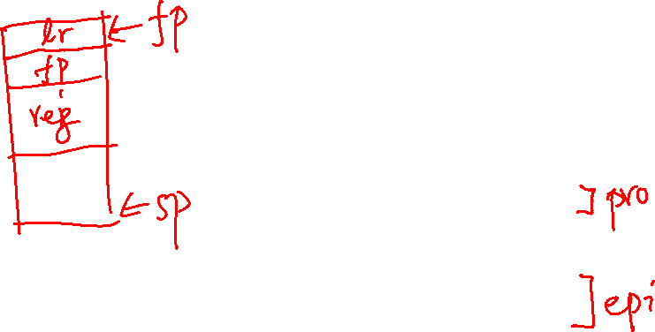
Using Minimal Stack Frames
000103f4 <b>:
103f4: e92d4800 push {fp, lr}
103f8: e28db004 add fp, sp, 4
103fc: e3a00000 mov r0, 0
10400: e24bd004 sub sp, fp, 4
10404: e8bd4800 pop {fp, lr}
10408: e12fff1e bx lr
0001040c <a>:
1040c: e92d4800 push {fp, lr}
10410: e28db004 add fp, sp, 4
10414: ebfffff6 bl 103f4 <b>
10418: e3a00000 mov r0, 0
1041c: e24bd004 sub sp, fp, 4
10420: e8bd4800 pop {fp, lr}
10424: e12fff1e bx lr
00010428 <main>:
10428: e92d4800 push {fp, lr}
1042c: e28db004 add fp, sp, 4
10430: ebfffff5 bl 1040c <a>
10434: ebfffff4 bl 1040c <a>
// not shown
int b(void)
{
return 0;
}
int a(void)
{
b();
return 0;
}
int main(void)
{
a();
a();
lr:
10418
lr:
10418
lr:
10418
Stack address
90300
902fc
10480 (lr)
fp
sp
lr:
10434
main()
90308 fp
lr:
10434
We are saving the lr on the stack on each function call and restoring it before returning.
Result: NO infinite loop and we return to the correct instruction in the caller no matter how many functions we call.
Even recursion will work!
lr:
10434
x

Slide 21
By following the saved fp, you can find each stack frame
main()
saved lr
main()
saved lr
fp
callers fp
callers fp
lr to main()
sp
funcA()
main() fp
lr to funcA()
saved lr
funcB()
funcA() fp
main()
callers fp
lr to funcB()
funcC()
fp
lr to main()
fp
FuncB() fp
funcA()
main() fp
sp
sp
main()
saved lr
callers fp
main()
saved lr
lr to main()
callers fp
funcA()
main() fp
lr to main()
lr to funcA()
funcA()
main() fp
funcB()
funcA() fp
lr to funcA()
fp
lr to funcB()
funcB()
funcA() fp
funcC()
sp
FuncB() fp
lr to funcC()
fp
funcD()
funcC() fp
How gdb finds stack frames
sp
x

Slide 22

Registers: Requirements for Use
Register | Function Call Use | Function Body Use | Save before use Restore before return
r0 | arg1 and return value | scratch registers | No
r1-r3 | arg2 to arg4 | scratch registers | No
r4-r10 | preserved registers | contents preserved across function calls | Yes
r11/fp | stack frame pointer | Use to locate variables on the stack | Yes
r12/ip | may used by assembler with large text file | can be used as a scratch if really needed | No
r13/sp | stack pointer | stack space allocation | Yes
r14/lr | link register | contains return address for function calls | Yes
r15 | Do not use | Do not use | No
Any value you have in a preserved register before a function call will still be there after the function returns
Contents are “preserved” across function calls
If the function wants to use a preserved register it must:
Save the value contained in the register at function entry
Use the register in the body of the function
Restore the original saved value to the register at function exit (before returning to the caller)
x

Slide 23
Argument and Return Value Requirements
When passing or returning values from a function you must do the following:
Make sure that the values in the registers r0-r3 are in their properly aligned position in the register based on data type
Upper bytes in byte and halfword values in registers r0-r3 when passing arguments and returning values are zero filled
Single Byte (char)
r0
0x00
0x00
0x00
0xe1
31
0
observe the zero fill
Single Halfword (short)
r0
0x00
0x00
0xe3
0xe1
31
0
observe the zero fill
Full Word (int or pointer)
r0
0x87
0x65
0xe3
0xe1
31
0
x

Slide 24
Global Variable access
var | global variable address into r0 (lside) | global variable contents into r0 (rside) | contents of r0 into global variable
x | ldr r0, =x | ldr r0, =x ldr r0, [r0] | ldr r1, =x str r0, [r1]
*x | ldr r0, =x ldr r0, [r0] | ldr r0, =x ldr r0, [r0] ldr r0, [r0] | ldr r1, =x ldr r1, [r1] str r0, [r1]
**x | ldr r0, =x ldr r0, [r0] ldr r0, [r0] | ldr r0, =x ldr r0, [r0] ldr r0, [r0] ldr r0, [r0] | ldr r1, =x ldr r1, [r1] ldr r1, [r1] str r0, [r1]
stderr | ldr r0, =stderr | ldr r0, =stderr ldr r0, [r0] | <do not write unless you really know what you are doing>
.Lstr | ldr r0, =.Lstr | ldr r0, =.Lstr ldrb r0, [r0] | <read only>
.bss // from libc
stderr:.space 4 // FILE *
.data
x: .data y //x = &y
.section .rodata
.Lstr: .string "HI\n"
stdin, stdout and stderr are global variables
x

Slide 25
Assembler Directives: Label Scope Control (Normal Labels only)
.extern printf
.extern fgets
.extern strcpy
.global fbuf
.extern <label>
Imports label (function name, symbol or a static variable name);
An address associated with the label from another file can be used by code in this file
.global <label>
Exports label (or symbol) to be visible outside the source file boundary (other assembly or c source)
label is either a function name or a global variable name
Only use with function names or static variables
Without .global, labels are usually (depends on the assembler) local to the file
x

Slide 26
Example calling fprintf()
r0 = function(r0, r1, r2, r3)
fprintf(stderr, "arg2", arg3, arg4)
create a literal string for arg2 which tells fprintf() how to interpret the remaining arguments
stdin, stdout, stderr are all global variable and are part of libc
these names are their lside (label names)
to use them you must get their contents to pass to fprintf(), fread(), fwrite()
#include <stdio.h>
#include <stdlib.h>
int
main(void)
{
int a = 2;
int b = 3;
int c;
c = a + b;
fprintf(stderr,"c=%d\n", c);
return EXIT_SUCCESS;
}
.extern fprintf //declare fprintf
.section .rodata // note the dots "."
.Lfst: .string "c=%d\n"
We are going to put these variables in temporary registers
// part of the text segment below
mov r2, 2 // int a = 2;
mov r3, 3 // int b = 3;
add r2, r2, r3 // arg 3: int c = a + b;
ldr r0, =stderr // get stderr address
ldr r0, [r0] // arg 1: get stderr contents
ldr r1, =.Lfst // arg 2: =literal address
bl fprintf
three passed args in this use of fprintf
r0, r1, r2
x

Slide 27
Preserved Registers: When to Use?
Register | Function Call Use | Function Body Use | Save before use Restore before return
r0 | arg1 and return value | scratch registers | No
r1-r3 | arg2 to arg4 | scratch registers | No
r4-r10 | preserved registers | contents preserved across function calls | Yes
r11/fp | stack frame pointer | Use to locate variables on the stack | Yes
r12/ip | may used by assembler with large text file | can be used as a scratch if really needed | No
r13/sp | stack pointer | stack space allocation | Yes
r14/lr | link register | contains return address for function calls | Yes
r15 | Do not use | Do not use | No
When to use a preserved register in a function you are writing?
Values that you want to protect from being changed by a function call
Local variables stored in registers
Parameters passed to you (in r0-r3) that you need to continue to use after calling another function
x

Slide 28

Saving Preserved registers and setting FP
// other code etc .equ FP_OFF, 20
main:
push {r4-r7, fp, lr}
add fp, sp, FP_OFF …….
sub sp, fp, FP_OFF
pop {r4-r7, fp, lr}
bx lr
after push {r4-r7,fp,lr}
add fp, sp, FP_OFF
Function Prologue
always at top of function saves regs and sets fp
saved lr
fp = sp + 20 bytes
saved fp
Function Epilogue
always at bottom of function restores regs including the sp
saved r7
FP_OFF:
Distance from lr to lowest saved register
Function Stack Frame
saved r6
saved r5
saved r4
sp
# regs saved | FP_OFF in Bytes Distance from lr to lowest saved register
2 | 4
3 | 8
4 | 12
5 | 16
6 | 20
7 | 24
8 | 28
9 | 32
low memory
4-byte words
grows down
FP_OFF = (#regs saved - 1) * 4
Means Caution, odd number of saved regs!
If odd number pushed, make sure frame is 8-byte aligned (later)
this must always be true: sp % 8 == 0
x

Slide 29
Example: using preserved registers for local variables
.extern getchar
.extern putchar
.section .rodata
.Lst: .string "Echo count: %d\n"
.text
.type main, %function
.global main
.equ EOF, -1 .equ FP_OFF, 12
.equ EXIT_SUCCESS, 0
main:
push {r4, r5, fp, lr}
add fp, sp, FP_OFF
mov r4, 0 //r4 = count
/* while loop code will go here */
mov r0, EXIT_SUCCESS
sub sp, fp, FP_OFF
pop {r4, r5, fp, lr}
bx lr
.size main, (. – main)
#include <stdio.h>
#include <stdlib.h>
int
main(void)
{
int c; // use r0
int count = 0; // use r4
while ((c = getchar()) != EOF) {
putchar(c);
count++;
}
printf("Echo count: %d\n", count);
return EXIT_SUCCESS;
}
You must assume that
both getchar() and
putchar() alter r0-r3
r0
r0 r1
r0
x

Slide 30

Putchar/getchar: The while loop
initialize count
mov r4, 0 //count
bl getchar
cmp r0, EOF
beq .Ldone
.Lloop:
bl putchar
bl getchar
add r4, r4, 1
cmp r0, EOF
bne .Lloop
.Ldone:
mov r1, r4 //arg2
ldr r0, =.Lst //arg1
bl printf
pre loop test with a call to getchar()
if it returns EOF in r0 we are done
echo the character read with getchar and then read another and increment count
#include <stdio.h>
#include <stdlib.h>
int
main(void)
{
int c;
int count = 0;
while ((c = getchar()) != EOF) {
putchar(c);
count++;
}
printf("Echo count: %d\n", count);
return EXIT_SUCCESS;
}
did getchar() return EOF if not loop
saw EOF, print count
address of string literal variable
.Lst: .string "Echo count: %d\n"
File header and footers are not shown
x

Slide 31
Accessing argv from Assembly (stderr version)
.extern printf
.extern stderr
.section .rodata
.Lstr: .string "argv[%d] = %s\n"
.text
.global main // main(r0=argc, r1=argv)
.type main, %function
.equ FP_OFF, 20
main:
push {r4-r7, fp, lr}
add fp, sp, FP_OFF
mov r7, r1 // save argv!
ldr r4, =stderr // get the address of stderr
ldr r4, [r4] // get the contents of stderr
ldr r5, =.Lstr // get the address of .Lstr
mov r6, 0 // set indx = 0;
.Lloop:
// fprintf(stderr, "argv[%d] = %s\n", indx, *argv)
ldr r3, [r7] // arg 4: *argv
cmp r3, 0 // check *argv == NULL
beq .Ldone // if so done
mov r2, r6 // arg 3: indx
mov r1, r5 // arg 2: "argv[%d] = %s\n"
mov r0, r4 // arg 1: stderr
bl fprintf
add r6, r6, 1 // indx++ for printing
add r7, r7, 4 // argv++ pointer
b .Lloop
.Ldone:
mov r0, 0
sub sp, fp, FP_OFF
pop {r4-r7, fp, lr}
bx lr
% ./cipher -e -b in/BOOK
argv[0] = ./cipher
argv[1] = -e
argv[2] = -b
argv[3] = in/BOOK
need to save r1 as we are calling a function - fprintf
"argv[%d] = %s\n"
Registers
r7
r6
r5
r4
r3
r2
r1
r0
NULL
indx
argv[3]
in/book
argv[2]
argv[1]
-b
file * stderr
argv[0]
-e
./cipher
**argv
observe the different increment sizes
argc
r0-r3 lost due to fprintf call
fprintf(stderr, "argv[%d] = %s\n", indx, *argv);
x

Slide 32
Local Variables on the Stack
Space for local variables is allocated on the stack right below the lowest pushed register
Move the sp towards low memory by the total size of all local variables in bytes plus padding
FRMADD = total local var space (bytes) + padding
Allocate the space after the register push by
add sp, sp, -FRMADD
Requirement: on function entry, sp is always 8-byte aligned
sp % 8 == 0
Padding (as required):
Additional space between variables on the stack to meet memory alignment requirements
Additional space so the frame size is evenly divisible by 8
fp (frame pointer) is used as a pointer (base register) to access all stack variables – later slides
saved lr
fp
saved fp
saved register
FP_OFF
saved register
Total size % 8 == 0
local
variables
FRMADD=
Local Space (bytes)
sp = sp - local space
sp
grows down
x

Slide 33
Function Prologue: Allocating the Stack Frame
at function entry
after
push {r4,r5,fp,lr}
Set FP
add fp, sp, FP_OFF
Allocate Space for locals
add sp, sp, -FRMADD
saved lr
fp
saved lr
fp
saved lr
Stack Frame
saved lr
callers fp
sp
callers fp
callers fp
callers fp
saved lr
saved lr
fp
saved lr
fp
New Stack Frame
callers fp
callers fp
callers fp
saved r5
callers r5
FP_OFF
FP_OFF
saved r5
saved r4
sp
callers r4
Stack Frame
sp
saved r4
Local Variables
low memory
low memory
low memory
FRMADD
sp
low memory
Function saves lr, fp using a push and only those preserved registers it wants to use on the stack
Do not push r12 or r13
Function was just called this how the stack looks
The orange blocks are part of the caller's stack frame
Function moves the fp to point at the saved lr as required by the Aarch32 spec
Allocate Space for Local Variables
Part of function prologue
x

Slide 34
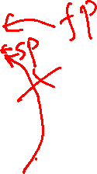
Function Epilogue: Deallocating the Stack Frame
Deallocate Space for locals
Put SP back so pop works
sub sp, fp, FP_OFF
At function exit after
pop {r4,r5,fp,lr}
Stack frame while during function body execution
saved lr
fp
saved lr
saved lr
Stack Frame
callers fp
sp
callers fp
callers fp
saved lr
saved lr
fp
saved lr
fp
callers fp
callers fp
Stack Frame
callers fp
saved r5
Deallocated
Eligible for reuse
out of scope
saved r5
FP_OFF
saved r5
FP_OFF
Stack Frame
saved r4
saved r4
saved r4
sp
Local Variables
Local Variables
Local Variables
FRMADD
Deallocated
stack space
sp
low memory
low memory
low memory
Use fp as a pointer to find local variables on the stack
Move SP back to where it was after the push in the prologue. So, the pop works properly (this also deallocates the local variables)
At function exit (in the function epilogue) the function uses pop to restore the registers to the values they had at function entry
Part of function epilogue
x

Slide 35

Local Variables on the stack
after push {r4-r5,fp,lr}
add fp, sp, FP_OFF
int main(void)
{
int c;
int count = 0;
// rest of code
}
.text
.type main, %function
.global main
.equ FP_OFF, 12
.equ FRMADD, 8
main:
push {r4, r5, fp, lr}
add fp, sp, FP_OFF
add sp, sp, -FRMADD
// but we are not done yet!
saved lr
fp
callers fp
saved r5
saved r4
sp after push
FRMADD = 8
c
count
sp after
allocating locals
// when FRMADD values fail to assemble
ldr r3, =-FRMADD
add sp, sp, r3
low memory 4-byte words
Add space on the stack for each local
we will allocate space in same order the locals are listed the C function shown from high to low stack address
gcc compiler allocates from low to high stack addresses
Order does not matter for our use
In this example we are allocating two variables on the stack
When writing assembly functions, in many situations you may choose allocate these to registers instead
x

Slide 36
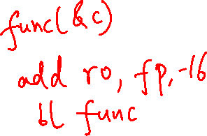
Accessing Stack Variables: Introduction
int main(void)
{
int c;
int count = 0;
// rest of code
}
4
saved lr
fp
callers fp
Total frame size
24 bytes
8-byte aligned
12
saved r5
FP_OFF
fp - 20
fp - 16
saved r4
4
c
FRMADD
4
count
TO Access data stored in the stack
use the ldr/str instructions
Use register fp with offset (negative distance in bytes) addressing (use either register offset or immediate offset)
No matter what address the stack frame is at, fp always points at saved lr, so you can find a local stack variable by using an offset address from the contents of fp
sp
low memory 4-byte words
.text
.type main, %function
.global main
.equ FP_OFF, 12
.equ FRMADD, 8
main:
push {r4, r5, fp, lr}
add fp, sp, FP_OFF
add sp, sp, -FRMADD
// but we are not done yet!
Variable | distance from fp | Read variable | Write Variable
int c | -16 | ldr r0, [fp, -16] | str r0, [fp, -16]
int count | -20 | ldr r0, [fp, -20] | str r0, [fp, -20]
x

Slide 37

Stack Frame Design – Local Variables
Rule: When the function is entered the stack is already 8-byte aligned
When writing an ARM equivalent for a C program, for CSE30 we will not re-arrange the order of the variables to optimize space (covered in the compiler course)
Arrays start at a 4-byte boundary (even arrays with only 1 element)
Exception: double arrays [ ] start at an 8-byte boundary
struct arrays are aligned to the requirements of largest member
Single chars (and shorts) can be grouped together in same 4-byte word (following the alignment for the short)
Padding may be required (see next slide)
int
4
a[1]
a[0]
4
0
E
4
D
C
B
A
4
pointer
4
pointers and integers
4 bytes
short
2 bytes
char
1
x

Slide 38
Stack Variables: Padding
4
saved lr
fp
Variable padding – start arrays at 4-byte boundary and leave unused space at end (high side address) before the variable higher on the stack
Frame padding – add space below the last local variable to keep 8-byte alignment
callers fp
12
saved r5
FP_OFF
fp - 24
fp - 20
fp - 16
Total frame size
32 bytes
8-byte aligned
saved r4
4
c
4
count
FRMADD
count
1 + 3
buf
pad
var pad
buf[2]
buf[1]
buf[0]
4
frame pad
sp
.text
.type main, %function
.global main
.equ FP_OFF, 12
.equ FRMADD, 16
main:
push {r4, r5, fp, lr}
add fp, sp, FP_OFF
add sp, sp, -FRMADD
// but we are not done yet!
int main(void)
{
int c;
int count = 0;
char buf[] = "hi";
// rest of code
}
var pad
buf
frame pad
sp
x

Slide 39
Accessing Stack Variables, the hard way
4
saved lr
fp
callers fp
.text
.type main, %function
.global main
.equ FP_OFF, 12
.equ FRMADD, 16
main:
push {r4, r5, fp, lr}
add fp, sp, FP_OFF
add sp, sp, -FRMADD
// but we are not done yet!
12
saved r5
FP_OFF
int main(void)
{
int c;
int count = 0;
char buf[] = "hi";
// rest of code
}
fp - 24
fp - 20
fp - 16
Total frame size
32 bytes
8-byte aligned
saved r4
4
c
4
count
FRMADD
1 + 3
pad
buf
4
pad`
sp
char buf[ ] by usage with ASCII chars we will use strb (or make it unsigned char)
Variable | distance from fp | Read variable | Write Variable
int c | 16 | ldr r0, [fp, -16] | str r0, [fp, -16]
int count | 20 | ldr r0, [fp, -20] | str r0, [fp, -20]
char buf[0] | 24 | ldrb r0, [fp, -24] | strb r0, [fp, -24]
char buf[1] | 23 | ldrb r0, [fp, -23] | strb r0, [fp, -23]
char buf[2] | 22 | ldrb r0, [fp, -22] | strb r0, [fp, -22]
var pad
buf[2]
buf[1]
buf[0]
fp - 21
fp - 22
fp - 23
fp - 24
increasing address
Calculating offsets is a lot of work to get it correct
It is also hard to debug
There is a better way!
x

Slide 40
Best Practice: Use Assembler Generated offsets
4
saved lr
fp
.type main, %function
.global main
.equ FP_OFF, 12
.equ C, 4 + FP_OFF
.equ COUNT, 4 + C
.equ BUF, 4 + COUNT
.equ PAD, 4 + BUF
.equ FRMADD, PAD – FP_OFF
// FRMADD = 28 - 12 = 16
callers fp
pushed reg fp distance
12
saved r5
FP_OFF
fp - 24
fp - 20
fp - 16
Prior allocation distance
Total frame size
32 bytes
8-byte aligned
saved r4
4
c
variable size in bytes
4
count
1 + 3
FRMADD
pad
buf
4
frame pad
sp
increasing address
var pad
buf[2]
buf[1]
buf[0]
fp –BUF+3
fp –BUF+2
fp –BUF+1
fp -BUF
Variable | distance from fp | Address on Stack | Read variable | Write Variable
int c | C | add r0, fp, -C | ldr r0, [fp, -C] | str r0, [fp, -C]
int count | COUNT | add r0, fp, -COUNT | ldr r0, [fp, -COUNT] | str r0, [fp, -COUNT]
char buf[0] | BUF | add r0, fp, -BUF | ldrb r0, [fp, -BUF] | strb r0, [fp, -BUF]
char buf[1] | BUF-1 | add r0, fp, -BUF+1 | ldrb r0, [fp, -BUF+1] | strb r0, [fp, -BUF+1]
char buf[2] | BUF-2 | add r0, fp, -BUF+2 | ldrb r0, [fp, -BUF+2] | strb r0, [fp, -BUF+2]
x

Slide 41
Initializing and Accessing Stack variables
4
saved lr
fp
.section .rodata
.Lmess: .string "%d %d %s\n"
.extern printf
.text
.type main, %function
.global main
.equ FP_OFF, 12
.equ C, 4 + FP_OFF
.equ COUNT, 4 + C
.equ BUF, 4 + COUNT
.equ PAD, 4 + BUF
.equ FRMADD, PAD – FP_OFF
main:
push {r4, r5, fp, lr}
add fp, sp, FP_OFF
add sp, sp, -FRMADD
// nothing to do for C
mov r2, 0
str r2, [fp, -COUNT]
strb r2, [fp, -BUF+2]
mov r2, 'h'
strb r2, [fp, -BUF]
mov r2, 'i'
strb r2, [fp, -BUF+1]
ldr r0, =.Lmess // arg1
ldr r1, [fp, -C] // arg2
ldr r2, [fp, -COUNT] // arg3
add r3, fp, -BUF // arg4
bl printf
callers fp
12
saved r5
FP_OFF
fp - 24
fp - 20
fp - 16
Total frame size
32 bytes
8-byte aligned
saved r4
4
c
4
count
FRMADD
1 + 3
pad
buf
4
pad
sp
int main(int argc, char **argv)
{
int c;
int count = 0;
char buf[] = "hi";
printf("%d %d %s\n", c, count, buf);
// rest of code
pass stack address
./a.out
-136572160 0 hi
passes contents of stack var C
Variable | distance from fp | Address on Stack | Read variable | Write Variable
int c | C | add r0, fp, -C | ldr r0, [fp, -C] | str r0, [fp, -C]
int count | COUNT | add r0, fp, -COUNT | ldr r0, [fp, -COUNT] | str r0, [fp, -COUNT]
char buf[0] | BUF | add r0, fp, -BUF | ldrb r0, [fp, -BUF] | strb r0, [fp, -BUF]
char buf[1] | BUF-1 | add r0, fp, -BUF+1 | ldrb r0, [fp, -BUF+1] | strb r0, [fp, -BUF+1]
char buf[2] | BUF-2 | add r0, fp, -BUF+2 | ldrb r0, [fp, -BUF+2] | strb r0, [fp, -BUF+2]
passes address of a stack variable buf
x

Slide 42
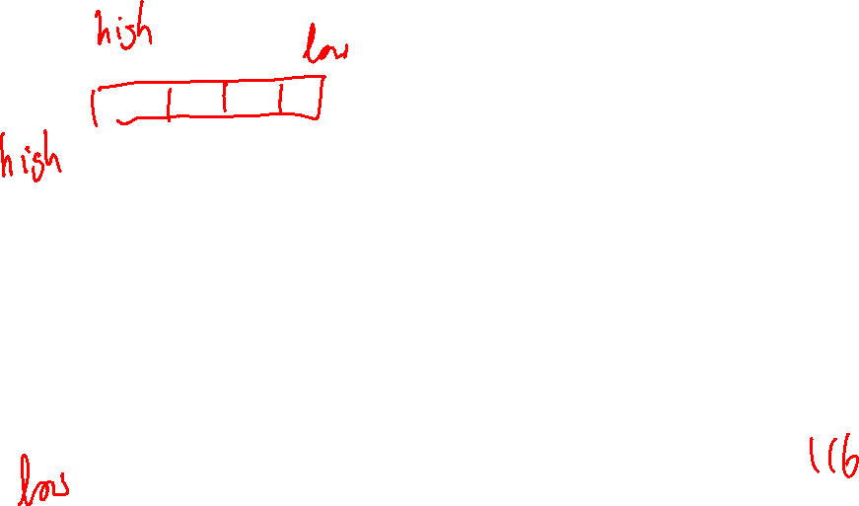
Frame Design Practice
Write the variables in C
Draw a picture of the stack frame
Write the code to generate the offsets
create the table to access the variables
saved lr
4
fp
void func(void)
{
signed char c;
signed short s;
unsigned char b[] = "Stack";
unsigned char *ptr = &bufl
// rest of code
}
callers fp
12
.equ FP_OFF, 12
.equ C, 2 + FP_OFF
.equ S, 2 + C
.equ B, 8 + S
.equ PTR, 4 + BUF
.equ PAD, 0 + PTR
.equ FRMADD, PAD – FP_OFF
// FRMADD = 28 - 12 = 8
saved r5
saved r4
var pad
C
s
1+1, 2
var pad
var pad
b[5]
b[4]
2 + 6
b[3]
b[2]
b[1]
b[0]
*ptr
4
sp
Variable | distance from fp | Address on Stack | Read variable | Write Variable
signed char c | C | add r0, fp, -C | ldrsb r0, [fp, -C] | strsb r0, [fp, -C]
signed short s | S | add r0, fp, -S | ldrsh r0, [fp, -S] | strsh r0, [fp, -S]
unsigned char b[0] | BUF | add r0, fp, -B | ldrb r0, [fp, -B] | strb r0, [fp, -B]
unsigned char *ptr | PTR | add r0, fp, -PTR | ldr r0, [fp, -PTR] | str r0, [fp, -PTR]
x

Slide 43
Working with Pointers on the stack
int
sum(int j, int k)
{
return j + k;
}
void
testp(int j, int k, int (*func)(), int *i)
{
*i = func(j,k);
return;
}
int
main()
{
int i;
int (*pf)() = add;
testp(1, 2, pf, &i);
printf("%d\n", i);
return EXIT_SUCCESS;
}
.section .rodata
.Lmess: .string "%d\n"
.extern printf
.text
.global main
.type main, %function
.equ FP_OFF, 4
.equ I, 4 + FP_OFF
.equ PF, 4 + I
.equ PAD, 0 + PF
.equ FRMADD, PAD-FP_OFF
saved lr
4
fp
callers fp
4
i
4
*(pf)()
4
sp
Variable | distance from fp | Address on Stack | Read variable | Write Variable
int i | I | add r0, fp, -I | ldr r0, [fp, -I] | str r0, [fp, -I]
int (*pf)() | PF | add r0, fp, -PF | ldr r0, [fp, -PF] | str r0, [fp, -PF]

Slide 44
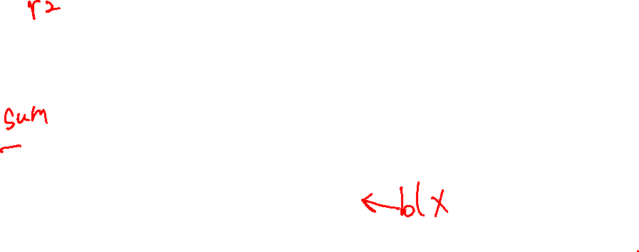
Working with Pointers on the stack
.global sum
.type sum, %function
add:
push {fp, lr}
add fp, sp, FP_OFF
add r0, r0, r1
sub sp, fp, FP_OFF
pop {fp, lr}
bx lr
.size sum, (. - sum)
.global main
.type main, %function
.equ FP_OFF, 4
.equ I, 4 + FP_OFF
.equ PF, 4 + I
.equ PAD, 0 + PF
.equ FRMADD, PAD-FP_OFF
main:
push {fp, lr}
add fp, sp, FP_OFF
add sp, sp,-FRMADD
ldr r2, =sum // func address
add r1, fp, -PF // PF address
str r2, [r1] // store in pf
mov r0, 1 // arg 1: 1
mov r1, 2 // arg 2: 2
ldr r2, [fp, -PF] // arg 3: (*pf)()
add r3, fp, -I // arg 4: &I
bl testp
ldr r0, =.Lmess // arg 1: "%d\n"
ldr r1, [fp, -I] // arg 2: i
bl printf
sub sp, fp, FP_OFF
pop {fp, lr}
bx lr
.size main, (. - main)
int
sum(int j, int k)
{
return j + k;
}
void
testp(int j, int k, int (*func)(), int *i)
{
*i = func(j,k);
return;
}
int
main()
{
int i;
int (*pf)() = add;
testp(1, 2, pf, &i);
printf("%d\n", i);
return EXIT_SUCCESS;
}
.global testp
.type testp, %function
.equ FP_OFF, 12
testp:
push {r4, r5, fp, lr}
add fp, sp, FP_OFF
mov r4, r3 // save i
blx r2 // r0=func(r0,r1)
str r0, [r4] // *i =r0
sub sp, fp, FP_OFF
pop {r4, r5, fp, lr}
bx lr
.size testp, (. - testp)
r0,r1,r2 already set
Variable | distance from fp | Address on Stack | Read variable | Write Variable
int i | I | add r0, fp, -I | ldr r0, [fp, -I] | str r0, [fp, -I]
int (*pf)() | PF | add r0, fp, -PF | ldr r0, [fp, -PF] | str r0, [fp, -PF]

Slide 45
Passing More Than Four Arguments – At the point of Call
r0 = function(r0, r1, r2, r3, arg5, arg6, … argn)
arg1, arg2, arg3, arg4, ...
Stack segment
high memory
Args > 4 are in the caller's stack frame at SP (argv5), an up
Called functions have the right to change stack args just like they can change the register args!
Caller must assume all args including ones on the stack are changed by the caller
Calling function prior to making the call
Evaluate first four args: place resulting values in r0-r3
Store Arg 5 and greater parameter values on the stack
One arg value per slot! – NO arrays across multiple slots
chars, shorts and ints are directly stored
Structs (not always), and arrays are passed via a pointer
Pointers passed as output parameters usually contain an address that points at the stack, BSS, data, or heap
saved lr
fp
saved fp
calling functions stack frame
saved regs
local
variables
PAD (if needed)
arg n
….
arg 6
arg 5
sp
r3
arg 4
r2
arg 3
r1
arg 2
r0
arg 1 & return
Temporary Registers
x

Slide 46
Calling Function: Allocating Stack Parameter Space
Previous stack frame
At the point of a function call (and obviously at the start of the called function):
sp must point at arg5
sp and therefore arg5 must be at an 8-byte boundary,
padding to force arg5 alignment if needed is placed above the last argument the called function is expecting
Approach: Extend the stack frame to include enough space for stack arguments function with the greatest arg count
Examine every function call in the body of a function
Find the function call with greatest arg count, Determines space needed for outgoing args
Add the space needed to the frame layout
saved lr
fp
Preserved registers
local vars
saved fp
local stack variables
Callers stack frame
Outgoing arg space part of calling functions frame
PAD (if needed)
arg 9
arg 8
arg 7
arg 6
arg 5
sp
Rules: At point of call
arg5 must be pointed at by sp
SP must be 8-byte aligned
x

Slide 47
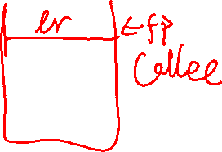
Calling Function: Pass ARG 5 and higher
.equ FP_OFF, 4
.equ CNT, 4 + FP_OFF // int cnt
.equ PAD, 4 + CNT // added as needed
.equ OARG6, 4 + PAD // int a
.equ OARG5, 4 + OARG6 // int b
.equ FRMADD OARG5 – FP_OFF
Previous stack frame
Preserved registers
local vars
fp
saved lr
callers fp
cnt
Rules: At point of call
arg5 must be pointed at by sp
SP must be 8-byte aligned
Callers stack frame
Outgoing arg space part of calling functions frame
PAD
oarg6
oarg5
sp
r0 = func(r0, r1, r2, r3, OARG5, OARG6);
Variable | distance from fp | Address on Stack | Read variable | Write Variable
int cnt | CNT | add r0, fp, -CNT | ldr r0, [fp, -CNT] | str r0, [fp, -CNT]
int oarg6 | OARG6 | add r0, fp, -OARG6 | ldr r0, [fp, -OARG6] | str r0, [fp, -OARG6]
int oarg5 | OARG5 | add r0, fp, -OARG5 | ldr r0, [fp, -OARG5] | str r0, [fp, -OARG5]
x

Slide 48
Called Function: Retrieving Args From the Stack
At function start and before the push{} the sp is at an 8-byte boundary
Args are in the caller's stack frame and arg 5 always starts at fp+4
Additional args are higher up the stack, with one “slot” every 4-bytes
This "algorithm" for finding args was designed to enable variable arg count functions like printf("conversion list", arg0, … argn);
No limit to the number of args (except running out of stack space)
Previous stack frame
.equ ARGN, (N-4)*4 // where n must be > 4
saved lr
saved fp
cnt
Callers stack frame
PAD
fp+8
oarg6
fp+4
oarg5
Rule:
Called functions always access stack parameters using a positive offset to the fp
saved lr
fp
saved fp
Called stack frame
fp-8
c
fp-12
count
sp
r0 = func(r0, r1, r2, r3, r4, ARG5, ARG6);
x

Slide 49
Called Function: Retrieving Args From the Stack
Previous stack frame
.equ FP_OFF, 4
.equ C, 4 + FP_OFF
.equ COUNT, 4 + C
.equ PAD, 4 + COUNT
.equ FRMADD, PAD – FP_OFF
.equ ARG6, 8
.equ ARG5, 4
saved lr
saved fp
cnt
PAD
oarg6
oarg5
r0 = func(r0, r1, r2, r3, r4, ARG5, ARG6);
saved lr
fp
Called stack frame
saved fp
Rule:
Called functions always access stack parameters using a positive offset to the fp
c
count
sp
Variable | distance from fp | Address on Stack | Read variable | Write Variable
int arg6 | ARG6 | add r0, fp, ARG6 | ldr r0, [fp, ARG6] | str r0, [fp, ARG6]
int arg5 | ARG5 | add r0, fp, ARG5 | ldr r0, [fp, ARG5] | str r0, [fp, ARG5]
int c | C | add r0, fp, -C | ldr r0, [fp, -C] | str r0, [fp, -C]
int count | COUNT | add r0, fp, -COUNT | ldr r0, [fp, -COUNT] | str r0, [fp, -COUNT]
x

Slide 50
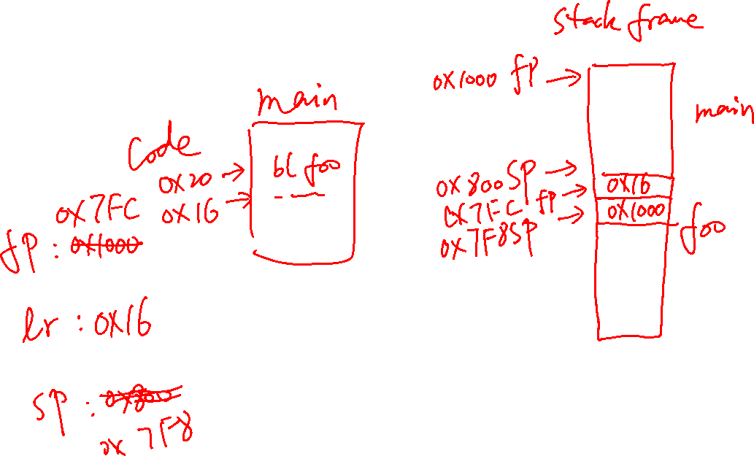
Passing 6 Args Example

Slide 51
REWRITE EVERYTHING AFTER THIS SLIDE

Slide 52
Determining Size of the Passed Parameter Area on The Stack
Find the function called by main with the largest number of parameters
That function determines the size of the Passed Parameter allocation on the stack
int main(void)
{
/* code not shown */
a(g, h);
/* code not shown */
sixsum(a1, a2, a3, a4, a5, a6);
/* code not shown */
b(q, w, e, r);
/* code not shown */
}
largest arg count is 6
allocate space for 6 - 4 = 2 arg slots
x

Slide 53
Structs and pointers
not sure on this….

