Slide 1
Version 2.14
UCSD CSE 30 Section B
Computer Organization and Systems Programming
Lecture 2
Keith Muller
DEC PDP 11/45 - 1973

Slide 2

Attendance Code

Slide 3

Memory is Organized in Units of Bytes
n-bit Memory
Address
One bit (digit) of storage (in memory) has two possible states: 0 or 1
Memory is organized into a fixed unit of 8 bits, called a byte
Conceptually, memory is a single, large array of bytes, where each byte has a unique address (byte addressable memory)
An address is an unsigned (positive #) fixed-length n-bit binary value
Range (domain) of possible addresses = address space
Each byte in memory can be individually accessed and operated on given its unique address
Word size: is the number of bits in an address
Memory
contents
High address
Bit position in Byte
7 | 6 | 5 | 4 | 3 | 2 | 1 | 0
0 | 0 | 1 | 0 | 0 | 0 | 0 | 0
Content of each bit
..00000111
10101010
..00000110
01010101
MSB
Most Significant Bit
LSB
(Least Significant Bit)
..00000101
10101010
..00000100
01010101
..00000011
10101010
..00000010
01010101
..00000001
10101010
..00000000
01010101
Low address
1 byte
(8-bits wide)
$$2^{N} Bytes of memory$$
x

Slide 4
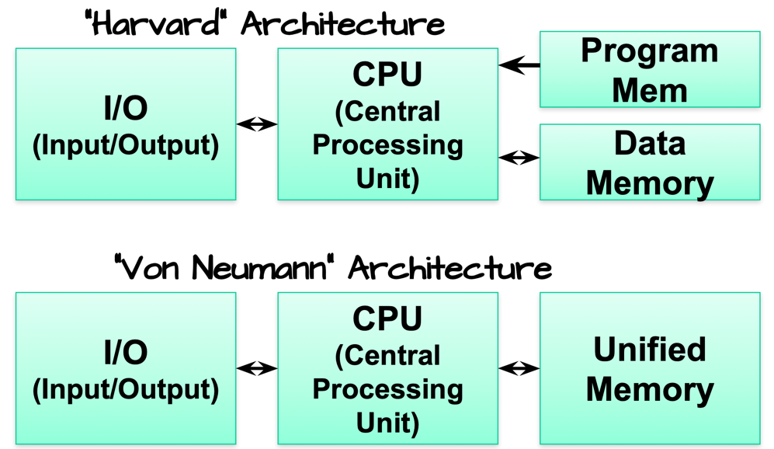
An Alternative that was not successful: Harvard Architecture
Harvard architecture premise: Instructions and data should not interact (claim is higher higher performance), and they can have different word sizes
Observation: Two memory subsystems (using similar state of the art technologies) can be accessed concurrently for higher throughput
Distinguishing feature: Independent instruction and data memories
Do you agree and why?
x

Slide 5
Machine Organization Example – Which Architecture is it?
Memory 2
data
A good exam question
Answer: Either you must be told where the Instructions and data are placed
How can this be a Harvard architecture?
Harvard Architecture: Use physical memory interleaving to achieve the performance increase with having to scale and size two different memory subsystems
The size of the interleave is some multiple of bytes (like 1024)
I/O
CPU
instruction
Memory 1
data
instruction
high
address
…
Low address
x

Slide 6
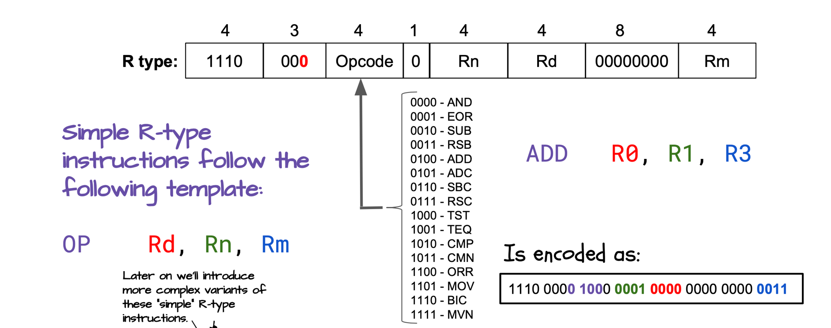
Assembly & Machine Code Example: ARM-32 (32-bits)
Consider an addition statement
R0 = R1 + R3;
Assembly Language (human readable)
machine code pattern in memory
Observe there are only enough bits to specify 16 registers
List of Different operations for this type of instruction
x

Slide 7
Why only 16 Registers & how to access all of memory
Consider a = b + c are operands are in memory
Operation code: add Destination: a
Operand 1: b Operand 2: c
Aarch32 Instructions were designed to always be: 32 bits wide
Some bits must be used to specify the operation code
Some bits must be used to specify the destination
Some bits must be used to specify the operands
To address all of memory you must store an address in a register
ARM-32 registers (the contents) are 32-bits (can contain data or an address)
0xFF…FF
32-bit Address space
32 bits wide
31 |  |  | 0
Opcode
Destination
Operand 1
Operand 2
31 | 0
Address of a location in memory
0x00…00
NOT ENOUGH BITS for FULL Addresses to be stored in the instruction
x

Slide 8
Machine code execution order
Register
Contents
Address
(Register name)
Memory
high memory address
data
data
CPU
registers
data
Rn
…
R2
R1
R0
data
…
machine code program
instruction #n
instruction #...
add
r0
r1
r2
instruction #3
Direction of execution
instructions
instruction #2
instruction register
instruction #1
low memory address
Execution order: Programs execute from instructions located in low address memory to high address memory stepping one machine instruction at a time (called execution order) unless there is a branch (example: loop, if statement etc.)
x

Slide 9
From Source code to Execution
$ cat test.c
#include <stdlib.h>
#include <stdio.h>
int main (void)
{
printf("Hello!\n");
return EXIT_SUCCESS;
}
$ gcc -Wall –Wextra –Werror -c -S test.c
$ ls -ls
total 8
4 -rw-r--r-- 1 kmuller kmuller 109 Mar 14 15:57 test.c
4 -rw-r--r-- 1 kmuller kmuller 725 Mar 14 15:58 test.s
$ gcc test.s
$ ls -ls
total 16
8 -rwxr-xr-x 1 kmuller kmuller 7708 Mar 14 15:58 a.out
4 -rw-r--r-- 1 kmuller kmuller 109 Mar 14 15:57 test.c
4 -rw-r--r-- 1 kmuller kmuller 725 Mar 14 15:58 test.s
$ ./a.out
Hello!
Volatile
Memory
(RAM)
Source to Execution Steps
Compile (c source to assembler)
Assemble (assembler source to object)
Link (Combine object files to executable)
Load (Copy executable into memory)
Execute (OS runs the code)
CPU
+
Registers
Volatile
Memory
(RAM)
compile
I/O HUB
loader
assemble and link
gcc automatically calls the assembler with .S or .s files
crt0 is the c runtime startup code
crt0.o
load and then execute
disk file
x

Slide 10
Equivalent Code: C -> Assembly -> Machine
#include <stdlib.h>
#include <stdio.h>
int main(void)
{
printf("Hello!\n");
return EXIT_SUCCESS;
}
C source
memory
address contents
high low bytes
corresponding assembly
00010408 <main>:
10408: e92d4800 push {fp, lr}
1040c: e28db004 add fp, sp, 4
10410: e59f0010 ldr r0, [pc, 16] //10428 <L1>
10414: ebffffb3 bl 102e8 <printf@plt>
10418: e3a00000 mov r0, 0
1041c: e24bd004 sub sp, fp, 4
10420: e8bd4800 pop {fp, lr}
10424: e12fff1e bx lr
00010428 <L1>:
10428: 0001049c
0001049c <mesg>:
1049c: 6c6c6548 // 'l, 'l', 'e', 'h'
104a0: 000a216f // '\0', '\n', '!', 'o'
Code aka TEXT
.section .rodata
mesg: .string "Hello!\n"
.text
.global main
.type main, %function
.equ FP_OFF, 4
.equ EXIT_SUCCESS, 0
main: push {fp, lr}
add fp, sp, FP_OFF
ldr r0, L1
bl printf
mov r0, EXIT_SUCCESS
sub sp, fp, FP_OFF
pop {fp, lr}
bx lr
L1: .word mesg
ARM-32 assembly
Machine code (instructions)
address of mesg
Data
address of mesg
x

Slide 11
PA2/PA3 Design: Using a Finite State Machine
Finite state machine (or Finite State Automaton) is a way of representing (or detecting) a language
Example: set of string patterns (e.g., HA) accepted or rejected based on an input sequence
Circle (States) and Arc representation
A circle (state) represents (remembers – a "path") what has already been seen in the input stream
An arc represents a transition from one state to the next state for a specified input and may specify an optional output (or operation to be performed)
The next state can be the same state or a different state
At any point in time, one of the states is the current state of the machine
Current state "remembers" the input sequence seen so far by the machine
Whenever a state is entered, it "reads" to get the next input (except the end state – next slide)
Arc
Arc
start
1
Arc
2
Arc
3
State
State
State
x

Slide 12
Machine States and Transitions
Two Special states
start state (machine starts "powers up" in this state) required
end state (done or final state) not required – if not present DFA runs forever
Each arc has a label(s) that uses the notation: input1, …, input n / output or action taken
When the input to the machine matches one of the input labels, it selects that arc to be taken
The arc taken also specifies the output produced or action taken
it is ok to have no output, or no operation associated with an arc
Example: FSA machine below recognizes the sequence HA on an input stream, then stops
Question: what is missing here? – What do we do for inputs NOT specified?
start
end
On this input
Either Output this or perform this action
start
H / no
H
A / yes
end
x

Slide 13
Arc labeling
output(c) indicates c is to be output (printed for example)
An action of – means no action (or output)
a / -
The labels all and other have special meanings
When an arch is labeled with an input of other, this represents all other character inputs that are not specified by other arcs
If you need to output the actual input character, you will label the arch as:
other / output(other)
When an arch is labeled with an input of all, then this arc is taken for all inputs
this must be the only arc out of the state
Question: Is the all label really needed?
If you need to output the actual input character, you will label the arch as:
all / output(all)
other / output(other)
start
H / output(H)
H
all / output(all)
end
x

Slide 14
Designing a Deterministic Finite State Automaton
Deterministic Finite State Automaton (or deterministic finite state machine)
For any given state, then for all possible inputs, there is always one next state
Step 1: Define the states (using the recognizer example from the previous slide)
Start (initial or power up) state: input has not seen an H (or no input so far)
H state: input has seen at least one H (or more than one H
end state: input has seen an H immediately followed by an A
Step 2: Define the arcs
Specify arcs at each state for all possible inputs (an arc can be taken on more than on input)
Specify output or action (if any) on each arc
Check: each state transition (arc) is unambiguous (unique – a specific input selects just one arc)
other / no
H / no
start
H / no
H
A / yes
end
other / no
x

Slide 15
DFA counting the instances of a pattern
The state machine on the previous slide would stop after seeing the first HA, and does not take any more input, missing later occurrences of HA in the input
Say you want to process the entire contents of a text file to find and count all HA's
from the top (top of file)
to the bottom (end of file)
Action: Alter the machine to process input from the file in sequential order until the end of the file (EOF) is reached
This is a text file with a lot
of HHAA in it.
There is a HA here and a HA
there and a HA everywhere.
There is also HAHA HA.
TOF
EOF
x

Slide 16
DFA counting the instances of a pattern - 2
We will adjust the DFA to act on continuous input (multiple instances of the pattern)
And to count the number of HA patterns
"redirect" the arc(s) that pointed at the end state to point to the start state
Convert output to counting actions
Add arcs from each state when EOF on input is detected to the eof state
EOF / Output (count)
other / -
H / -
start
H / -
H
EOF / Output (count)
end
this is power up
/ count = 0
other /
A / (count = count + 1)
x

Slide 17
Merging DFA's: Step one design each sequence -1
EOF / -
L / output(@)
other / output(other)
S / output(S)
S / output(S),
output(O)
EOF / output(S),
output(O)
start
S / -
S
O
end
O / -
other / output(S),
output(other)
EOF / output(S)
other / output(S),
output(O),
output(other)
This DFA replaces SOL with a @
x

Slide 18
Merging DFA's: Step one design each sequence - 2
EOF / -
M / output(D),
output(A),
output(D)
other / output(other)
S / output(S)
S / output(S),
output(A)
EOF / output(S),
output(A)
start
S / -
S
A
end
A / -
other / output(S),
output(other)
EOF / output(S)
other / output(S),
output(A),
output(other)
This DFA replaces SAM with DAD
x

Slide 19
Merging DFA's: Step one design each sequence - 3
To merge two DFA's
combine common states
make sure all the arcs out of the combined states represent the arcs in the two DFA's
Example:
The prior two DFAs both have the same initial state sequence (start and S) which will be in the merged DFA
Next add all the unique arcs out of state S from both the separate DFAs and adjust the labels if necessary
Add the remaining states and arcs that are unique to each DFA
We are going to simplify the combination process by assuming the input is infinite in length
So, both EOF processing and the end state is not shown
You will use this same assumption in PA2
S / output(S),
output(O)
other / output(other)
S / output(S)
O
O / -
start
S / -
S
A / -
other / output(S),
output(other)
A
S / output(S),
output(A)
x

Slide 20
Merging DFA's – 3 (Finished)
This DFA replaces SOL with a @
and This DFA replaces SAM with DAD
other / output(S),
output(O),
output(other)
L / output(@)
O
other / output(other)
S / output(S)
O / -
start
S / -
S
S / output(S),
output(O)
other / output(S),
output(other)
A / -
S / output(S),
output(A)
M / output(D),
output(A),
output(D)
A
other / output(S),
output(A),
output(other)
x

Slide 21
Introduction: C Program Structure (Single file)
#include <stdlib.h>
#include <stdio.h>
/*
* This is a block comment
*/
// this is a line comment
int main(int argc, char *argv[]) // or int main() or int main(void)
{
char x = '\n';
printf("Hello World!%c", x); // "Hello World!\n"
return EXIT_SUCCESS; // main always returns either
// EXIT_SUCCESS or EXIT_FAILURE
}
directives to the preprocessor
main() is the first function to run
Every executable program must have one function called main()
char literal '\n'
library function for writing to stdout
string literal "Hello World!%c"
x

Slide 22
What is the preprocessor (cpp)?
C
two.c
cpp
C
two.i
gcc
ARM Machine two.o
temp files
assembly three.S
cpp
assembly three.i
gcc(gas)
ARM Machine three.o
Preprocessing is the first phase in the compilation (.c files) or assembly (.S files only) process
The preprocessor (cpp) transforms your source code, then passes it to the compiler (on .c files) or the assembler (on .S files only, not .s files)
cpp is automatically invoked by gcc (when compiling .c or assembling .s files)
Usually, the input to cpp is a C source file (.c) or an assembly source file (.S only) and output from cpp is still a C file or assembly file
output from cpp is in a temporary .i file (deleted after use)
cpp does not modify the input source file
Common use: When a program is divided across multiple source files (including library files), cpp helps you keep consistency among the files (one version of the truth)
Examples: Consistent values for a constants, correct function definitions, etc.
x

Slide 23
Reference Slides
Slides in this section are not used in class but contain material that you will find useful
x

Slide 24
PA3: Programming a Deterministic Finite Automaton
Rules for this DFA example
Copy input to output while removing everything in "strings" from output
input: ab"foo"cd
output: abcd
Special Case: If Inside a string, a \ is an escape sequence, ignore the next char
Allows you to put an " in a string
input: ab"foo\"bar"cd
output: abcd
end program
other / output(other)
EOF/No error
EOF/error
EOF/error
start
" / -
quote
\ / -
slash
" / -
all/-
the – means no output
other / -
x

Slide 25
Programming a Deterministic Finite Automaton – The Files
Break the program into three files
noq.c is where main loop is, imports declarations in states.h
states.h is the public interface to the state handlers in states.c
states.c definition of the state handler functions, imports declarations in states.h
Observe there is no .h file for noq.c, as it does not have any exports
noq.c
#include "states.h"
main() function
current state variable
states.h
#defines for each state "value"
function prototypes for each state
states.c
#include "states.h"
function definitions for each state
x

Slide 26
Programming a Deterministic Finite Automaton - states.h
// public interface file states.h
#ifndef STATES_H
#define STATES_H
// Assign a value for each state
#define START 0
#define QUOTE 1
#define SLASH 2
// Function prototypes
// for each state handler
int STARTstate(int);
int QUOTEstate(int);
int SLASHstate();
#endif
Will not need to be a state
end program
other / output(other)
EOF/No error
EOF/error
EOF/error
start
" / -
quote
\ / -
slash
" / -
all/-
other / -
Each function implements the arcs out of that state
returns the next state based on the input
performs any actions associated with arc taken
x

Slide 27
Programming a Deterministic Finite Automaton – states.c
#include <stdio.h>
#include "states.h"
int STARTstate(int c)
{
if (c == '\"')
return QUOTE; // saw a double quote
putchar(c); // echo input
return START; // stay in START
}
int QUOTEstate(int c)
{
if (c == '\\')
return SLASH; // backslash ignore next char
else if (c == '\"')
return START; // closing " go to START
return QUOTE;
}
int SLASHstate()
{
return QUOTE;
}
states.c
other / output(other)
start
" / -
quote
\ / -
slash
" / -
all/-
other / -
x

Slide 28
Programming a Deterministic Finite Automaton – noq.c
int main(void)
{
int c; // input char
int state = START; // initial state of DFA
while ((c = getchar()) != EOF) {
switch (state) {
case START:
state = STARTstate(c);
break;
case QUOTE:
state = QUOTEstate(c);
break;
case SLASH:
state = SLASHstate();
break;
default:
fprintf(stderr, "Error: Invalid state (%d)\n");
return EXIT_FAILURE;
} // end switch
} // end while
/*
* All done. No explicit end state used here.
* if not in start state, we have an error
*/
if (state == START)
return EXIT_SUCCESS;
// ok we had an error
fprintf(stderr, "noq error: Missing end quote \"\n");
return EXIT_FAILURE;
}
primary loop read a char at a time until EOF
process input based on current state
call state handlers based on current state
state handlers return next state
end program
other / output(other)
EOF/No error
EOF/error
EOF/error
start
" / -
quote
\ / -
slash
" / -
all/-
check ending "state"
x

Slide 29
Aside: Remember make from CSE15L?
# CSE30SP24 DFA Example
# if you type 'make' without arguments, this is the default
PROG = noq
all: $(PROG)
# header files and the associated object files
HEAD = states.h
SRC = noq.c states.c
OBJ = ${SRC:%.c=%.o}
# special libraries
LIB =
LIBFLAGS = -L ./ $(LIB)
# select the compiler and flags you can over-ride on command line
# e.g., make DEBUG=
CC = gcc
DEBUG = -ggdb
CSTD =
WARN = -Wall -Wextra -Werror
CDEFS =
CFLAGS = -I. $(DEBUG) $(WARN) $(CSTD) $(CDEFS)
$(OBJ): $(HEAD)
# specify how to compile/assemble the target
$(PROG): $(OBJ)
$(CC) $(CFLAGS) $(OBJ) $(LIB) -o $@
# remove binaries
.PHONY: clean clobber
clean:
rm -f $(OBJ) $(PROG)
x

Slide 30
Programming a Deterministic Finite Automaton - testing
$ make
gcc -I. -ggdb -Wall -Wextra -Werror -c -o noq.o noq.c
gcc -I. -ggdb -Wall -Wextra -Werror -c -o states.o states.c
gcc -I. -ggdb -Wall -Wextra -Werror noq.o states.o -o noq
$ ./noq
123"456"789
123789
"123"45"67"
45
"123
456
78"9
9
"test
^d
noq error: Missing end quote "
$ cat in
line1"34"
"line2"line2
line3"
line4
$ ./noq < in > out
noq error: missing end quote "
$ cat out
line1
line2
line3$
typed input in red
output in blue
x

Slide 31
C Versus Java
Note: Sorry for the "poor" code indentation; adjusted to fit into the table
 | Java | C
Overall Program Structure | source file: Hello.java public class Hello { public static void main (String[] args) { System.out.println( "hello world!"); } } | source file: hello.c #include <stdio.h> #include <stdlib.h> int main(void) { printf("hello world!\n"); return EXIT_SUCCESS; }
Access a library | import java.io.File; | #include <stdio.h> // may need to specify library at compile time with -llibname
Building | % javac Hello.java | % gcc –Wall –Wextra -Werror hello.c –o hello
Running (execution) | % java Hello hello world! | % ./hello hello world!
x

Slide 32
C Versus Java
 | Java | C
Strings | String s1 = "Hello"; | char *s1 = "Hello"; // pointer version char s1[] = "Hello"; // array version
String Concatenation | s1 + s2 s1 += s2; | #include <string.h> strcat(s1, s2);
Logical ops | &&, ||, ! | &&, ||, !
Relational ops | ==, !=, <, >, <=, >= | ==, !=, <, >, <=, >=
Arithmetic ops | +, -, *, /, %, unary - | +, -, *, /, %, unary -
Bitwise ops | <<, >>, >>>, &, ^, |, ~ | <<, >>, &, ^, |, ~
Assignment ops | =, +=, -=, *=, /=, %=, <<=, >>=, >>>=, &=, ^=, |= | =, +=, -=, *=, /=, %=, <<=, >>=, &=, ^=, |=
x

Slide 33
C Versus Java
 | Java | C
Arrays | int [] a = new int [10]; float [][] b = new float [5][20]; | int a[10]; float b[5][20];
Array bounds checking | // run time checking | // no run time checks – speed optimized
Pointer type | // Object reference is an // implicit pointer | int *p; char *p;
Record type | class Mine { int x; float y; } | struct Mine { int x; float y; };
x

Slide 34
C Versus Java
 | Java | C
if, switch, for, do-while, while, continue, break, return | // equivalent | // equivalent
exceptions | throw, try-catch-finally | // no equivalent
labeled break | break somelabel; | // no equivalent
labeled continue | continue somelabel; | // no equivalent
calls: Java method C function | f(x, y, z); someObject.f(x, y, z); SomeClass.f(x, y, z); | f(x, y, z); // other differences, later…
x

Slide 35
C Programming Toolchain - Basic Tools
gcc
Is a front end for all the tools and by default will turn C source or assembly source into executable programs
preprocessor
Insertion into source files during compilation or assembly of files containing macros (expanded), declarations etc.
compiler
Translates C programs into hardware dependent assembly language text files
assembler
Converts hardware dependent assembly language source files into machine code object files
Linker (or link editor)
Combines (links) one or more object files and libraries into executable program files
this may include modification of the code to resolve uses with definitions and relocate addresses
x

Slide 36
C Programming Toolchain: The Source files
The C development toolchain uses several different file types (indicated by .suffix in the filename)
filename.h public interface "header or include files" often used as <filename.h> or "filename.h"
common contents: public (exported) function and variable declarations, and constants and language macros
Processed by cpp (the C pre-processor) to do inline expansion of the include file contents and insert it into a source file before the compilation starts, enables consistency
filename.c
a source text file in C language source
Processed by gcc
filename.S
a source text file in hardware specific assembly language (programmer created)
processed by gcc which calls gas (assembler)
filename.s
machine generated by the compiler from a .c file
processed by gcc which calls gas (assembler)
x

Slide 37
C Programming Toolchain: The Generated files
filename.o "relocatable object file"
Compiled from a single source file in a .c file or assembled from a single .s file into machine code
A .o file is an incomplete program (not all references to functions or variables are defined) this code will not execute
The .o and .c, .s, or .S files share the same root name by convention
created by gcc calling ld (linkage editor)
library.a "static library file"
aggregation of individual .o files where each can be extracted independently
during the process of combining .o files into an executable by the linkage editor, the files are extracted as needed to resolve missing definitions
created by ar, processed by ld (usually invoked via gcc)
a.out "executable program"
Executable program (may be a combination of one or more .o files and .a files) that was compiled or assembled into machine code and all variables and functions are defined
processed by ld (usually invoked via gcc)
x

Slide 38
Basic gcc toolchain usage
Run gcc with flags
-Wall -Wextra
required flag for c programs in cse30
output all warning messages
-c
Optional flag (lower case)
Compile or assemble to object file only do not call ld to link
creates a .o file
-ggdb
Optional flag
Compile with debug support (gdb)
generates code that is easier to debug
removes many optimizations
-o <filename>
specifies filename of executable file
a.out is the default
-S
Optional flag (upper case S)
Compiles to assembly text file and stops
creates a .s file
Producing an executable file
gcc –Wall –Wextra -Werror mysrc.c
creates an executable file a.out
To use a specific version of C use of one the std= option
gcc –Wall –Wextra –Werror –std=c11 mysrc.c
Producing an object file with gdb debug support add -ggdb
gcc –Wall -Wextra –Werror –c –ggdb mysrc.c
creates an object file mysrc.o
gcc –Wall –Wextra -Werror –c –ggdb mymain.c
creates an object file mymain.o
Linkage step
combining a program spread across multiple files
gcc –Wall -Wextra –Werror –o myprog mymain.o mysrc.o
creates executable file myprog
Compile and linkage of file(s) in one step
gcc –Wall –Wextra -Werror -o myprog mysrc.c mymain.c
run the program (refer to cse15l notes)
% ./myprog
x

