Slide 1
Version 2.11
UCSD CSE 30 Section B
Computer Organization and Systems Programming
Lecture 1
April 2, 2024
Keith Muller
DEC PDP 11/45 - 1973

Slide 2
CSE30 Section B Spring 2024
In Person Office Hours: CSE 2109
Tue, Thu: 2:00 PM to 3:00 PM
These office hours are group meetings
Ask questions, review material, or just come to listen
Students who attend office hours tend to do better in the course
Instructor: Keith Muller
I highly encourage feedback
Please bring any issues to my attention, I will promptly address them
How to contact me directly:
kmuller@ucsd.edu
Please do not use canvas messages
Zoom Office Hours
https://ucsd.zoom.us/j/94331007124
Friday: 4:00 PM to 4:45 PM
These office hours can be indivual of for a group if you like
Additional office times By Appointment
Send me email to schedule
x

Slide 3
CSE 30 Spring 2024 – Staff Covers Both Sections A & B
Section A (Cao) and B (Muller) share the same pool of TA's and Tutors
TA's
Nitya Agarwal
Mihir Kekkar
Yuchen Jing
Liam Fernandez
Tutors
Ali Alabiad
Bryan Cho
Charlotte Dong
Vivian Liu
Kate Romero
Kevin Shen
Charvi Sukla
Fong Vachirathanusorn
Joseph Edmonston
Thanh-Nhan Lam
Tutors
Christian Lee
Jessie Ouyang
Brandon Reponte
Adrian Rosing
Luffy Saito
Leica Shen
Shijie Wang
Alex Simonyan
Reese Whitlock
x

Slide 4
Overview of Grading - See Syllabus (Canvas) for More Details
70 pts – Attending Lecture in person
5 points per section B lecture
120 pts total – Canvas Quizzes
240 pts total – Programming Assignments
190 pts - Midterm – In Person
380 pts - Final – In Person
1000 pts total for graded assignments
Special grading circumstances (e.g., extended absence, illness, other issues, etc.)
PROMPTLY Contact me directly (kmuller@ucsd.edu)
x

Slide 5

Lecture 1 QR Code
Class attendance points: To encourage you to attend lecture
Over the years we have found that students that attend lectures in CSE30 get better grades
Section B has 20 lectures, attend 14 to get the 70 points
Attending more than 14 gets you up to 30 more points
Attendance is taken at the start of class using google forms that is accessed with a lecture QR code in the slides
For the first lecture only, the form will be open until 9 PM
bring a device that can use QR codes to access goggle forms and allows you to sign into UCSD SSO
You will be required to supply a code word announced in class
You will eventually get an email acknowledgement from google that your attendance was recorded
ONLY If you cannot access the google form, send me email (kmuller@ucsd.edu) with the code word in the subject line
The email must be timestamped within the first 20 minutes of lecture
If you have issues with this method,
please contact me
x

Slide 6
CSE30 Spring 2024 Section B Specific
There are two sections: Section A (Cao) and Section B (Muller)
What is the same in the two sections
study topics (roughly in-sync by the end of each week)
quizzes
Programming Assignments
What is different between the two sections
lecture materials
midterm questions (from Sect B lecture)
final questions (from Sect B lecture)
In-person lecture attendance is strongly encouraged (attendance points)
Lectures are podcast recorded
Discussion section attendance is optional but strongly encouraged
You may attend either discussion section and still be enrolled in Sect B
Section B sections are podcast recorded
See the syllabus for grading details
x

Slide 7
CSE30 Class Resources
Section B Lecture Slides: https://github.com/cse30-sp24/Muller-Slides
Located on class github in both pptx and pdf format
Slides are updated constantly to correct errors and to improve content
Version is at the upper left on the title slide
Always check you have the current version the morning before lecture
Class github: https://github.com/cse30-sp24
Piazza: https://piazza.com/ucsd/spring2024/cse30_sp24_a0/home
First Place to go to for Q/A and important announcements
Public piazza posts are for: general questions on PA's and lectures
Do not post publicly any parts of an assignment, quiz or exam solution
Private posts are for: specific situation relating to just you or you are not sure
Tutor Lab hour schedule: https://autograder.ucsd.edu
For getting help from the tutors
Canvas: https://canvas.ucsd.edu/courses/54650
Links to quizzes, textbooks, programming assignments, exams
Gradescope: https://www.gradescope.com
Quizzes and Submitting programming assignments
x

Slide 8
Surviving Section B Lectures (In-person)
Make sure you bring your copy of lecture slides to class, it helps
How to get my attention in class
I never intentionally ignore questions; I just may not see you
Raise your hand, or just call out if I appear to ignore you by accident
You must SLOW ME DOWN: Otherwise, I tend to speed up
Please do not be shy, speak up and remind me to slow down
If you have questions, or I went too fast, or the material is not clear, etc.
Please ask me to go over it again (do this right away, not 5 slides later)
Just don’t sit there and waste your time
my responsibility: help you learn the material
your responsibility: ask questions (I love questions, they also slow me down!)
x

Slide 9
How to do well in CSE30 - 1
Go to lecture
Before lecture go over the class slides
Lecture slides are posted the day before class (last minute updates that morning)
Keep your lecture slides up to date (I update them to fix errors and address questions)
Go to Discussion Sessions
ask the TA’s and Tutors for help
Studying for exams
All the exam question topics are found in my slides and the PA writeups
Try to write the exam yourself, with practice you will be able to guess the questions
Post to piazza when you have questions
Do the readings on time
Review the material: watch the podcasts and occasional special topic videos
x

Slide 10
How to do well in CSE30 - 2
Most important: Keep up, do not procrastinate as it is hard to catch up
The class material starts easy and gets much harder over the quarter
Do not expect you can do later programming assignments in less than 5 days
Do not expect to learn the material by binge watching podcasts, this never ends well
Please be careful when using web resources for this class
a lot of the material you will find is either not correct or does not apply to our programming environment
this is especially true with assembly language programming topics
Are you struggling?
Do not wait, ask for help as soon as possible – do not fall behind
Best advice: Come to my office hours (or schedule a zoom meeting)
Give me a chance to help you
I will spend as much time as necessary to help you understand the material
x

Slide 11
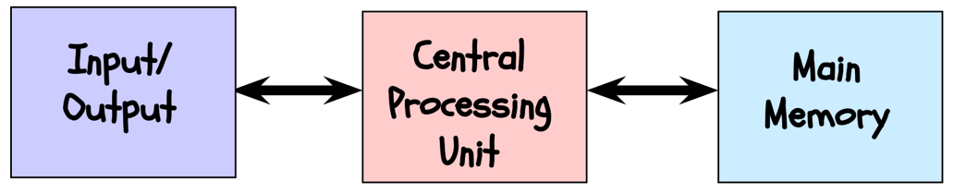
A General-Purpose Computer – Von Neuman Architecture
Since the middle of the 20th century, many architectural approaches to the general-purpose computer have been tried
The architecture which nearly all modern computers are based was proposed by John Von Neuman in the late 1940's
The major components are:
Central Processing Unit (CPU): a device which fetches, interprets (decodes), and executes a specified set of operations called instructions
Memory: Storage of N words of W bits, where W is a fixed architectural parameter, and N can can be expanded to meet workload (the programs running on the CPU) and cost requirements
I/O: Devices for communication with the outside world (including external persistent storage)
External connections (from CPU to memory and I/O) typically use industry "standards"
Standards enable technologies from different companies to interoperate
x

Slide 12
What is Computer Architecture?
Instruction Set Architecture (ISA)
Functional behavior of a computer system as viewed by a programmer
describes how the CPU is controlled by software programs
specifies both what the processor can do as well as how it gets it done
Architectural Characteristics (partial list):
supported data types (how data is encoded)
CPU registers (number, size, use, etc.)
how the hardware manages main memory
instructions a microprocessor can execute
Operations they perform
Instruction "format" (bit patterns) in memory
input/output model
Machine Organization
Physical (design) realization of what is specified by the instruction set architecture
It deals with how the hardware components are linked together to meet the requirements specified by instruction set architecture
The ISA allows variability in the physical design implementation to address different workload needs (cost, scalability, etc.)
Machine organizational characteristics (partial)
Hardware component choices to achieve:
Expandability
Configurability
etc.
Physical layout
Number and type of peripherals (I/O devices)
x

Slide 13
Von Neuman Architecture
Register
Contents
Distinguishing feature: Memory contains both program CPU instructions and data
CPU Instructions are encoded in memory with patterns of ones and zeros (similar to binary numbers)
Encoded CPU instructions are called machine code (or machine language)
Example: three 32-bit instructions (shown in hexadecimal format below)
Instructions operate on data that is stored in a small capacity volatile (fast) memory in the CPU
This memory is called registers
CPU reads/writes data from memory from these data registers to operate on the data
Address
(Register name)
data
Memory
CPU
data
registers
data
Rn
…
R2
R1
R0
…
data
81 fe 89 32
81 54 22 af
81 22 10 9A
add
r0
r1
r2
instructions
instruction #3
instruction #2
instruction register
instruction #1
x

Slide 14
C, Assembly and Executable Programs
Assembly language is a symbolic version of the machine code (language)
Instructions describe operations the hardware can perform (e.g., =, +, -, *)
Unique to a specific ISA: e.g., ARM-32 versus IA-64
May be stored in a human readable text file
You can write in assembly language just like C or Java
Assembly is much easier to program than machine code
A high-level language (like C) is compiled into an assembly language equivalent
A statement in C is represented by a sequence of one or more assembly language instructions (why a do you think it is a sequence?)
Assembly language program
assembly language program is translated (assembled) into machine code
An executable program contains
series of instructions in machine code (the program)
(maybe some) data to operate on
x

Slide 15
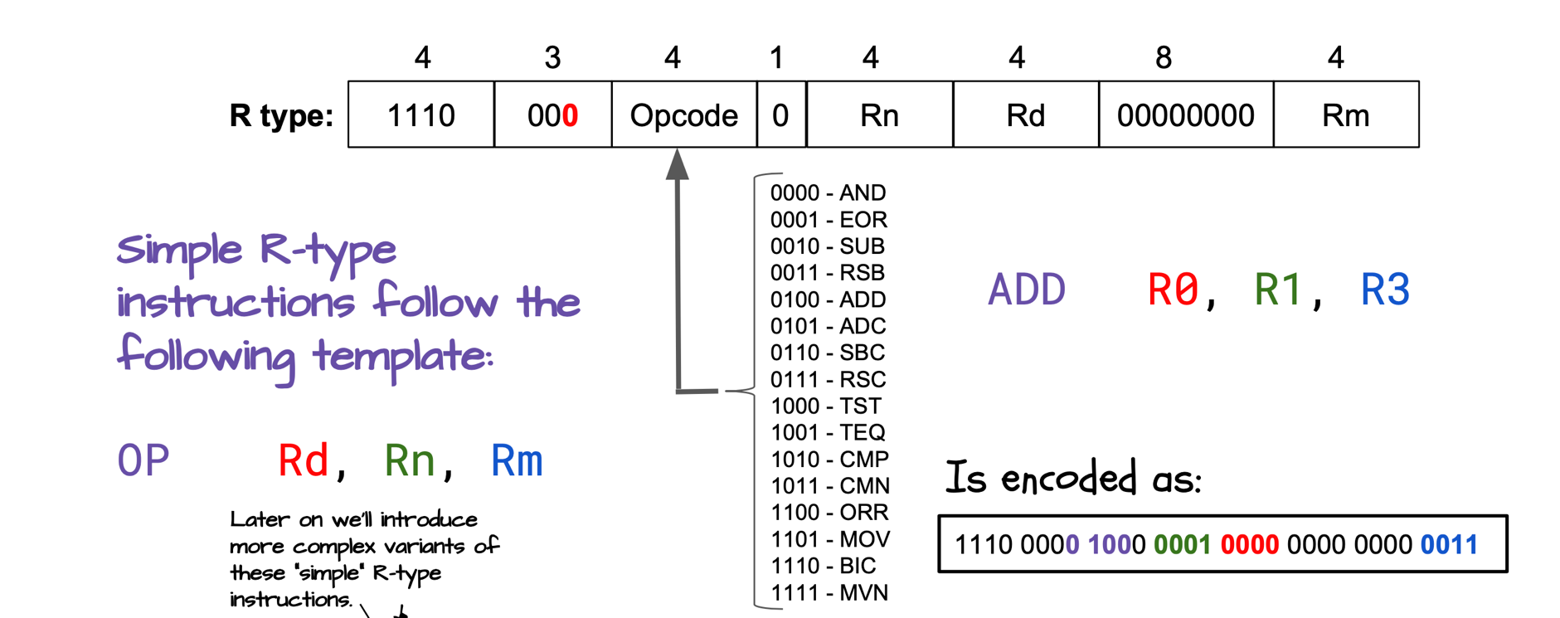
Assembly & Machine Code Example: ARM-32 (32-bits)
Consider an addition statement
R0 = R1 + R3;
Assembly Language (human readable)
machine code pattern in memory
List of Different operations for this type of instruction
x

Slide 16
Review: Machine Organization – Von Neuman
CPU executes a machine code program
Machine code is specific to a particular CPU Instruction set Architecture (ISA)
Memory contains both data and programs
I/O (input/Output): Connects the CPU and memory to the external world
An I/O operation is where data (including machine code) is copied between persistent storage (like an SSD) and ram memory
Volatile (non-persistent) memory
contents lost when power is removed
Memory dimms (memory bus)
CPU registers (memory inside the CPU)
Non-volatile (persistent) memory
contents preserved when power is removed
SSD (I/O bus attached)
NVDIMM (memory bus attached)
Memory Bus
DDR5
Volatile
Memory
(RAM)
Optional
Video
Adapter
CPU
+
Registers
Volatile
Memory
(RAM)
I/O
PCI-E
Storage
Non-volatile
Memory
I/O HUB
Network
I/O
PCI-E
Keyboard + Mouse
USB
x

Slide 17

Memory Triangle: Hardware Cost/Performance/Capacity Tiers
Assume each instruction takes 1 clock cycle
Clock cycle =~ time to access; larger is slower
Smallest Capacity
Highest Performance
Highest cost/capacity
Registers
ALU & Logic
Address
Data
Caches
CPU
Address
Data
DIMM memory Module
~300 K Cycles
Largest Capacity
Slowest performance
Lowest Cost $/capacity
PCI-E
Design Goal: best performance at the lowest (or specific) cost
Other goals: performance/energy (operating cost), expandability, high margin (price/cost)
x

Slide 18
Machine code execution order
Register
Contents
Address
(Register name)
Memory
high memory address
data
data
CPU
registers
data
Rn
…
R2
R1
R0
data
…
machine code program
instruction #n
instruction #...
add
r0
r1
r2
instruction #3
Direction of execution
instructions
instruction #2
instruction register
instruction #1
low memory address
Execution order: Programs execute from instructions located in low address memory to high address memory stepping one machine instruction at a time (called execution order) unless there is a branch (example: loop, if statement etc.)
x

Slide 19
From Source to Machine code
C source
Rust source
go source
High level Language
File (text)
C source
Rust source
go source
compiler
compiler
ARM Assembly
Assembly file
(text)
intel Assembly
assembler
assembler
ARM Machine code
Object file
(binary)
intel Machine code
The granularity of compilation and assembly is a single text file (called a translation unit)
.c file is a C source file (file.c)
.S file (upper case S) is a human written assembly source file (file.S)
.s file (lower case s) is a compiler generated assemble source file (file.s)
.o file is a machine code binary (object) file (file.o)
Multiple .o files are combined (linked) into an executable file
x

Slide 20
Linker: Combines object files to create an executable file
C
one.c
ARM Machine one.o
one.o
linker
two.o
Executable file
(a.out)
three.o
C
two.c
ARM Machine two.o
func1.o
func3.o
func1.o
assembly three.S
ARM Machine three.o
func2.o
func3.o
Static
Library file (libsample.a)
func4.o
Each source file (Translation unit) is compiled (or assembled) independently to an object file
When we modify a single file in a multi-source file program, we want to only recompile the file that changed and combine it with the other already compiled object files
Library file (libXX.a – where XX is the library name) is an aggregation of distinct object (.o) files
Linker combines all the listed object files together plus just those object files in libraries whose contents are referenced
Example: one.c and two.c call functions contained in func1.o and func3.o (no calls to func2.o or func4.o)
Important: Object files created from C and assembly source can be linked (call each other) into a working executable when certain rules are followed (we will be doing a lot of this later this quarter)
x

Slide 21
From Source to Execution: Different ISA
C source
Rust source
go source
High level Language
File (text)
C source
Rust source
go source
compiler
compiler
ARM Assembly
Assembly file
(text)
intel Assembly
assembler
assembler
ARM Machine code
Object file
(binary)
intel Machine code
ARM Machine
intel Machine
ARM Machine
intel Machine
linker
linker
ARM Machine
intel Machine
library file
library file
intel executable on linux
arm executable on linux
Executable file
(binary)
Pi-cluster system (all CSE30 PA's)
ieng6
x

Slide 22
From Source code to Execution
$ cat test.c
#include <stdlib.h>
#include <stdio.h>
int main (void)
{
printf("Hello!\n");
return EXIT_SUCCESS;
}
$ gcc -Wall –Wextra –Werror -c -S test.c
$ ls -ls
total 8
4 -rw-r--r-- 1 kmuller kmuller 109 Mar 14 15:57 test.c
4 -rw-r--r-- 1 kmuller kmuller 725 Mar 14 15:58 test.s
$ gcc test.s
$ ls -ls
total 16
8 -rwxr-xr-x 1 kmuller kmuller 7708 Mar 14 15:58 a.out
4 -rw-r--r-- 1 kmuller kmuller 109 Mar 14 15:57 test.c
4 -rw-r--r-- 1 kmuller kmuller 725 Mar 14 15:58 test.s
$ ./a.out
Hello!
Volatile
Memory
(RAM)
Source to Execution Steps
Compile (c source to assembler)
Assemble (assembler source to object)
Link (Combine object files to executable)
Load (Copy executable from into memory)
Execute (OS runs the code)
CPU
+
Registers
Volatile
Memory
(RAM)
compile
I/O HUB
loader
assemble and link
gcc automatically calls the assembler with .S or .s files
crt0 is the c runtime startup code
crt0.o
load and then execute
disk file
x

Slide 23
Equivalent Code: C -> Assembly -> Machine
#include <stdlib.h>
#include <stdio.h>
int main(void)
{
printf("Hello!\n");
return EXIT_SUCCESS;
}
C source
memory
address contents
high low bytes
corresponding assembly
00010408 <main>:
10408: e92d4800 push {fp, lr}
1040c: e28db004 add fp, sp, 4
10410: e59f0010 ldr r0, [pc, 16] //10428 <L1>
10414: ebffffb3 bl 102e8 <printf@plt>
10418: e3a00000 mov r0, 0
1041c: e24bd004 sub sp, fp, 4
10420: e8bd4800 pop {fp, lr}
10424: e12fff1e bx lr
00010428 <L1>:
10428: 0001049c
0001049c <mesg>:
1049c: 6c6c6548 // 'l, 'l', 'e', 'h'
104a0: 000a216f // '\0', '\n', '!', 'o'
Code aka TEXT
.section .rodata
mesg: .string "Hello!\n"
.text
.global main
.type main, %function
.equ FP_OFF, 4
.equ EXIT_SUCCESS, 0
main: push {fp, lr}
add fp, sp, FP_OFF
ldr r0, L1
bl printf
mov r0, EXIT_SUCCESS
sub sp, fp, FP_OFF
pop {fp, lr}
bx lr
L1: .word mesg
ARM-32 assembly
Machine instructions
address of mesg
Data
address of mesg
x

