Slide 1
Version 2.00
UCSD CSE 30
Computer Organization and Systems Programming
Lecture 5
Keith Muller

Slide 2


Slide 3
Compiling Multi-File Programs (assembly steps not shown)
"file.h"
file.c
file.o
cpp
gcc –c
cpp
<stdlib.h>
myprog
myprog.c
myprog.o
cpp
gcc –c
<stdio.h>
libraries are a
collection of .o files
(e.g. libc)
ld – link editor
(called by gcc)
compile each .c file independently to a .o object file this requires you use the –c flag to gcc to only compile and assemble and NOT to call the liner yet
gcc -Wall –Wextra –Werror –c file.c # creates file.o
gcc -Wall –Wextra –Werror –c myprog.c # creates myprog.o
link all the .o objects files and libraries (aggregation of multiple .o files) to produce an executable file (gcc calls ld, the linker
The .o's in the libraries are automatically linked in as needed to produce an executable file
gcc -Wall –Wextra myprog.o file.o –o myprog
x

Slide 4
C standard I/O Library (stdio) File I/O File Position Pointer and EOF
Read/write functions in the standard I/O library advances the file position pointer from the top of a file (before the 1st byte if any) towards the end of the file after each call to a read/write function
Side effect of call: file position pointer moves towards the end of file by number of bytes read/written
standard I/O File position pointer indicates where in the file (byte distance from the top of the file) the next read/write I/O will occur
Performing a sequence of read/write operations (without using any other stdio functions to move the file pointer between the read/write calls) performs what is called Sequential I/O (sequential read & sequential write)
EOF condition state may be set after a read operation
After the last byte is read in a file, additional reads results in a function return value of EOF
EOF signals no more data is available to be read
EOF is NOT a character in the file, but a condition state on the stream
EOF is usually a #define EOF -1 macro located in the file stdio.h (later in course)
TOF
file
Old file position pointer
read N
bytes/chars
New file position pointer
EOF
x

Slide 5
C Library Function API : Simple Character I/O – Used in PA3
Operation | Usage Examples
Write a char | int status; int c; status = putchar(c); /* Writes to screen stdout */
Read a char | int c; c = getchar(); /* Reads from keyboard stdin */
#include <stdio.h> // import the public interface
int putchar(int c);
writes c (demoted to a char) to stdout
returns either: c on success OR EOF (a macro often defined as -1) on failure
see % man 3 putchar
int getchar(void);
returns the next input character (if present) promoted to an int read from stdin
see % man 3 getchar
Make sure you use int variables with putchar() and putchar()
Both functions return an int because they must be able to return both valid chars and indicate the EOF condition (-1) which is outside the range of valid characters
Why is character I/O using an int?
Answer: Needs to indicate an EOF (-1) condition that is not a valid char
x

Slide 6
Character I/O (Also the Primary loop in PA3)
// copy stdin to stdout one char at a time
#include <stdio.h>
#include <stdlib.h>
int main(void)
{
int c;
while ((c = getchar()) != EOF) {
(void)putchar(c); // ignore return value
}
return EXIT_SUCCESS;
}
% ./a.out
thIS is a TeSt
thIS is a TeSt
^d
%
%./a.out < a > b
Typed on keyboard
Always check return code to handle EOF
EOF is a macro integer in stdio.h
Printed by program
Typed on keyboard
Copies file a to file b
Always check return codes unless you do not need it
Sometimes you may see a (void) cast which indicates ignoring the return value is deliberate this is often required by many coding standards
Make sure you use int variable with getchar() and putchar()!
x

Slide 7
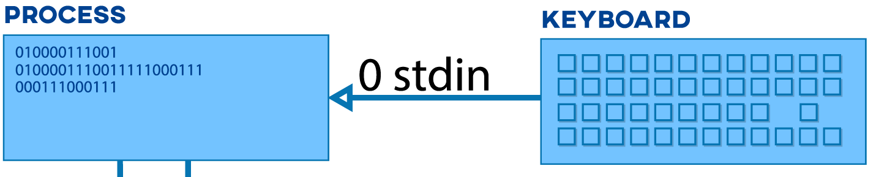
stdio File I/O – Working with a Keyboard
How do I
signal EOF?
How can you have an EOF when reading from a keyboard?
stdio I/O library functions designed to work primarily on files
With keyboard devices the semantics of file operations needs to be "simulated"
Example: when a program (or a shell) is reading the keyboard and is blocked waiting for input it is waiting for you to type a line
This is NOT an EOF condition
To set an EOF condition from the keyboard, type on an input line all by itself:
two key combination (ctrl key and the d key at same time), followed by a return/enter
ctrl-d often shown in slides etc. as ^d
x

Slide 8
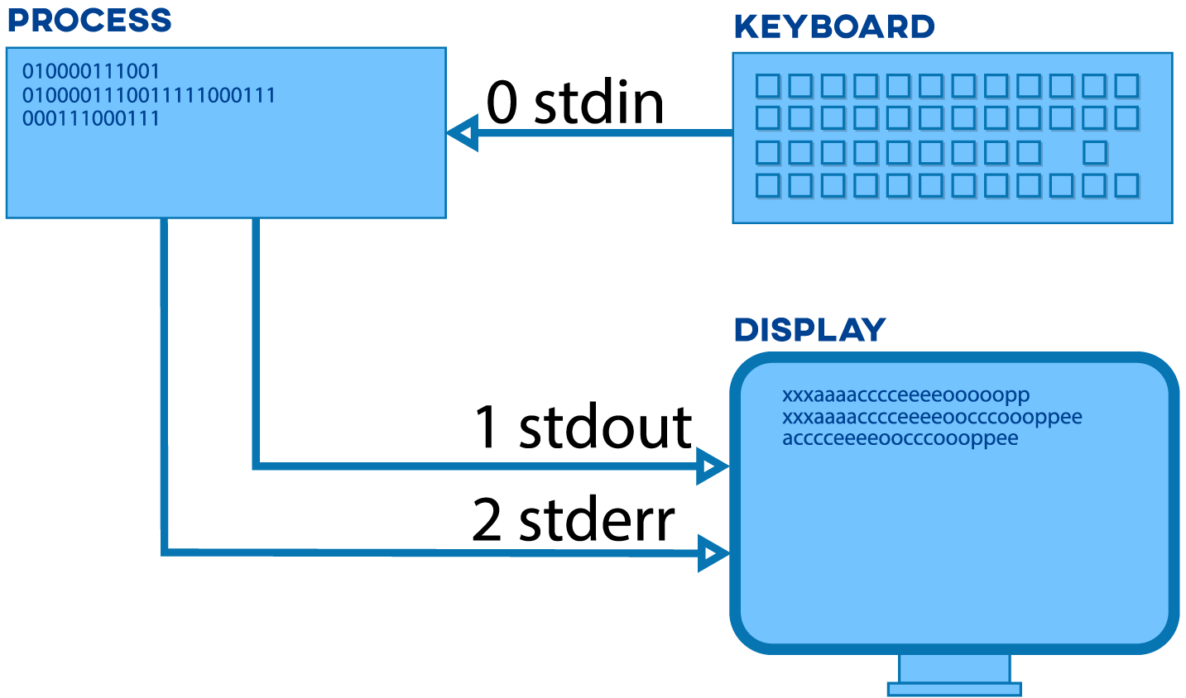
Linux/Unix Process and Standard I/O (CSE 15L)
c stdio file handle/pointer (file *)
echo input to output
THIS IS A TEST
Linux OS "file descriptor number"
THIS IS A TEST
THIS IS A TEST
I/O Is not part of C it is supplied in the runtime environment: standard C library
x

Slide 9
C Library Function: Simple Formatted Printing
Task | Example Function Calls
Write formatted data | int status; status = fprintf(stderr, "%d\n", i); status = printf("%d\n", i); /* Writes to stdout */
#include <stdio.h> // import the public interface
int fprintf(FILE *file, const char *format, ...);
Write chars to the file identified by file (stdout, stderr are already open)
Convert values to chars, as directed by format
Return count of chars successfully written
Format is the output specifications enclosed in a "string"
Returns a negative value if an error occurs
int printf(const char *format, ...); // *format - later in course
Equivalent to fprintf(stdout, format, ...);
Type % man 3 printf for more information on format
x

Slide 10
Some Formatted Output Conversion Examples
Conversion specifications example
%d conversion specifier for int variables
%c conversion specifier for char variables
many more conversion specifiers (online manual: % man printf and the textbooks)
Output
int i = 10; char z = 'i';
char a[] = " Hello\n";
printf("%c = %d,%s", z, i, a); // write to stdout
fprintf(stderr, "This is an error message to stderr\n");
i = 10, Hello
This is an error message to stderr
x

Slide 11
Conditional Statements (if, while, do...while, for)
C conditional test expressions: 0 (NULL) is FALSE, any non-0 value is TRUE
C comparison operators ( ==, !=, >, etc.) evaluate to either 0 (false) or 1 (true)
Legal in Java and in C:
Illegal in Java, but legal in C (often a typo!):
i = 0; if (i == 5) statement1; else statement2;
Which statement is executed
after the if statement test?
i = 0; if (i = 5) statement1; else statement2;
Assignment operators evaluate to
the value that is assigned, so….
Which statement is executed
after the if statement test?
x

Slide 12
Program Flow – Short Circuit or Minimal Evaluation
In evaluation of conditional guard expressions, C uses what is called short circuit or minimal evaluation
Each expression argument is evaluated in sequence from left to right including any side effects (modified using parenthesis), before (optionally) evaluating the next expression argument
If after evaluating an argument, the value of the entire expression can be determined, then the remaining arguments are NOT evaluated (for performance)
if ((x == 5) || (y > 3)) // if x == 5 then y > 3 is not evaluated
x

Slide 13
Program Flow – Short Circuit or Minimal Evaluation
if ((a != 0) && func(b)) // if a is 0, func(b) is not called
do_something();
// if (((x > 0) && (c == 'Q')) evaluates to non zero (true)
// then (b == 3) is not tested
while (((x > 0) && (c == 'Q')) || (b == 3)) { // c short circuit
x = x / 2;
if (x == 0) {
return 0;
}
}
x

Slide 14
Be Careful with the comma , sequence operator
Sequence Operator ,
expr1,expr2
Evaluates expr1 first and then expr2 evaluates to or returns expr2
Unexpected results with , operator (some compilers will warn)
for (i = 0, j = 0; i < 10; i++, j++)
…
i = 64,323; // i = 64 (assigns first)
i = (64, 323); // i = 323 (value of expression)
x

Slide 15

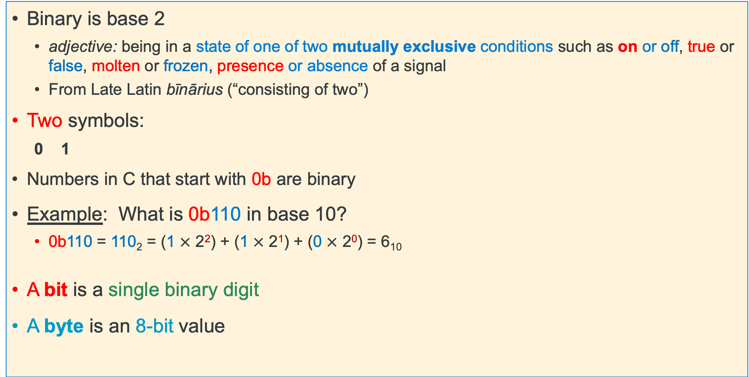
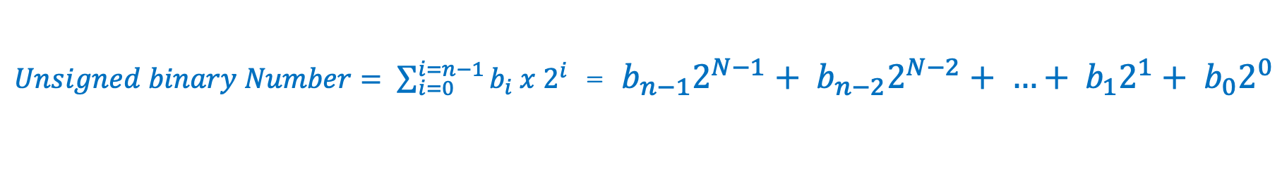
Review: Binary Numbering
Binary is base 2
adjective: being in a state of one of two mutually exclusive conditions such as on or off, true or false, molten or frozen, presence or absence of a signal
From Late Latin bīnārius (“consisting of two”)
Two symbols:
0 1
Numbers in C that start with 0b are binary
Example: What is 0b110 in base 10?
0b110 = 110₂ = (1 $×$ 2²) + (1 $×$ 2¹) + (0 $×$ 2⁰) = 6₁₀
A bit is a single binary digit
A byte is an 8-bit value
powers of two
$Unsigned binary Number= \sum_{i=0}^{i=n−1}{b_{i} x 2^{i}}$ = ${b_{n−1}2}^{N−1}+ {b_{n−2}2}^{N−2}+ …+ {b_{1}2}^{1}+ b_{0}2^{0}$
x

Slide 16

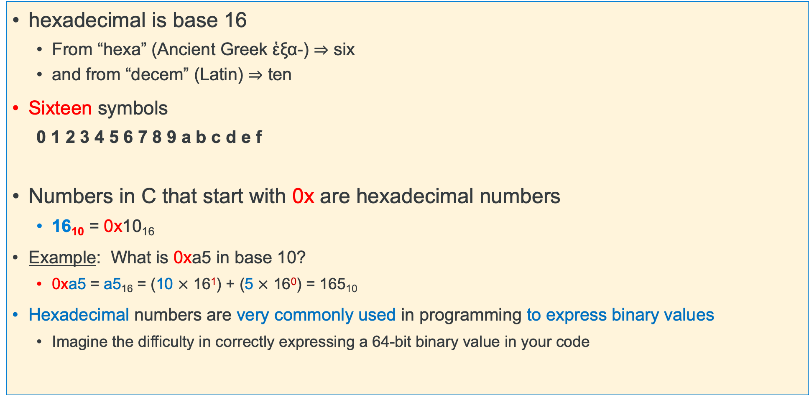
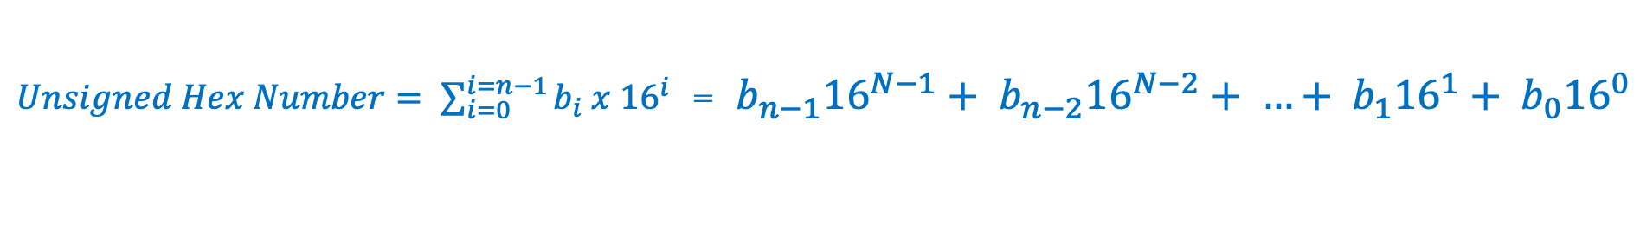
Review: Hexadecimal Numbering
hexadecimal is base 16
From “hexa” (Ancient Greek ἑξα-) ⇒ six
and from “decem” (Latin) ⇒ ten
Sixteen symbols
0 1 2 3 4 5 6 7 8 9 a b c d e f
Numbers in C that start with 0x are hexadecimal numbers
16₁₀ = 0x10₁₆
Example: What is 0xa5 in base 10?
0xa5 = a5₁₆ = (10 $×$ 16¹) + (5 $×$ 16⁰) = 165₁₀
Hexadecimal numbers are very commonly used in programming to express binary values
Imagine the difficulty in correctly expressing a 64-bit binary value in your code
$Unsigned Hex Number= \sum_{i=0}^{i=n−1}{b_{i} x {16}^{i}}$ = ${b_{n−1}16}^{N−1}+ {b_{n−2}16}^{N−2}+ …+ {b_{1}16}^{1}+ b_{0}{16}^{0}$
x

Slide 17
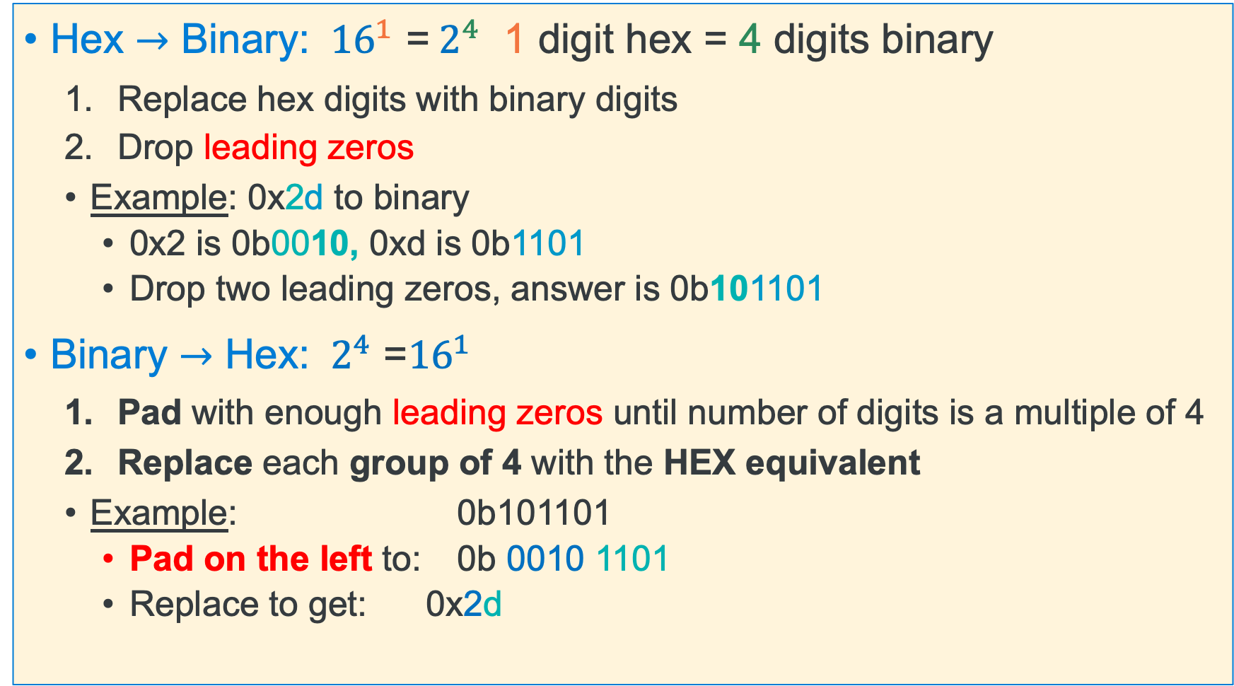
Binary <---> Hexadecimal Equivalences
Hex $→$ Binary: ${ 16}^{1}$ =${ 2}^{4}$ 1 digit hex = 4 digits binary
Replace hex digits with binary digits
Drop leading zeros
Example: 0x2d to binary
0x2 is 0b0010, 0xd is 0b1101
Drop two leading zeros, answer is 0b101101
Binary $→$ Hex: ${{ 2}^{4}\text{ =}16}^{1}$
Pad with enough leading zeros until number of digits is a multiple of 4
Replace each group of 4 with the HEX equivalent
Example: 0b101101
Pad on the left to: 0b 0010 1101
Replace to get: 0x2d
x

Slide 18
Number Base Overview (as written in C)
Decimal is base 10 and Hexadecimal is base 16,
Hex digits have 16 values 0 - 9 a - f (written in C as 0x0 – 0xf)
No standard prefix in C for binary (most use hex)
gcc (compiler) allows 0b prefix others might not
Hex digit | 0x0 | 0x1 | 0x2 | 0x3 | 0x4 | 0x5 | 0x6 | 0x7
Decimal value | 0 | 1 | 2 | 3 | 4 | 5 | 6 | 7
Binary value | 0b0000 | 0b0001 | 0b0010 | 0b0011 | 0b0100 | 0b0101 | 0b0110 | 0b0111
Hex digit | 0x8 | 0x9 | 0xa | 0xb | 0xc | 0xd | 0xe | 0xf
Decimal value | 8 | 9 | 10 | 11 | 12 | 13 | 14 | 15
Binary value | 0b1000 | 0b1001 | 0b1010 | 0b1011 | 0b1100 | 0b1101 | 0b1110 | 0b1111
x

Slide 19
Hex to Binary (group 4 bits per digit from the right)
Each Hex digit is 4 bits in base 2 ${ 16}^{1}$ =${ 2}^{4}$
0x f
a
5
3
1111 1010 0101 0011
0b1111101001010011
binary start with a 0b in C
x

Slide 20
Binary to Hex (group 4 bits per digit from the right)
4 binary bits is one Hex digit ${{ 2}^{4}\text{ =}16}^{1}$
0b 0110 1010 0011 1111
6
a
3
f
0x6a3f
hex start with 0x in C
x

Slide 21
Address and Pointers
32-bit address
(hex)
An address refers to a location in memory, the lowest or first byte in a contiguous sequence of bytes
A pointer is a variable whose contents (or value) can be properly used as an address
The value in a pointer should be a valid address allocated to the process by the operating system
The variable x is at memory address 0x90001008
The variable pt is at memory location 0x90001000
The contents of pt is the address of x 0x90001008
(1 Byte)
0x9000100F
0x9000100E
0x9000100D
0x9000100C
00
0x9000100B
00
0x9000100A
int x =
0x77; ------>
00
0x90001009
77
0x90001008
0x90001007
0x90001006
0x90001005
0x90001004
90
0x90001003
00
0x90001002
01
0x90001001
pt is a pointer to x------>
08
0x90001000
x

Slide 22
Variables in Memory: Size and Address
The number of contiguous bytes a variable uses is based on the type of the variable
Different variable types require different numbers of contiguous bytes
Variable names map to a starting address in memory
Example Below: Variables all starting at address 0x80, each box is a byte
memory
int
4 bytes
memory
short int
2 bytes
83
00000000
memory
char
82
11111111
10101010
Size in bytes
81
81
10101010
Start
Size in bytes
Start
80
01010101
Start
80
01010101
80
01010101
x

Slide 23
Variables: Size
Integer types
char, int
Floating Point
float, double
Modifiers for each base type
short [int]
long [int, double]
signed [char, int]
unsigned [char, int]
const: variable read only
char type
One byte in a byte addressable memory
Signed vs Unsigned Char implementations
Be careful char is unsigned on arm and signed on other HW like intel
C Data Type | AArch-32 contiguous Bytes | AArch-64 contiguous Bytes | printf specification
char (arm unsigned) | 1 | 1 | %c
short int | 2 | 2 | %hd
unsigned short int | 2 | 2 | %hu
int | 4 | 4 | %d / %i
unsigned int | 4 | 4 | %u
long int | 4 | 8 | %ld
long long int | 8 | 8 | %lld
float | 4 | 4 | %f
double | 8 | 8 | %lf
long double | 8 | 16 | %Lf
pointer * | 4 | 8 | %p
size of a pointer is the word size
x

Slide 24
sizeof(): Variable Size (number of bytes) Operator
#include <stddef.h>
/* size_t type may vary by system but is always unsigned */
sizeof() operator returns a value of type size_t:
the number of bytes used to store a variable or variable type
size_t size = sizeof(variable_type);
or
size_t size = sizeof(variable_name); // preferred!
The argument to sizeof() is often an expression:
size = sizeof(int * 10);
reads as:
number of bytes required to store 10 integers (an array of [10])
x

Slide 25
Memory Addresses & Memory Content
32-bit address
(hex)
(1 Byte)
0x9000100F
Variable names in a C statement evaluation
x = x + 1; // Lvalue = Rvalue
Lvalue: when on the left side (Lside or Left value) of the = sign
address where it is stored in memory – a constant
Address assigned to a variable cannot be changed at runtime
Does not require a memory read
Rvalue: when on the right side (Rside or Right value) of an = sign
contents or value stored in the variable (at its memory address)
requires a memory read to obtain contents
0x9000100E
0x9000100D
0x9000100C
00
0x9000100B
x's
contents (Rvalue)
00
0x9000100A
x's
address (Lvalue)
00
0x90001009
77
0x90001008
0x90001007
0x90001006
0x90001005
0x90001004
00
0x90001003
00
0x90001002
01
0x90001001
08
0x90001000
x

Slide 26
Memory Addresses & Memory Content
y = 42;
x = y; // Lvalue = Rvalue
x on left side (Lside) of the assignment operator = evaluates to:
Address of the memory assigned to the x – this is x's Lvalue
y on right side (Rside) of the assignment operator = evaluates to:
Contents of the memory assigned to the variable y (type determines length – number of bytes) - this is y’s Rvalue
So, x = y; is:
Read memory at y (Rvalue); write it to memory at x's address (Lvalue)
One memory write required
One memory read required
y
42
copy
x
42
x

Slide 27
Introduction: Address Operator: &
Unary address operator (&) produces the address of where an identifier is in memory
Assigned address to g
Example this might print:
value of g is: 42
address of g is: 0x71a0a0
(the address will vary)
Tip: printf() format specifier to display an address/pointer (in hex) is "%p"
int main(void)
{
int g = 42;
printf("value of g is: %d\n", g);
printf("address of g is: %p\n", &g);
return EXIT_SUCCESS;
}
x

Slide 28
Introduction: Address Operator: &
Requirement: identifier must have a Lvalue
Cannot be used with constants (e.g., 12) or expressions (e.g., x + y)
Example: &12 does not have an Lvalue,
so, &12 is not a legal expression
How can I get an address for use on the Rside?
&var (any variable identifier or name)
function_name (name of a function, not func());
&funct_name is equivalent
array_name (name of the array like array_name[5]);
&array_name is equivalent
x

Slide 29
Pointer Variables
In C, there is a variable type for storing an address: a pointer
Contents of a pointer is an unsigned (positive numbers) memory address
A pointer is defined by placing a star (or asterisk) (*) before the identifier (name)
You also must specify the type of variable to which the pointer points
Pointers are typed! Why?
The compiler needs to know the size (sizeof()) of the data you are pointing at (number of consecutive bytes to access) to use the pointer
When the Rside of a variable contains a memory address, (it evaluates to an address) the variable is called a pointer variable
type *name; // defines a pointer; name contains address of a variable of type
x

Slide 30
Pointer Variables - 2
A pointer cannot point at itself, why?
p is defined as (int *), a pointer to an int, but
the type of &p is (int **), a pointer to a pointer to an int
Pointer variables all use the same amount of memory no matter what they point at
Above prints on a 32-raspberry pi
int *p = &p; /* is not legal – type mismatch */
int *iptr;
char *cptr;
printf("iptr(%u) cptr(%u)\n", sizeof(iptr), sizeof(cptr));
% ./example
iptr(4) cptr(4)
x

Slide 31
Defining Pointer Variables
Assigning a value to a pointer:
int *p = &i; /* p points at i (assign address i to p) */
Is the same as writing the following definition and assignment statements
int *p; /* p is defined (not initialized) */
p = &i; /* p points at i (assign address i to p */
The * is part of the definition of p and is not part of the variable name
The name of the variable is simply p, not *p
C mostly ignores whitespace, so these three definitions are equivalent
int *p = &i; /* Style A */
int * p = &i; /* Style B */
int* p = &i; /* Style C */
x

Slide 32
Using Pointer Variables and the Address Operator & - 1
Recommended: be careful when defining multiple pointers on the same line:
is not the same as:
Use instead:
int i = 42;
int *p; /* p contains the address of an integer */
p = &i; /* p "points at" i (assign address of i to p) */
Memory
contents
4 bytes
Memory
address
4 bytes
i
42
i
42
0x10000
p
p = &i
0x10000
0x8000
Low address
int *p1, p2;
int *p1, *p2;
int *p1;
int *p2;
x

Slide 33
Using Pointer Variables and the Address Operator & - 2
As with any variable, its value can be changed
p = &j; /* p now points at j */
p = &i; /* p now points at i */
Address
0x1000
i
42
j
77
0x900
p
0x900
0x800
Address
0x1000
i
42
j
77
0x900
p
0x800
0x1000
x

Slide 34
Indirection (or dereference) Operator: *
The indirection operator (*) or the dereference operator to a variable is the inverse of the address operator (&)
address operator (&) can be thought of as:
"get the address of this box”"
indirection operator (*) can be thought of as:
"follow the arrow to the next box and get its contents”"
Indirection operator causes an additional read to occur, when on either the Rside or Lside of a statement
i or (*p)
42
0x900
p = &i
0x900
0x800
x

Slide 35
Rside Indirection (or dereference) Operator: *
Performs the following steps when the * is on the Rside:
read the contents of the variable to get an address
read and return the contents at that address
(requires two reads of memory on the Rside)
z = *x; // copy the contents of memory pointed at by x to z
read (address)
read
Rside x
0x0c
Two reads here
read to get an address
(2) read the address to get the value
z
0x0c
copy
x

Slide 36
Rside Indirection (or dereference) Operator: *
Contents of p is the address of i (p points at i)
Memory
contents
4 bytes
Memory
address
4 bytes
int i = 42;
int *p;
p = &i;
printf("*p is %d\n", *p);
i or (*p)
42
0x10000
No reads here
p = &i
0x10000
0x8000
% ./a.out
*p is 42
Two reads here
read to get an address
(2) read the address to get the value
Low address
x

Slide 37
Lside Indirection Operator
Performs the following steps when the * is on the Lside:
read the contents of the variable to get an address
write the evaluation of the Rside expression to that address
(requires one read of memory and one write of memory on the Lside)
*p = x; // copy the value of x to the memory pointed at by p
int x
0x0c
copy
Lside p
0x0c
read (address)
write
x

Slide 38
Lside Indirection (or dereference) Operator: *
Contents of p is the address of i (p points at i)
Memory
contents
4 bytes
Memory
address
4 bytes
int i;
int *p;
p = &i;
*p = 42;
printf("*p is %d\n", *p);
No reads here
one write
i or (*p)
42
0x10000
One read here
read to get an address
one write
p = &i
0x10000
0x8000
% ./a.out
*p is 42
Low address
x

Slide 39
Each use of a * operator results in one additional read -1
RULE: Each * when used as a dereference operator in a statement (either Lside or Rside) generates an additional read
int z = 2, y = 1;
z = y; // one read
2
z
int z = 2, y = 1;
int *p;
p = &y;
z = *x; // two reads on rside
write integer
1
y
read integer
y
read
1
p
read address
p
1
y
z
2
read (address)
write
read
z
2
write
Aside: z = *(&x); // same as z = x
x

Slide 40
Each use of a * operator results in one additional read -2
Address
0x10c
0x108
0x104
int z = 2, y = 1;
int *x;
p = &z;
*p = y; // one read on lside
z
2
write integer
1
y
read integer
0x10c
p
read address
p
1
y
read
read (address)
z
2
write
x

Slide 41
Each use of a * operator results in one additional read -2
int z = 2, y = 1; int *w;
int *p;
p = &z;
w = &y;
*p = *w;
Address
0x10c
0x108
0x104
0x100
2
z
write integer
1
y
read integer
0x108
w
read address
2
z
0x10c
p
read address
p
read address
write
w
1
y
read address
read
x

Slide 42
Pointer to Pointers (Double Indirection)
Define a pointer to a pointer (p2 below)
C allows any number of pointer indirections
more than two levels is very uncommon in real applications as it reduces readability and generates at lot of memory reads
RULE (important): number of * in the definition tells you how many reads it takes to get to the base type
#reads to base type = number * + 1
Example:
int **p2; // requires 3 reads to get to the int
i
2
int i = 2;
int *p1;
int **p2;
p1 = &i;
p2 = &p1;
printf("%d\n", (**p2) * (**p2));
p1
p2
x

Slide 43
Double Indirection
int z = 2, y = 1; int *w;
int *p;
int **d;
p = &z;
w = &y;
d = &p;
**d = *w;
Address
0x10c
0x108
0x104
0x100
0x0fc
2
z
write integer
1
y
read integer
0x108
w
read address
0x1c
p
read address
d
p
2
z
read address
read address
write
0x100
d
read address
w
1
y
read address
read
x

Slide 44
Double Indirection
int z = 2, y = 1; int *w;
int *p;
int **d;
p = &z;
w = &y;
d = &p;
**d = **d + *w;
Address
0x10c
0x108
0x104
0x100
0x0fc
write integer
2
z
2 + 1
1
y
read integer
write Integer
2 + 1
0x108
w
read address
read address
read address
p
0x1c
read address
d
2
z
p
read
0x100
d
read address
w
1
y
read address
read
Important Observe
**d on Lside is two reads
**d on Rside is three reads
x

Slide 45
What is Aliasing?
Two or more variables are aliases of each other when they all reference the same memory (so different names, same memory location)
Example: When one pointer is copied to another pointer it creates an alias
Side effect: Changing one variables value (content) changes the value for other variables
Multiple variables all read and write the same memory location
Aliases occur either by accident (coding errors) or deliberate (careful: readability)
int i = 5;
int *p;
int *q;
p = &i;
q = p; // *p & *q are aliases
*q = 4; // changes i
p
4
i
*p and *q are aliases
q
Result *p, *q and i all have the value of 4
x

Slide 46
Double Indirection Aliases
int z = 2, y = 1; int *w;
int *p;
int **d;
p = &z;
w = &y;
d = &p;
**d = **d + y;
Address
0x10c
0x108
0x104
0x100
0x0fc
write integer
2
z
2 + 1
1
y
read integer
write Integer
2 + 1
0x108
w
read address
read address
read address
p
0x1c
read address
d
2
z
p
read
0x100
d
read address
w
1
y
read
Important Observe
**d, *p and y are all aliases
x

Slide 47
The NULL Constant and Pointers
NULL is a constant that evaluates to zero (0)
You assign a pointer variable to contain NULL to indicate that the pointer does not point at anything
A pointer variable with a value of NULL is called a “NULL pointer” (invalid address!)
Memory location 0 (address is 0) is not a valid memory address in any C program
Dereferencing NULL at runtime will cause a program fault (segmentation fault)!
p = NULL;
i = *p; /* segmentation fault! */
*(int *)900000 = 25; /* cast 900000 to a pointer */
/* if writeable address space, it works */
/* that memory location just changed */
x

Slide 48
Using the NULL Pointer
Many functions return NULL to indicate an error has occurred
NULL is considered “false” when used in a Boolean context
Remember: false expressions in C are defined to be zero or NULL
The following two are equivalent (the second one is preferred for readability):
/* these are all equivalent */
int *p = NULL;
int *p = (int *)0; // cast 0 to a pointer type
int *p = (void *)0; // automatically gets converted to the correct type
if (p) ... if (p != NULL) ...
x

Slide 49
Defining Arrays
Definition: type name[count]
"Compound" data type where each value in an array is an element of type
Allocates name with a fixed count array elements of type type
Allocates (count * sizeof(type)) bytes of contiguous memory
Common usage is to specify a compile-time constant for count
Array names are constants and cannot be assigned (the name cannot appear on the Lside by itself)
1 word
(int = 4 bytes)
high
memory
address
??
??
??
??
#define BSZ 6
int b[BSZ];
BSZ is a macro replaced by the C preprocessor at compile time
??
??
??
??
b[5]
??
9020
a = b; // invalid does not copy the array
// copy arrays element by element
b[4]
??
9016
b[3]
??
9012
b[2]
??
9008
b[1]
??
9004
int b[6];
b[0]
??
9000
x

Slide 50
Array Initialization
1 word (int = 4 bytes)
Initialization: type name[count] = {val0,…,valN};
{ } (optional) initialization list can only be used at time of definition
If no count supplied, count is determined by compiler using the number of array initializers
int block[20] = {}; //only works with constant size arrays
defines an array of 20 integers each element filled with zeros
Performance comment: do not zero automatic arrays unless really needed!
When a count is given:
extra initialization values are ignored
missing initialization values are set to zero
??
high
address
??
??
??
no initialization values given; then elements are initialized to 0
??
??
??
??
b[5]
??
90020
11
90016
b[4]
00
6
b[3]
00
90012
5
90008
b[2]
00
int block[5] = {2, 3, 5, 6, 11, 13};
3
90004
b[1]
00
2
90000
b[0]
00
not needed and if used may truncate initialization list
6 initialization values given, only 5 are used
low
address
x

Slide 51
Accessing Arrays Using Indexing
1 word
(int = 4 bytes)
name[index] selects the index element of the array
index should be unsigned
Elements range from: 0 to count – 1 ( int x[count]; )
name[index] can be used as an assignment target or as a value in an expression
Array name (by itself with no [ ]) on the Rside evaluates to the address of the first element of the array
??
high
address
??
int a[5];
int b[5];
??
9020
b[4]
??
9016
b[3]
??
9012
b[2]
??
9008
int b[5];
int *p = b;
??
b[1]
9004
9000
b[0]
??
9000
p
low
address
x

Slide 52
How many elements are in an array?
1 word
(int = 4 bytes)
The number of elements of space allocated to an array (called element count) and indirectly the total size in bytes of an array is not stored anywhere!!!!!!
An array name is just the address of the first element in a block of contiguous memory
So an array does not know its own size!
high
memory
address
??
??
??
??
??
??
??
#define SZ 6
int block[SZ]; // you specify the array has SZ elements
int indx; // use when SZ is defined
for (indx = 0; indx < SZ; indx++)
block[indx] = 0;
??
b[5]
??
90020
b[4]
??
90016
b[3]
??
90012
b[2]
??
90008
b[1]
??
90004
int b[6];
b[0]
??
90000
x

Slide 53
Determining Element Count for a compiler calculated array
Programmatically determining the element count in a compiler calculated array
sizeof(array) / sizeof(of just one element in the array)
sizeof(array) only works when used in the SAME scope as where the array variable was defined
#include <stddef.h>
int block[] = {2, 3, 5, 6, 11, 13}; // automatic: compiler calculates array size
int cnt = (int)(sizeof(block) / sizeof(block[0])); // in this case cnt = 6
for (int indx = 0; indx < cnt; indx++)
block[indx] = 0;
x

Slide 54
Pointers and Arrays - 1
1 byte Memory Content
One byte per row
A few slides back we stated: Array name (by itself) on the Rside evaluates to the address of the first element of the array
Array indexing syntax ([ ]) an operator that performs pointer arithmetic
buf and &buf[0] on the Rside are equivalent, both evaluate to the address of the first array element
Byte
Memory
Address
int buf[] = {2, 3, 5, 6, 11};
p2
0x00
0x12345687
0x00
0x12345686
0x00
0x12345685
0x03
0x12345684
p1
0x00
0x12345683
0x00
0x12345682
int *p = buf; // or int *p = &buf[0];
int *p1 = &buf[1];
int *p2 = &buf[2];
int *p3 = &buf[3];
*p = *p + 10;
*p1 = *p1 + 10; // {12, 13, 5, 6, 11}
0x12345681
0x00
0x02
0x12345680
p
x

Slide 55
Pointers and Arrays - 2
1 byte Memory Content
One byte per row
When p is a pointer, the actual value of (p+1) depends on the type that pointer p points at
(p+1) adds 1 x sizeof(what p points at) bytes to p
++p is equivalent to p = p + 1
Using pointer arithmetic to find array elements:
Address of the second element &buf[1] is (buf + 1)
It can be referenced as *(buf + 1) or buf[1]
index
buf[2]
pointer
*(buf+2)
pointer
*(p+2)
0x00
0x00
0x00
0x03
buf[1]
*(buf+1)
*(p+1)
0x00
int buf[] = {2, 3, 5, 6, 11};
int *p;
p = buf;
*p = *p + 10;
*(p + 1) = *(p + 1) + 10; // {12, 13, 5, 6, 11}
0x00
0x00
0x02
buf[0]
*buf
*p
x

Slide 56
Pointer Arithmetic In Use – C's Performance Focus
address
&a[3]
a+3
a+2
&a[2]
char a[] = {'A', 'B', 'C'};
a+1
&a[1]
a
&a[0]
Alert!: C performance focus does not perform any array “bounds checking”
Performance by Design: bound checking slows down execution of a properly written program
Example: array a of length i, C does not verify that a[ j ] or *(a + j) is valid (does not check: 0 ≤ j < i)
C simply “translates” and accesses the memory specified from: a[j] to be *(a + j)which may be outside the bounds of the array
OS only "faults" for an incorrect access to memory (read-only or not assigned to your process)
It does not fault for out of bound indexes or out of scope
lack of bound checking is a common source of errors and bugs and is a common criticism of C
x

Slide 57
Pointer Arithmetic
p+3
0x08c
You cannot add two pointers (what is the reason?)
A pointer q can be subtracted from another pointer p when the pointers are the same type – best done only within arrays!
The value of (p-q) is the number of elements between the two pointers
Using memory address arithmetic (p and q Rside are both byte addresses):
4-byte integer
int *q = p+2;
p+2
0x088
4-byte integer
distance in elements = (p − q) / sizeof(∗p)
(p + 3) – p = 3 = (0x08c – 0x080)/4 = 3
p+1
0x084
4-byte integer
int *p;
p
0x080
x

Slide 58
Pointer Comparisons
Pointers (same type) can be compared with the comparison operators:
<, <=, ==, !=, >=, >
Invalid, Undefined, or risky pointer arithmetic (some examples)
Add, multiply, divide on two pointers
Subtract two pointers of different types or pointing at different arrays
Compare two pointers of different types
Subtract a pointer from an integer
int numb[] = {9, 8, 1, 9, 5};
int *end;
int *a;
end = numb + (int) (sizeof(numb)/sizeof(*numb));
a = numb;
while (a < end) // compares two pointers (address)
/* rest of code including doing an a++ */
x

Slide 59
Using Pointers to Traverse an array
0x??
0x1234568c
int x[] = {0xd4c3b2a1, 0xd4c3b200, 0x12345684};
int cnt = (int)(sizeof(x) / sizeof(*x));
for (int j = 0; j < cnt; j++)
printf("%#x\n", x[j]);
}
0x12
0x1234568b
0x??
0x34
0x1234568a
0x??
0x56
0x12345689
0x??
cnt = 3;
actual space used =
cnt * sizeof(*x);
= 12
0x84
0x12345688
0x??
0xd4
0x12345687
0x??
0xc3
0x??
0x12345686
0xb2
0x12345685
int x[] = {0xd4c3b2a1, 0xd4c3b200, 0x12345684};
int cnt = (int)(sizeof(x) / sizeof(*x));
int *ptr = x; // or &x[0]
for (int j = 0; j < cnt; j++)
printf("%#x\n", *(ptr + j));
}
0x??
0x00
0x??
0x12345684
0xd4
0x??
0x12345683
0xc3
0x??
0x12345682
0xb2
0x??
0x12345681
0x??
ptr
0xa1
0x12345680
Brute force translation to pointers
0x??
0x1234567f
1 byte
x

Slide 60
Fast Ways to Traverse an Array: Use a Limit Pointer
xpt
0x??
0x1234568c
int x[] = {0xd4c3b2a1, 0xd4c3b200, 0x12345684};
int cnt = (int)(sizeof(x) / sizeof(*x));
int *ptr;
int *xptr;
ptr = x; //or &x[0]
xptr = ptr + cnt;
while (ptr < xptr) {
printf("%#x\n", *ptr);
ptr++;
}
0x12
0x1234568b
0x??
0x34
0x1234568a
0x??
0x56
0x12345689
0x??
0x84
0x12345688
cnt = 3;
actual space used =
cnt * sizeof(*x);
= 12
0x??
0xd4
0x12345687
0x??
0xc3
0x??
0x12345686
0xb2
0x12345685
0x??
0x00
xpt is a loop limit pointer
it points 1 element past the end of the array
0x??
0x12345684
0xd4
0x??
0x12345683
0xc3
0x??
0x12345682
0xb2
% ./a.out
0xd4c3b2a1
0xd4c3b200
0x12345684
0x??
0x12345681
0x??
ptr
0xa1
0x12345680
0x??
0x1234567f
1 byte
x

