Slide 1
Version 2.19
UCSD CSE 30 Section B
Computer Organization and Systems Programming
Lecture 3
Keith Muller
DEC PDP 11/45 - 1973

Slide 2

Attendance code

Slide 3
Merging DFA's – 3 (Finished)
This DFA replaces SOL with a @
and This DFA replaces SAM with DAD
other / output(S),
output(O),
output(other)
L / output(@)
O
other / output(other)
S / output(S)
O / -
start
S / -
S
S / output(S),
output(O)
other / output(S),
output(other)
A / -
S / output(S),
output(A)
M / output(D),
output(A),
output(D)
A
other / output(S),
output(A),
output(other)
x

Slide 4
Quick Look: Character and String Literals (more later)
Usually used to store characters – thus things like file names
char literals: a single (1) character inside a set of single quotes 'a'
string literals: 0 or more characters inside a set of double quotes "string"
char x = 'a'; // 'a' is a character literal
printf("Hello World!"); // "Hello World!" is a string literal
char a1[] = "xyz"; // char array initialized with contents of a string literal
char b[] = ""; // empty string
Problem: How do you place a non-printable character like a newline in a literal?
The following are not legal in C as a newline in a source file represents a statement delimiter (white space) in C
Solution: C has a special line continuation character \
char x = 'a
';
printf("Hello World!
");
x

Slide 5
There are three different uses for \ in C
Line continuation sequence a \ followed by zero or more whitespace ending in a newline at the end of a source line
How do you put a single ' in a character literal or a single " inside a string literal?
You use an escape character \ which escapes the special meaning (if any) of the next character inside a character or a string literal
Use only when no other choice
Poor style use a block comment
Not needed do not do this
char a[] = "string: Hello \
World";
// line comment \
rest of line comment
x = x +\
5;
char a = '\''; // char: '
char b = '\\'; // char: \
char sequence | Description
'\\' or "\\" | \ char
'\'' or "\'" | single quote
'\"' or "\"" | double quote
char c = '"'; // char: "
char d[] = "ab\""; // string: ab"
char e[] = "ab\\"; // string: ab\
char f[] = "ab'"; // string: ab'
char a[] = "a "string""; // syntax error ; expected
char a[] = "a \"string\""; // ok
x

Slide 6
There are three different uses for \ in C - continued
You can embed characters with a special meaning inside a (char or string) literal using a two-character sequence starting with a \ followed by a single character
This is typically used for characters that are "non-printable"
Here are some examples:
char sequence | Description
'\n' or "\n" | newline char
'\r' or "\r" | carriage return
'\t' or "\t" | tab char
'\b' or "\b" | backspace
'\0' or "\0" | null char
printf("\n\nHello World!\n\n");
printf("\n\nHello\tWorld!\n\n");
x

Slide 7
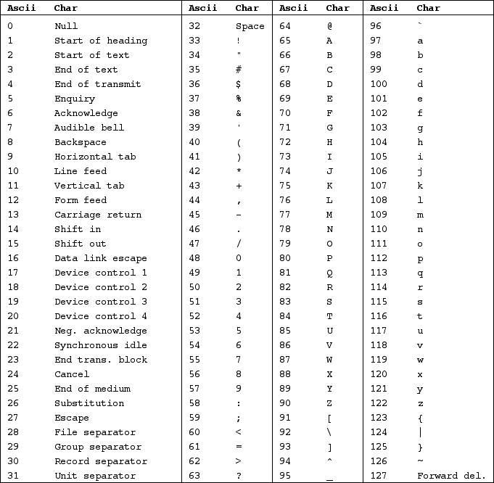
Characters In C
\0 in c encodes a null
\b in c encodes a backspace
\t in c encodes a horizontal tab
\n in c encodes a linefeed
Ascii column: decimal integers
ASCII Chars are 0-127 (stored in 8 bits)
Many of the values are not "printable"
x

Slide 8
Understanding Comments in C (Prep for PA2 and PA3)
In PA2 (design) and PA3 (program in C), you are going to write equivalent preprocessor code to replace each comment in an input file with a single space character (a blank space) while writing the rest of the input to output unaltered (preserving all newlines)
IMPORTANT: the preprocessor does NOT perform any syntax checking
/* this is /* one block comment */ text outside comment
// this is // one line comment
text outside comment
/* block comment // part of block comment not a line comment
yet more block comment
*/ text outside comment
// line comment /* part of line comment not a block comment */
// line comment /* part of line comment not the start of a block comment oops! text outside of comment, this is not a comment anymore */
x

Slide 9
What is the preprocessor (cpp)?
C
two.c
cpp
C
two.i
gcc
ARM Machine two.o
temp files
assembly three.S
cpp
assembly three.i
gcc(gas)
ARM Machine three.o
Preprocessing is the first phase in the compilation (.c files) or assembly (.S files only) process
The preprocessor (cpp) transforms your source code, then passes it to the compiler (on .c files) or the assembler (on .S files only, not .s files)
cpp is automatically invoked by gcc
Usually, the input to cpp is a C source file (.c) or an assembly source file (.S only) and output from cpp is still a C file or assembly file
output from cpp is in a temporary .i file (deleted after use)
cpp does not modify the input source file
Common use: When a program is divided across multiple source files (including library files), cpp helps you keep consistency among the files (one version of the truth)
Examples: Consistent values for a constants, correct function definitions, etc.
x

Slide 10
Common Preprocessor (cpp) Operations
Comments are replaced with a single space /* */ , // and all newlines are preserved
You will do a design for this in PA2 and program it in PA3
Continued lines: where the last character in a line is a \ causes the line to be joined with the next line
A preprocessor directive: commands to cpp to perform an operation (these start with a #)
#include <stdio.h> contents of the file stdio.h is to be inserted at that spot in the source file
#define MAX 8
Does two things: Defines MAX to be a macro name and assigns it the value 8
#define MINE just defines MINE to be a macro name with no value (for conditional tests – later)
Convention: MACRO names are in CAPITAL letters
Macros with values – cpp replaces MAX with 8 everywhere in the source file
#define MAX 8
int main(void)
{
int x[MAX]; // histogram array
for (int i = 0; i < MAX; i++) {
…
}
…
}
int main(void)
{
int x[8];
for (int i = 0; i < 8; i++) {
…
}
…
}
file ex.i
cpp input
cpp out (only showing macro substitution)
x

Slide 11
Complexity for programming a preprocessor: Literals may contain what appears to be comments, but are not
char x = 'a'; // 'a' is a character literal
printf("Hello World!"); // "Hello World!" is a string literal
"/* text */" not a comment but a string literal whose contents looks like a block comment
"// text" not a comment but a string literal whose contents looks like a line comment
'/* text */' not a comment but a character literal (not legal, but that is the compilers job) whose contents looks like a block comment
'// text' not a comment but a character literal (not legal, but that is the compilers job) whose contents looks like a line comment
x

Slide 12
cpp conditional (and macro) only operations
You can use conditional preprocessor tests (like if-else statements) around blocks of code
#ifdef MACRO, #ifndef MACRO, #else, #endif
In this use, MACRO is called the guard MACRO ("guards" entry to the following block)
#ifdef MACRO if MACRO is defined, then the block is included, otherwise the #else block (if any) is included
#ifndef MACRO if MACRO is NOT defined, then the block is included, otherwise the #else block (if any) is included
#endif is the end of a block
#define MACRO // defines MACRO -- #define MACRO 8 defines macro and assigns a value of 8
#undef MACRO // undefines MACRO
#define VERS1
#define MAX 8
// file ex.c
void func(void)
{
#ifdef VERS1
int x[MAX];
#else
short x[MAX];
#endif
….
return;
}
after the preprocessor runs
// #define VERS1
#define MAX 8
// file ex.c
void func(void)
{
#ifdef VERS1
int x[MAX];
#else
short x[MAX];
#endif
….
return;
}
after the preprocessor runs
void func(void)
{
int x[8];
….
return;
}
void func(void)
{
short x[8];
….
return;
}
x

Slide 13
First Look at Header Files (also called .h or "include" files)
Header file: a file whose only purpose is to be #include’d by the preprocessor
Contains: Exported (public) Interface declarations
Examples: function prototypes, user defined types, global variable, macros, etc.
Used to import the public interface of another C source file
#include its header (interface) file
NEVER EVER use cpp to #include a .c file, a .S or a .s file
Convention (strongly enforced): header files use a .h filename extension (example: filename.h)
Example: Source file src.c exported (public) interface is in the header file src.h
How to specify the file to be #include’d
<system-defined> are system header files (typically located under /usr/include/…)
#include <stdio.h> // located in /usr/include/stdio.h
"programmer-defined" header files usually in a relative Linux path (see –I flag to gcc)
#include "else.h" // looks in the current directory first
Convention: #include directives are usually placed near the top of a source file above any code
x

Slide 14
Compilation Process Operations
#include <stdlib.h>
#include <stdio.h>
// A simple C Program
int
main(void)
{
printf("Hello World!\n");
return EXIT_SUCCESS;
}
preprocessor: inserts and processes the contents of files here. Inserts: Function protype for printf (later in course)
macro value for EXIT_SUCCESS
File locations: /usr/include/stdio.h & /usr/include/stdlib.h
preprocessor: replaces the line Comment with one blank
compiler generates assembly code to call the library function printf() and pass the string "Hello World!"
compile: gcc –Wall –Wextra prog.c -o prog
cpp first processes the file (cpp is called by gcc)
Compiler (gcc) compiles main to assembly
Assembler (gas – called by gcc) translates the assembly to machine code
Linker (ld) merges the machine code for printf() (from a library) with your programs machine code to create the executable file prog (machine code)
-o specifies the name of the executable (default: a.out)
cpp: replaces EXIT_SUCCESS with 0
on Linux
x

Slide 15
cpp conditional tests: header guards
Header guards ensure that only one copy of a .h file is included in a source file
A Convention: header guard (macro) NAME (all capital letters) is created as follows:
use the filename of header file but in all caps
replace the period in header file name with an _
Example: file sum.h header guard macro name is SUM_H
How do you use "header guards" in your code?
#ifndef NAME_H // first line in the file
#define NAME_H
. . .
#endif // last line in the file
#include "sum.h"
// file ex.c
int main(void)
{
int x[MAX];
#ifndef SUM_H
#define SUM_H
#define MAX 8
#endif
#include "sum.h"
// file func.c
int func(void)
{
int z[MAX];
header guards
(two lines)
header guards
(one line)
ex.i
file sum.h
func.i
int main(void)
{
int x[8];
int func(void)
{
int z[8];
x

Slide 16
Why header guards are needed
#ifndef SUM_H
#define SUM_H
#define MAX 8
#endif
#ifndef SUM_H
#define SUM_H
#define MAX 8
#endif
#ifndef BAR_H
#define BAR_H
#ifndef SUM_H
#define SUM_H
#define MAX 8
#endif
#define MIN 1
#endif
// file ex.c
int main(void)
{
int x[MAX];
int z = MIN;
file sum.h
SUM_H is defined here
SUM_H is already defined here
So
#define MAX 8 is not included again
#ifndef BAR_H
#define BAR_H
#include "sum.h"
#define MIN 1
#endif
file bar.h
#include "sum.h"
#include "bar.h"
// file ex.c
int main(void)
{
int x[MAX];
int z = MIN;
int main(void)
{
int x[8];
int z = 1;
x

