Slide 1

Team 3 Inception
Govinda Raj Joshi, Othman D Kamel, Michael Stokes, Yunika Upadhayaya

Slide 2
Vision
Our goal is to create a mobile app that makes day to day trips more efficient by prioritizing the places the user inputs in order to save travel time and distance. The app should accept input from the user which then provides a map of the locations and the order in which the user should visit these locations.

Slide 3
Features
Member registration/authentication
Input: Listing places the user needs to go to
Output: The order in which the user should go to these locations
Provides the priority location(ex: The business is closing soon)
Editing a location
Deleting a location

Slide 4
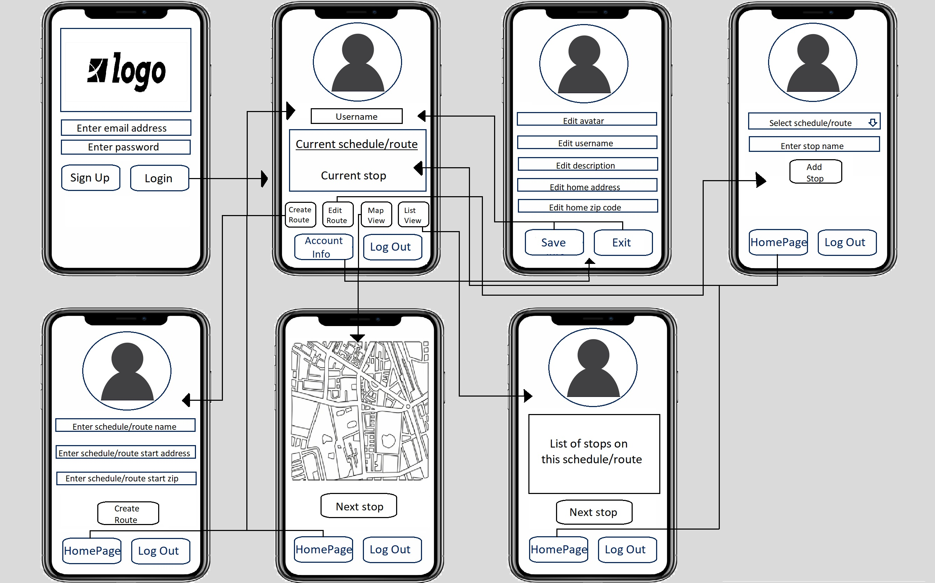
Screen Flow

Slide 5
Customers & Users
Smartphone users
Travelers who use their phones for travel
Demographics: Age group -18 and above
Available in app store/play store
Professor Csallner as our customer representative.
Regular communication through “teams” chat and office hours.
Frequent feedback throughout the project.

Slide 6
Competitors
Travel planning apps in the market:
Wanderlog – iOS / Android
Allows to map out a day itinerary with start and end times
Can be stored offline
Collaborate with friends
Skratch - Build your own Skratch map – iOS / Android
Allows to create scratch map and shows places you have been to
Track the map offline
TripIt: Travel Planner – iOS / Android
Helps organizing multiple itineraries automatically
Track the itinerary offline

Slide 7
Competitors
How are we different?
Related competitors:
No priority for distance and time.
Only manual entry and displays the map in the same order as user enters the locations
Our app:
Priority for distance and time.
Automatically displays the map based on the priority location order feature considering shortest distance and time.

Slide 8
Risks
Promotion of the application
The outcome of the application not being user friendly
Highly competitive market
Knowledge of Tools and licensing availability
Data privacy
Fluctuation of budget while developing the application
There is no on-site support for the customers
Project might not be completed due to time constraint

Slide 9
Risk Management
Planning early design of UI helps in making user friendly UI
Limited admin access for security of data
Proper research before starting the project
The app will be built in minimum cost
The application deadline will be before the schedule given by professor
Customer reviews will be prioritized in every iteration.

Slide 10
Assumptions
Only people older than 18 can sign up
Maintenance required after deployed
X number of location can be selected
The business hours of the selected location will be pulled in the map
With the help of google API, app will compare the different distances and give user the reliable location accordingly

Slide 11
Tentative Schedule
Iteration/Date | Tasks
1. September 26 | Home Page Member Registration/Authentication Page
2. October 17 | Listing places functionality Map Page
3. November 7 | Connecting list of places with the map Editing location feature Deleting location feature
4. November 28 (final) | The order of locations feature Priority location feature

Slide 12
GitHub Link
https://github.com/cse3311Team3/Team3-project

Slide 13
References
https://www.travelinglifestyle.net/best-travel-planning-apps/
Professor’s slides on “Inception”

