Slide 1
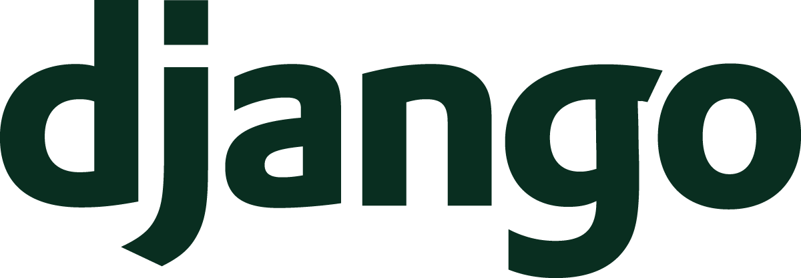
Django
A python based web framework

Slide 2
Table of Contents
Python Introduction - Kevin
Django Introduction - Joey
Django video
Demo program - Stephen
Rails vs Django - Marcus
Quiz - Alex
Conclusion

Slide 3
Before we learn about Django, let’s check out Python

Slide 4
Only four primitive data type
Integers
Float
Strings
Boolean

Slide 5
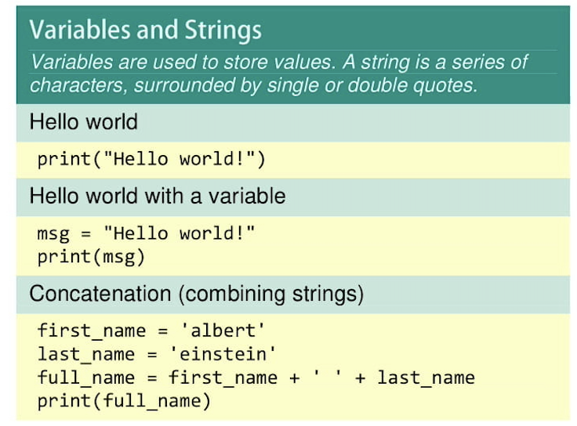

Slide 6
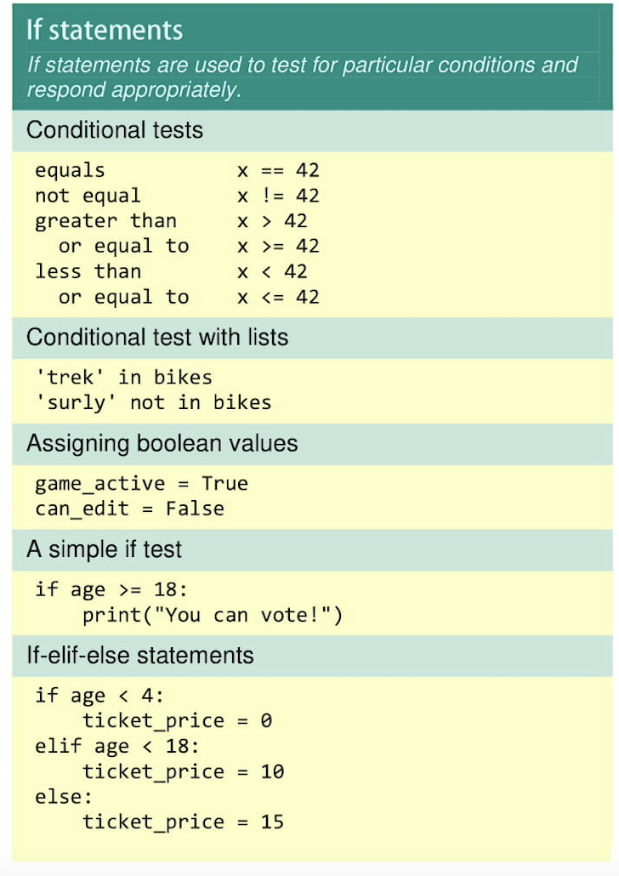
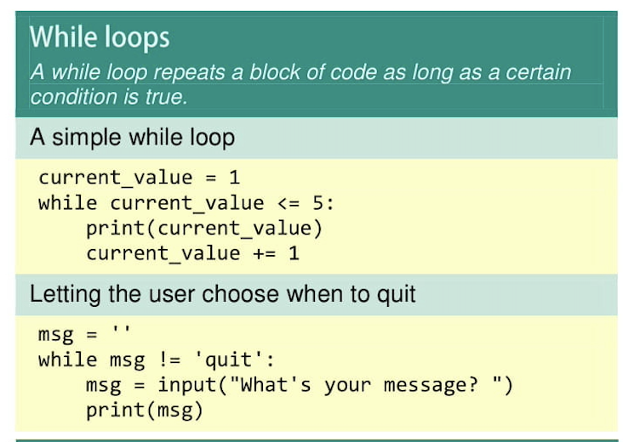

Slide 7
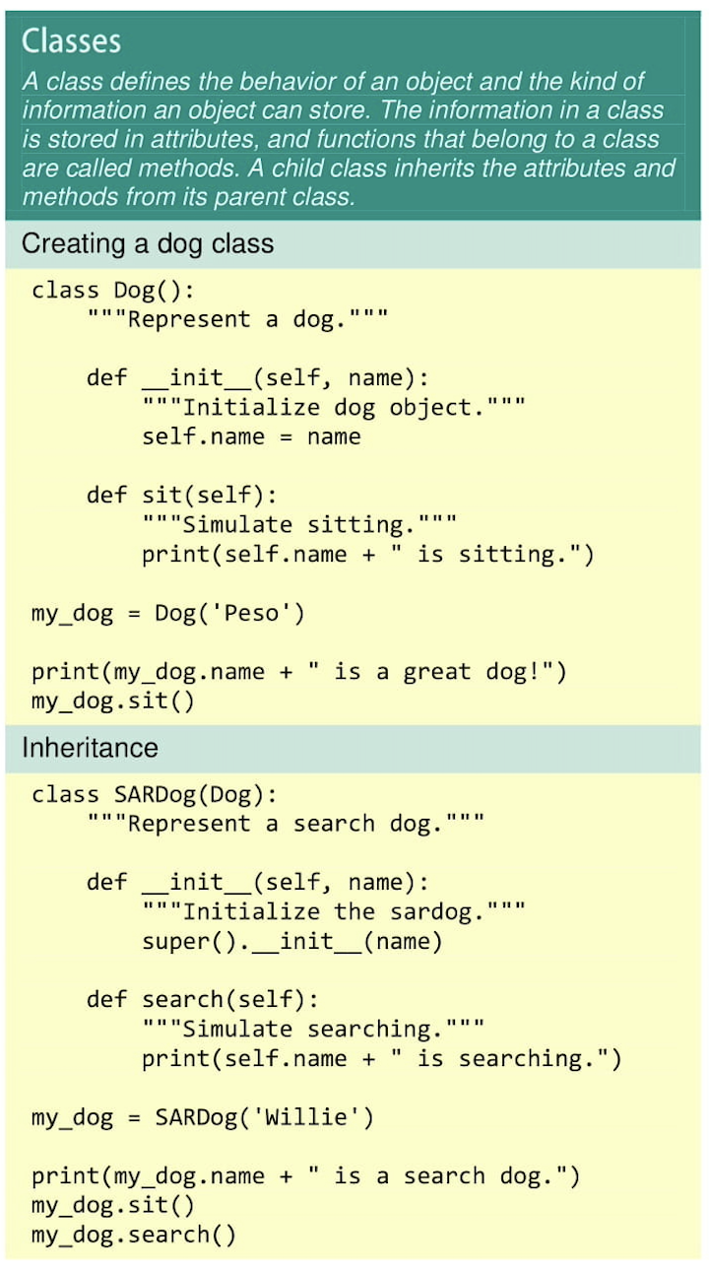
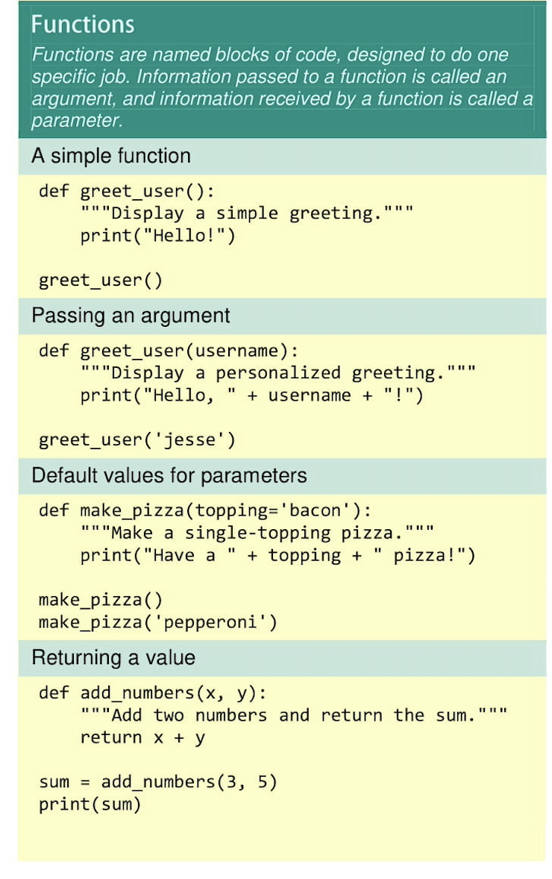

Slide 8
For people who are interested in learning python more, here is a link https://docs.python.org/3/tutorial/

Slide 9
What is Django?
“The web framework for perfectionists with deadlines”
Released in 2005
Open source web framework
A ton of prewritten code to help with site building
Essentially a Python version of MVC framework (MTV)
Python: Model
Simplifies large database-driven sites
many components, good documentation
Used by Mozilla, Instagram, NatGeo, Pinterest, etc.

Slide 10

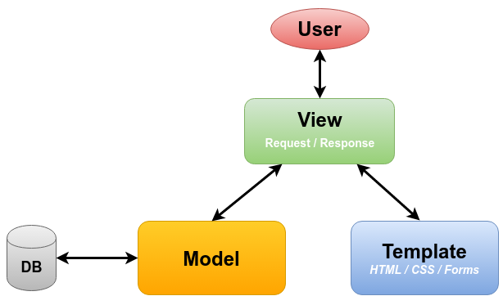
Model View Controller (MVC) vs Model Template View (MTV)
MVC
Source: Wikipedia
MTV
Source:

Slide 11
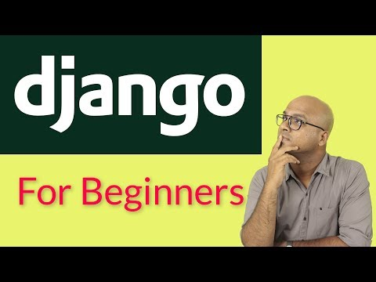
Django’s Capabilities

Slide 12
A Demonstration of Django

Slide 13
Rails
Django
Ruby
Python
Development Language
Model View Controller (MVC)
Model Template View (MTV)
Architectural Pattern
FOSS
Django Software Foundation
FOSS
Formal Organization & FOSS?
Convention over Configuration, CoC
Don’t Repeat Yourself, DRY
Reusability/pluggability of components
Don’t Repeat Yourself, DRY
Principles

Slide 14
Django Quiz
What language is Django written in?

Slide 15
Django Quiz
What language is Django written in?
Python

Slide 16
Django Quiz
What language is Django written in?
Python
Can you explain what views do in Django?

Slide 17
Django Quiz
What language is Django written in?
Python
Can you explain what views do in Django?
“ A view is a request handler function, which receives HTTP requests and returns HTTP responses. Views access the data needed to satisfy requests via models, and delegate the formatting of the response to templates.”
“Django Introduction - Learn Web Development: MDN.” Learn Web Development | MDN, https://developer.mozilla.org/en-US/docs/Learn/Server-side/Django/Introduction.

Slide 18
Conclusion
Django
is a Python-based web framework used for creating websites
shares some similarities with Rails
is fast, widely used, and has great documentation
can be used to make a website with songs and artists

