Slide 1


Angular
Presented by:
Karthick Sivasubramanian, Evan Huang
Jeremy Yao, Megha Rajesh, Jike zhOng

Slide 2
Topics Covered for Presentation
History
Syntax
Comparisons vs other JS technologies
Demo

Slide 3


History (Jeremy)
2008-2009 Misko Hevery (Google) wanted to:
Simplify web app development for web designers – work in HTML file
Develop a technology so that if you have a static web server --> build a simple web application (worry less about backend)
Angular
Name came from Adam Abrons, friend of Misko
Saw that normal and Angular's HTML tags had angular brackets

Slide 4
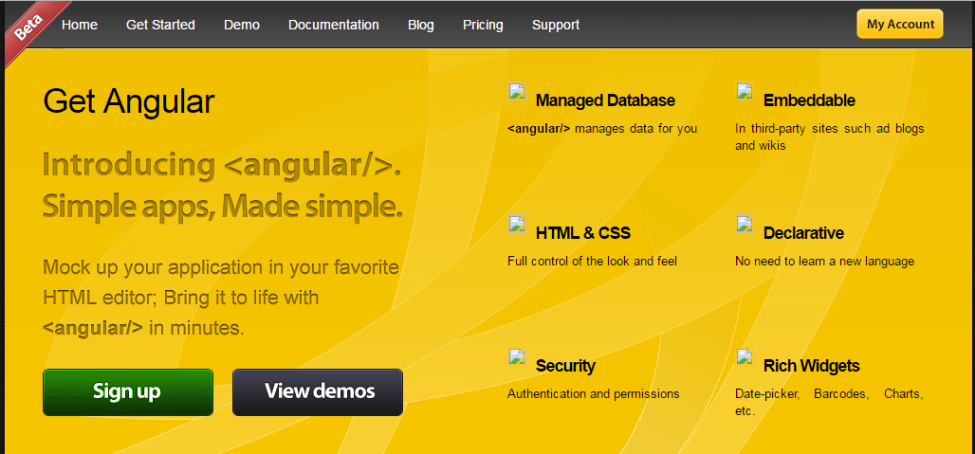
Old Angular Website Snapshot (getangular.com)

Slide 5
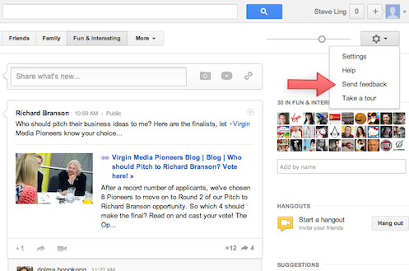
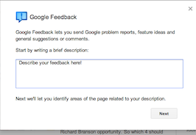
History Cont.
Google Feedback Tool
Used Google web tool kit (GWT) framework, written in Java
Framework developed internal tools and projects
Tedious: hard to write code and test
HTML tags required writing Java Code and compile it, transform to HTML, JS to display
Misko challenged his manager: he could write the project in 2 weeks using Angular
Completed in 3 weeks
Google shipped tool written in Angular
Became open source
Saw widespread use by companies
rapid development and small code-bases

Slide 6

Logo (inspired by HTML5 shield logo)

Slide 7
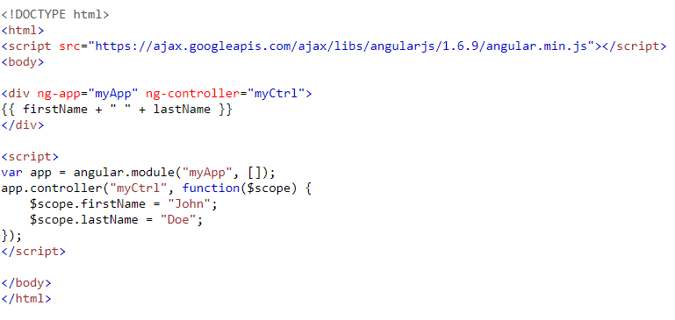


The basics (Jeremy)
Built on TypeScript
MVC
modules define AngularJS applications
controllers control AngularJS applications.
Define each w/ ng directives
HTML - view
Extends HTML w/ ng-directives such as:
ng-app – Angular apps: "where the Angular part is", define modules are
Refer to HTML elements
var app = angular.module("app_name", []);
ng-model – HTML controls to application data
ng-bind – app data to view
Can do even more with ng-directives, analogous to <% ruby code %>
Expressions
<p>5+5={{ 5 + 5 }}</p>
{{expression}}
written inside a directive: ng-bind="expression"

Slide 8

TypeScript vs. Vanilla JavaScript
Angular written in TypeScript
Compiles to Plain JavaScript
Class Based Object Oriented Design vs Vanilla JavaScript Prototypes
Additions of Static Typing, Modules, and Interfaces
Advantages
Feature of static typing allows easier debugging
Easier code structuring and maintainability
Disadvantages
Needs to be Compiled

Slide 9
Key features
2-way data binding
Changes in the UI affect the data and changes in the data affect the UI
Decreases amount of manual code needed to interact with the data model
Testing
Dependency injection allows for injecting mock data for tests
HTTP mocking
Fully cross-platform
Built-in components in addition to the ability to create custom ones
Plain Old JavaScript Objects (POJO)
Makes it easier to keep track/interact with the data model

Slide 10
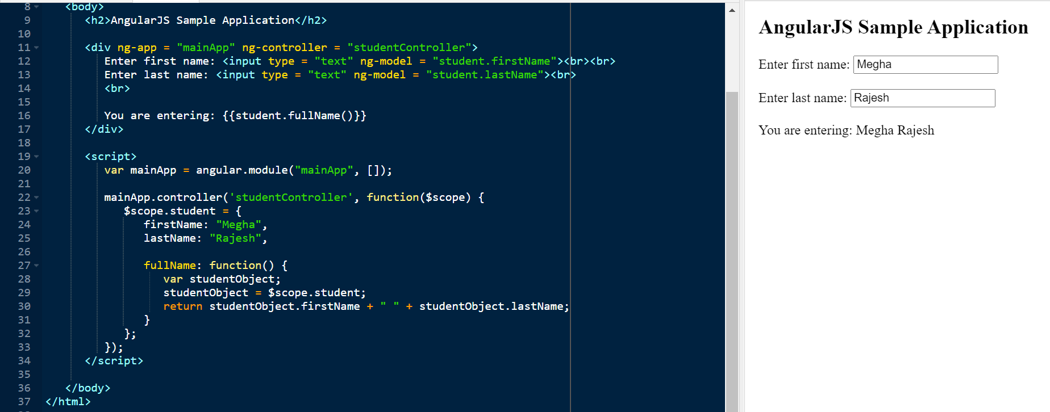
Let's Go Through An Example

Slide 11

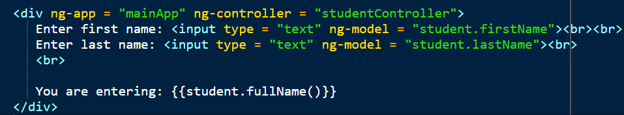
Components of an AngularJS App
Pointing back to the AngularJS app
Connects the part of html that relates to the Angular application
Ng-app directive starts an AngularJS Application
The View
Ng-controller tells angularJS which controller to use from script for this view
Ng-model directive binds a "view"
Notes:
AngularJS lets you extend HTML with new attributes called Directives.
it is required to tell which part of HTML contains the AngularJS app. You can do this by adding the ng-app attribute to the root HTML element of the AngularJS app. You can either add it to the html element or the body element as shown below −
ng-controller tells AngularJS which controller to use with this view. Student.fullName() tells AngularJS to write the model value named student.fullName() in HTML at this location.
Ng-model tells AngularJS to write the model value student.lastName and student.FirstName attributes in the input boxes into the view

Slide 12
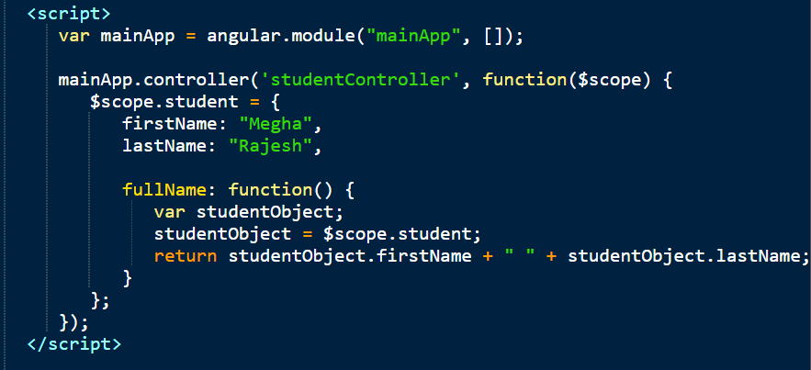
Components of an AngularJS App
The Controller
Controller is an object that contains properties and functions
$scope is a parameter of each controller
$scope is the application that the controller needs to handle
$ - built-in objects for a DOM
Notes:
AngularJS application mainly relies on controllers to control the flow of data in the application. A controller is defined using ng-controller directive. A controller is a JavaScript object that contains attributes/properties, and functions. Each controller accepts $scope as a parameter, which refers to the application/module that the controller needs to handle.
$scope is a built in object which basically binds the “controller” and the “view”
The $scope refers to application which uses the studentController object.
The $scope.student is a property of studentController object.
The firstName and the lastName are two properties of $scope.student object. We pass the default values to them.
The property fullName is the function of $scope.student object, which returns the combined name.
In the fullName function, we get the student object and then return the combined name.

Slide 13
DEMOS
Hello World
Todo List

Slide 14
More Things You Can Do
Tables
ng-repeat directive
Table From Angular Example
Angular Services
$http service to make request to server (GET, POST, PUT, UPDATE)
Get HTTP Request Example
Angular Filters
Filters allow application data to be transformed
Filter Expression Example
Angular Forms/Input Validation
Email Validation Example
AngularJS Reference (W3)

Slide 15
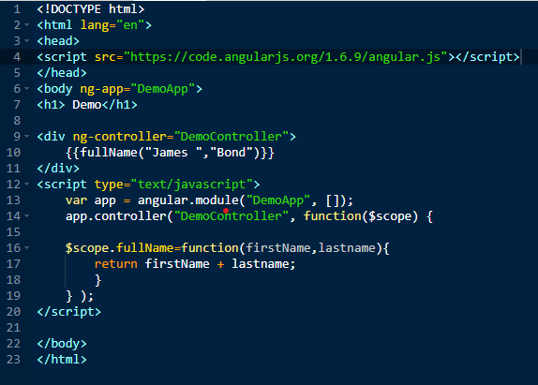
Practice
What is the name of the controller?
What is the scope of DemoApp?
What is fullName?
What portion of the code is considered view?
Notes:
DemoController
Scope is for the body tag
Full name is function attribute of democontroller
Div

Slide 16
Angular vs. React
Similarities
Both are mature and have large community behind
Both are scalable and can be used to develop complex project
Both are frontend frameworks
Both are component based
Differences/Metrics | Angular | React
Origin | Google 2016 – AdWords | Facebook 2013 – Instagram, WhatsApp
Language/Modes | JS/TypeScript | JS/JSX
Main Use | Dynamic Web Apps | UI Components
Learning Curve | Entire ecosystem, more difficult | Easy to Start, harder improvement
Data Binding | Unidirectional | Bidirectional
Dom/Architecture | Real Dom (MVC) | Virtual Dom
Performance | Worse on large apps | Good overall

Slide 17
Summary
Simplifies web development by integrating backend functionality to frontend - HTML
Rapid development and small code-base
Based on Typescript – OOP and compilation
React – very similar, but also has differences
ng-directives – supports notion of MVC
Powerful! Can extend HTML (new attributes) and further functionality

Slide 18
Questions?
How does the Scope change depending on where you place ng-app?
What is $scope?
What is one advantage of AngularJS over regular JS?
What are the components of MVC model?
Is AngularJS accessible on all platforms?
Notes:
1. Scope can get bigger or smaller depending on where you insert ng-app. If you put in the body tag the whole body tag has the scope, but if you put in the diiv tag that is all the range is
2. $scope is a parameter of each controller
3. Feature of static typing allows easier debugging, Easier code structuring and maintainability
4. modules define AngularJS applications
controllers control AngularJS applications.
Define each w/ ng directives
HTML – view
5. Yes it is accessible

