Slide 1
Learn jQuery:
The Basics
By Team Michelangelo

Slide 2
Selectors and Syntax
jQuery is an easy to use JavaScript API, with simple syntax, for making interactive websites. The jQuery library can be included in JavaScript by adding
“<script src="https://code.jquery.com/jquery-3.5.0.js"></script>” to an HTML file before the scripts that use jQuery are run.
jQuery:
$(selector).action();
$ used to access jQuery API
(selector) selects elements by ID, class, tag name, attributes, etc
Selector syntax is same as CSS
JavaScript:
document.getElementById(idName);
document.getElementsByClass(className);
document.getElementsByTagName(tagName);
document.querySelector('[someAttribute="someValue"]');
Notes:
Majority of jQuery statements will use $(selector) not all though

Slide 3
Selectors and Syntax
Additional Benefits:
jQuery comes in 1 file, just include <script src="..."> to use in any website
Handles the quirks of different browsers
Recall using “defer” to ensure the document is loaded before JavaScript executes:
// Wait to execute function until document is loaded
$(document).ready(function() { /* ... */ });

Slide 4
Selectors and Syntax
Document Traversal:
.first() => first element of selected elements returned
.last() => Opposite of .first()
.next() => next sibling of selected element
.find(selector2) => Select all descendants of selected element that match selector2
.children() => Return all direct children of selected element
// Get the first button in the document
$("button").first();
// Get all children of elements from class "content"
$(".content").children();

Slide 5
HTML and DOM Manipulation
jQuery allows us to manipulate HTML in several ways. With jQuery, we get or set the content of the selected element. Add new content before, after, at the start or end of the selected element.
Get and Set Content:
.text( [text] ) => Get or set content of selected element, tags are escaped
.html( [html] ) => Get or set content of selected element, tags are not escaped
.val( [val] ) => Get or set value of form element
Link to Example: Codepen

Slide 6
HTML and DOM Manipulation
Add Content:
.append(content) => Add new content to end of element
.prepend(content) => Add new content to beginning of element
.after(content) => Add new content after the end of the element
.before(content) => Add new content before the selected element
Remove Content:
.empty() => Leave selected element present but empty out contents
.remove( [selector2] ) => Remove selected element and all descendents of element, selector2 is just an additional filter we can apply

Slide 7
HTML and DOM Manipulation - Examples
// Get the text (excludes tags)
$("#first").text() // => "Hello"
// Get the inner html of the selected element
$("#first").html() // => "<p>Hello</p>"
// Add paragraph just after element with id="first"
$("#first").after("<p>Test paragraph</p>");
// Empty out all <div> tags
$("div").empty();
Link to Example: Codepen
Sample HTML:
<div id="first" style="color: blue;">
<p>Hello</p>
</div>
<div class="second">
<p><b>Goodbye</b></p>
</div>

Slide 8
CSS Manipulation - Overview
JQuery has 5 methods to manipulate css styling in your code.
.css
.addClass
.removeClass
.hasClass
.toggleClass
Most of the methods serve to dynamically control the classes that an element has, rather than direct properties.

Slide 9
CSS Manipulation - Methods
Method Syntax:
$("selector").css("property", "value"); // Sets a CSS property
$("selector").css("property"); // Gets a CSS property
$("selector").addClass("classname") //Adds a class
$("selector").removeClass("classname") //Removes a class
$("selector").hasClass("classname") //Returns True if element belongs to “classname”
$("selector").toggleClass("classname") //Toggles between classes

Slide 10
CSS Manipulation - Example
HTML:
<script src= "https://ajax.googleapis.com/ajax/libs/jquery/3.3.1/jquery.min.js"></script>
// Elements to create a box and a button
<div>
<p>I am a box</p>
<button id= "button1">Click
Here To Toggle My Class</button>
</div>
JS:
$(document).ready(function() {
// Give the button an event listener
$("#button1").click(function() {
// Toggles an active class on box when button is pressed
$("div").toggleClass("classOne");
});
});
Link to Example: Codepen
CSS:
// Extra classes to toggle between
.classOne {
background-color: pink;
min-height:220px;
}
.classTwo {
min-width: 500px;
color: white;
}
// Default styling of box
div {
width: 200px;
min-height: 120px;
background-color: lightgreen;
padding: 20px;
font-weight: bold;
font-size: 20px;
}

Slide 11
Event Handling - Overview
jQuery provides a simplified and powerful interface for handling events on an HTML page using the following methods:
.on();
.one();
.off();
.trigger();
With jQuery’s full event handling capabilities, you can:
Bind Events
Unbind Events
Delegate Events
Create Custom Events
Create Event Extensions (not recommended)

Slide 12
Event Binding - .on() and .one()
Event binding is when an element on an HTML
element is assigned an event handler.
Base JavaScript:
Element.addEventListener(event, function() {...});
jQuery:
Element.on(event, function() {...});
.one():
Binds an event just like .on()
Unbinds the handler after that event occurs once
Useful for initial setups

Slide 13
Event Binding - Example
$(document.body).html("<button id=\"setup\">Setup</button>"); // Button that works once
$(document.body).append("<button id=\"btn\">Button</button>"); // Button that works every time
// Event handler for setup button (only works once)
$("#setup").one("click", function() {
$(document.body).append("<p>The setup button was clicked! --- Everything is set up, button no longer functional</p>");
// ... setting up ...
});
// Event handler for reusable button
$("#btn").on("click", function() {
$(document.body).append("<p>Doing something after clicking the button</p>");
});
Link to Example: Codepen

Slide 14
Event Unbinding - .off()
An event can be unbound using the .off() method.
Events should be unbound because:
They are no longer needed
The handlers use a lot of memory
They are causing performance issues
The .one() method uses .off() after the first occurrence of the event.

Slide 15
Event Unbinding - Example
$(document.body).html("<button id=\"btn\">Click Me!</button>"); // Button that works until unbound
$(document.body).append("<button id=\"off\">Turn the other button off</button>"); // Button that toggles the first button
// Event handler for reusable button
$("#btn").on("click", function() {
$(document.body).append("<p>Doing something after clicking the button</p>");
});
// Event handler to toggle the functionality of the first button
$("#off").one("click", function() {
$("#btn").off();
$(document.body).append("<p>The other button no longer works</p>");
});
Link to Example: Codepen

Slide 16
Event Delegation - Bubbling Up!
Event delegation uses the DOM to attach events to all of the descendants of a specific element (i.e. all <li> in a <ul>).
Event delegation can be used to:
Attach event handlers to elements that don’t yet exist
Attach event handlers to many elements at once
Event delegation utilizes the “selection” parameter of on. This allows you to select which descendant elements should trigger the handler:
//Attaches event handler to all <a> elements in the table with id “mytable”
$(“#mytable”).on(“click”, “a”, function(event) {
event.preventDefault();
console.log(“The link was clicked”);
});

Slide 17
Event Delegation - Example
HTML:
<body>
<ul id="mylist">
<li><button>This button existed</button></li>
<li>This is not a button, you cannot click this</li>
</ul>
<button id="create">Add new button</button>
</body>
JS:
// This adds the delegated event handler to all <a> tags in all <ul>
$("ul").on("click", "button", function(event) {
$(document.body).append("<p>You have clicked a listed button</p>");
});
// This event handler adds a new button to the <ul>
$("#create").on("click", function(event) {
$("ul").append("<li><button>This is a new button</button></li>");
});
Link to Example: Codepen

Slide 18
Custom Events
Analogy:
Standard Functions (toString, min, max, etc.) => User Written Functions
Standard Events (click, mouseover, load, etc.) => Custom Events
Custom events allow you to create event types that can be triggered with the use of the .trigger() method. These custom events can be used for:
Easily triggering a handler with different events on different elements on a page
Triggering handlers on multiple similar elements with one event occurrence
Better readability and easier maintenance of code
Custom Event Naming Standards:
category:event
Examples:
car:start
light:toggle

Slide 19
Custom Events - Example
HTML:
<html lang="en">
<head>
<meta charset="utf-8">
<title>Custom Events Example</title>
<script
src="https://code.jquery.com/jquery-3.5.0.js">
</script>
</head>
<body>
<pre id="car" class="off"> ______
/|_||_\`.__
( _ _ _\
=`-(_)--(_)-'
</pre>
<button class="buttonpress">Press Start</button>
<button class="keyturn">Turn Key</button>
</body>
</html>
Link to Example: Codepen
// Turning car on when car:start event happens
$("#car").on("car:start", function(event) {
$(this).removeClass("off");
$(this).addClass("running");
$(this).html(" ----- ______\n" +
" - -- - /|_||_\\`.__ **kachow**\n" +
"--- -- ( _ _ _\' \n" +
" ---- =`-(_)--(_)-'')\n");
});
// Turning car off when car:off event happens
$("#car").on("car:off", function(event) {
$(this).removeClass("running");
$(this).addClass("off");
$(this).html(" ______\n" +
" /|_||_\\`.__\n" +
" ( _ _ _\' \n" +
" =`-(_)--(_)-'')\n");
});
// Clicking either button triggers the toggling event
$(".buttonpress, .keyturn").click(function(event) {
let vehicle = $("#car");
if (vehicle.hasClass("off")) {
vehicle.trigger("car:start");
} else {
vehicle.trigger("car:off");
}
});

Slide 20
Effects and Animations
The jQuery library provides several techniques for adding effects and animations to web pages
The Animate Function
Simple Effects functions
Queues

Slide 21
The Animate Function
The animate function allows us to create animation effects on numerical CSS properties only.
The only required parameter is properties. This is plain css property object, and it contains the css properties and values we want to change to create the animation.
Duration is the length of time in ms the animation runs, and its default is 400. ‘Fast’ and ‘Slow’ correspond to 200 and 600 ms.
Easing is a string value that specifies the easing function used for the animation. Options include the default ‘swing’ and ‘linear’.
Complete is a function that runs when the animation is completed.
.animate(properties [, duration] [, easing ] [, complete ])

Slide 22
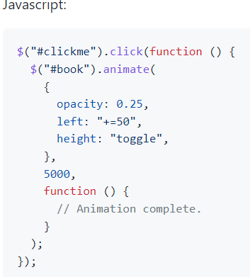
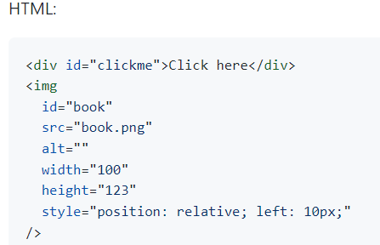
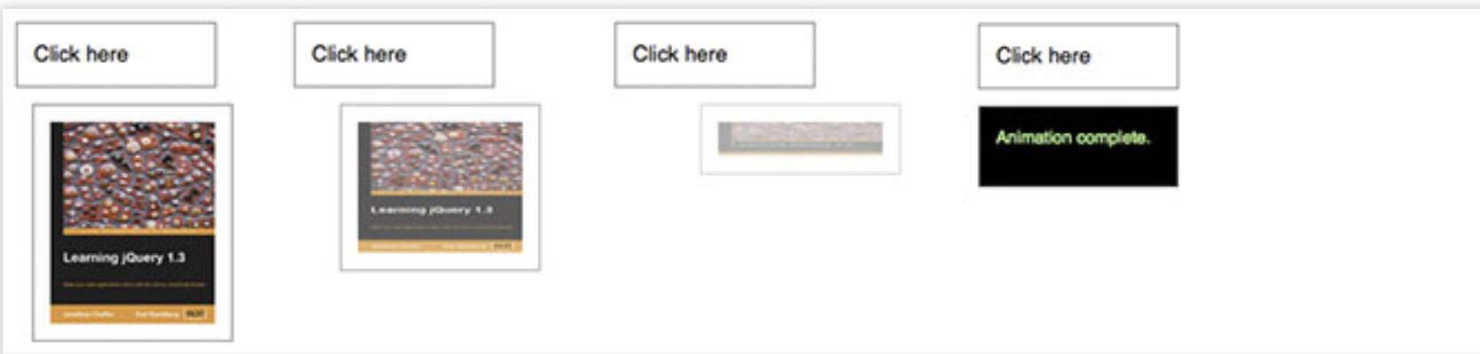
Animate Example
Parameters:
Css object: opacity, left, height
‘Toggle’, ‘show’, and ‘hide’ are all possible values
‘Toggle’ switches the height from original to 0 and vice versa
Duration: 5000ms
Empty completion function
https://api.jquery.com/animate/

Slide 23
Effects
There are numerous effects functions that add visual effects to selected elements.
.fadeIn([duration][, callback]) => fades an object into view, and completes an optional callback function upon completion
.fadeOut([duration][, callback]) => similar to fadeIn, but object is faded out of view
.fadeTo(duration, opacity[, callback]) => similar to functions above, but fades an object to a specified opacity
.slideDown([duration][, callback]) => slides an object down into view
.slideUp([duration][, callback]) => slides an object up into view
.hide([duration][, callback]) => hides matched objects

Slide 24
Queues
Queues allow for animations and effect methods to be queued up on page elements, and the resulting animations/effects can then be run asynchronously. Below are important queue methods:
.queue([queueName]) - Show the queue of functions/animations to be executed on an element. An elements queue name is "fx" by default.
.queue([queueName], newQueue) - Manipulate the queue of functions to be executed on an element. An elements queue name is "fx" by default. New functions can be appended to the queue to add to the queued animation.
.clearQueue() - removes all queued animation items
.dequeue() - the next function is removed on the queue and executed. All functions on queue should also call dequeue to continue running the sequences.
.stop() - stops a currently running animation on an object

Slide 25
Queue Example
HTML:
<!DOCTYPE html>
<html lang="en">
<head>
<style>
div {
margin: 3px;
width: 40px;
height: 40px;
position: absolute;
left: 0px;
top: 60px;
background: green;
display: none;
}
</style>
<script src="https://code.jquery.com/jquery-3.5.0.js"></script>
</head>
<body>
<p>The queue length is: <span></span></p>
<div></div>
</body>
</html>
JS:
let div = $("div");
function runIt() {
div
.show("slow")
.animate({ left: "+=200" }, 2000)
.slideToggle(1000)
.slideToggle("fast")
.animate({ left: "-=200" }, 1500)
.hide("slow")
.show(1200)
.slideUp("normal", runIt);
// Note the callback function
// sets us in a loop
}
function showIt() {
var n = div.queue("fx");
$("span").text(n.length);
setTimeout(showIt, 100);
}
runIt();
showIt();
Note that a series of animations are ‘queued’ up on the div element
The function show it is called every 100 ms and shows the queue length
div.queue(‘fx’) returns the queue object, enabling us to see its length
The animation repeats because of a completion function callback to runIt()
Link to Example: Codepen

Slide 26
AJAX
Asynchronous Javascript And XML
Use:
AJAX is mainly used for exchanging data with a server and updating parts of a web page without needing to reload the page.
AJAX is used to load data in the background that can be displayed on demand
Uses XML, plain text, or JSON to transfer data

Slide 27
AJAX - Common Uses
Gmail - In app back button
Google Maps - Dynamic map that allows for tilting, scrolling, rotating
Twitter, Facebook, etc - Comments, followers, likes

Slide 28
AJAX - Background Operations
Event occurs =>
JavaScript creates a request object =>
Request is sent to and handled by server =>
Response updates the page in the background
These requests are comprised of Load, Get, or Post HTTP requests

Slide 29
AJAX - GET
$.get(URL, callback)
HTML:
<script>
$(document).ready(function(){
$("button").click(function(){
// Populates data, more
$.get("test.asp", function(data, more){
alert("Data: " + data + " More: " + more);
});
});
});
</script>

Slide 30
AJAX - LOAD
$(selector).load(URL[, data][, callback])
HTML:
<head>
<script src="https://ajax.googleapis.com/ajax/libs/jquery/3.6.0/jquery.min.js"></script>
</head>
<body>
<div id="target"><h2>This will be replaced</h2></div>
<button>Press here</button>
</body>
test.txt Contents:
<h2>This will be loaded in</h2>
// Load test.txt when button is clicked
$(document).ready(function(){
$("button").click(function(){
$("#target").load("test.txt");
});
});

Slide 31
AJAX - POST
$.post(URL[, data][, callback])
$(document).ready(function(){
$("button").click(function(){
// “test.asp” is URL parameter
$.post("test.asp",
{
// This object is the Data parameter
info1: "Information",
info2: "More information"
},
// This function is the Callback parameter
function(data,status){
alert("Data: " + data + "\nStatus: " + status);
});
});
});

Slide 32
Utilities
$.function
Accomplishes routine programming tasks
Predates ES5
Works in all browsers

Slide 33
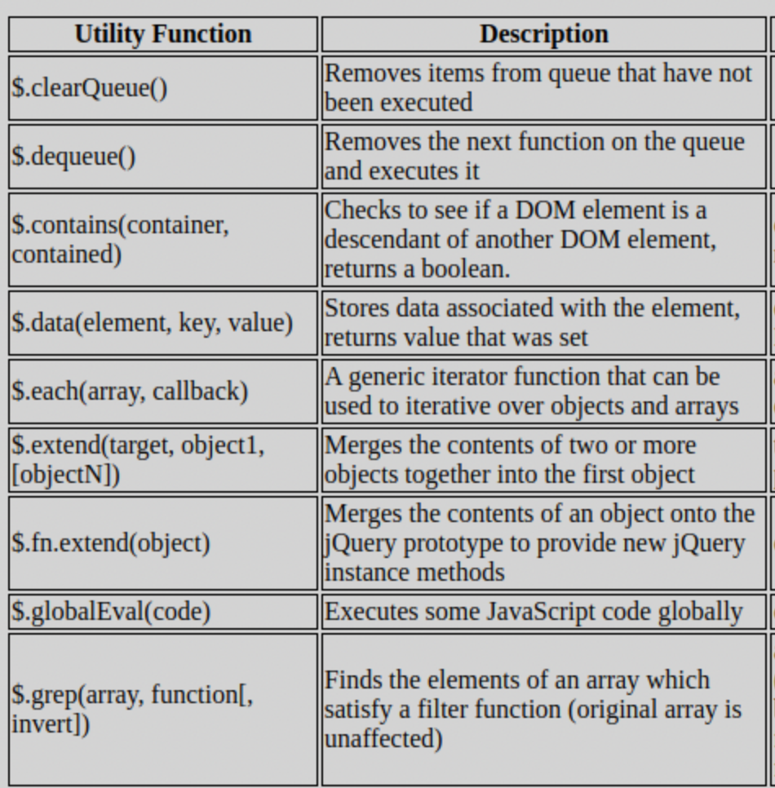

Slide 34
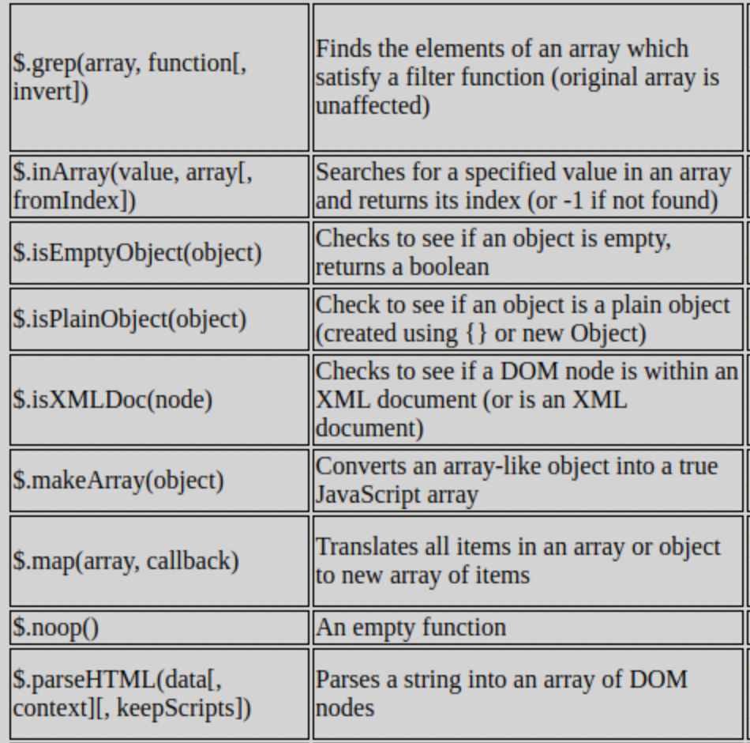

Slide 35
Example: Iteration
$(document).ready(function() {
let months = [ 'January', 'February', 'March', 'April', 'May',
'June', 'July', 'August', 'September', 'October',
'November', 'December'];
$.each(months, function(index, value) {
$('#months').append('<li>' + value + '</li>');
});
});
Notes:
jQuery Cookbook by Cody Lindley
https://learning.oreilly.com/library/view/jquery-cookbook/9780596806941/ch04.html#introduction-id3

Slide 36
Example: Filtering
$(document).ready(function() {
let months = [ 'January', 'February', 'March', 'April', 'May',
'June', 'July', 'August', 'September', 'October',
'November', 'December'];
months = $.grep(months, function(value, i) {
return ( value.indexOf('J') == 0 );
});
$('#months').html( '<li>' + months.join('</li><li>') + '</li>' );
});
Notes:
jQuery Cookbook by Cody Lindley
https://learning.oreilly.com/library/view/jquery-cookbook/9780596806941/ch04.html#introduction-id3

