Slide 1
INTRODUCTION
Bitcoin is an online virtual currency which is already being used based on public key cryptography.
proposed in 2008 in a paper written by someone named Satoshi Nakamoto as pseudonym.
It is fully working from January 2009 and its broad acceptance, simplified by the presence of exchange markets allowing easy changing with conventional currencies (EUR or USD)

Slide 2
Background
Fiat currency and Bitcoin
Fiat currency vs Cryptocurrency
Is Bitcoin a Fiat Currency?
Why Bitcoins have values?
Why Bitcoins have values?
BITCOIN IS LIKE GOLD!

Slide 3
Prototype of Bitcoin
How Bitcoin mining works?
How to Store Bitcoin
Where does the math problem comes from?
What is the Resources of Bitcoin?

Slide 4
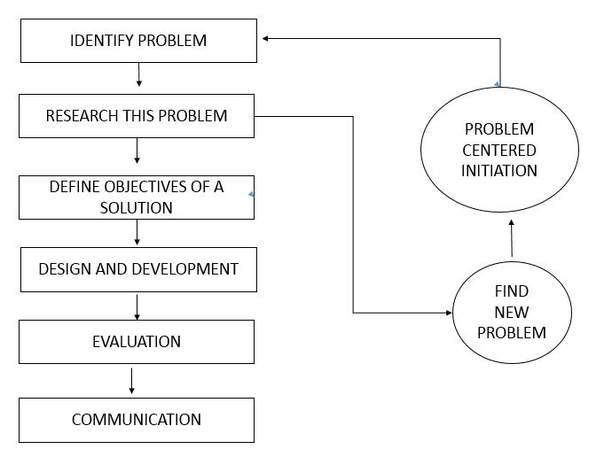

Slide 5
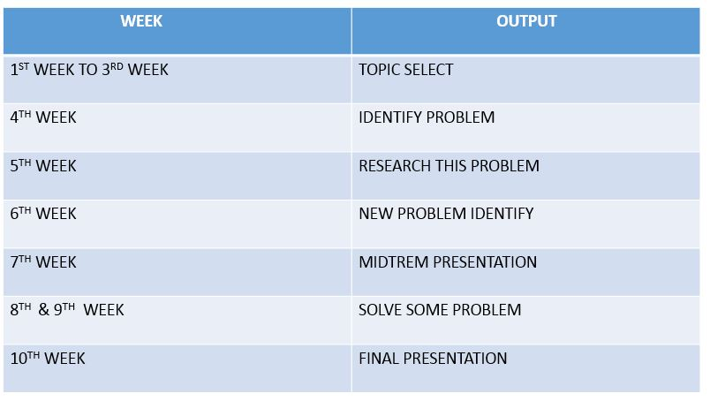

Slide 6
Results

Slide 7
Discussion

Slide 8
Conclusions

Slide 9
Future works

