Slide 1
RECONSTRUCTION OF GENE REGULATORY NETWORKS USING A HYBRID MODEL
Name: Debapriya Paul
Roll No.: 97/CSM/191019
Registration No.: D01-1211-0094-19
Prof. Rajat Kumar Pal
M. Tech. in Computer Science and Engineering
(3rd Semester)

Slide 2
OUTLINE
INTRODUCTION
GENE REGULATORY NETWORK (GRN)
TIME-SERIES GENE DATA
MATHAMETICAL MODELS
MEAN SQUARED ERROR (MSE)
OPTIMIZATION TECHNIQUE
PROPOSED WORK
REFERENCE

Slide 3
INTRODUCTION
Central Dogma of Molecular Biology provides an insight about the flow of genetic information within a biological system.
This process has two steps:
1) Transcription
2) Translation
Genes are the component which encode proteins for the various functionality in a biological system.
In reverse, proteins control the gene expressions; results a complex relationship among gene and protein.

Slide 4
CENTRAL DOGMA
DNA
TRANSCRIPTION
mRNA
TRANSLATION
PROTEINS

Slide 5
GENE REGULATORY NETWORK (GRN)
Central Dogma can not explain the nature and strength of such regulatory interactions.
Using wet lab, it is not possible to find out the correct regulation nature and strength between the genes.
Computational tool is required to find out such nature of the regulatory interactions.
A Gene Regulatory Network (GRN), a bidirectional graph is used to represent the interactions between the genes.

Slide 6
GENE REGULATORY NETWORK (GRN) (contd..)
Gene Regulatory Network (GRN) is a graph that is used to represent the regulatory interaction computationally.
The nodes in the graph represent the genes, and the edges are the interactions between the genes.
A GRN can have maximum four regulator and minimum two regulator.
The activation and repression of the genes are represented by direction of the edge.

Slide 7
GENE REGULATORY NETWORK (GRN) (contd…)
Fig. 1. 8-gene SOS DNA repair network of E. coli.
recA
lexA
uvrD
umuDC
uvrY
uvrA
ruvA
polB

Slide 8
TIME-SERIES DATA
Gene expression data set is represented by a 2D matrix; which can be said as time-series data set.
Time-series data can be classified into two types:
(a) metrics
(b) events
Some examples of time-series data are weather records, economic indicators, patient health evolution metrics, etc.
Along the row genes are represented and along the column the time point is represented.

Slide 9
RECURRENT NEURAL NETWORK (RNN)
Recurrent Neural Network (RNN) is a special family from Artificial family of neural network.
It has the capable to learn from data.
It is robust to noisy data.
Mathematically it is exponential-law based tool popularly used in reverse engineering.
The recurrent structure of RNNs effectively reflects the existence of feedback.

Slide 10
RECURRENT NEURAL NETWORK (RNN) (contd…)
. . .
. . .
. . .
. . .
. . . .
. . . .
.
. . .
t₁ t₂ t _{n}
Fig. 2. The representation of a GRN using an RNN model. The network shown is unfolded from t = t₁ to t = t₂. All possible connections amongst the genes have been shown, whereas real-world networks are sparse.
GGG
G₁
G₁
G₁
G₂
G₂
G₂
G₃
G₃
G₃
G_{N}
G_{N}
G_{N}

Slide 11
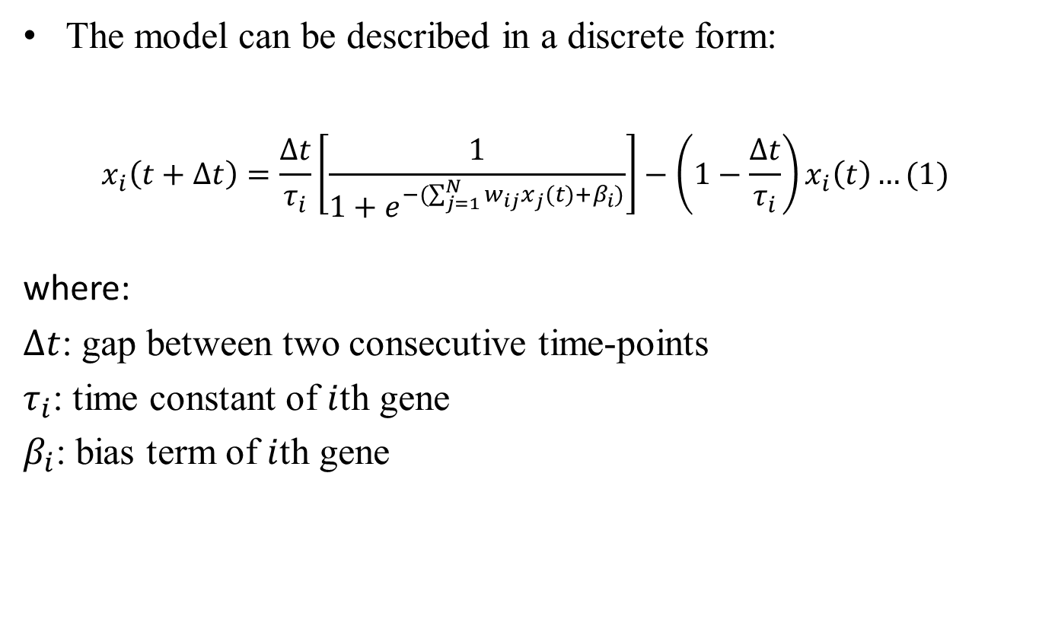
RECURRENT NEURAL NETWORK (RNN) (contd…)
The model can be described in a discrete form:
$$x_{i}\left(t+∆t\right)=\frac{∆t}{τ_{i}}\left[\frac{1}{1+e^{−(\sum_{j=1}^{N}{w_{ij}x_{j}}(t)+β_{i})}}\right]−\left(1−\frac{∆t}{τ_{i}}\right)x_{i}\left(t\right)…(1)$$
where:
$∆t$: gap between two consecutive time-points
$τ_{i}$: time constant of $i$th gene
$β_{i}$: bias term of $i$th gene

Slide 12
S-SYSTEM
S-system, a power-law based computational tool, is a set of non-linear differential equations of the first order used for the reconstruction process of GRN.
It is capable to explain two essential characteristics biological system i.e., saturable and synergistic behaviour of GRN.

Slide 13
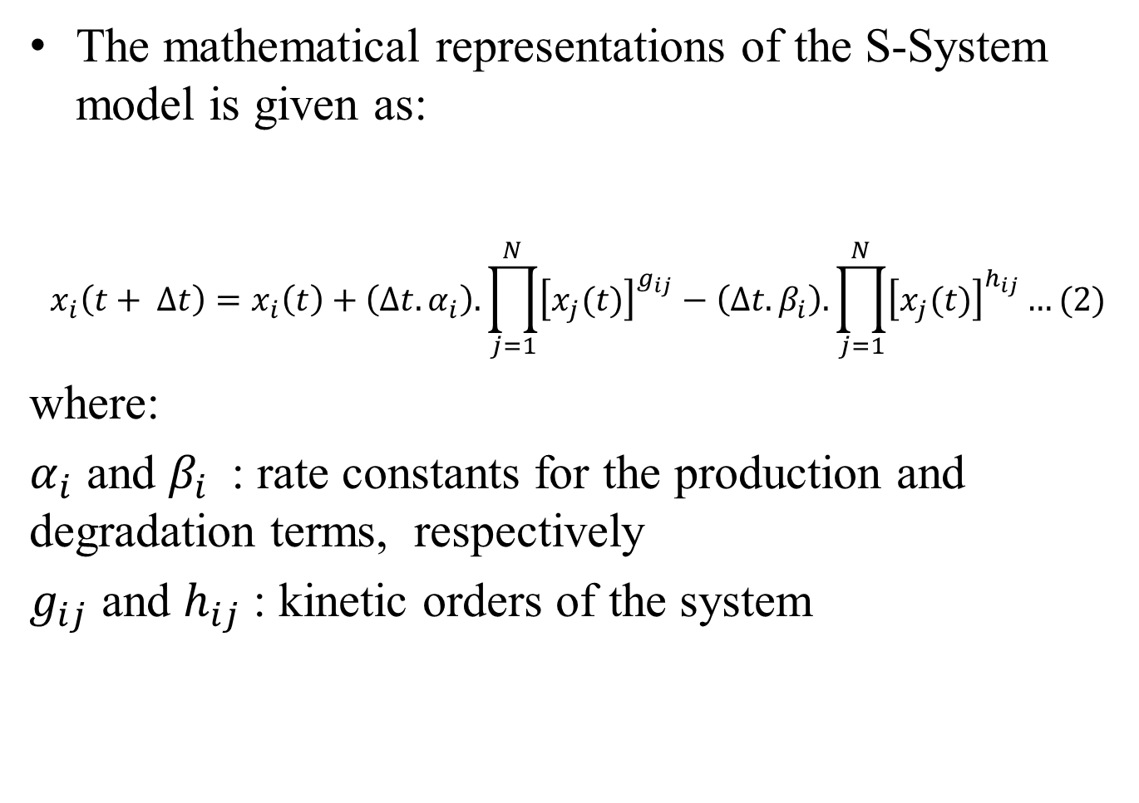
S-SYSTEM (contd…)
The mathematical representations of the S-System model is given as:
$$x_{i}\left(t+ ∆t\right)=x_{i}\left(t\right)+\left(∆t.α_{i}\right). \prod_{j=1}^{N}{{\left[x_{j}(t)\right]}^{g_{ij}}−\left(∆t.β_{i}\right).\prod_{j=1}^{N}{{\left[x_{j}(t)\right]}^{h_{ij}}…(2)}}$$
where:
$α_{i}$ and $β_{i}$: rate constants for the production and degradation terms, respectively
$g_{ij}$ and $h_{ij}$: kinetic orders of the system

Slide 14
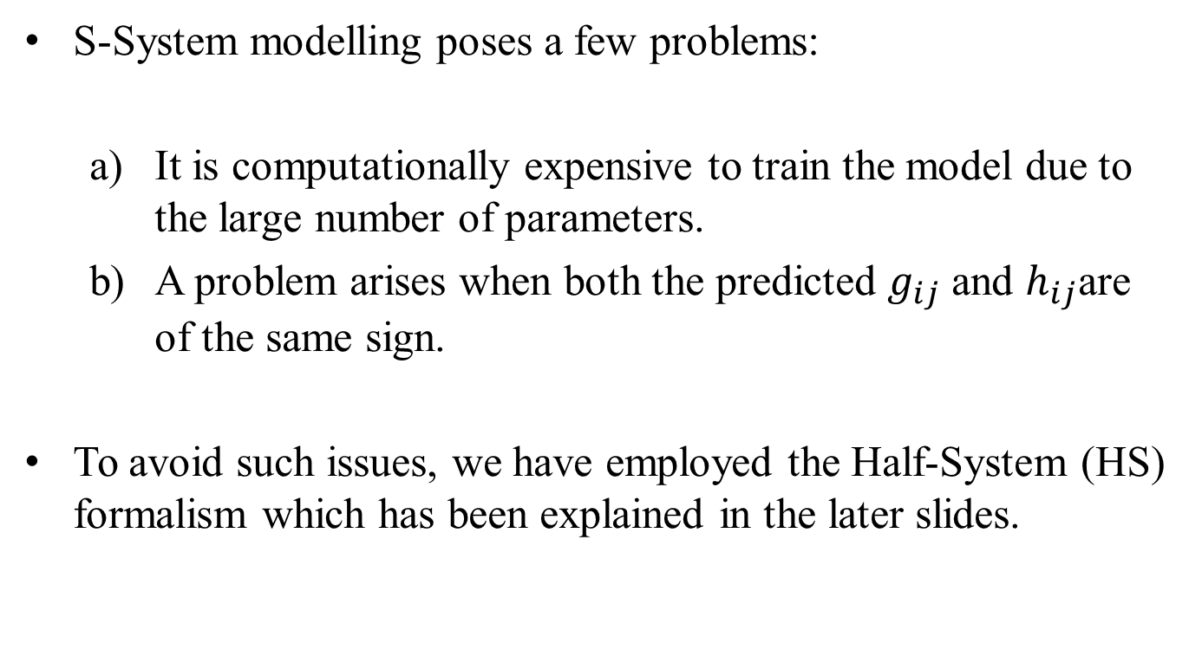
S-SYSTEM (contd…)
S-System modelling poses a few problems:
It is computationally expensive to train the model due to the large number of parameters.
A problem arises when both the predicted $g_{ij}$ and $h_{ij}$are of the same sign.
To avoid such issues, we have employed the Half-System (HS) formalism which has been explained in the later slides.

Slide 15
HALF-SYSTEM (HS)
Half-system (HS) is an improved version of the S-system where the number of parameters is exactly half of that of the S-system.
The computational problem of the S-system is reduced in this version.
The total number of parameters required for training is thus (N + 1). Thus, the model requires N (N + 1) parameters for a N -gene network.

Slide 16
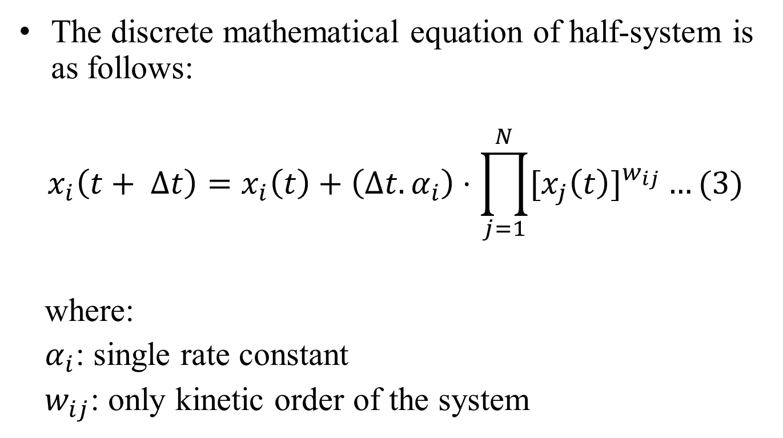
HALF-SYSTEM (HS) (contd…)
The discrete mathematical equation of half-system is as follows:
$$x_{i}\left(t+ ∆t\right)=x_{i}\left(t\right)+\left(∆t.α_{i}\right)⋅\prod_{j=1}^{N}{{[x_{j}\left(t\right)]}^{w_{ij}}}…(3)$$
where:
$α_{i}$: single rate constant
$w_{ij}$: only kinetic order of the system

Slide 17
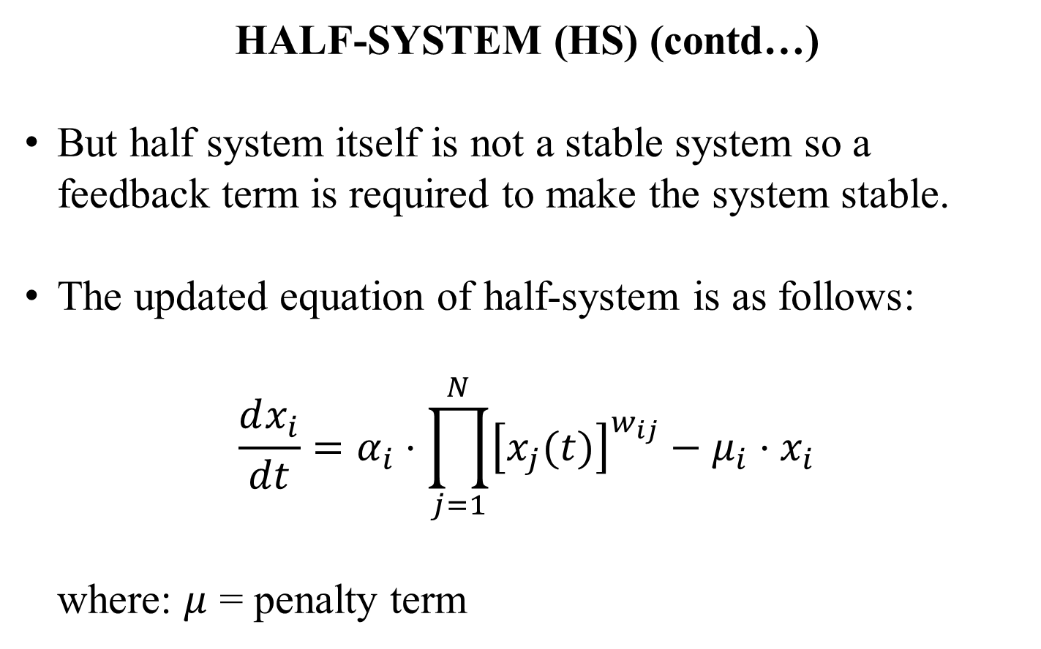
HALF-SYSTEM (HS) (contd…)
But half system itself is not a stable system so a feedback term is required to make the system stable.
The updated equation of half-system is as follows:
$$\frac{dx_{i}}{dt}=α_{i}⋅\prod_{j=1}^{N}{{\left[x_{j}(t)\right]}^{w_{ij}}−μ_{i}⋅x_{i}}$$
where: $μ$ = penalty term

Slide 18
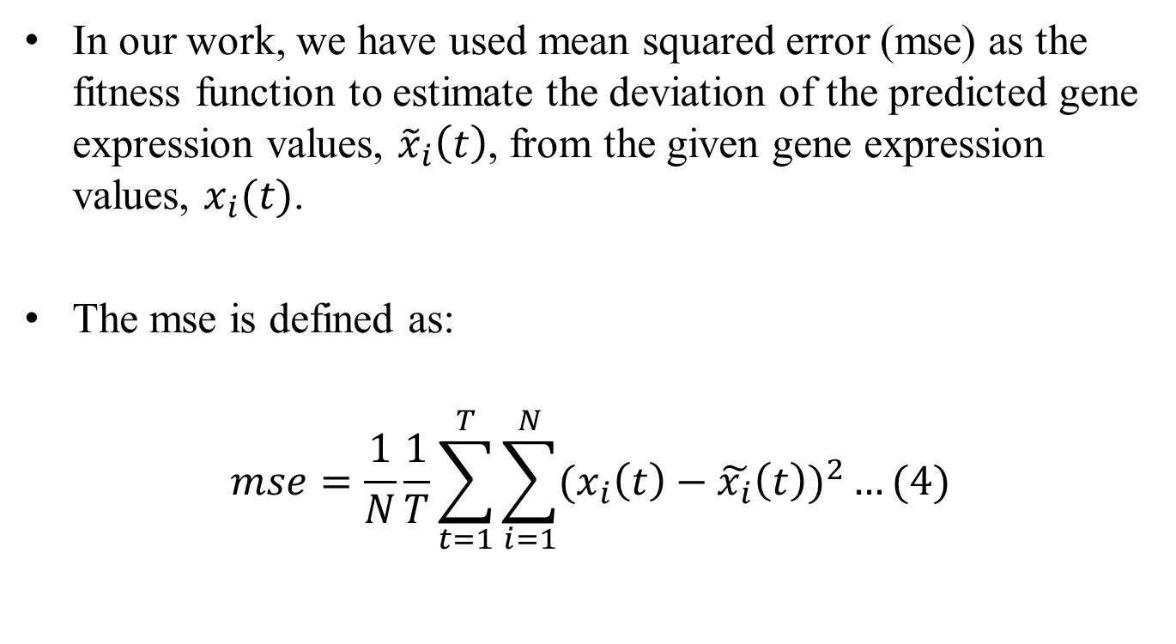
MEAN SQUARED ERROR (MSE)
In our work, we have used mean squared error (mse) as the fitness function to estimate the deviation of the predicted gene expression values, ${\tilde{x}}_{i}\left(t\right)$, from the given gene expression values, $x_{i}(t)$.
The mse is defined as:
$$mse=\frac{1}{N}\frac{1}{T}\sum_{t=1}^{T}{\sum_{i=1}^{N}{({x_{i}\left(t\right)−\tilde{x_{i}}\left(t\right))}^{2}…(4)}}$$

Slide 19
PARTICLE SWARM OPTIMIZATION (PSO)
Particle Swarm Optimization (PSO) is an evolutionary swarm based optimization algorithm.
It is based on the flocking behavior of birds.
It improves the candidate solutions in an iterative process.
PSO consists of a swarm of particles, each of which randomly searches through the problem space by updating itself with its own memory and the social information gathered from other particles.

Slide 20
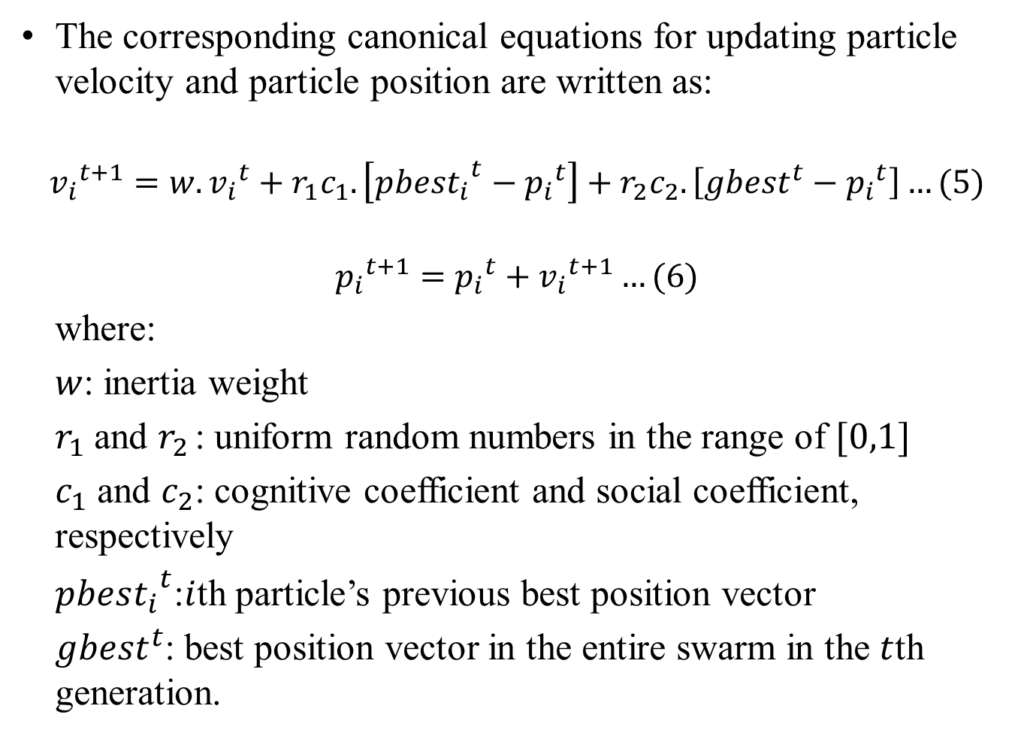
PARTICLE SWARM OPTIMIZATION (PSO) (contd…)
The corresponding canonical equations for updating particle velocity and particle position are written as:
$${v_{i}}^{t+1}=w. {v_{i}}^{t}+r_{1}c_{1}.\left[{pbest_{i}}^{t}−{p_{i}}^{t}\right]+r_{2}c_{2}.\left[{gbest}^{t}−{p_{i}}^{t}\right]…(5)$$
$${p_{i}}^{t+1}={p_{i}}^{t}+{v_{i}}^{t+1}…(6)$$
where:
$w$: inertia weight
$r_{1}$ and $r_{2}$: uniform random numbers in the range of $[0,1]$
$c_{1}$ and $c_{2}$: cognitive coefficient and social coefficient, respectively
${pbest_{i}}^{t}$:$i$th particle’s previous best position vector
${gbest}^{t}$: best position vector in the entire swarm in the $t$th generation.

Slide 21
PROPOSED WORK
Combining the two above mentioned models i.e., half-system and RNN.
Using PSO to optimize the parameters.
We will apply the proposed methodology on two datasets; 8 gene SOS DNA repair network and DREAM3 challenge network of 10 gene.
After that validation will be performed based on traditional statistical metrics.
Post processing will be done for the reconstruction of the GRN.

Slide 22
REFERENCE
P. D'haeseleer. Reconstructing gene network from large scale gene expression data. Dissertation, University of New Mexico, 2000.
Rui Xu, Donald Wunsch II, and Ronald Frank. Inference of genetic regulatory networks with recurrent neural network models using particle swarm optimization. IEEE/ACM Transactions on Computational Biology and Bioinformatics, 4(4):681-692, 2007.
Yuji Zhang, Jianhua Xuan, Benildo G de los Reyes, Robert Clarke, and Habtom W Ressom. Reverse engineering module networks by PSO-RNN hybrid modelling. Genomics, 10(1):S15, 2009.

Slide 23
REFERENCE (contd…)
Haixin Wang, Lijun Qian, and Edward Dougherty. Inference of gene regulatory networks using s-system: a unified approach. IET Systems Biology, 4(2): 145-156,2010.
Kyriakos Kentzoglanakis and Matthew Poole. A swarm intelligence framework for reconstructing gene networks: searching for biologically plausible architectures. IEEE/ACM Transactions on Computational Biology and Bioinformatics, 9(2):358-371, 2012.
Abhinandan Khan, Sudip Mandal, Rajat Kumar Pal, and Goutam Saha. Construction of Gene Regulatory Network using Recurrent Neural Networks and Swarm Intelligence, 2016.

Slide 24
THANK YOU

